Slide 1

Let the sunshine in! News from the Dawn side of life
Martin Flügge
martin.fluegge@mftech.org
http://www.mftech.org
http://www.mftech.org/blog
Berlin, Germany
EclipseCon Europe
Ludwigsburg, November 4, 2011

Slide 2




What is Dawn?
CDO
file://
Customized User Interfaces

Slide 3


Slide 4
Runtime
Collaborative UI extensions
Generators
Conflict Handling
Programming interfaces
Locking
Real-Time Shared Editing
Authentication/ Authorization

Slide 5
How does it work?
CDO Model Repository
Dawn Runtime
GMF UI Extension
(generated Fragment)
EMF UI Extension
(generated Fragment)
Your GMF Editor
Your EMF Editor

Slide 6
Internally
Dawn Runtime
IDawnUIElement
IDawnListener
IDawnEditingSupport
Extended UI
Dawn Runtime Extension
XYZEditor
DawnXYZListener
Dawn XYZEditor
DawnXYZEditingSupport

Slide 7
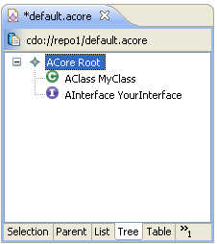
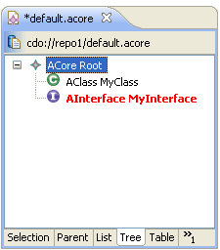
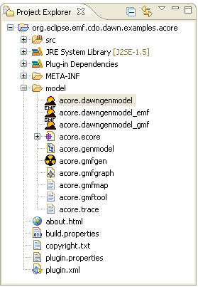
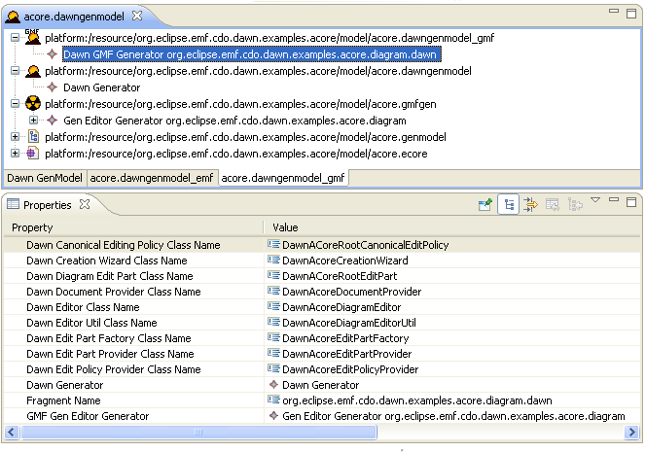
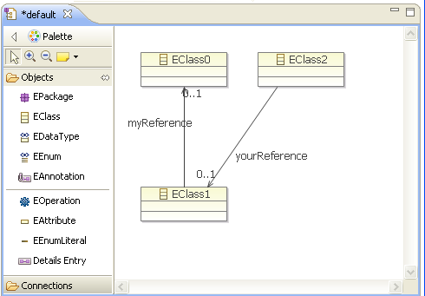
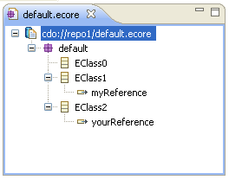
Dawn 1.0
EMF editor integration
Dawn-GenModel spit up
Ecore Tools Editor und Ecore Editor extension

Slide 8
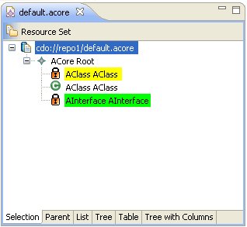
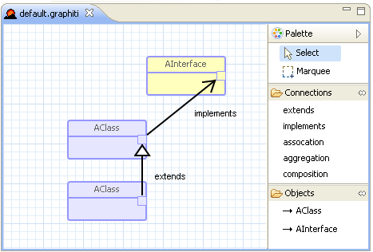
Dawn 2.0 …
Locking for all editors
Visualization of local/remote locks
Locking Strategies
No generation needed
Generic Editor and Wizard
Custom editor and Wizard
No Legacy Mode required

Slide 9
Demo Time

Slide 10

Dawn - On the Road to Indigo
Indigo
Runtime Extension (split up) (done)
Integration of Graphiti (work in progress)
UI Locking Support (work in progress)
Property View Integration
UI Access Control Support
Web Portal
...
Juno

Slide 11
Thank you for your attention!
http://wiki.eclipse.org/Dawn
martin.fluegge@mftech.org

