Slide 1

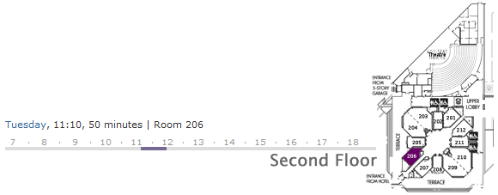
Scale, Share and Store your Models with CDO 2.0
Eike Stepper
stepper@esc-net.de
http://www.esc-net.de
http://thegordian.blogspot.com
Berlin, Germany
EclipseCon Talk, January 29, 2009

Slide 2
Business Logic
Persistence Logic
Input
Output
Business Objects
ResourceSet
.xml
.xml
.dat

Slide 3
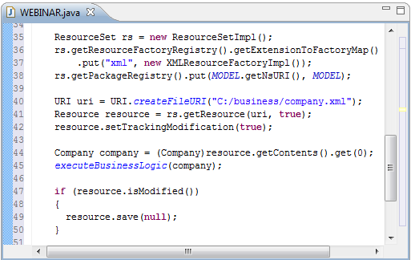
Business Logic
Persistence Logic
Input
Output
Business Objects
ResourceSet
.xml
.xml
.dat

Slide 4
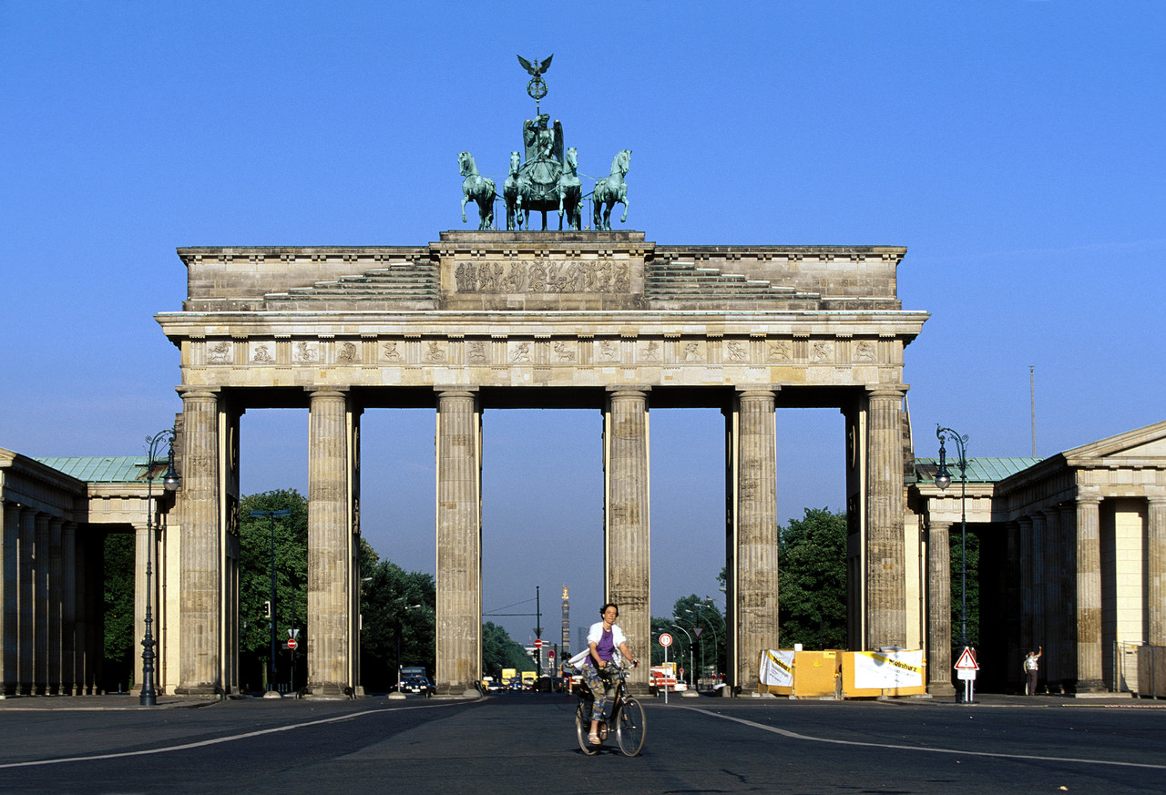
CDO Model Repository Framework
Scalability
Distribution
Transactions
Queries
Persistence
Versioning

Slide 5
Client 1
Client 2
Client 3
Model Repository
Database

Slide 6
Model Repository
Package Registry
Package Unit
Package Unit
Package Unit
Package Unit
MEM Store
DB Store
Hibernate Store
Objectivity Store
Model Repository
Store
Store Accessors
Chunk Readers
Database

Slide 7

Model Repository
Package Registry
Package Unit
Package Unit
Package Unit
Type
State
EPackage
Package Unit
Package Info
Package Unit
Package Info
Store
Database

Slide 8
Model Repository
Package Registry
Revision Manager
Package Unit
1
2
3
4
v3
v3
v3
v3
Package Unit
v2
v2
v2
v2
v2
v2
v2
v2
Package Unit
v1
v1
v1
v1
v1
v1
v1
v1
Package Unit
Store
Database

Slide 9
Model Repository
Package Registry
Revision Manager
Package Unit
1
2
3
4
Revision
v3
v3
v3
v3
Revision Data
Package Unit
v2
v2
v2
v2
v2
v2
v2
EClass
CDOID
int
long
long
eClass
id
version
created
revised
v2
CDOID resourceID
CDOID containerID
int containerFeature
Object[] values
Package Unit
v1
v1
v1
v1
v1
v1
v1
v1
Package Unit
Store
Database

Slide 10
Model Repository
Package Registry
Revision Manager
Package Unit
1
2
3
4
v3
v3
v3
v3
Package Unit
v2
v2
v2
v2
v2
v2
v2
v2
Package Unit
v1
v1
v1
v1
v1
v1
v1
v1
Package Unit
Store
Database

Slide 11
Model Repository
Session Manager
Session 1
Session 2
Session 3
Notifcation Manager
Commit Manager
Read / Write Access Handlers
Lock Manager
Query Manager / Handlers
Package Registry
Revision Manager
Store
Database

Slide 12

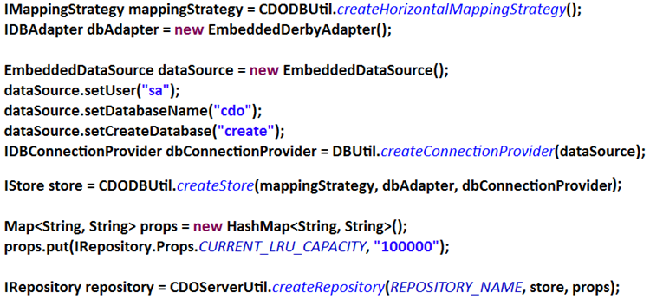
Model Repository
Session Manager
Session 1
Session 2
Session 3
Notifcation Manager
Commit Manager
Read / Write Access Handlers
Lock Manager
Query Manager / Handlers
Package Registry
Revision Manager
Store
Database

Slide 13
Server
Acceptor
Connector
Channel
Channel
Channel
Protocol
Protocol
Protocol
Session Manager
Session 1
Session 2
Session 3
Notifcation Manager
Commit Manager
Read / Write Access Handlers
Lock Manager
Query Manager / Handlers
Package Registry
Revision Manager
Store
Database

Slide 14
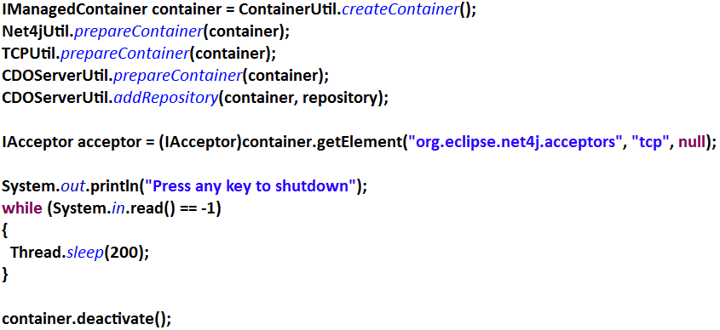
Server
Acceptor
Connector
Channel
Channel
Channel
Protocol
Protocol
Protocol
Session Manager
Session 1
Session 2
Session 3
Notifcation Manager
Commit Manager
Read / Write Access Handlers
Lock Manager
Query Manager / Handlers
Package Registry
Revision Manager
Store
Database

Slide 15
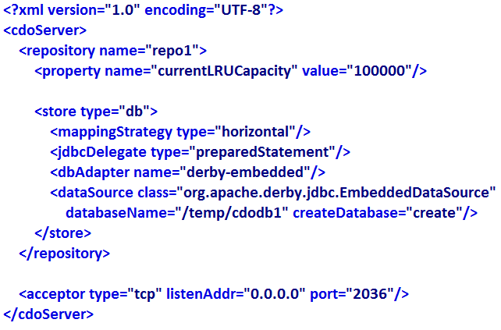
Server
Acceptor
Connector
Channel
Channel
Channel
Protocol
Protocol
Protocol
Session Manager
Session 1
Session 2
Session 3
Notifcation Manager
Commit Manager
Read / Write Access Handlers
Lock Manager
Query Manager / Handlers
Package Registry
Revision Manager
Store
Database

Slide 16
Client
Session
Protocol
Channel
Connector
Server
Acceptor
Connector
Channel
Channel
Channel
Protocol
Protocol
Protocol
Session Manager
Session
Session
Session
Notifcation Manager
Commit Manager
Read / Write Access Handlers
Lock Manager
Query Manager / Handlers
Package Registry
Revision Manager
Store

Slide 17
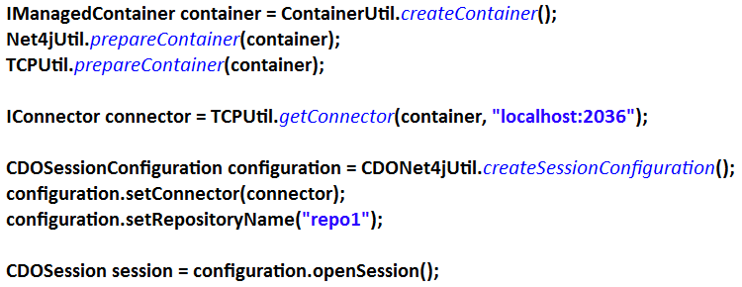
Client
Session
Protocol
Channel
Connector
Server
Acceptor
Connector
Channel
Channel
Channel
Protocol
Protocol
Protocol
Session Manager
Session
Session
Session
Notifcation Manager
Commit Manager
Read / Write Access Handlers
Lock Manager
Query Manager / Handlers
Package Registry
Revision Manager
Store

Slide 18
Session
Session
View
Audit
Transaction
View
Audit
Transaction
View
Audit
Transaction
1
1
1
v4
Protocol
Package Registry
Revision Manager
1
Package Unit
1
1
2
2
3
3
4
v3
4
v3
v3
v3
v3
v3
Package Unit
v2
v2
v2
v2
v2
v2
v2
v2
v2
Package Unit
v1
v1
v1
v1
v1
v1
v1
v1
Package Unit
Protocol
1100101001110111010010011110101110101

Slide 19
Session
BookImpl
View
Audit
Transaction
View
Audit
Transaction
View
Audit
Transaction
1
Package Registry
Reflective Delegation
String title
int pages
Category category
Writer author
Revision Manager
String title
int pages
Category category
Writer author
Root Extends Class
v4
1
Package Unit
1
v3
v3
v3
Package Unit
v2
v2
v2
Package Unit
v1
v1
Package Unit
Protocol
1100101001110111010010011110101110101

Slide 20
Session
CDOObjectImpl
View
P E R S I S T E N T
View
Audit
Transaction
View
Audit
Transaction
Audit
Transaction
attach to view
NEW
commit
commit
DIRTY
CDOID id
TRANSIENT
remote
invalidate
Package Registry
Revision Manager
Root Extends Class
CDOState state
v4
1
CDOView view
Package Unit
1
CLEAN
write
v3
v3
detach from view
v3
CDORevision revision
Package Unit
remote
invalidate
Object[] settings
v2
v2
read
v2
Package Unit
PROXY
CONFLICT
v1
v1
Package Unit
reload
Protocol
1100101001110111010010011110101110101

Slide 21
?
?
?
?
ResourceSet
?
Session
Session
View
Audit
Transaction
View
Audit
Transaction
View
Audit
Transaction
Package Registry
Revision Manager
Protocol

Slide 22
ResourceSet
Package Registry
View Set
Session
Session
Session
Transaction
Transaction
Transaction
Transaction
Transaction
Transaction
Transaction
Transaction
Transaction
Package Registry
Package Registry
Package Registry

Slide 23
1
1
3
2
4
4
4
2
1
3
5
2
5
3
ResourceSet
Package Registry
View Set
Transaction
Transaction
Transaction

Slide 24
ResourceSet
View Set
Transaction
Transaction
Transaction

Slide 25
XA Transaction
View Set
View Set
View Set
Transaction
Transaction
Transaction
Transaction
Transaction
Transaction
Transaction
Transaction
Transaction
1
2
3
4
5
6
7
8
9

Slide 26
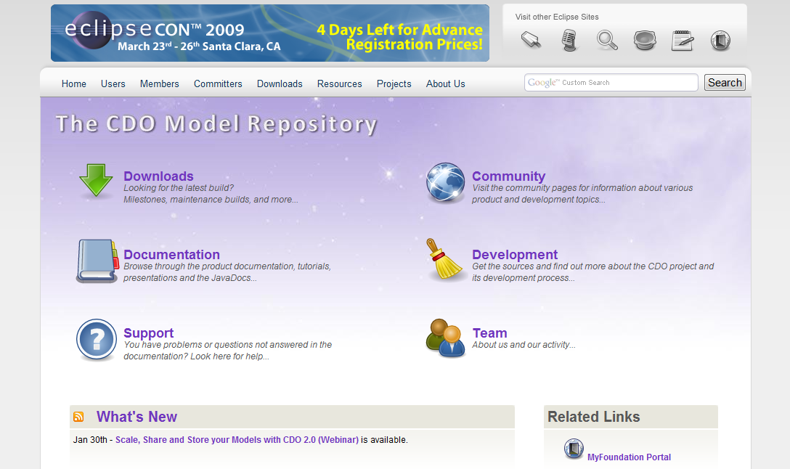
XA Transaction
View Set
View Set
View Set
http://www.eclipse.org/cdo
Transaction
Transaction
Transaction
Transaction
Transaction
Transaction
Transaction
Transaction
Transaction
1
2
3
4
5
6
7
8
9

Slide 27
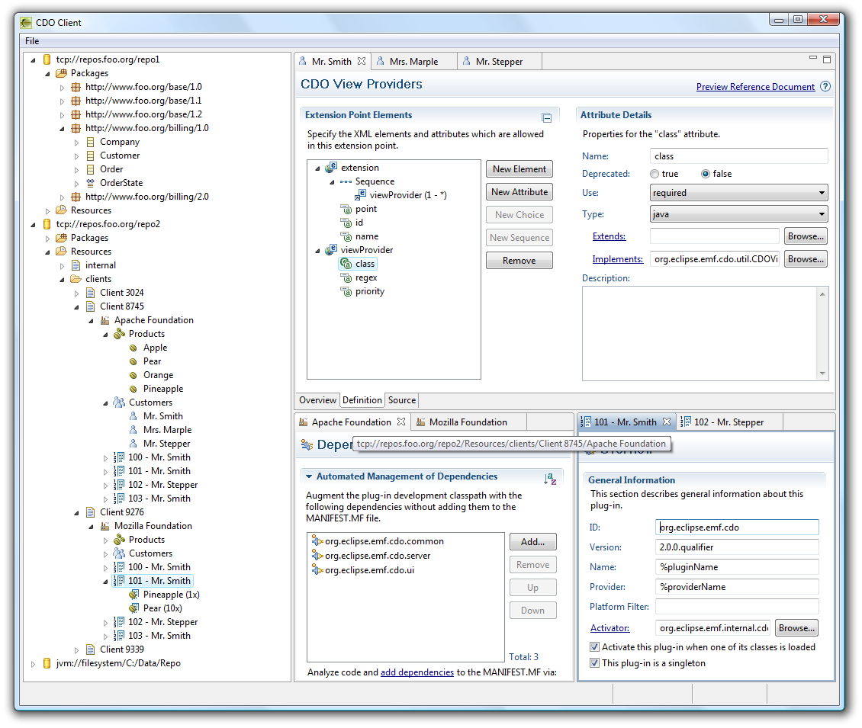
NEXT
Offline mode
Checkout
Re-sync
Legacy model support
Ecore
UML
3rd party models
OCL server-side
As common query language
For commit validation
Model code server-side
Custom data types (persistence)
Operations (e.g. in OCL)
Integrations
GMF integration
Workspace integration
Team integration
CDO Explorer
STEPS

Slide 28
Opening Views, Audits and Transactions
// Open multiple views on a session CDOView view = session.openView();
CDOAudit audit = session.openAudit(new Date("2009-01-19").getTime());
CDOTransaction transaction= session.openTransaction();
// Use own ResourceSet
ResourceSet resourceSet = new ResourceSetImpl();
CDOTransaction transaction2= session.openTransaction(resourceSet);
// Associate transactions with a distributed transaction
CDOXATransaction xa = CDOUtil.createXATransaction();
xa.add(transaction.getViewSet());
xa.add(transaction2.getViewSet());

Slide 29
Structured Resources / Queries
// Open CDO session and view
CDOSession session = openSession(); CDOView view = session.openView(); // Navigate through the resource folder structure for (CDOResourceNode node : view.queryResources(null, "business", false)) { if (node instanceof CDOResourceFolder) { EList<CDOResourceNode> subNodes = ((CDOResourceFolder)node).getNodes(); } else { EList<EObject> contents = ((CDOResource)node).getContents(); } } // Close the session when done
session.close();

Slide 30
Explicit Locking
CDOSession session = openSession(); CDOTransaction transaction = session.openTransaction();
transaction.setAutoReleaseLocksEnabled(true);
// Lock a single object for writing CDOResource resource = transaction.getResource("/my/resource"); resource.cdoWriteLock().lock();
// Modify that object resource.getContents().add(new Company()); resource.getContents().add(new Company()); resource.getContents().add(new Company());
// Commit atomically and release all locks transaction.commit(); session.close();

Slide 31
Save Points
CDOSession session = openSession(); CDOTransaction transaction = session.openTransaction();
// Create and populate a resource
CDOResource resource = transaction.getOrCreateResource("/my/resource"); resource.getContents().add(new Customer()); resource.getContents().add(new Customer());
// Set save point, modify and rollback CDOSavepoint savepoint = transaction.setSavepoint(); resource.getContents().add(new Supplier()); resource.getContents().add(new Supplier()); transaction.rollback(savepoint);
// Commit only the first changes (customers) transaction.commit(); session.close();

Slide 32
Passive Updates
CDOSession session = openSession(); CDOView view = session.openView(); CDOResource resource = view.getResource("/my/resource"); // Decouple from passive updates
session.options().setPassiveUpdateEnabled(false); for (EObject object : resource.getContents()) { Company company = (Company)object;
// Work with local model… } session.refresh(); // Work with refreshed model…
// Stay in sync from here session.options().setPassiveUpdateEnabled(true);

Slide 33
Change Subscriptions
CDOSession session = openSession(); CDOView view = session.openView();
// Subscribe to repository for CDO adapters view.options().setChangeSubscriptionPolicy(CDOAdapterPolicy.CDO);
// Define your CDO adapter class MyAdapter extends AdapterImpl implements CDOAdapter { @Override public void notifyChanged(Notification msg) { System.out.println("Modified remotely: " + msg.getNotifier()); } }
// Attach your adapter to any object to trigger a particular subscription CDOResource resource = view.getResource("/my/resource"); resource.eAdapters().add(new MyAdapter());

Slide 34
Query Framework
CDOSession session = openSession(); CDOView view = session.openView();
// Create query CDOQuery query = view.createQuery("SQL",
"SELECT cdoid FROM Company WHERE name LIKE ${name}"); query.setParameter("name", "Foo%"); query.setMaxResults(35);
// Send query to server and iterate the result asynchronously for (Iterator<Company> it = query.getResultAsync(Company.class); it.hasNext()) { Company company = it.next(); System.out.println(company); }
// Closing the view closes all open queries session.close();

