Slide 1

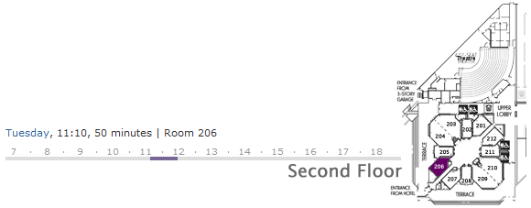
Scale, Share and Store your Models with CDO 2.0
Eike Stepper
stepper@esc-net.de
http://www.esc-net.de
http://thegordian.blogspot.com
Berlin, Germany
EclipseCon Talk, January 29, 2009

Slide 2
Business Logic
Persistence Logic
Input
Output
Business Objects
ResourceSet
.xml
.xml
.dat

Slide 3

CDO Model Repository Framework
Scalability
Distribution
Transactions
Persistence
Temporality
Concurrency

Slide 4
Client 1
Client 2
Client 3
Model Repository
Database

Slide 5
Model Repository
Package Registry
Package Unit
Package Unit
Package Unit
Package Unit
MEM Store
DB Store
Hibernate Store
Objectivity Store
Model Repository
Store
Store Accessors
Chunk Readers
Database

Slide 6

Model Repository
Package Registry
Package Unit
Package Unit
Package Unit
Type
State
EPackage
Package Unit
Package Info
Package Unit
Package Info
Store
Database

Slide 7
Model Repository
Package Registry
Revision Manager
Package Unit
1
2
3
4
v3
v3
v3
v3
Package Unit
v2
v2
v2
v2
v2
v2
v2
v2
Package Unit
v1
v1
v1
v1
v1
v1
v1
v1
Package Unit
Store
Database

Slide 8
Model Repository
Package Registry
Revision Manager
Package Unit
1
2
3
4
Revision
v3
v3
v3
v3
Revision Data
Package Unit
v2
v2
v2
v2
v2
v2
v2
EClass
CDOID
int
long
long
eClass
id
version
created
revised
v2
CDOID resourceID
CDOID containerID
int containerFeature
Object[] values
Package Unit
v1
v1
v1
v1
v1
v1
v1
v1
Package Unit
Store
Database

Slide 9
Model Repository
Package Registry
Revision Manager
Package Unit
1
2
3
4
v3
v3
v3
v3
Package Unit
v2
v2
v2
v2
v2
v2
v2
v2
Package Unit
v1
v1
v1
v1
v1
v1
v1
v1
Package Unit
Store
Database

Slide 10
Model Repository
Session Manager
Session 1
Session 2
Session 3
Notifcation Manager
Commit Manager
Read / Write Access Handlers
Lock Manager
Query Manager / Handlers
Package Registry
Revision Manager
Store
Database

Slide 11
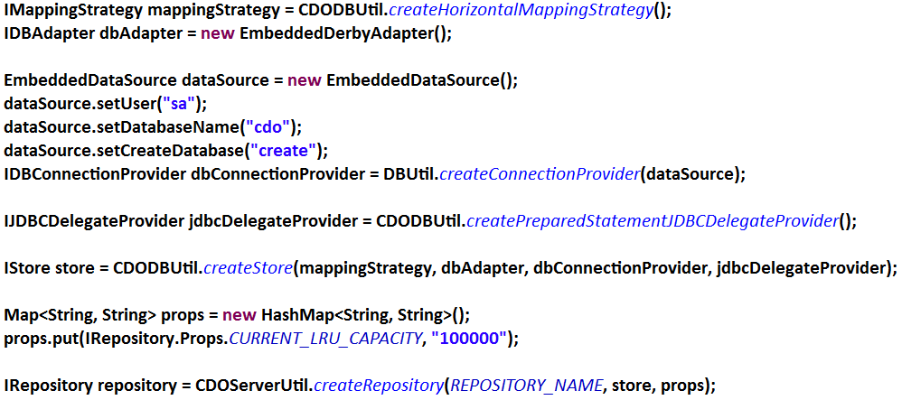
Model Repository
Session Manager
Session 1
Session 2
Session 3
Notifcation Manager
Commit Manager
Read / Write Access Handlers
Lock Manager
Query Manager / Handlers
Package Registry
Revision Manager
Store
Database

Slide 12
Server
Acceptor
Connector
Channel
Channel
Channel
Protocol
Protocol
Protocol
Session Manager
Session 1
Session 2
Session 3
Notifcation Manager
Commit Manager
Read / Write Access Handlers
Lock Manager
Query Manager / Handlers
Package Registry
Revision Manager
Store
Database

Slide 13
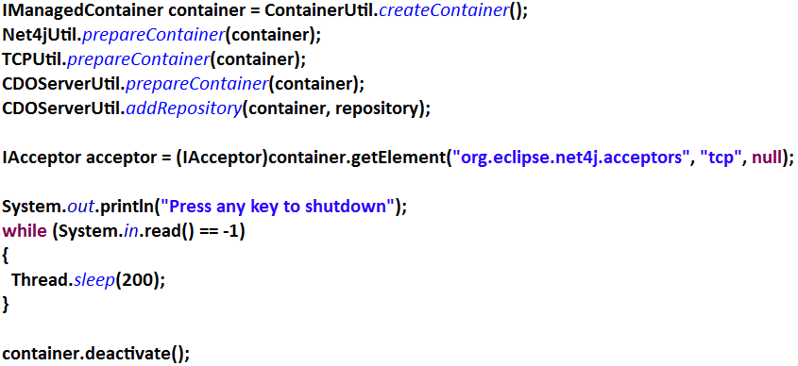
Server
Acceptor
Connector
Channel
Channel
Channel
Protocol
Protocol
Protocol
Session Manager
Session 1
Session 2
Session 3
Notifcation Manager
Commit Manager
Read / Write Access Handlers
Lock Manager
Query Manager / Handlers
Package Registry
Revision Manager
Store
Database

Slide 14
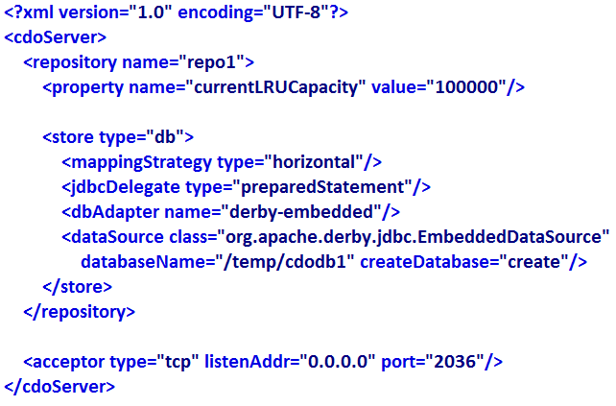
Server
Acceptor
Connector
Channel
Channel
Channel
Protocol
Protocol
Protocol
Session Manager
Session 1
Session 2
Session 3
Notifcation Manager
Commit Manager
Read / Write Access Handlers
Lock Manager
Query Manager / Handlers
Package Registry
Revision Manager
Store
Database

Slide 15
Client
Session
Protocol
Channel
Connector
Server
Acceptor
Connector
Channel
Channel
Channel
Protocol
Protocol
Protocol
Session Manager
Session
Session
Session
Notifcation Manager
Commit Manager
Read / Write Access Handlers
Lock Manager
Query Manager / Handlers
Package Registry
Revision Manager
Store

Slide 16
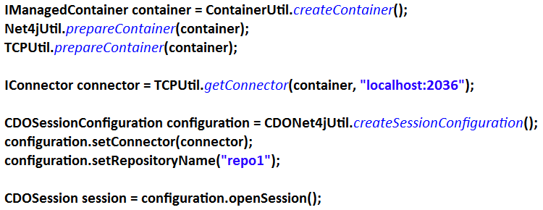
Client
Session
Protocol
Channel
Connector
Server
Acceptor
Connector
Channel
Channel
Channel
Protocol
Protocol
Protocol
Session Manager
Session
Session
Session
Notifcation Manager
Commit Manager
Read / Write Access Handlers
Lock Manager
Query Manager / Handlers
Package Registry
Revision Manager
Store

Slide 17
Session
Session
View
Audit
Transaction
View
Audit
Transaction
View
Audit
Transaction
1
1
1
v4
Protocol
Package Registry
Revision Manager
1
Package Unit
1
1
2
2
3
3
4
v3
4
v3
v3
v3
v3
v3
Package Unit
v2
v2
v2
v2
v2
v2
v2
v2
v2
Package Unit
v1
v1
v1
v1
v1
v1
v1
v1
Package Unit
Protocol
1100101001110111010010011110101110101

Slide 18
Session
BookImpl
View
Audit
Transaction
View
Audit
Transaction
View
Audit
Transaction
1
Package Registry
Reflective Delegation
String title
int pages
Category category
Writer author
Revision Manager
String title
int pages
Category category
Writer author
Root Extends Class
v4
1
Package Unit
1
v3
v3
v3
Package Unit
v2
v2
v2
Package Unit
v1
v1
Package Unit
Protocol
1100101001110111010010011110101110101

Slide 19
Session
CDOObjectImpl
View
Audit
Transaction
View
Audit
Transaction
View
Audit
Transaction
CDOID id
Package Registry
Revision Manager
Root Extends Class
CDOState state
v4
1
CDOView view
Package Unit
1
v3
v3
v3
CDORevision revision
Package Unit
Object[] settings
v2
v2
v2
Package Unit
v1
v1
Package Unit
Protocol
1100101001110111010010011110101110101

Slide 20
?
?
?
?
ResourceSet
?
Session
Session
View
Audit
Transaction
View
Audit
Transaction
View
Audit
Transaction
Package Registry
Revision Manager
Protocol

Slide 21
ResourceSet
Package Registry
View Set
Session
Session
Session
Transaction
Transaction
Transaction
Transaction
Transaction
Transaction
Transaction
Transaction
Transaction
Package Registry
Package Registry
Package Registry

Slide 22
ResourceSet
Package Registry
View Set
Session
Session
Session
Transaction
Transaction
Transaction
Transaction
Transaction
Transaction
Transaction
Transaction
Transaction
Package Registry
Package Registry
Package Registry

Slide 23
1
1
3
2
4
4
4
2
1
3
5
2
5
3
ResourceSet
Package Registry
View Set
Transaction
Transaction
Transaction

Slide 24
ResourceSet
View Set
Transaction
Transaction
Transaction

Slide 25
XA Transaction
View Set
View Set
View Set
Transaction
Transaction
Transaction
Transaction
Transaction
Transaction
Transaction
Transaction
Transaction
1
2
3
4
5
6
7
8
9

Slide 26
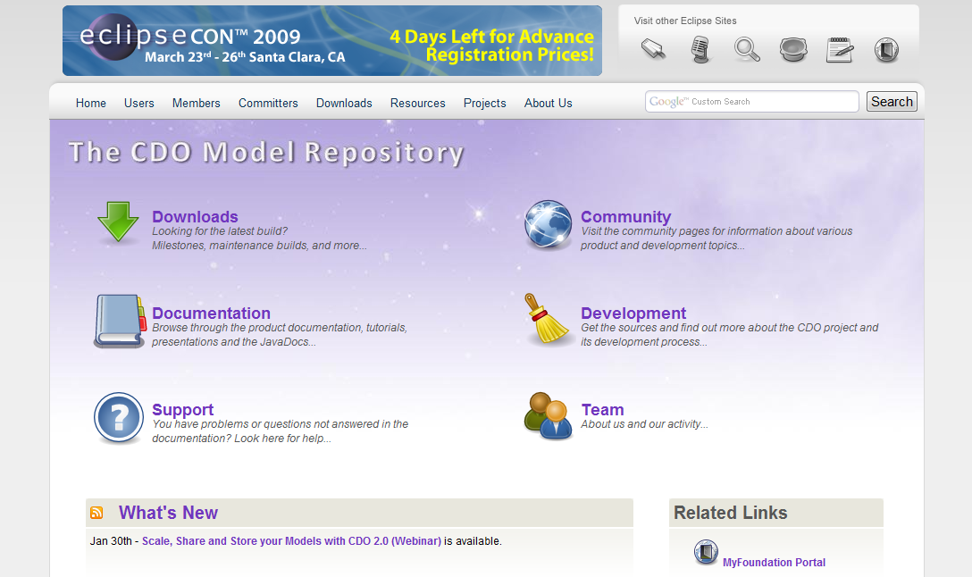
XA Transaction
View Set
View Set
View Set
http://www.eclipse.org/cdo
Transaction
Transaction
Transaction
Transaction
Transaction
Transaction
Transaction
Transaction
Transaction
1
2
3
4
5
6
7
8
9

