Slide 1
Eclipse Persistence Services Project – EclipseLink
Graduation Review
Doug Clarke, Peter Krogh - Project Leads

Slide 2
Project Overview
Complete persistence framework that is both comprehensive and universal
Will run in any Java Environment
  OSGi, Java EE, Java SE, Spring Framework
Read and write objects to virtually any type of data source
  Including Relational Databases, XML and EIS systems
Standards Based
  Java Persistence API (JPA): relational databases
  Java Architecture fore XML Binding (JAXB): XML
  J2EE Connector Architecture (JCA): EIS
  Service Data Objects (SDO)
Currently incubating under RT Project

Slide 3
Project Overview (cont’d)
Key Contributions
  Oracle Corp: Initial Code base came from Oracle TopLink (900K LOC)
    2 Project Leads + 25 Committers
  Sun Microsystems: Contributed to initial source contribution
    1 committer
  Other contributors
    TmaxSoft
    Adam Bien
    60 bugs filed by non-committers
Milestones
  Creation Review – May 30th, 2007
  Initial Source Drop – Aug 23rd, 2007
  Monthly Milestone builds – M1 Nov 5^{th,} 2007 – M9 June 19th, 2008
  Graduation Review – June 26th, 2008
Project home page: http://www.eclipse.org/eclipselink

Slide 4
Project Health
Active Code Base
  Average 125 svn commits / month
  Average 3000 files / month
Testing
  JUnit test cases for regression testing
  Continuous build
    Run every half hour (if code changes)
    Compile and Smoke tests
  22,500 tests run nightly on Eclipse Foundation servers
Additional Testing
  Additional configurations run regularly on Oracle servers
    Various DBs, Various App Servers

Slide 5
Project Health (cont’d)
Documentation
  Full Technical Docs on Wiki
    http://wiki.eclipse.org/EclipseLink/UserGuide
  Javadocs hosted online – regenerated every monthly milestone
    http://www.eclipse.org/eclipselink/api/1.0/index.html
  Other documentation on wiki
    Features index
    FAQ
    Examples - http://wiki.eclipse.org/EclipseLink/Examples
      Over 25 How to examples

Slide 6
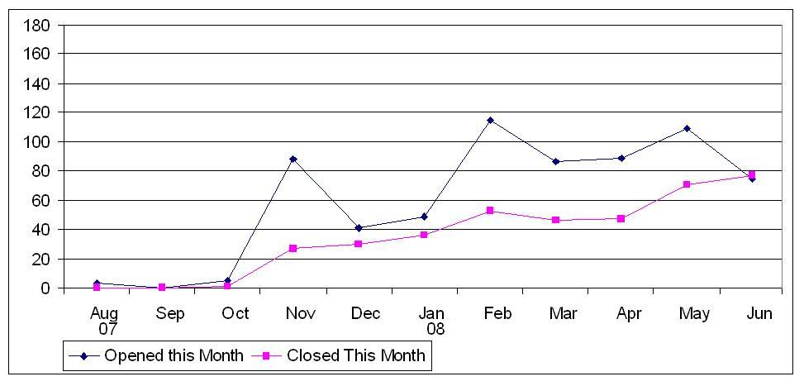
Project Health (cont’d)
Bugs
  388 bug/enhancements Closed
  Average 45 bugs closed per month
    Approximately 55 per month since Jan

Slide 7
Open Source
Permeable
  Issue discussions
    mailing lists (eclipselink-dev and eclipselink-users)
    Eclipse Bugzilla
  Weekly Open Project Status Meeting
  Weekly Bug council
  All code available through anonymous SVN
  Architecture described on project Wiki along with feature design docs
Receptive
  Bug fixes and features implemented in a timely manner
  Newsgroup and mailing list question fielded promptly

Slide 8
Open Source (cont’d)
Intellectual Property
  All IP (except 3rd Party jars) dual licensed under EPL and EDL
  All 3rd party dependencies are IP approved
  IP Log contains all CQs and all fixes from contributors.
    http://wiki.eclipse.org/EclipseLink/IPLog

Slide 9
Community
Developers
  28 committers
  Code contributions from individual contributors
Users
  Growing community of enterprise development orgs
    Oracle
    Sun
    TmaxSoft
    SpringSource
  Eclipse projects
    EMF Teneo, others?
Distributions
  GlassFish, Spring Framework, and Oracle (Future)

Slide 10
Community (cont’d)
EclipseLink Continues to upgrade on line documentation and website to make adoption easy
  Updated Wiki Pages
  Javadocs available online and updated with every milestone
  Wiki used to facilitate open communication
Many EclipseLink presentation have been given at conferences and workshops.
  EclipseWorld, EclipseCon, JavaOne, SpringOne, Oracle OpenWorld, ….
  http://wiki.eclipse.org/EclipseLink/Presentations
Many press releases have been written, and dozens of articles and blog entries have mentioned EclipseLink

Slide 11
EclipseLink 1.0 – JPA Features
JPA 1.0 compliant implementation
Java EE, Java SE, Web, Spring, and OSGi
Any JDBC/SQL compliant database
Schema generation
Advanced features
  Additional Mappings
  Configurable caching
  Extensive querying

Slide 12
EclipseLink 1.0 – MOXy Features
Supports Object-XML standard - JAXB
  Provides additional flexibility to allow complete control on how objects are mapped
Provides complete Object-XML mapping
  Direct, composite object, composite collection, inheritance, positional, path, transformation ….
  Allows developers to work with XML as objects
  Efficiently produce and consume XML
  Document Preservation
Rich set of mappings providing complete control and flexibility to map objects to any XSD
Supports any JAXP compliant parser
  SAX, DOM, StAX
Visual Mapping support using Workbench

Slide 13
EclipseLink 1.0 – SDO Features
SDO 2.1 Compliant
  Marshal/Unmarshal objects to/from XML
  Define Types/Properties programmatically or derive from XSD
  Generate interfaces that offer JavaBean like access to DataObjects
  Advanced mapping support for greater flexibility

Slide 14
EclipseLink 1.0 – EIS Features
Provide persistence support for non-relational data stores using Java EE Connector Architecture (JCA)
Mapping interaction inputs and outputs to persistent domain model
  XML mapping leveraging EclipseLink MOXy and ORM mappings
  Common Client Interface (CCI) mapping
Visual mapping Workbench support
Out of the box support for:
  MQSeries, OracleAQ, Sun JCA, XML Files

Slide 15
API’s
Supported Spec APIs
  Implements: JPA 1.0, JAXB 2.1, SDO 2.1
  Integrates with: JDBC, JCA, JAXP, JTA
Classic API
  Extensive API for Persisting Java Objects
  Migration tools and strategy from earlier Oracle TopLink releases
Workbench
  Swing GUI tool for design time usage
  Metadata manipulated visually

Slide 16
Architectural Features
Basic Architecture built on Product with 10 years of commercial usage
  Stable and Performant
Adaptable architecture - easily add/modify features in EclipseLink
  Database Platform – add/modify support for specific database
  Server Platform - add/modify support for specific Application Server
  Events triggered on data store access
  Policies – most features implemented with pluggable policies
    Optimistic Locking
    Caching
    Object Instantiation
    and many more

Slide 17
End Of Life Strategy
1.0 release
  No EclipseLink features are being discontinued
1.1 release
  Plan to introduce new fully functional meta data
    1.0 supports partial solution.
  Will begin migration story from old meta data
    Deprecate meta-data
    Discontinue in a future release

Slide 18
Roadmap
EclipseLink 1.0 – July, 2008
  Delivering the full functionality of the initial contribution (Oracle TopLink)
  Functionality Summary
    JPA: 1.0 compliance with advanced ORM capabilities
    MOXy: JAXB 2.1 functionality (not complete compliance) with advanced mapping capabilities
    SDO: 2.1 compliance
    OSGi Bundles for JPA, MOXy, and SDO components
    Utils: Workbench and migration utilities
    Examples: How-to's, complete examples, and tutorials
    Documentation available on Wiki

Slide 19
Roadmap (continued)
EclipseLink 1.0.1
  Early September – planned (1.0 + 8 weeks)
  Primarily a maintenance release
EclipseLink 1.1
  Early December – tentative
  Features:
    JPA 2.0 functionality
    DBWS using JAX-WS
EclipseLink 2.0
  Spring 2009 – tentative – align with next Eclipse RT release?
  Features
    Complete JPA 2.0
    SDO-DAS

Slide 20
Feedback
Newsgroup: eclipse.technology.eclipselink
Mailing lists:
  eclipselink-dev@eclipse.org
  Eclipselink-users@eclipse.org
Eclipse Bugzilla
  RT
  Product: EclipseLink

