Slide 1
Java Annotation Processing (APT) in the Eclipse JDT
Gary Horen BEA Systems
Jess Garms BEA Systems
Walter Harley BEA Systems

Slide 2
Agenda
Background
Demo of annotation editing tools
Mirror API and APT
Design Principles
Futures

Slide 3
History of metadata-driven programming model
First metadata lived in external files
  e.g. deployment descriptor
Then in javadoc comments processed by XDoclet
  Processed separately from compilation
Now in JSR 175 annotations
  Formal part of language spec in JDK 1.5
  Real Java types, processed during compilation
  Compiler resolves references; does much of syntax analysis
  Annotation developer worries about semantics

Slide 4
Who uses annotations?
J2SE – builtin annotations
J2EE – EJB 3.0, JSR 181, JSR 250, JAXB 2.0, JAX-WS 2.0
3rd party frameworks: Hibernate, Beehive, Spring
@Deprecated – built into Java
@WebService – JSR 181 web services stack
@Entity – JSR 220 EJB Persistence

Slide 5
What do annotations do?
Usually, help a POJO run inside a framework.
  EJB container
  Web services stack
Annotation values can be stored in class file.
Annotation can cause new files to be generated at build time:
  Arbitrary data files (e.g. XML)
  Java types (may contain further annotations)
Framework uses values and generated files to support POJO
Notes:
Annotations enable a simpler, POJO based programming model. The goal is to allow the user to write a plain old java object, then annotate it, and then the framework uses the metadata to help the user code do its work.

Slide 6
What annotations look like
Declared by framework developer
public @interface WebService {
String endpointInterface();
String name();
…
}
Used by application developer
@WebService
public class Foo {
…
}

Slide 7
Example: calling a method starts a transaction
User annotates source code
public class Stuff {
@Transaction(“start”)
public void someMethod(String s)
...
}
Container
examines annotation values at run time with java.lang.reflect
private void dispatchMethod(Method name) {
Annotation a = name.getAnnotation(Transaction.class);
if annotation on element says “start”
this.startTransaction();
build parameter list
name.invoke(parameters);
}

Slide 8
Example: helping a POJO become a web service
Annotations on user code generate helper objects
  Endpoint interface: receives and parses SOAP message
  Bindings embody the message as parameters to the POJO method
@WebService
public class Foo {
@WebMethod
public Thing mumble()
}
generates
Endpoint Interface
XML-Java Bindings

Slide 9
Processing annotations at build time
Many annotation effects happen at build time, not run time
  Verify that element values are valid
  Verify arbitrary constraints on decorated declaration:
    Does this method return the right type?
    Does this class implement a required interface?
  Generate files
The components we need to make this work:
  Something to process a set of annotations – an annotation processor
    Contributed by whoever defines the annotation(s)
  A build time container to dispatch the available processors
  Enhanced visual tools – Eclipse improves the editing experience

Slide 10
Agenda
Background
Demo of annotation editing tools
Mirror API and APT
Design Principles
Futures

Slide 11
Demo
Stuff that happens in both command-line build and Eclipse
  Verifying element values
  Generating (and deleting) new Java types
Stuff that only happens in Eclipse
  Quick Fix
  Auto Completion
  Annotation Editing View

Slide 12
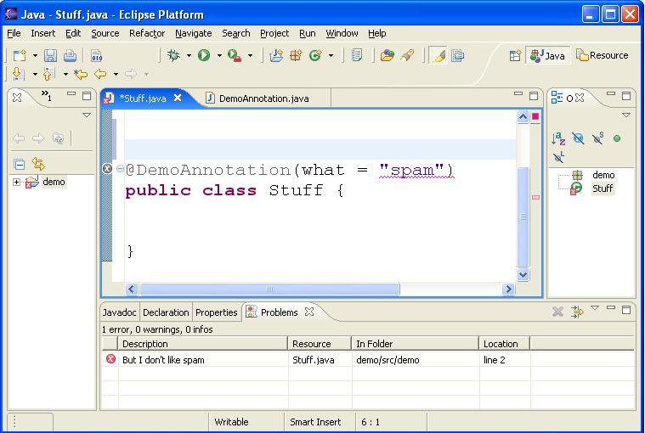
Demo: processor finds invalid value

Slide 13
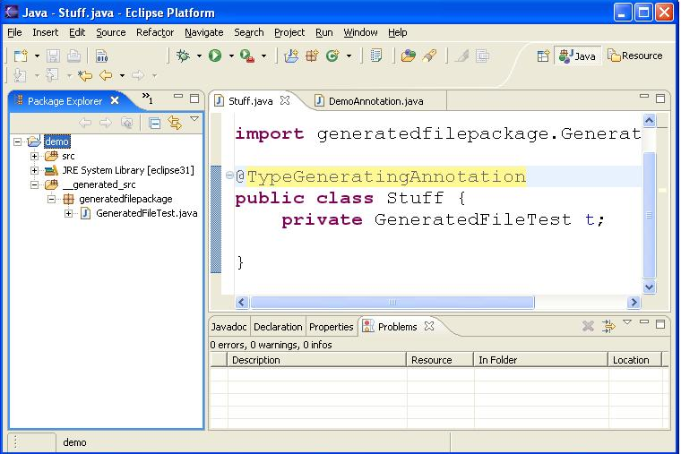
Demo: annotation generates type

Slide 14
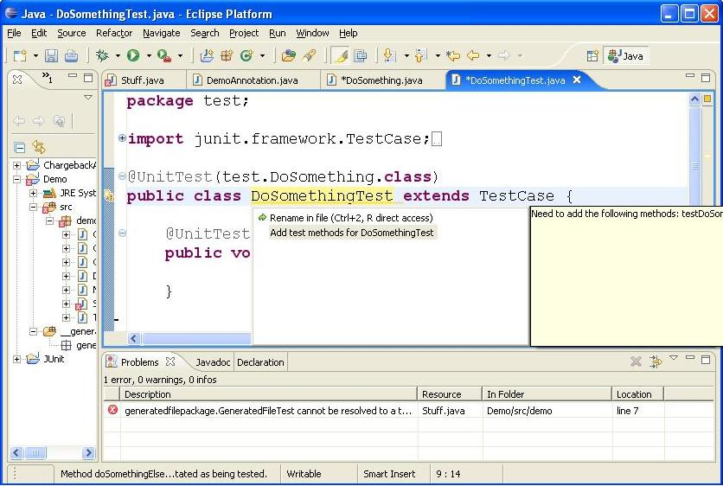
Demo: quick fix for processor’s error message

Slide 15
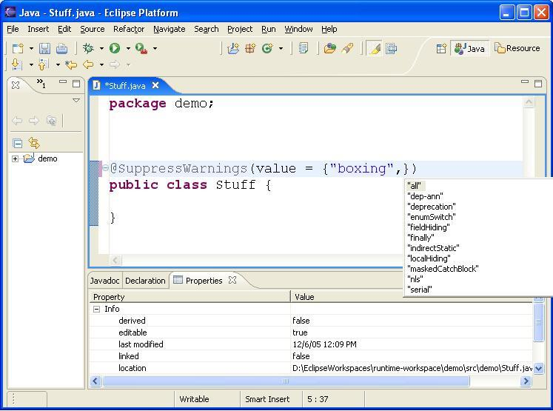
Demo: auto completion in annotation value

Slide 16
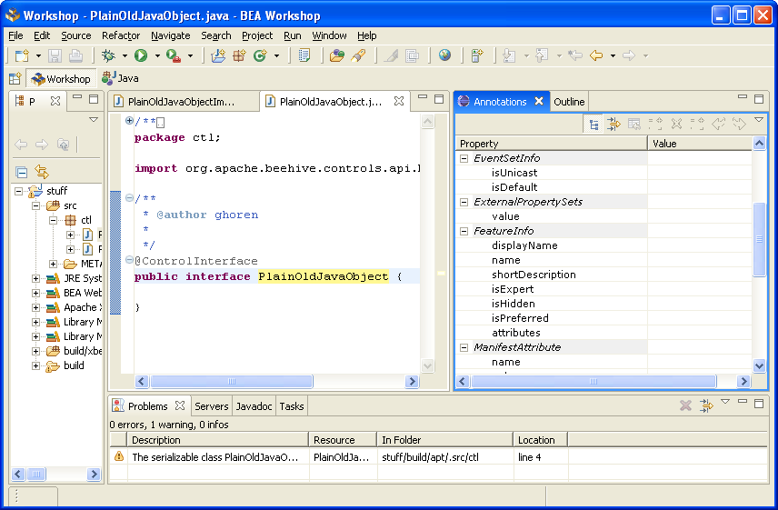
Demo: annotation editing view

Slide 17
Agenda
Background
Demo of annotation editing tools
Mirror API and APT
Design Principles
Futures

Slide 18
APIs in the Eclipse APT plugin
Sun’s Mirror API (com.sun.mirror.*)
  Examining source code
  Generating new files, java and non-java
Eclipse-specific APIs (org.eclipse.jdt.apt.*)
  Quick Fix
  Auto completion: prototype API
  Visual annotation editor: prototype API

Slide 19
Mirror API
Annotation processor runs in one of two ways:
  Command line: Sun APT (batch processing)
  In Eclipse: o.e.jdt.apt.core plug-in: (while user edits file)
Processor uses Mirror API to do its work
Binary compatible between APT and Eclipse
But, there are behavioral differences (as we will see)

Slide 20
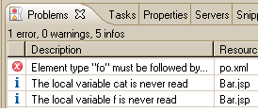
Mirror API
Annotation Processor Environment
@Foo
class Bar
{…}
...
a
d
b
c
Declarations to process
Type system exploration
File generation
Error messages

Slide 21
Processor dispatch
APT sees annotation; dispatches corresponding processor
  AnnotationProcessor.process()
Within process() call, AnnotationProcessorEnvironment available
environment.getSpecifiedTypeDeclarations()
  returns list of files to be processed

Slide 22
Processing rounds
Round 1: Original source files
Round 2: Types generated by processing original files in round 1
Round 3: Types generated in round 2

Slide 23
Pitfall: APT round implementation
All of round 1 arrives in first call to process()
@Foo
class A
@Foo
class B
@Foo
class C
Round 1
Then all of round 2 in second call
Round 2
@Foo
class A_Gen
@Foo
class B_Gen
@Foo
class C_Gen
Obtain types by calling AnnotationProcessorEnvironment.getSpecifiedTypeDeclarations()

Slide 24
Pitfall: Eclipse round implementation
Each file arrives in a separate call to process()
@Foo
class A
@Foo
class B
@Foo
class C
Round 1
Round 2
@Foo
class A_Gen
@Foo
class B_Gen
@Foo
class C_Gen
Rounding in Eclipse must be file-at-a-time for performance reasons.

Slide 25
Pitfall: referencing a generated type
WRONG
From processor:
A
B
process() {
if annotatedDecl == A {
Type t = env.getTypeDecl(B_Gen);
t.foo(); // sometimes t will not exist!
}
}
A_Gen
B_Gen
CAUTION
From application code:
A_Gen2
class A {
private B_Gen bg;
}

Slide 26
Agenda
Background
Demo of annotation editing tools
Mirror API and APT
Design Principles
Futures

Slide 27
Design Principles
One year of user experience in the community:
Three principles for good annotation processors
  Be Fast
  Watch Your References
  Play Well With Others

Slide 28
Design Principles: Be Fast
Your processor may be called on every keystroke! So...
  Don’t iterate over all files in the project
  Don’t iterate over all discoverable types
  Avoid APIs that might require additional compilation
    AnnotationProcessorEnvironment:
    getPackage(String name) – cached, but first call expensive
    getTypeDeclaration(String name) – likewise
    PackageDeclaration:
    just about every method is expensive, and there’s no cache
  Execute long-running operations only on build, not on reconcile
    EclipseAnnotationProcessorEnvironment.getPhase()

Slide 29
Design Principles: Be Fast – design annotations wisely
Use class literals rather than class names, in annotation values
  if your annotations look like this:
  @ReferencesType(“org.example.SomeType”) // avoid!
  then your processor will need code like this:
  String typeName = ... // read type name from annotation value
    AnnoProcEnv.getTypeDeclaration(typeName) // expensive
  instead, try for annotations like this:
    @ReferencesType(org.example.SomeType.class)
In general, prefer strong types (enums, boolean, ...) over strings

Slide 30
Design Principles: Watch Your References
Avoid multiple source files contributing to a single output file.
  If you must – e.g., for a deployment descriptor – try to build it in a separate user-initiated operation, such as Publish.
Avoid the rounding pitfalls discussed earlier.
  In user code, try not to reference generated types.
  In the processor, don’t search for types generated from other files or types generated in later rounds.

Slide 31
Design Principles: Watch Your References
Use caution when maintaining state within processors.
  Don’t make assumptions within the processor about how many times it will be called, or what files it will process on which call.
  Separate instances of processors may be executing on multiple threads simultaneously. Use caution with class-scoped variables.
Or else: run processor in “batch mode”.
  No processing on reconcile; process all files on every build
  Slow, and user experience is compromised (e.g. no error check while typing)

Slide 32
Design Principles: Play Well With Others
Your processor may be running alongside other processors and plug-ins.
  Package as a plug-in, to take advantage of Eclipse-specific APIs
  e.g. DOM AST, quick-fix API, ...
  (unless command-line apt compatibility is important)
  Put processor and annotations in separate Java packages
  Annotations are public code; processors are private
  Don’t claim “*” in supportedAnnotationTypes()
    Processors lower in factory path order will never get called

Slide 33
End-user Pitfall: no file generation during reconcile
New files are only generated during a build
  During reconcile, existing files can be modified but new files can’t be created.
Until all files are generated, user experience may be confusing
  E.g., generated types appear to be missing
Good reason to Watch Your References.
End Users: build new projects before starting to edit
  Turn on project auto-build – build on every Save

Slide 34
Agenda
Background
Demo of annotation editing tools
Mirror API and APT
Design Principles
Futures

Slide 35
Present and Future
Future
  Processor API for Java 1.6: JSR 269
  Further Eclipse tooling
    Code completion within string values
    Reconcile-time type generation
Now
  Comes built-in with Eclipse 3.2M5 and later
  Beta available for Eclipse 3.1.2 on update site
  Try it out! http://www.eclipse.org/jdt/apt/introToAPT.html

Slide 36
Java Annotation Processing (APT) in the Eclipse JDT
Gary Horen BEA Systems
Jess Garms BEA Systems
Walter Harley BEA Systems
Try it out! http://www.eclipse.org/jdt/apt/introToAPT.html

