Slide 1
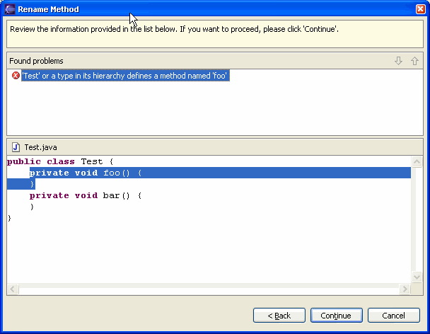
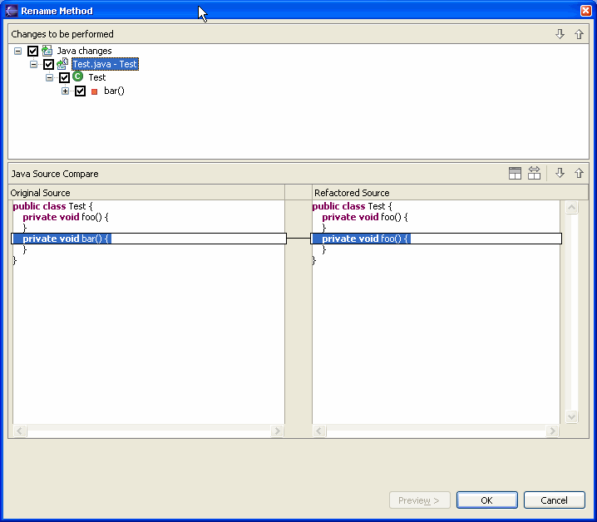
1 .. n
Concrete
User Input
Page
Generic
Refactoring
Action
Concrete
Refactoring
Wizard
1
Generic
Error
Page
Concrete
Status
Viewer
1
Generic
Preview
Page
Concrete
Content
Provider
Generic
Refactoring
Concrete
Preview
Viewer
1
0 .. n
Concrete
Processor
Concrete
Participant
Legend
predefined reference
configurable via extension points

