Slide 1
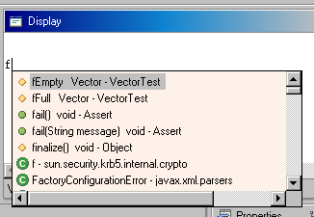
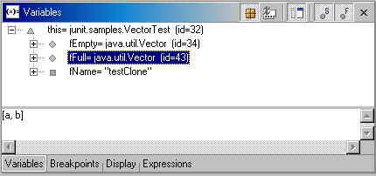
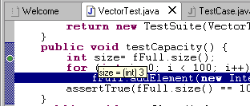
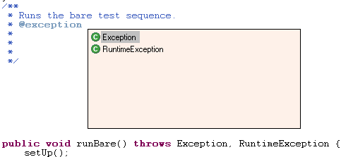

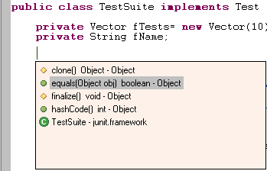
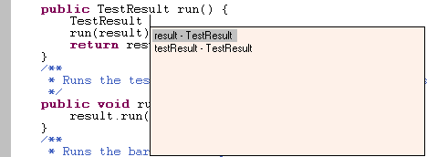
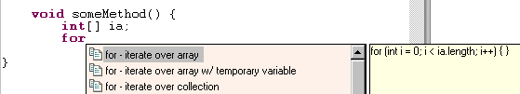

Eclipse Java Tooling
“Easter Eggs” – Features you might not know about
Debugger
toString support
value hovering
code assist in
Display View
Editor/Code Assist
JavaDoc code assist
anonymous inner type code completion (inserts method stubs)
declaration
code assist (inserts inherited method declaration)
variable name
suggestion
templates with variable name guessing
Argument hints and
proposed argument names

Slide 2
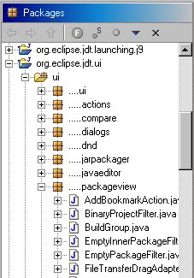
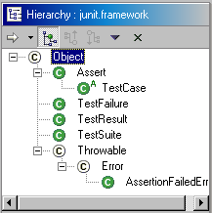
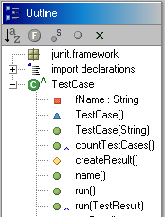
Views
open type hierarchy
on a package/project
override
indicator
package name
compression
Debugger
  run code with errors
  automatic suspend in debugger when error is encountered
  method entry/exit breakpoints
  variable changed indication in Variables view
Refactoring
  refactorings integrated with drag & drop
  extract local variable can replace all occurrences of an expression
Editor
  structured selection support
Import management – automatic import on…
  code assist type completion
  override methods, getter setter generation
  refactoring
Compiler
  JDK 1.3/JDK 1.4 switch
Search
  read/write access to fields
Compare
  structure compare for .java and .properties files
  option for ignore white space – in Java structure compare ignores formatting and comments

