Slide 1
JUnit for Eclipse
Goals
Tightly integrated support for running and writing JUnit tests
in Eclipse:
“Showing the existing JUnit UI in a standalone window doesn’t count!”
  requires that UI runs in Eclipse
  test runs must not have any side effects on the Eclipse run-time VM
Leverage Eclipse and Java infrastructure for:
  finding tests to be run
  navigation from a failure to its source location
  debugging a test failure
  “hot test fixing” – fixing a test without having to restart a test run
Support for running Eclipse plugin tests
  tests have to run inside an Eclipse workspace
  support UI based and headless tests
Simple support for writing and maintaining tests
  creating tests for a class and methods
  creating and updating a test suite

Slide 2
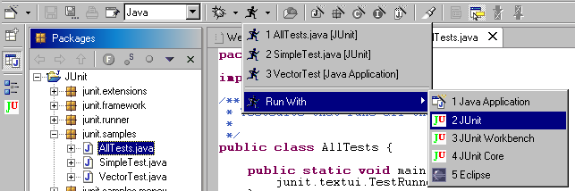
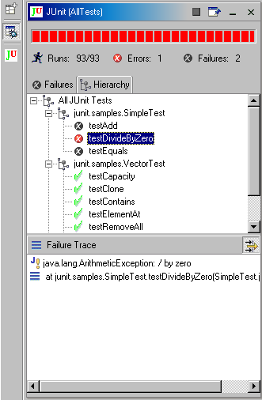
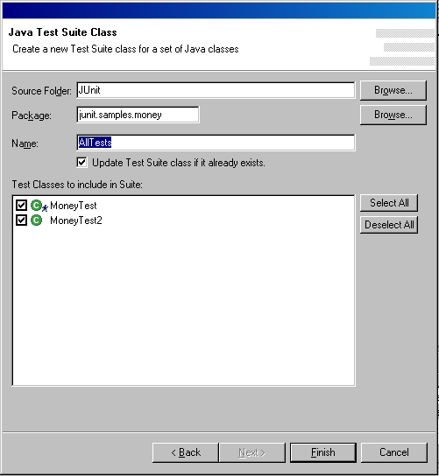
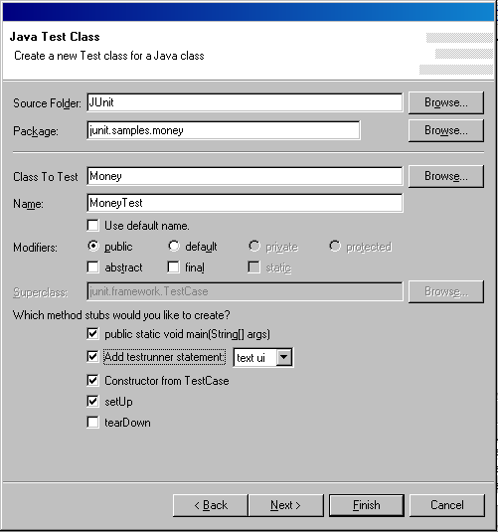
Test Launching
Test Results View
Test Creation Wizards

Slide 3
Implementation
RemoteTestRunner
  test UI runs inside Eclipse – RemoteTestRunner runs tests inside a separate VM
  RemoteTestRunner communicates with a simple socket based protocol with Eclipse
  enables test debugging, decouples tests execution from Eclipse
Launcher
  extends the Eclipse debugger’s launcher extension point
  uses the JDT VM launching support to start the RemoteTestRunner
  JUnit plugin listens for JUnit launches and connects JUnit Results View with RemoteTestRunner
Hot Test Fixing
  leverages Debugger’s hot code replace support (requires running on J9 or JDK 1.4)
  RemoteTestRunner provides option to keep the VM alive at the end of test run
  RemoteTestRunner protocol supports re-running individual tests
Plugin Tests – Plugin Test Launcher
  Launches an Eclipse application that starts a RemoteTestRunner inside an Eclipse workspace
  RemoterTestRunner uses the PluginClassloader to load test cases
Test Creation Wizards
  uses JDT Type creation wizard framework
  tests to be implemented are marked with a Task marker
Eclipse
start/stop/rerun tests
Remote
TestRunner
test results
test suite hierarchy

Slide 4
Comparison with standalone JUnit Test Runners
Eclipse UI mechanisms could be reused resulting in seamless integration and richer functionality:
  window management (fast views)
  launch history
  preferences
  markers for indicating unimplemented tests
  test browsing
Status
org.eclipse.jdt.junit: part of the Eclipse SDK since
build 20020204
org.eclipse.pde.junit: available as an optional plugin, will be integrated into PDE
Future work ideas
running JUnit tests as a post build action
Ant task to invoke the Eclipse JUnit TestRunner from Ant scripts
remind users to rerun tests – green status fades away

