Slide 1

System Overview
DBC file
DBC2VSS
mapping
Information
Data
Knowledge
KUKSA.val server
Data Consumer/GUI
CAN

Slide 2

System Overview
Information
Data
Knowledge
CAN

Slide 3
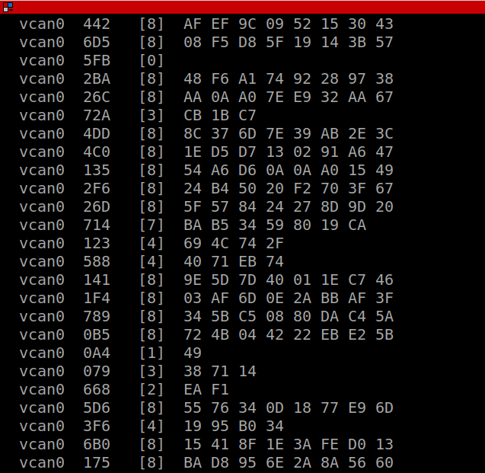
System Overview
Information
Data
Knowledge
KUKSA.val server
KUKSA Hardware
CAN

Slide 4
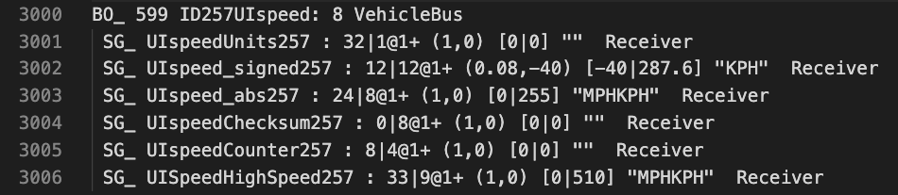
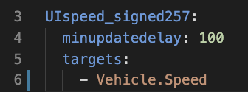
System Overview
DBC file
VSS Mapping
Information
Data
Knowledge
KUKSA.val server
KUKSA Hardware
CAN

Slide 5
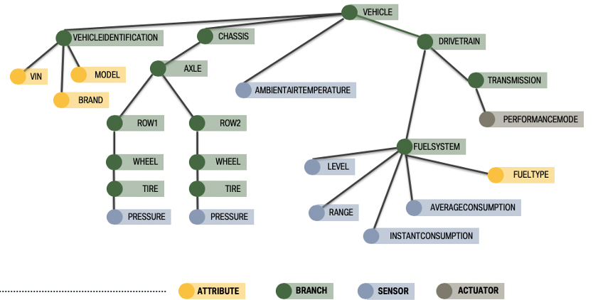
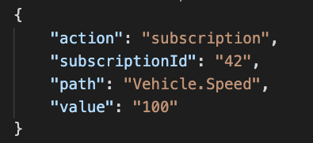
System Overview
DBC file
VSS Mapping
Query REST
Pub/sub Websocket
Information
Data
Knowledge
KUKSA.val server
KUKSA Hardware
CAN

Slide 6
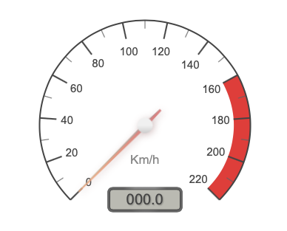
System Overview
Data Consumer
DBC file
VSS Mapping
Query REST
Pub/sub Websocket
Information
Data
Knowledge
KUKSA.val server
KUKSA Hardware
CAN

Slide 7

Cloud
Offboard
KUKSA.val APP
Wisdom: Use
DBC file
VSS Mapping
Information
Data
Knowledge
KUKSA.val
Onboard
KUKSA Hardware
CAN

