Slide 1

The Eclipse Modeling Framework
Introducing Modeling to the Java™ Technology Mainstream
Ed Merks, Ph.D.
Software Architect
IBM Canada Ltd.
www.eclipse.org/emf

Slide 2
Goal
Eclipse Modeling Framework (EMF)
  Learn about modeling and how the Eclipse Modeling Framework can help you write your application in significantly less time, simply by leveraging the data model you've probably already defined, although you might not know it

Slide 3
Agenda
What is Modeling?
EMF Model Definition
Code Generation
EMF Architecture
Demo
Summary

Slide 4
What is Modeling?
Model Driven Architecture (MDA)™
A software development architecture proposed by the OMG (Object Management Group)
Application is specified in a high-level platform independent model (PIM)
  abstracts away underlying platform technology
Transformation technologies are used to convert PIM to platform specific model (PSM), implementation code, etc.
Includes several open modeling standards
  UML, MOF, XMI, CWM

Slide 5
What is Modeling?
Why don’t we care about MDA?
It’s mostly vaporware
“Real programmers” know that implementing complex systems by simply transforming a picture, is a “pipe dream”
  not to mention the fact that it could put us “real programmers” out of business!
Smart people know that all the expressive power of Java ™ software can’t be available in the model
  if it was, it wouldn't be any simpler (higher level)
  it would just be another “programming language”

Slide 6
What is Modeling?
Why should we care about MDA?
It’s not totally vaporware
“Real programmers” know that generating some of the code that we write over and over, must be possible
  It will simply pave the way for even more complex systems on top of it … programmers like us will never be out of business!
Smart people (that have been around long enough) recognize many of the same arguments that were used to oppose high-level languages vs. assembly language

Slide 7
What is Modeling?
Model Driven Development with EMF
Contrary to most programmers’ belief, modeling can be useful for more than just documentation
Just about every program we write manipulates some data model
  It might be defined using Java ™, UML, XML Schema, or some other definition language
EMF aims to extract this intrinsic "model" and generate some of the implementation code
  Can be a tremendous productivity gain

Slide 8
Agenda
What is Modeling?
EMF Model Definition
Code Generation
EMF Architecture
Demo
Summary

Slide 9
EMF Model Definition
What is an EMF “model”?
Specification of an application’s data
  Object attributes
  Relationships (associations) between objects
  Operations available on each object
  Simple constraints (e.g., multiplicity) on objects and relationships
Essentially the Class Diagram subset of UML

Slide 10
EMF Model Definition
Model Sources
EMF models can be defined in (at least) three ways:
  Java ™ Interfaces
  UML Class Diagram
  XML Schema
Choose the one matching your perspective or skills, and EMF can generate the others as well as the implementation code

Slide 11
EMF Model Definition
1. Java Interfaces
public interface PurchaseOrder {
String getShipTo();
void setShipTo(String value);
String getBillTo();
void setBillTo(String value);
List getItems(); // List of Item
}
public interface Item {
String getProductName();
void setProductName(String value);
int getQuantity();
void setQuantity(int value);
float getPrice();
void setPrice(float value);
}

Slide 12
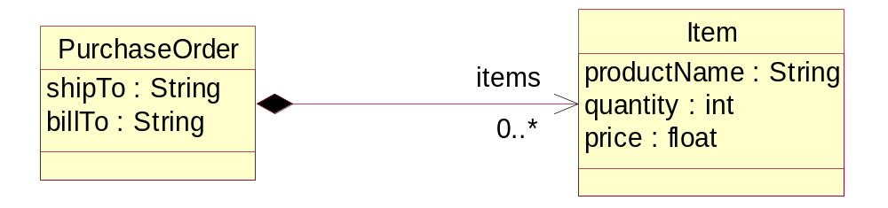
EMF Model Definition
2. UML Class Diagram

Slide 13
EMF Model Definition
3. XML Schema
<xsd:complexType name="PurchaseOrder">
<xsd:sequence>
<xsd:element name="shipTo" type="xsd:string"/>
<xsd:element name="billTo" type="xsd:string"/>
<xsd:element name="items" type="PO:Item"
minOccurs="0" maxOccurs="unbounded"/>
</xsd:sequence>
</xsd:complexType>
<xsd:complexType name="Item">
<xsd:sequence>
<xsd:element name="productName" type="xsd:string"/>
<xsd:element name="quantity" type="xsd:int"/>
<xsd:element name="price" type="xsd:float"/>
</xsd:sequence>
</xsd:complexType>

Slide 14
EMF Model Definition
Unifying Java™, XML, and UML technologies
All three forms provide the same information
  Different visualization/representation
  The application’s “model” of the structure
From a model definition, EMF can generate:
  Java™ implementation code, including UI
  XML Schemas
  Eclipse projects and plug-ins

Slide 15
Agenda
What is Modeling?
EMF Model Definition
Code Generation
EMF Architecture
Demo
Summary

Slide 16
Code Generation
Feature Change Notification
Efficient notification from “set” methods
  Observer Design Pattern
public String getShipTo() {
return shipTo;
}
public void setShipTo(String newShipTo) {
String oldShipTo = shipTo;
shipTo = newShipTo;
if (eNotificationRequired())
eNotify(new ENotificationImpl(this, ... );
}

Slide 17
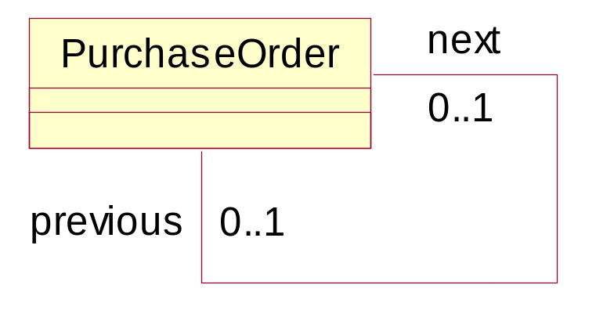
Code Generation
Bidirectional Reference Handshaking
next
public interface PurchaseOrder {
...
PurchaseOrder getNext();
void setNext(PurchaseOrder value);
PurchaseOrder getPrevious();
void setPrevious(PurchaseOrder value);
}

Slide 18
Code Generation
Bidirectional Reference Handshaking (cont)
next
next
next
p1
p2
next
p3
previous
previous
previous
change
notification
p2
previous
p1.setNext(p3);

Slide 19
Code Generation
Reflective EObject API
All EMF classes implement interface EObject
Provides an efficient API for manipulating objects reflectively
  Used by the framework (e.g., generic serializer, copy utility, generic editing commands, etc.)
  Also key to integrating tools and applications built using EMF
public interface EObject {
Object eGet(EStructuralFeature f);
void eSet(EStructuralFeature f, Object v);
...
}

Slide 20
Code Generation
Reflective EObject API (cont)
Efficient generated switch implementation of reflective methods
public Object eGet(EStructuralFeature eFeature) {
switch (eDerivedStructuralFeatureID(eFeature))
{
case POPackage.PURCHASE_ORDER__SHIP_TO:
return getShipTo();
case POPackage.PURCHASE_ORDER__BILL_TO:
return getBillTo();
...
}

Slide 21
Code Generation
Model Persistence
Save model objects using EMF Resources
  Generic XML Resource implementation
  Other Resource implementations possible
poResource = ...createResource(..."p1.xml"...);
poResource.getContents.add(p1);
poResource.save(...);
p1.xml:
<PurchaseOrder>
<shipTo>John Doe</shipTo>
<next>p2.xml#p2</next>
</PurchaseOrder>

Slide 22
Code Generation
Proxy Resolution and Demand Load
p1.xml
p2.xml
next
p1
next
next
p2
proxyURI=“p2.xml#p2”
proxyURI=“p2.xml#p2”
PurchaseOrder p2 = p1.getNext();

Slide 23


Code Generation
EMF.Edit Model Viewers and Editors
My.po
PurchaseOrder
Complete Eclipse SWT/JFace based editor
Partial view support for other UI libraries (e.g., Swing)
EMF command framework provides full undo/redo support
Item
(Apples)
Item
(Oranges)

Slide 24
Agenda
What is Modeling?
EMF Model Definition
Code Generation
EMF Architecture
Demo
Summary

Slide 25
EMF Architecture
Model Import and Generation
Ecore
Model
Generator features:
Customizable JSP-like templates (JET)
Command-line or integrated with Eclipse JDT
Fully supports regeneration and merge
I
M
P
O
R
T
UML
GENERATE
XML
Schema
Java
model
Java
model
Java
edit
Java
editor*
* requires Eclipse to run

Slide 26
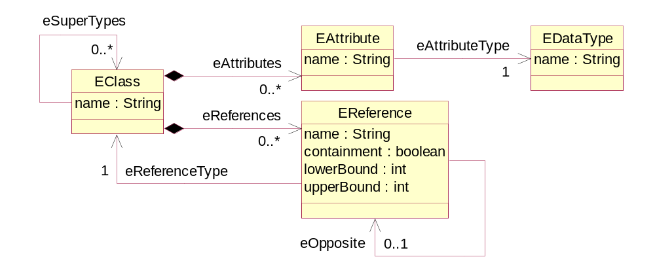
EMF Architecture
Ecore
Ecore is EMF’s model of a model (metamodel)
  Persistent representation is XMI

Slide 27
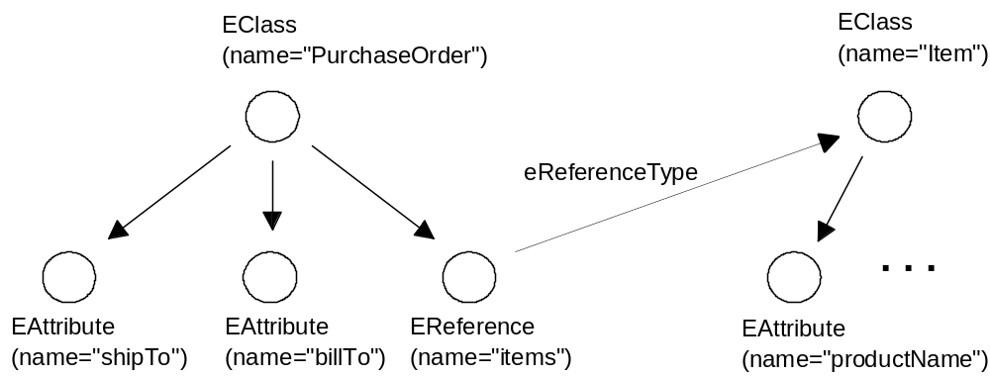
EMF Architecture
PurchaseOrder Ecore Model

Slide 28
EMF Architecture
PurchaseOrder Ecore XMI
<eClassifiers xsi:type="ecore:EClass"
name="PurchaseOrder">
<eReferences name="items" eType="#//Item"
upperBound="-1" containment="true"/>
<eAttributes name="shipTo"
eType="ecore:EDataType http:...Ecore#//EString"/>
<eAttributes name="billTo"
eType="ecore:EDataType http:...Ecore#//EString"/>
</eClassifiers>
Alternate serialization format is EMOF
  Part of OMG MOF 2 Standard

Slide 29
EMF Architecture
Dynamic EMF
Given an Ecore model, EMF also supports dynamic manipulation of instances
  No generated code required
  Dynamic implementation of reflective EObject API provides same runtime behavior as generated code
  Also supports dynamic subclasses of generated classes
All EMF model instances, whether generated or dynamic, are treated the same by the framework

Slide 30
EMF Architecture
Who is using EMF today?
IBM WebSphere/Rational product family
Other Eclipse projects (XSD, UML2, VE, Hyades)
ISV’s (TogetherSoft, Ensemble, Versata, Omondo, and more)
SDO reference implementation
Large open source community
  O(1K) downloads/day
  and growing …

Slide 31
Agenda
What is Modeling?
EMF Model Definition
Code Generation
EMF Architecture
Demo
Summary

Slide 32
Demo
Using EMF

Slide 33
Agenda
What is Modeling?
EMF Model Definition
Code Generation
EMF Architecture
Demo
Summary

Slide 34
Summary
EMF is low-cost modeling for the Java™ technology mainstream
Leverages the intrinsic model in an application
  No high-level modeling tool required
Boosts productivity and facilitates integration
Mixes modeling with programming to maximize the effectiveness of both
A breakthrough for model-based software development? You be the judge

Slide 35
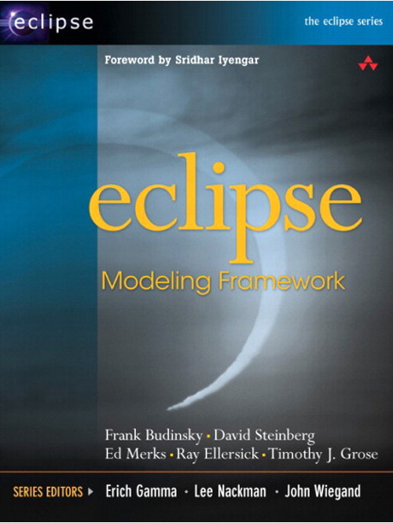
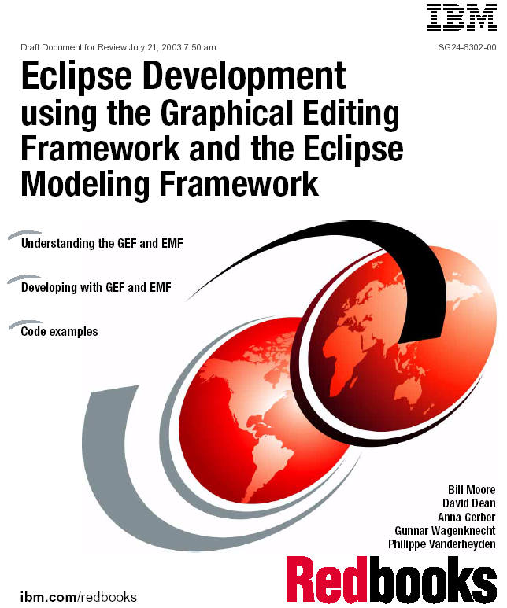
For More Information
Eclipse EMF Help
  overviews, tutorials, API reference
EMF Project Web Site
  http://www.eclipse.org/emf/
  documentation, newsgroup, mailing list, Bugzilla
Eclipse Modeling Framework by Frank Budinsky et al.
  Addison-Wesley; 1st edition (August 13, 2003)
  ISBN: 0131425420.
IBM Redbook
  publication number: SG24-6302-00

Slide 36
Q&A

Slide 37
The Eclipse Modeling Framework
Introducing Modeling to the Java™ Technology Mainstream
Ed Merks, Ph.D.
Software Architect
IBM Canada Ltd.
www.eclipse.org/emf

