Slide 1
Rapid plug-in development and integration using the Eclipse Modeling Framework (EMF)
Sridhar Iyengar, IBM Distinguished Engineer
Ed Merks, Eclipse XSD Project Lead

Slide 2
Topics
EMF Overview
Developing plug-ins using EMF
EMF, MDA, and building an open, integrated tools platform

Slide 3

Role of EMF in Tool Integration
Software Integration
(Tool Integration)
Code Integration
(Eclipse : Code)
Data Integration
(EMF : Data)
For simplicity we don’t discuss ‘process integration’ which is not addressed by EMF today

Slide 4
What is EMF?
A modeling & data Integration framework for Eclipse
What do we mean by an EMF “model”?
  Specification of an application’s data
    Object attributes
    Relationships (Associations) between objects
    Operations available on each object
    Simple constraints (ex: cardinality) on objects and relationships
  Essentially the Class Diagram subset of UML
From a model definition, EMF can generate efficient, correct, and easily customizable implementation code
  Java code, XML documents, XML Schemas…

Slide 5
What is EMF? (cont)
EMF takes a pragmatic middle ground in the modeling vs. programming world
Very low cost of entry
  Full scale graphical modeling tool not required
  Can be used with richer modeling and XML development tools
Designed to make modeling practical and useful to the mainstream Java programmer
Pragmatic unification of key technologies
  Java (Model implementation)
  XML (Model persistence)
  UML & MOF (Model definition)
Influence of & by OMG MOF, XMI, and UML

Slide 6
EMF - The Data Integration Foundation of Eclipse
UML
Model & Design
XMI
XSD
XML Documents
Transformation
Tools
Database Tools
Integrate
Testing Tools
EMF
Model Driven
App Development
Annotated Java
XSD, XMI…
Java
MetaData
Management
Java Tools
Etc..
www.eclipse.org/emf
Notes:
Note – EMF does not support JMI – It has it’s own Java mapping. Goal is to resolve this for JMI2 as we did for MOF2

Slide 7
EMF History
Originally based on MOF (Meta Object Facility)
  From OMG (Object Management Group)
  Abstract language and framework for specifying, constructing, and managing technology neutral meta-models
EMF evolved based on experience supporting a large set of tools
  Efficient Java implementation of a practical subset of the MOF API
  To avoid confusion, the MOF-like core meta model in EMF is called Ecore instead of MOF
Foundation for model based WebSphere Studio family product set
  Example: J2EE model in WebSphere Studio Application Developer
2003: EMOF defined (Essential MOF)
  Part of MOF 2 specification; UML2 based; recently approved by OMG
  EMF is approximately the same functionality
    Significant contributor to the spec; adapting to it
    Supports MOF2::EMOF XMI import now
Notes:
EMF used to be much richer and was a implementation of the MOF spec. That was too much for most users’ needs so it was scaled back to EMF.
EMF is an efficient modeling f/w for Java. It is used in many IBM tools. Models like J2EE, Java, and web services are based on EMF
EMF is getting standardized under sponsorship of the OMG as EMOF
EMOF info from Barbara Price
Jim Hi Barbara...
Jim Is there any URL for EMOF. I need some basic info
bprice@us.ibm.... hi Jim
bprice@us.ibm.... do you want the spec
Jim sure
bprice@us.ibm.... ok, I can just send it to you
Jim thanks!
bprice@us.ibm.... np
Jim got it. thanks
bprice@us.ibm.... :-)
Jim is there a project publication date?
Jim projected
Jim I am creating a single page history of EMF. this is the lastest chapter
Jim single chart
bprice@us.ibm.... it's already had a publication, this is the next level of edits - mainly to put it more into OMG format. offically, the spec has been adopted by the OMG.
Jim ok. I did not see the spec listed on the OMG site
bprice@us.ibm.... it's probably still under "work in progress", waiting for this draft to be approved by the chairs
Jim ah
bprice@us.ibm.... but it is officially adopted.
Jim I realize that EMF is approximately the implementation of the EMOF spec. Will is someday claim to be a full implementation? a reference implementation? How would you like me to state it in a bullet...sorry to bug you but I have to get a pitch done
bprice@us.ibm.... np - there are differences between Ecore and EMOF, but they are minor - mainly things like class names. We are in the process of implementing an EMF resource that reads and writes an Ecore model from/to an EMOF serialization transparently - at which point we can say we conform to the standard.
Jim works for me
Jim thanks
bprice@us.ibm.... :-)

Slide 8
What is Model Driven Development (MDD)?
A discipline that commonly uses
  Models (UML class models, Data models, XML Schemas, etc.) to represent application concepts
  Code generation patterns to translate artifacts in these models to more detailed (not necessarily complete) implementation artifacts such as Java code, XML documents, XML Schemas, etc.
    Patterns derived after years of experience in specific usage scenarios
  The generated code (usually CRUD operations, simple events, referential integrity for relationships, persistence, etc.) is complemented by programmer developed code
The Object Management Group (OMG) is defining a set of standards that enable MDD using the Model Driven Architecture (MDA) initiative
  More on this initiative and how to use EMF to bootstrap an MDD tools platform after we delve into EMF

Slide 9
A Simple Example
Let’s say you want to write a program to manage purchase orders for some store or supplier
  Purchase orders include “bill to” and “ship to” addresses, and a collection of (purchase) items
  Items include a product name, quantity, and price
Depending on your perspective and skills, you could start by defining the “model” in one of three ways:
  Java Interfaces
  UML Class Diagram
  XML Schema

Slide 10
A Simple Example (cont) – 1. Java Interfaces
public interface PurchaseOrder
{
String getShipTo();
void setShipTo(String value);
String getBillTo();
void setBillTo(String value);
List getItems(); // List of Item
}
public interface Item
{
String getProductName();
void setProductName(String value);
int getQuantity();
void setQuantity(int value);
float getPrice();
void setPrice(float value);
}

Slide 11
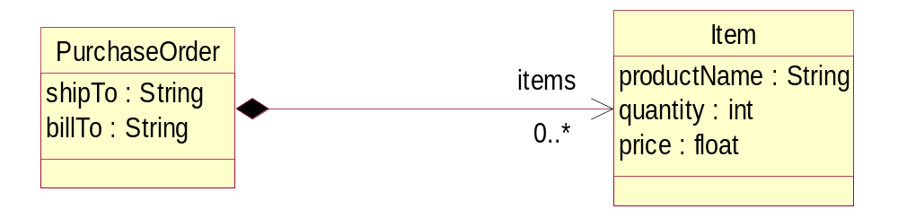
A Simple Example (cont) – 2. UML Class Diagram

Slide 12
A Simple Example (cont) – 3. XML Schema
<?xml version=”1.0” encoding=”UTF-8”?>
<xsd:schema xmlns:xsd=”http://www.w3.org/2001/XMLSchema”
targetNamespace=”http://www.example.com/SimplePO”
xmlns:PO=”http://www.example.com/SimplePO”>
<xsd:complexType name=”PurchaseOrder”>
<xsd:sequence>
<xsd:element name=”shipTo” type=”xsd:string”/>
<xsd:element name=”billTo” type=”xsd:string”/>
<xsd:element name=”items” type=”PO:Item”
minOccurs=”0” maxOccurs=”unbounded”/>
</xsd:sequence>
</xsd:complexType>
<xsd:complexType name=”Item”>
<xsd:sequence>
<xsd:element name=”productName” type=”xsd:string”/>
<xsd:element name=”quantity” type=”xsd:int”/>
<xsd:element name=”price” type=”xsd:float”/>
</xsd:sequence>
</xsd:complexType>
</xsd:schema>

Slide 13
A Simple Example (cont)
All three forms provide the same information
  Different visualizations/representation
The application’s “Model” of the structure
  EMF Models are not intended to be complete (i.e., no detailed behavior – this is coded in Java)
  UML models can be used for more complete application generation
    www.eclipse.org/uml2

Slide 14
Generating a Model Implementation
EMF can import any form of a model (Java, XSD, UML representations), and generate the others, as well as Java implementation code
Generated Java code includes:
  Model change notification
  Persistence/serialization of model data
    XML by default, but other persistent formats possible
  Bidirectional reference handshaking (referential integrity)
  Proxy resolution and demand-load
EMF also automatically creates/generates other Eclipse parts (projects, plugin.xml, etc.)

Slide 15
The Ecore Meta-model
EMF canonical representation of a data model is called Ecore
The persistent form of Ecore is XMI
  XMI : XML Metadata Interchange – an OMG standard for serializing models and metadata in XML
Ecore model supports a superset of the modeling concepts in EMOF (Essential MOF), part of the OMG MOF 2.0 Specification
  EMF supports EMOF definition of a model
  EMOF/XMI2 is the supported “standard” interchange format
  UML tools can be used to design EMOF/Ecore models

Slide 16
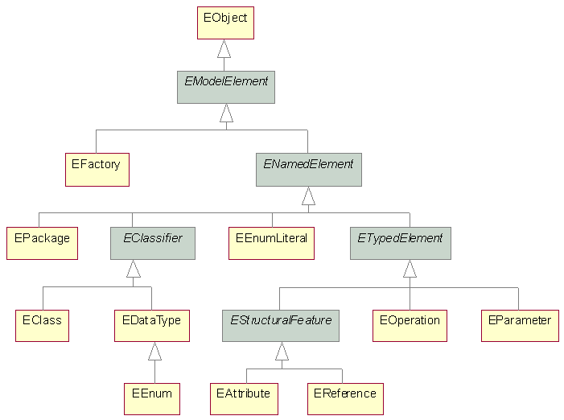
The Ecore Meta-model (cont)
EObject is the model root. Equivalent to java.lang.Object

Slide 17
EMF Runtime Framework
All EMF models (generated or not) can be accessed using an efficient EMF reflective API (in interface EObject)
  eGet(), eSet(), etc.
  A standard common API that can be used to access models generically
This is the key to integrating tools and applications built using EMF
Also the key to providing generic editing commands (see next slide)

Slide 18
Generating Viewers/Editors for an EMF Model
From an EMF Model, EMF can also generate view adapters and even a working Eclipse Editor for the model
  Optionally in additional Plug-ins/Projects
EMF.Edit provides a framework for easily building Eclipse editors for EMF-based applications
  Content and label providers, property source support, and other convenience classes to display EMF models using standard desktop (JFace) viewers and property sheets
  Command framework, including generic command implementation classes for building editors that support fully automatic undo and redo

Slide 19
EMF Demo
In the Following Demo you will see:
  Importing a simple model definition into EMF
  Generating code – model, adapters, and an editor
  Running the generated editor
  Hand modifying the generated Java code
  Modifying the model and regenerating the code

Slide 20
EMF Summary
EMF provides low-cost modeling for the Java mainstream
Boosts productivity and facilitates integration
Mixes modeling with programming to maximize the effectiveness of both
EMF is the foundation for fine-grain data integration in Eclipse

Slide 21
Who is using EMF today?
IBM WebSphere Studio product family
IBM WebSphere Application Server
IBM Rational product family (in development)
SDO Reference Implementation
Eclipse Subprojects
  Hyades Project (framework for testing and logging tools)
  UML2 Project (implementation of the UML 2.0 metamodel)
  VE Project (Visual Editor framework for creating GUI builders)
  XSD Project (Java API for manipulating XML Schemas)
  EMF Project itself (of course!)
ISV’s
  TogetherSoft (UML editor and code generation)
  Ensemble (support for Weblogic servers)
  Versata (extend J2EE to capture their business rules)
  Omondo (UML editor tightly coupled to EMF tools)

Slide 22
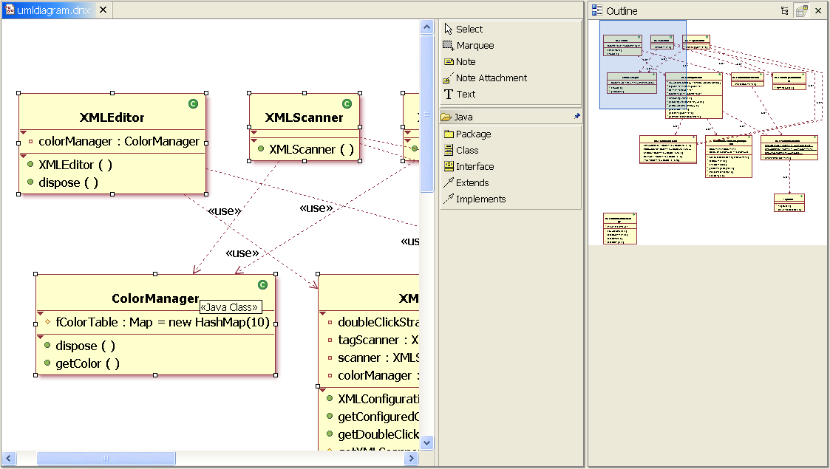
WebSphere Studio Application Developer:
EMF based UML Visualization/Editing Tool for J2EE
Notes:
This component of WSAD provides a UML visualization tool based on EMF

Slide 23
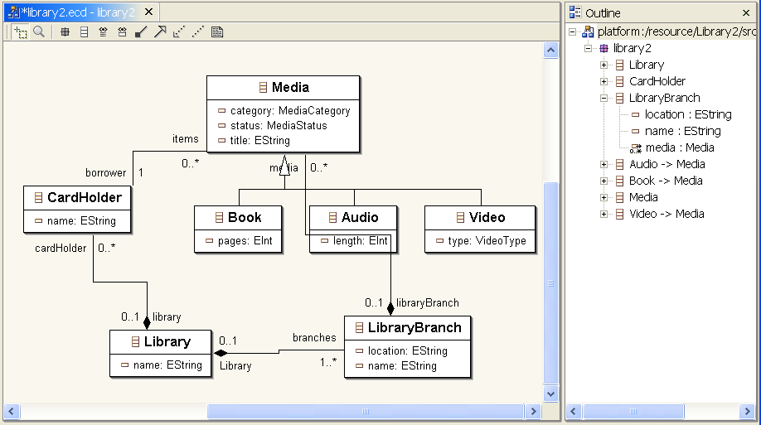
Omondo UML EMF Ecore Graphical Editor
Notes:
Omando provides a graphical editor for EMF models. Free to download
This is a little more elaborate version of the library model. We will come back to it later

Slide 24
EMF, MDA, and building an open, integrated tools platform

Slide 25
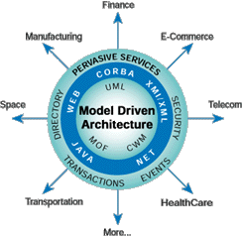
An Open Model Driven Integration Framework
OMG ™ Model Driven Architecture (MDA)TM
An integration of best practices in Modeling, Middleware, Metadata, and Software Architecture
Model Driven (UML, MOF, CWM…)
  Platform Independent Models (PIM) – Technology or increasingly Business Models
  Platform Specific Models (PSM) - J2EE, .Net, SQL
  Mappings : PIM<->PIM, PSM<->PSM, PIM<->PSM
  Applies across the software life cycle
Key Benefits
  Improved Productivity for Architects, Designers, Developers and Administrators
  Lower cost of Application Development and Management
  Enhanced Portability and Interoperability
  Business Models and Technologies evolve at their own pace on platform(s) of choice
MDA is a framework, process
and a set of standards
Source: OMG

Slide 26
Open Modeling Standards: The Foundation of MDA
Unified Modeling Language (UML)
  For describing the problem domain and the solution architecture
Meta Object Facility (MOF)
  For describing and manipulating models
XML Model Interchange (XMI)
  For exchanging model information in XML format and generating XSD
Common Warehouse Model (CWM)
  For describing data mappings and database schemas
And more
Supported by UML profiles
  For customizing UML to specific domains (e.g., J2EE, EAI, Real-time, Systems Engineering…)
IBM & the Industry is driving the core MDA standards
Eclipse.org is driving pragmatic integration of MDA standards using Eclipse

Slide 27


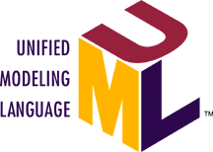
Model Transformations using
OMG Model Driven Architecture (MDA)
Mappings
PIM – PSM
PIM – PIM…
Platform Specific
Implementation Model
Business Models
XMI
XSD,DTD
Java, C#
XML Doc.
Auto
Engine
Class Auto
{public String color;
public int Door;
public int Engine}
<Auto>
<Color> Red </Color>
<Door> 4 </Door>
<Engine> 1 </Engine>
</Auto>
Color : String
Cyl : integer
Door : Integer
Fuel : String
JMI, EMF4J..
Engine : Integer
Comp : Float
XML Schema
Computation
Independent
Model View
<xsd:ComplexType name = “Auto”>
<xsd:sequence>
<xsd:element name = “Color” type = “xsd:string”/>
<xsd:element name = “Door” type = xsd:integer”/>
<xsd:element name = “Engine” type = xsd:integer”/>
<xsd:/sequence>
<xsd:/ComplexType>
JOLAP, JDM
UML4EJB…
Platform Independent
Models (PIM)
Platform/Language Specific
Models (PSM)
Mappings to UDDI, WSDL, BPEL4WS being defined
Notes:
This illustration shows how a platform independent UML model can be translated using standard design patterns to Java,C#, XML, IDL etc.
We use a simple illustration of a UML model that represents a small aspect of a car. (Example simplified for illustration only) UML was championed by Rational who licensed the XML interchange for UML (XMI) from Unisys.
Using standard design patterns in the UML to Java mapping, Java interfaces (and code using appropriate tools) can be generated. This is based on the Sun JMI standard – an effort being driven by Unisys. The same approach can easily be used for C# (in the .Net framework) because the same design patterns apply.
If the customer chooses to use XML and Web Services, the standard design patterns in UML/MOF to XML mapping in the XMI standard provide XML interchange and interoperability and XML DTD for validation.
The ability to abstract away the details of a technology platform using models and provide standard mappings lets the developer focus on the business problem.

Slide 28
MDA as an ‘Architectural Style’ for Model Driven Development & Integration
Understand the problem domain (technology or business)
Model the problem domain
  Use UML for the visual modeling, analysis & design of meta model
  Use UML profiles & MOF Models to define Domain Specific Metamodels or Languages as needed
Formally represent the models and metadata using UML, MOF & XML
  Simple class modeling is all you need to know
  OCL (Object Constraint Language) can capture additional semantics
  Reverse engineer existing DTD, XSD, XMI, Java to MOF/UML (jump start)
Use Standard transformation (mappings & patterns) for
  Metadata Interchange (XMI – MOF to XML, DTD, XSD)
  Metadata Interfaces (JMI – MOF to Java, EMF4J – MOF2::EMOF to Java, MOF to WSDL, etc.)
Use open source modeling frameworks for model integration and management
  Eclipse EMF : www.eclipse.org/emf , Eclipse UML2 : www.eclipse.org/uml2
Summary : Understand, Model, Map and Manage metadata to integrate

Slide 29
An Enterprise Application Development Life Cycle
Architecture Centric, Business driven,
Complex Life Cycle, Many Tools
Discovery and Transformation
Manage
Components
Modeling
Architecture,
Object, Biz…
Add
Business
Logic
Build /Wrap Components
Assemble
& Test
Components
Configure &Deploy Components
Component
Runtimes
(J2EE, COM+)
Models, Metadata, Mappings, Middleware
Business
Requirements Modeling
Rigorous
Acquired
Components
Rapid
And do this with quality in a distributed environment

Slide 30
Possible Application Life Cycle Integration Platform
A call to action to the Eclipse Community
Language Tooling
(J2EE, Web Services, Deployment)
Database Tools
(RDBMS, XML…)
MDD Tools
(Object, Data Modeling,
Code generators…)
Domain Specific
Tools…
End to End Application Lifecycle Tooling (Eclipse.org member value add tools)
Eclipse MDD platform (Models, APIs, XML formats…)
Web Services
(XSD…)
J2EE
(EJB, JSP…)
MDA
(UML2,U2TP…)
App Mgmt
(TBD…)
ETC.
EMF
GEF
JDT/CDT
VCM
ETC.
Eclipse Core
Code/Artifact Repositories, Management Tools (Eclipse.org member value add tools)

Slide 31
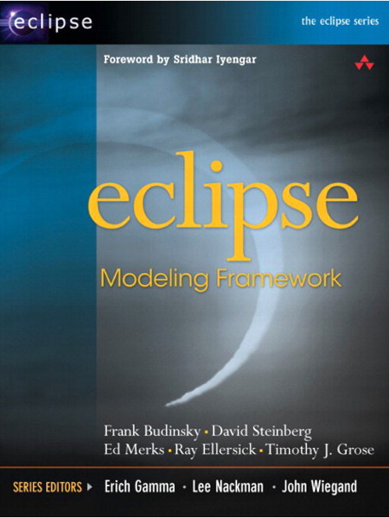
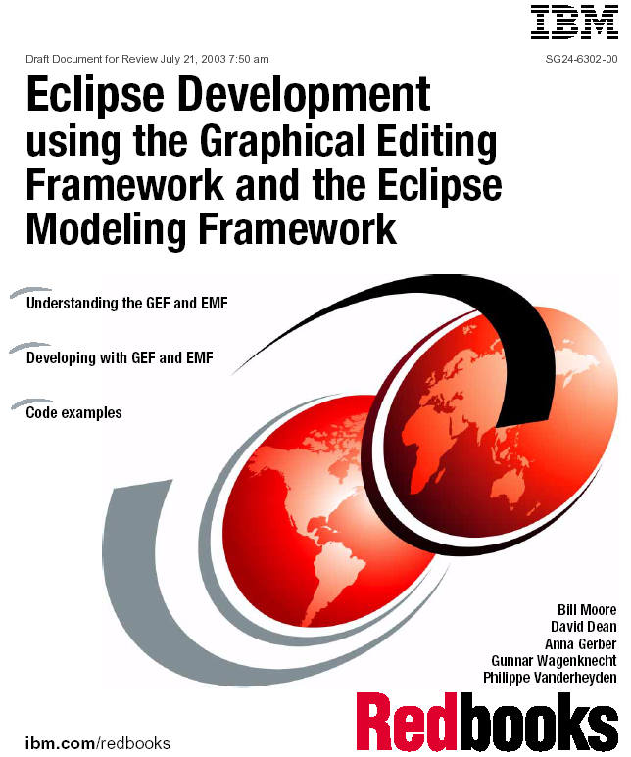
Additional Information Sources
EMF documentation in Eclipse help
  Documents, tutorials, API reference
EMF project web site
  http://www.eclipse.org/emf/
  Documentation, newsgroup, mailing list, Bugzilla
Eclipse Modeling Framework by Frank Budinsky et al. *
  Addison-Wesley; 1st edition (August 13, 2003), ISBN: 0131425420
Eclipse Development using the GEF and EMF
  IBM Redbook
  Publication number: SG24-6302-00
www.omg.org/mda
* Material and images derived from this book

Slide 32
Trademarks
OMG™, MDA™, UML™, MOF™, and XMI™ are trademarks of the Object Management Group
IBM™ is a trademark of the IBM Corporation
Java™ and J2EE™ are trademark of SUN Microsystems
XML™ is a trademark of W3C
All other trademarks belong to their respective organizations

