Slide 1
EMF CDO 1.0.0
Ganymede Simultaneous Release
May 18th, 2008
© 2008 by Eike Stepper; made available under the EPL v1.0 | 05-18-2008 | Page <number>

Slide 2
EMF CDO - Ganymede Release Talking Points
Noteworthy New Features:
  Network transfer of only deltas of changes (201266)
  Partial loading of collections (201265)
  Hibernate integration server-side (217117)
Quality of APIs
  No “provisional” APIs, all non-API code in “internal” packages
End of Life Issues:
  None
IP Issues:
  None
Committer Diversity
  Second committer for Hibernate integration
  Third committer election in progress
© 2008 by Eike Stepper; made available under the EPL v1.0 | 05-18-2008 | Page <number>

Slide 3
EMF CDO - Connected Data Objects
The EMF Model Repository
Provides distributed shared models for EMF
Overcomes all the issues with XML files
Integrates with the EMF persistence framework
Uses Net4j to implement a network protocol
Supports multiple repositories on the server
Connects with heterogeneous back ends
Uses OSGi™ at client and server side (optional)
© 2008 by Eike Stepper; made available under the EPL v1.0 | 05-18-2008 | Page <number>

Slide 4
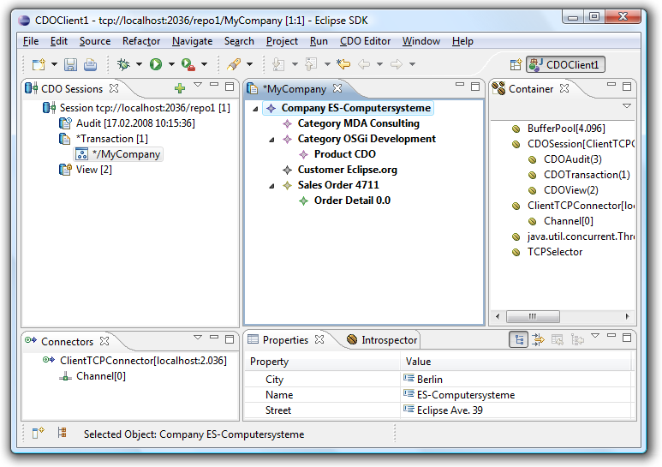
EMF CDO - Connected Data Objects
The EMF Model Repository
© 2008 by Eike Stepper; made available under the EPL v1.0 | 05-18-2008 | Page <number>

Slide 5
Features & Non-Code Aspects
Features
  New features regularly announced via release notes
  70 enhancements provided since 0.7.0
Non-Code Aspects
  New example for server configuration with Spring Framework™
  Wiki with tutorials and design docs: http:/wiki.eclipse.org/CDO
© 2008 by Eike Stepper; made available under the EPL v1.0 | 05-18-2008 | Page <number>

Slide 6
APIs
No “provisional” APIs; all non-API code in “internal” packages
Deprecated API
  None
No ‘discouraged access’ warnings (internal usage)
2 x 98 JUnit tests (MEMStore + HibernateStore)
© 2008 by Eike Stepper; made available under the EPL v1.0 | 05-18-2008 | Page <number>

Slide 7
Standards, Architectural Details, UI Usability
Standards
  Support for standard EMF (and the standards supported by EMF)‏
Architectural Details
  Requires a 5.0 JVM™ or greater
  Client based on EMF 2.4
  Server with exchangeable backends (JDBC™, Hibernate™, ...)
  Can run standalone (No OSGi), on OSGi and Eclipse
UI Usability
  As a pure runtime technology all UIs are only exemplary
© 2008 by Eike Stepper; made available under the EPL v1.0 | 05-18-2008 | Page <number>

Slide 8
Schedule
CDO is a “+2” component in the simultaneous release
1.0 Release Plan according to the Ganymede schedule
CDO uses a continuous build approach
© 2008 by Eike Stepper; made available under the EPL v1.0 | 05-18-2008 | Page <number>

Slide 9
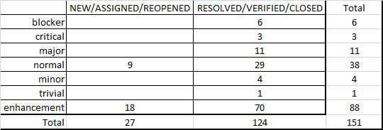
Bugzilla
As of May 18th, 2008:
© 2008 by Eike Stepper; made available under the EPL v1.0 | 05-18-2008 | Page <number>

Slide 10
Communities
Active newsgroup
  eclipse.technology.emft
Conference Participation
  Long Talk at EclipseCon 2008
© 2008 by Eike Stepper; made available under the EPL v1.0 | 05-18-2008 | Page <number>
Notes:
Second tutorial was end-to-end modeling, where GMF was one portion.

Slide 11
IP Issues
The CDO component leadership verifies that
  The about files and use licenses are in place as per the Guidelines to Legal Documentation.
  All contributions (code, documentation, images, etc) have been committed by individuals who are either Members of the Foundation, or have signed the appropriate Committer Agreement. In either case, these are individuals who have signed, and are abiding by, the Eclipse IP Policy.
  All significant contributions have been reviewed by the Foundation's legal staff.
  All non-Committer code contributions, including third-party libraries, have been documented in the release and reviewed by the Foundation's legal staff.
© 2008 by Eike Stepper; made available under the EPL v1.0 | 05-18-2008 | Page <number>

Slide 12
IP Issues
The CDO component leadership verifies that (cont.)
  All Contribution Questionnaires have been completed.
  The "provider" field of each plug-in is set to "Eclipse.org“.
  The "copyright" field of each feature is set to the copyright owner (the Eclipse Foundation is rarely the copyright owner).
  Any third-party logos or trademarks included in the distribution (icons, help file logos, etc) have been licensed under the EPL.
  Any fonts or similar third-party images included in the distribution (e.g. in PDF or EPS files) have been licensed under the EPL.
  IP Log at
    http://www.eclipse.org/modeling/emft/project-info/ipquery.php
    http://www.eclipse.org/modeling/emf/project-info/ipquery.php
© 2008 by Eike Stepper; made available under the EPL v1.0 | 05-18-2008 | Page <number>

Slide 13
Project Plan
A draft development plan for CDO 2.0.0 is not yet available
Important planned features
  Extensible remote queries (SQL, OCL, …)
  JPA support (Java Persistence API)
  XA support (distributed transactions)
  Support for save points
© 2008 by Eike Stepper; made available under the EPL v1.0 | 05-18-2008 | Page <number>

Slide 14
Graduation: Active Community
Integration with both EMF and Teneo
Active Community (> 600 newsgroup posts per year)
Complete redesign and rewrite ~ 1 year ago
124 bugzillas filed and solved
© 2008 by Eike Stepper; made available under the EPL v1.0 | 05-18-2008 | Page <number>

Slide 15
Graduation: Open and Transparent
Very responsive support on newsgroup, open discussions and reactions on proposals from users
All core bugzillas solved immediately
Project Materials are all available to the public
Follow IP-policy (approval for use of derby jar files, for example)‏
© 2008 by Eike Stepper; made available under the EPL v1.0 | 05-18-2008 | Page <number>

Slide 16
Graduation Review: The Eclipse Way
Long talk on EclipseCon 2008 (ESE 2008 planned)
Integrates with other Eclipse projects: EMF, Teneo
Frequent/Continuous builds (every 1-2 weeks)‏
Every build solves all outstanding core bugs
Builds are automatically tested in multiple scenarios,
test cases run with different databases
© 2008 by Eike Stepper; made available under the EPL v1.0 | 05-18-2008 | Page <number>

Slide 17


Graduation Review: Technical Architecture
Client VM
Server VM
Client Applications
CDO Store
CDO Client
CDO Server
CDO Protocol
CDO Protocol
Generated Models
EMF
Net4j TCP
Net4j TCP
Net4j
Net4j
Backend
OSGi / Eclipse
OSGi / Eclipse
© 2008 by Eike Stepper; made available under the EPL v1.0 | 05-18-2008 | Page <number>

Slide 18
Legal Notices
OSGi is a trademark of the OSGi Alliance
XML is a trademark of the World Wide Web Consortium; marks of W3C are registered and held by its host institutions MIT, ERCIM, and Keio
Java, JVM, JDBC and all Java-based trademarks are trademarks of Sun Microsystems, Inc. in the United States, other countries, or both
Hibernate is a registered trademark of Red Hat, Inc.
Other company, product, or service names may be trademarks or service marks of others
© 2008 by Eike Stepper; made available under the EPL v1.0 | 05-18-2008 | Page <number>

