Slide 1
MDE for Eclipse
Contribution to GMF
David Zygmont
CTO
M1 Global Solutions, Inc.
dzygmont@m1global.com

Slide 2
Agenda
MDE Operation
MDE for Eclipse Modeling Conventions
MDE for Eclipse MetaSolution

Slide 3
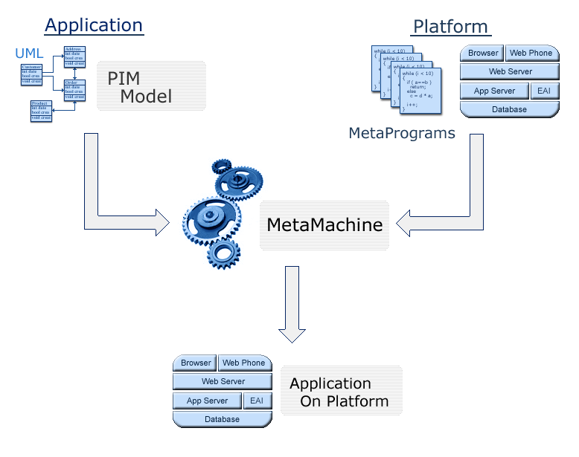
MDE Operation

Slide 4
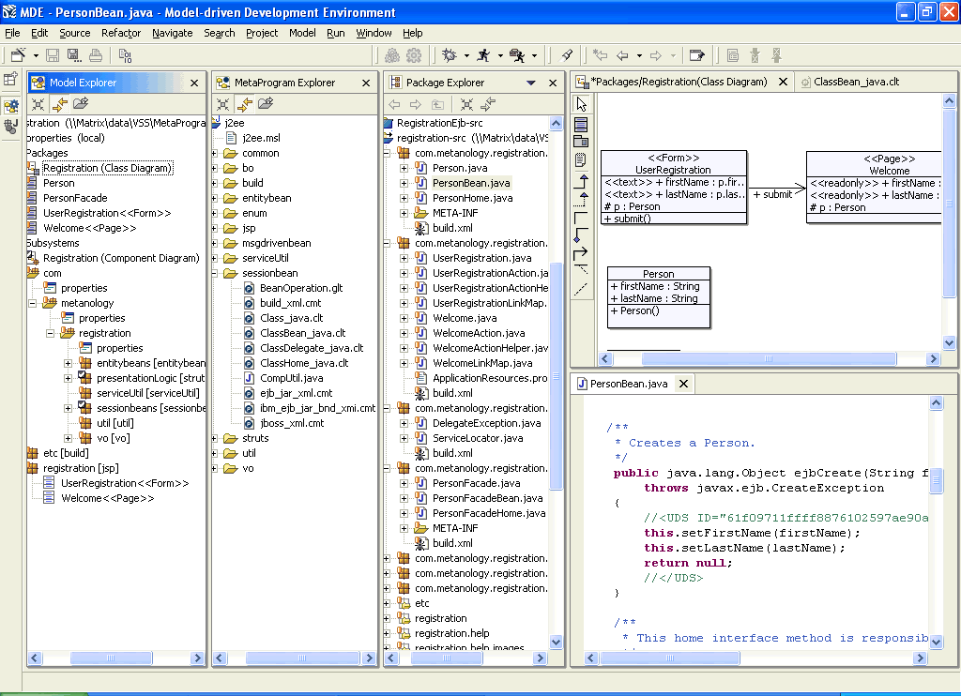
MDE Screen Shot

Slide 5
MDE Modeling Techniques
UML Static View
  Classes
  Associations
  Attributes
  Operations
UML Subsystem View
  Components
UML Extension Mechanism
  Stereotypes
  Tagged Values

Slide 6
MetaProgramming
Meta Model API
Example MetaProgram

Slide 7
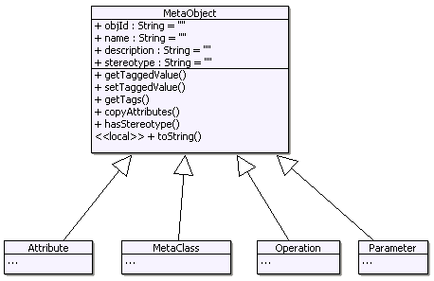
MetaObject

Slide 8
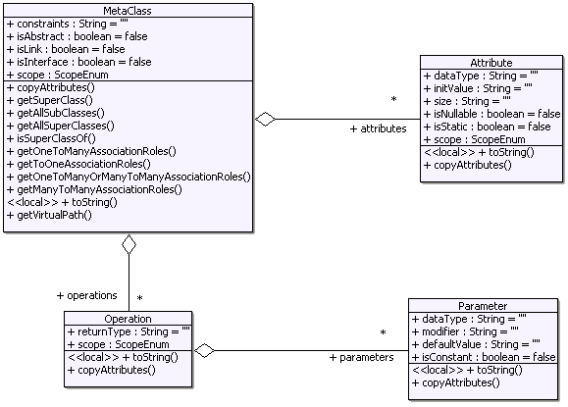
MetaClass

Slide 9
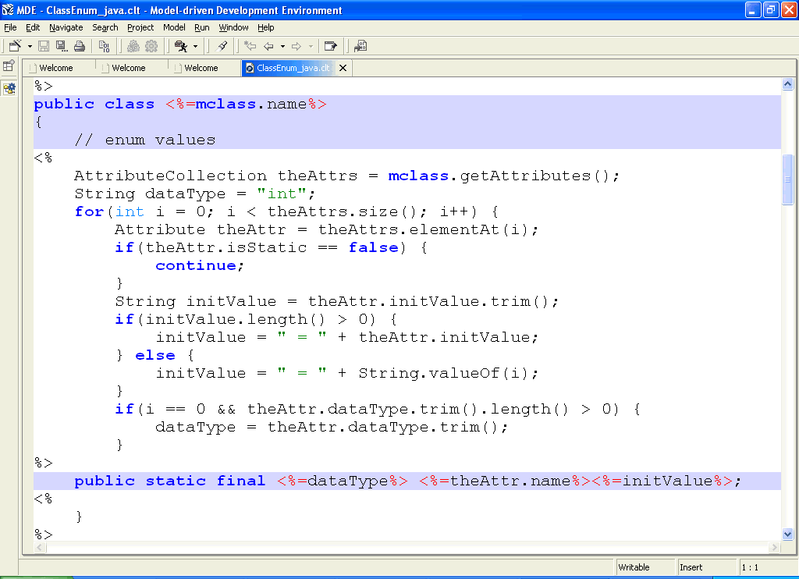
Example MetaProgram

Slide 10
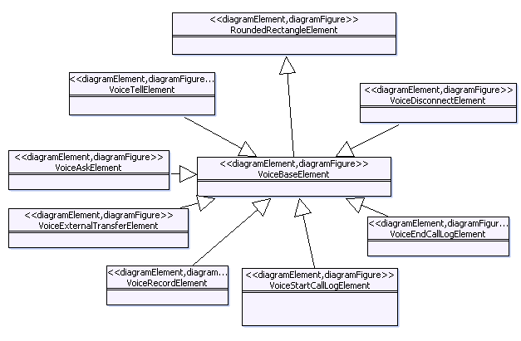
Example MDE for Eclipse Model 1

Slide 11
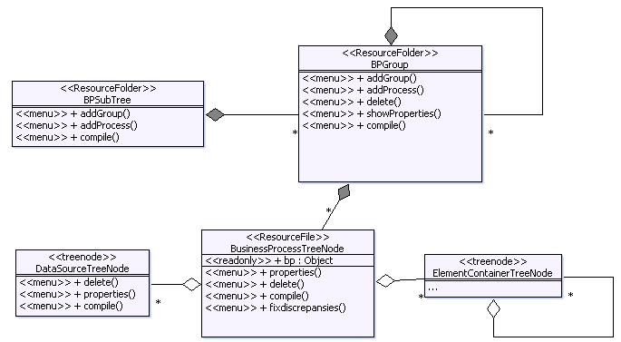
Example MDE for Eclipse Model 2

Slide 12
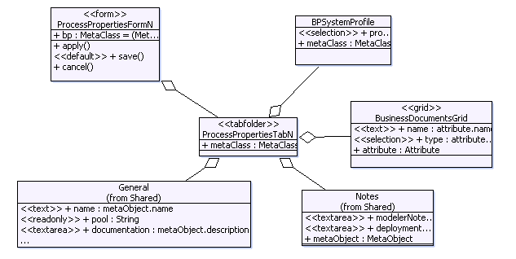
MDE for Eclipse Model 3

Slide 13
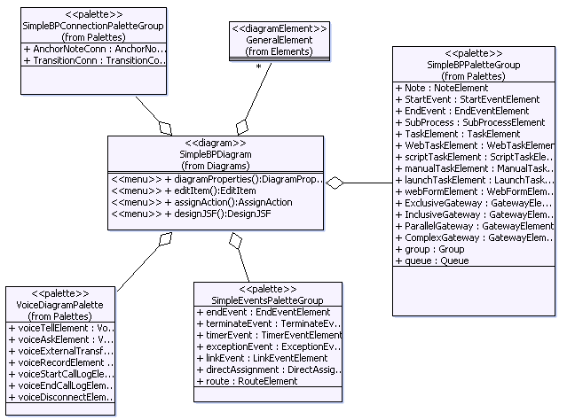
MDE for Eclipse Model 4

Slide 14
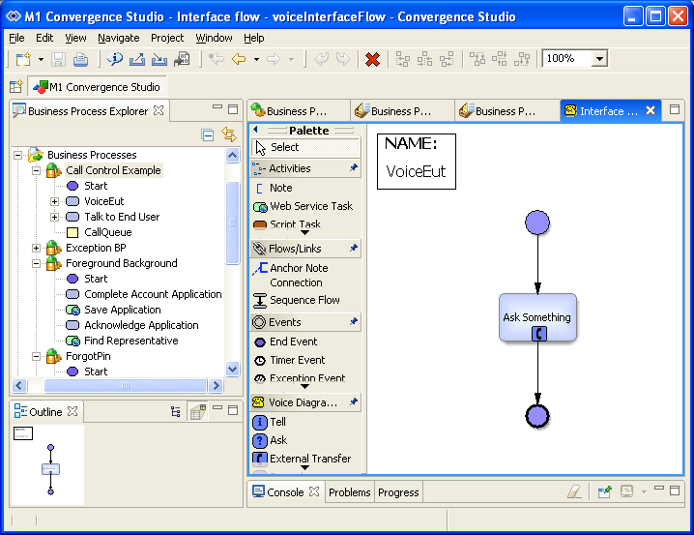
M1 Convergence Studio

Slide 15
Generation Statistics for BCS Studio
Classes | 228
LOC | 107258
Gen LOC | 69336
%Gen | 0.646441
Lines of Meta Code | 35,000

