Slide 1
Generierung grafischer Editoren mit GEF
Bernd Kolb
bernd@kolbware.de
www.kolbware.de
Markus Völter
voelter@acm.org
www.voelter.de

Slide 2
C O N T E N T S
What is MDSD - Brief Overview
Characteristics of (DS)-Languages
Example DSLs and their Metamodels
Editor Alternatives
  UML Tools
  Generic Drawing Tool
  Custom-Made Tools
Brief Intro to GEF
Using GEF for MDSD-Editors
Context: openArchitectureWare
Example
Related Stuff

Slide 3
C O N T E N T S
What is MDSD - Brief Overview
Characteristics of (DS)-Languages
Example DSLs and their Metamodels
Editor Alternatives
  UML Tools
  Generic Drawing Tool
  Custom-Made Tools
Brief Intro to GEF
Using GEF for MDSD-Editors
Context: openArchitectureWare
Example
Related Stuff

Slide 4
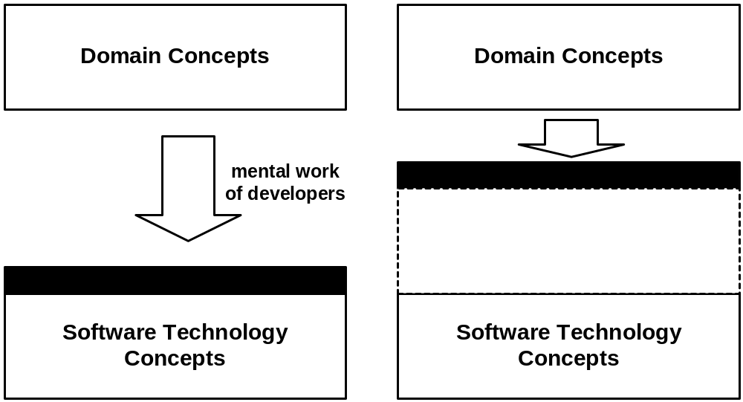
What is MDSD?
Domain Driven Development is about making software development more domain-related as opposed to computing related. It is also about making software development in a certain domain more efficient.

Slide 5
What is MDSD? II
Model-Driven Software Development is about making models first class development artifacts as opposed to “just pictures”.
Various aspects of a system are not programmed manually; rather they are specified using a suitable modelling language.
The language for expressing these models is specific to the domain for which the models are relevant. The modelling languages used to describe such models are called domain-specific languages (DSL).
Models have to be translated into executable code for a specific platform.
Such a translation is implemented using model transformations.

Slide 6
What is MDSD? III
several
Metametamodel
target
subdomains
software
software
design
expertise
architecture
architecture
bounded area of
composable
partial
knowlege/interest
multi-step
knowledge
multiple
viewpoint
transform
Domain
single-step
compile
Model
semantics
Ontology
no
interpret
precise/
roundtrip
executable
Domain
Specific
Language
graphical
Metamodel
textual
Related Approaches (Specializations):
MDA, SF, DSM, GP, …

Slide 7
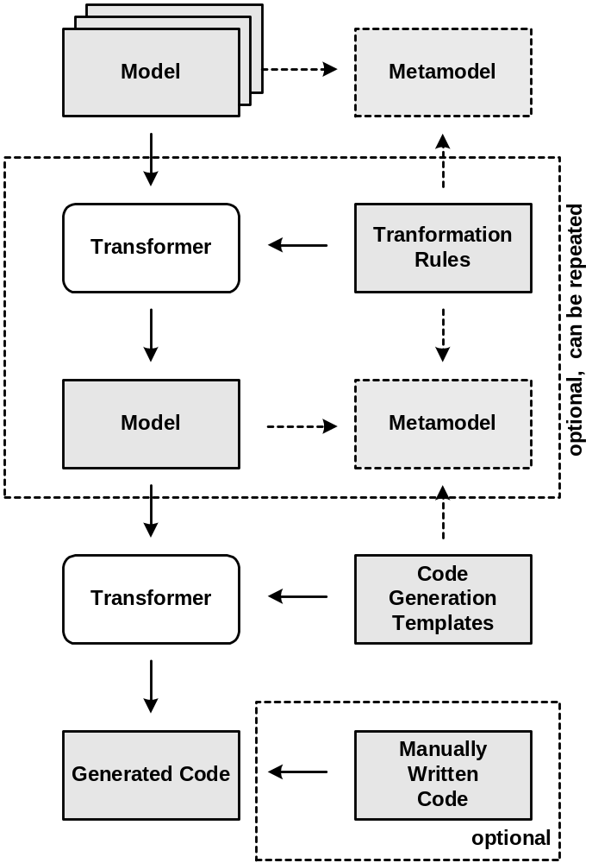
How does MDSD work?
Developer develops model(s)
based on certain metamodel(s).
Using code generation templates, the model is transformed to executable code.
Optionally, the generated code is merged with manually written code.
One or more model-to-model transformation steps may precede code generation.

Slide 8
C O N T E N T S
What is MDSD - Brief Overview
Characteristics of (DS)-Languages
Example DSLs and their Metamodels
Editor Alternatives
  UML Tools
  Generic Drawing Tool
  Custom-Made Tools
Brief Intro to GEF
Using GEF for MDSD-Editors
Context: openArchitectureWare
Example
Related Stuff

Slide 9
What are DSLs
A Domain-Specific Language is a language that allows the concise and precise expression of domain concepts.
A language in general consists of three main constituents:
  An abstract syntax (also called metamodel)
  Defines the concepts of the domain, as well as their relationships and constraints on these.
  A concrete syntax
  The representation used to express valid sentences, or models in the language.
    Can be textual or graphical
    Many concrete syntaxes can be used for the same AS
  And Semantics
  The meaning of the concepts, and thus, models

Slide 10
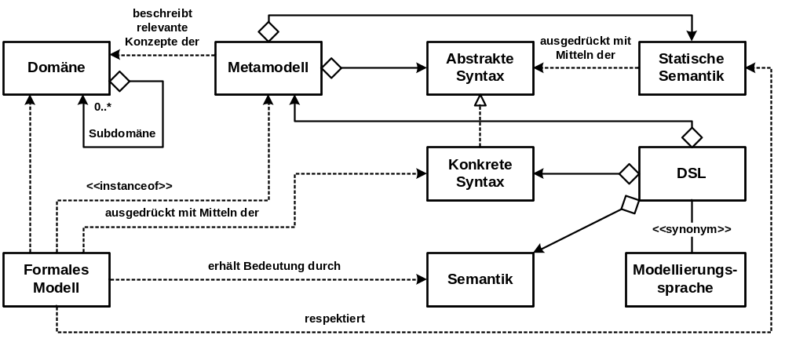
What are DSLs

Slide 11
C O N T E N T S
What is MDSD - Brief Overview
Characteristics of (DS)-Languages
Example DSLs and their Metamodels
Editor Alternatives
  UML Tools
  Generic Drawing Tool
  Custom-Made Tools
Brief Intro to GEF
Using GEF for MDSD-Editors
Context: openArchitectureWare
Example
Related Stuff

Slide 12
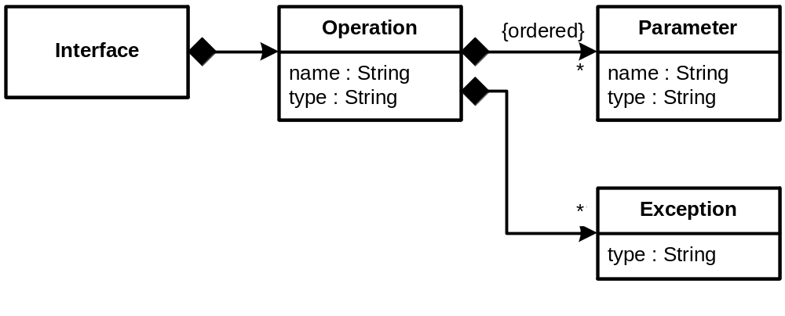
Example 1: Model and Metamodel
interface Sensor {
operation start():void;
operation stop():void;
operation measure():float;
}
interface Controller {
operation reportProblem(Sensor s,
String errorDesc ):void;
}

Slide 13
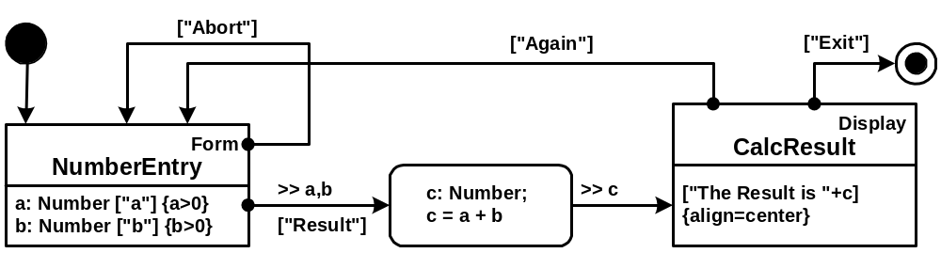
Example 2: Model (J2ME apps)

Slide 14
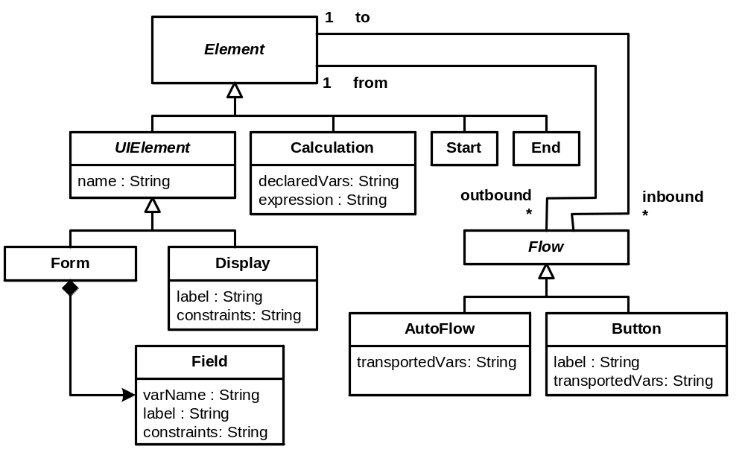
Example 2: Metamodel (J2ME apps)

Slide 15
Example 3: Model (Components, Ports, Connectors)
<system name=”weatherStation”>
<node name=”main”>
<container name=”main”>
<instance name=”controller”
type=”Control”/>
</container>
</node>
<node name=”inside”>
<container name=”sensorInside”>
<instance name=”tempInside”
type=”TemperatureSensor”>´
<param name=”unit” value=”centigrade”/>
</instance>
</container>
</node>
<node name=”outside”>…</node>
<!-- temperature sensor outside -->
<connector name="toSensorTempOutside">
<providedPort instance="tempOutside"
port="measurementPort">
<requiredPort instance="controller"
port="sensorsPort">
</connector>
<connector name="fromSensorTempOutside">
<providedPort instance="controller"
port="controllerPort">
<requiredPort instance="tempOutside"
port="controllerPort>
</connector>
<!-- humidity sensor outside -->
<connector name="toSensorHumOutside">…</connector>
<connector name="fromSensorHumOutside">…</connector>
<!-- temperature sensor inside -->
<connector name="toSensorTempInside">…</connector>
<connector name="fromSensorTempInside">…</connector>
</system>

Slide 16
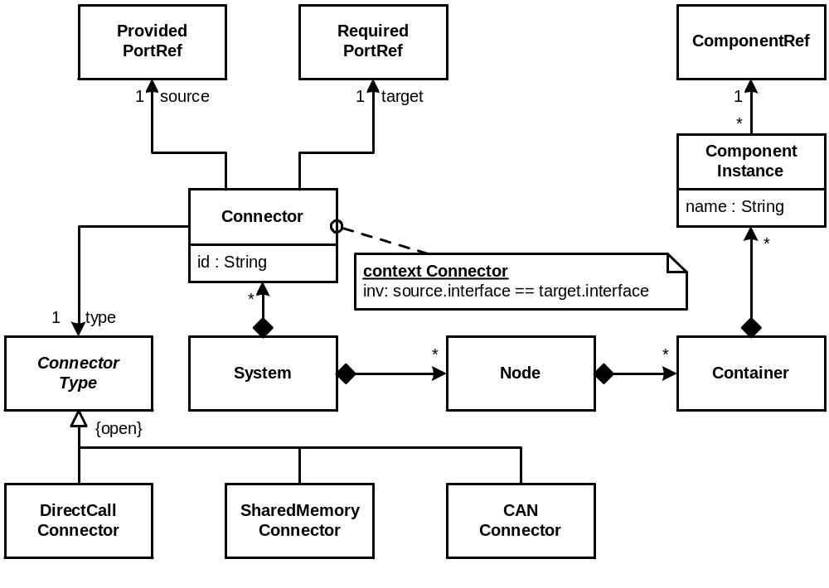
Example 3: Metamodel (Components, Ports, Connectors)

Slide 17
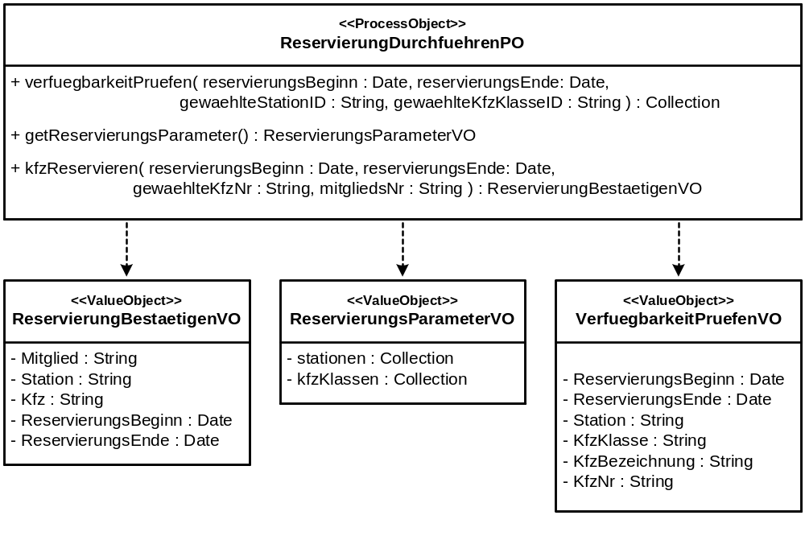
Example 4: Workflow Model (UML + Stereotypes)

Slide 18
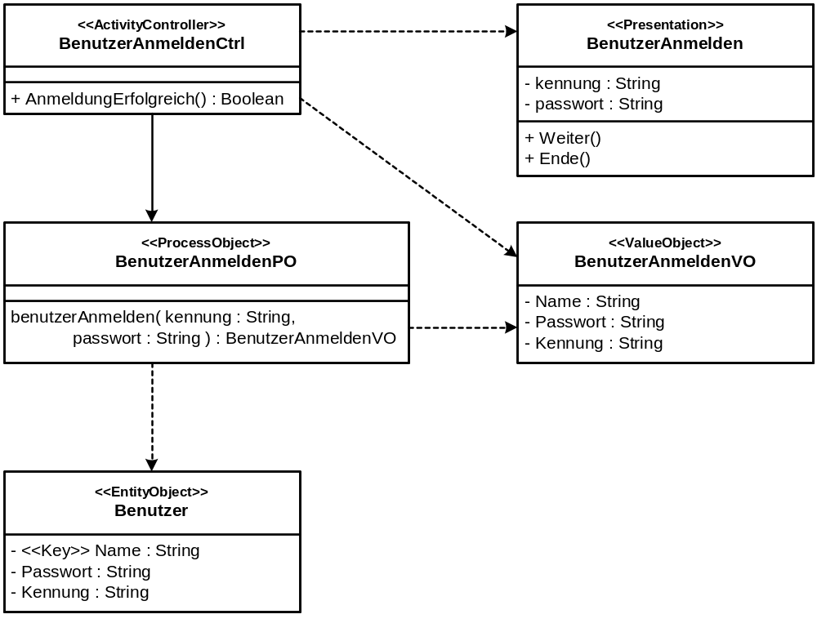
Example 4: Workflow Model II (UML + Stereotypes)

Slide 19
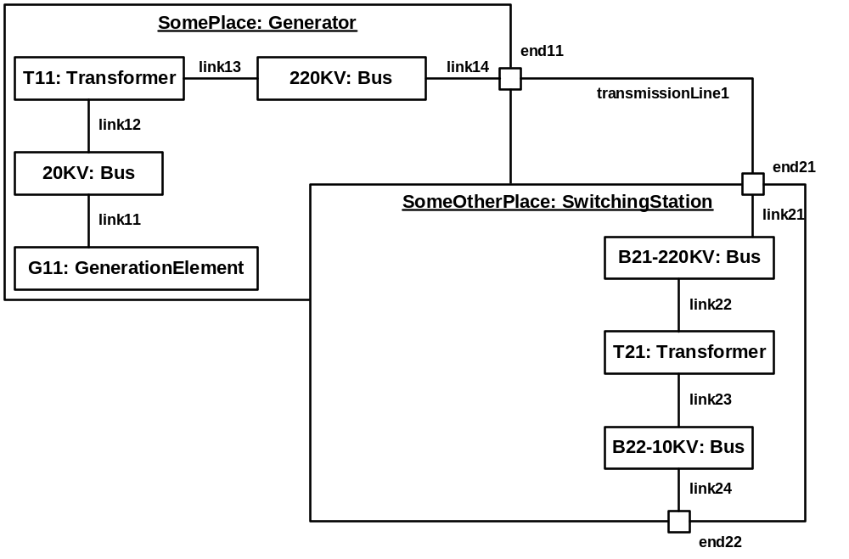
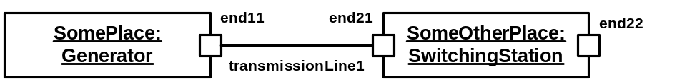
Example 5: Power Grid

Slide 20
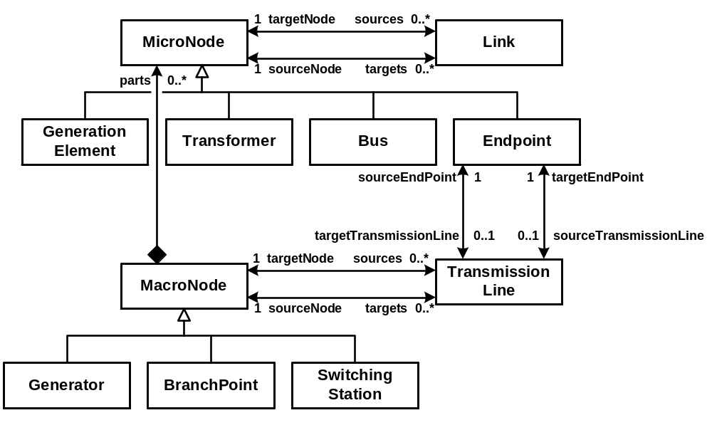
Example 5: Power Grid Metamodel

Slide 21
C O N T E N T S
What is MDSD - Brief Overview
Characteristics of (DS)-Languages
Example DSLs and their Metamodels
Editor Alternatives
  UML Tools
  Generic Drawing Tool
  Custom-Made Tools
Brief Intro to GEF
Using GEF for MDSD-Editors
Context: openArchitectureWare
Example
Related Stuff

Slide 22
Why Editors
In order to build models using the DSL, you need to have a suitable editor.
  In case you use a textual DSL, an ASCII editor in enough, in principle. Although people are used to syntax highlighting, code completion, and the like.
  In case you have a graphical concrete syntax, you need an editor that can work with the graphical symbols you defined.
Ideally, the DSL editor should also check for syntactic errors and validate the constraints defined in the metamodel.
  I.e. only structurally correct models should be builable.

Slide 23
C O N T E N T S
What is MDSD - Brief Overview
Characteristics of (DS)-Languages
Example DSLs and their Metamodels
Editor Alternatives
  UML Tools
  Generic Drawing Tool
  Custom-Made Tools
Brief Intro to GEF
Using GEF for MDSD-Editors
Context: openArchitectureWare
Example
Related Stuff

Slide 24
UML Tools as DSL editors
If you want to use a UML tool as the editor for you DSL, the DSL must be mapped onto a UML profile, i.e. a set of
  Stereotypes,
  Tagged values, and
  Constraints
Pros:
  Easy to implement
  (Looks like a) standard
  More or less acceptable export format (XMI)
  Model Management features (searching, paritioning…)
  Integration into the tool suite (versioning, etc.), if provided by the UML tool and indeed necessary
DEMO

Slide 25
UML Tools as DSL editors II
Cons:
  Graphical Features are very limited (especially, data-dependent graphics!)
  Constraints cannot be checked in real time (this may change over time – tool vendors improve!)
  You cannot „remove“ UML semantics completely (try to draw a line between two attributes…).
  You always have to use the complete UML tool – complex UI

Slide 26
C O N T E N T S
What is MDSD - Brief Overview
Characteristics of (DS)-Languages
Example DSLs and their Metamodels
Editor Alternatives
  UML Tools
  Generic Drawing Tool
  Custom-Made Tool
Brief Intro to GEF
Using GEF for MDSD-Editors
Context: openArchitectureWare
Example
Related Stuff

Slide 27
Editor Alternatives: Adapting a Generic Drawing Tool
If you want to use a generic drawing tool (such as Visio), a connection between the to-be-built model and the “drawing” must be made.
  Export/Import Format
  Metamodel Mapping
Pros:
  Implementation Effort Depends on Tool (Visio: easy!)
  Powerful graphics features, Data Dependent Graphics possible (at least for Visio)
  No inherited features forced upon you by the tool
DEMO

Slide 28
Editor Alternatives: Adapting a Generic Drawing Tool
Cons:
  Usually, the tool knows nothing about the metamodel, i.e.
    Very limited concrete syntax checking
    No realtime constraint checking
  A later phase (after saving) validated syntax and constraints
  Often limited partitioning and model management support
  Proprietary – no standard.

Slide 29
C O N T E N T S
What is MDSD - Brief Overview
Characteristics of (DS)-Languages
Example DSLs and their Metamodels
Editor Alternatives
  UML Tools
  Generic Drawing Tool
  Custom-Made Tools
Brief Intro to GEF
Using GEF for MDSD-Editors
Context: openArchitectureWare
Example
Related Stuff

Slide 30
Editor Alternatives: Developing a Custom Tool
Pros:
  Typically, quite powerful graphics features
  No inherited features forced upon you by the tool
  Only valid concrete syntax is possible
  Constraints can be checked in realtime
  Tool can be as simple as possible – no UML mess
Cons:
  Implementation Effort usually high
  Often limited partitioning and model management support (depends ultimately on the effort you want to put in)

Slide 31
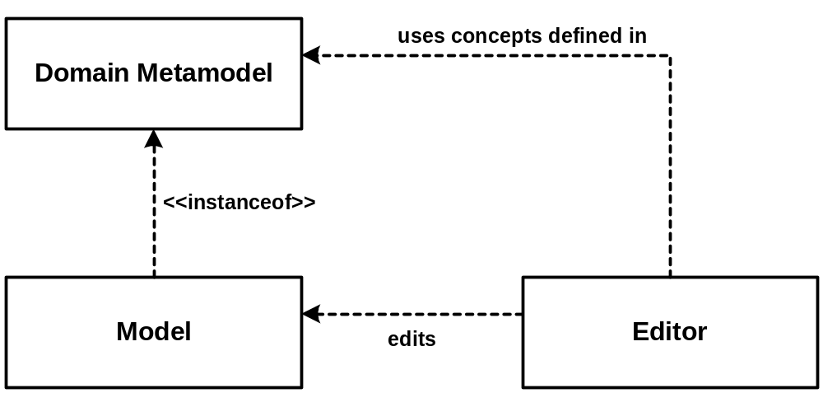
Editor Alternatives: Developing a Custom Tool II
Models are instances of their metamodel.
The Editor edits models…
… and uses concepts from the metamodel

Slide 32
C O N T E N T S
What is MDSD - Brief Overview
Characteristics of (DS)-Languages
Example DSLs and their Metamodels
Editor Alternatives
  UML Tools
  Generic Drawing Tool
  Custom-Made Tools
Brief Intro to GEF
Using GEF for MDSD-Editors
Context: openArchitectureWare
Example
Related Stuff

Slide 33
What is GEF
GEF is an abbreviation of Graphical Editing Framework.
  It is a framework for developing graphical editors for arbitrary domain models.
  It is based on Eclipse – the resulting Editors are thus easily integratable with the Eclipse IDE.
GEF is quite powerful, but not easy to use.
  This is why we generate the GEF stuff.
GEF does not really provide much support for the figures used in the editors – it uses Draw2D for this purpose.

Slide 34
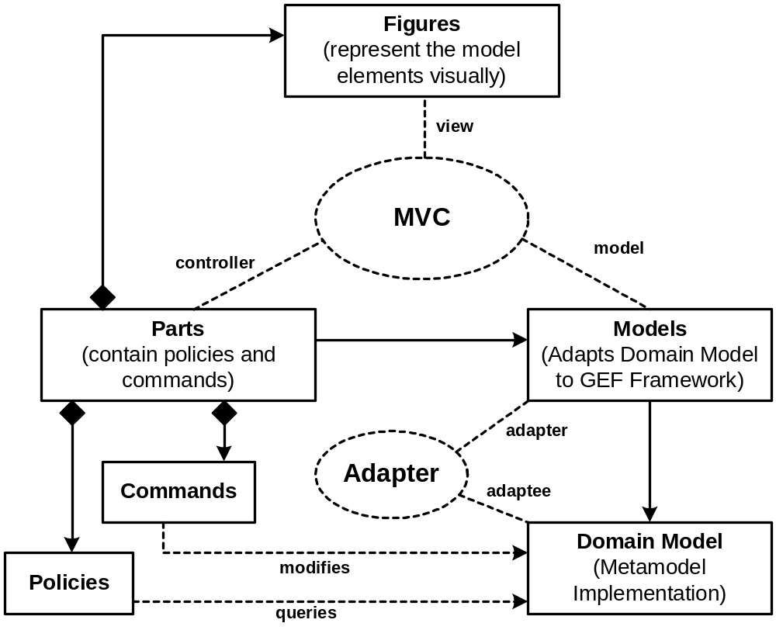
GEF Principles

Slide 35
C O N T E N T S
What is MDSD - Brief Overview
Characteristics of (DS)-Languages
Example DSLs and their Metamodels
Editor Alternatives
  UML Tools
  Generic Drawing Tool
  Custom-Made Tools
Brief Intro to GEF
Using GEF for MDSD-Editors
Context: openArchitectureWare
Example
Related Stuff

Slide 36
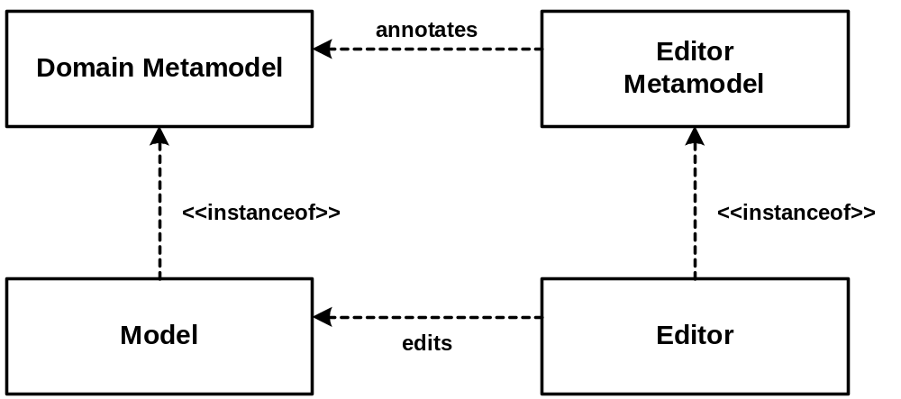
Using GEF for Custom Editors
As mentioned, GEF is powerful, but hard to use.
Especially, if the domain metamodel changes regularly in a project, adapting the editors correspondingly is annoying.
As a consequence, we generate the editors from the domain metamodel and additional editor descriptions.

Slide 37
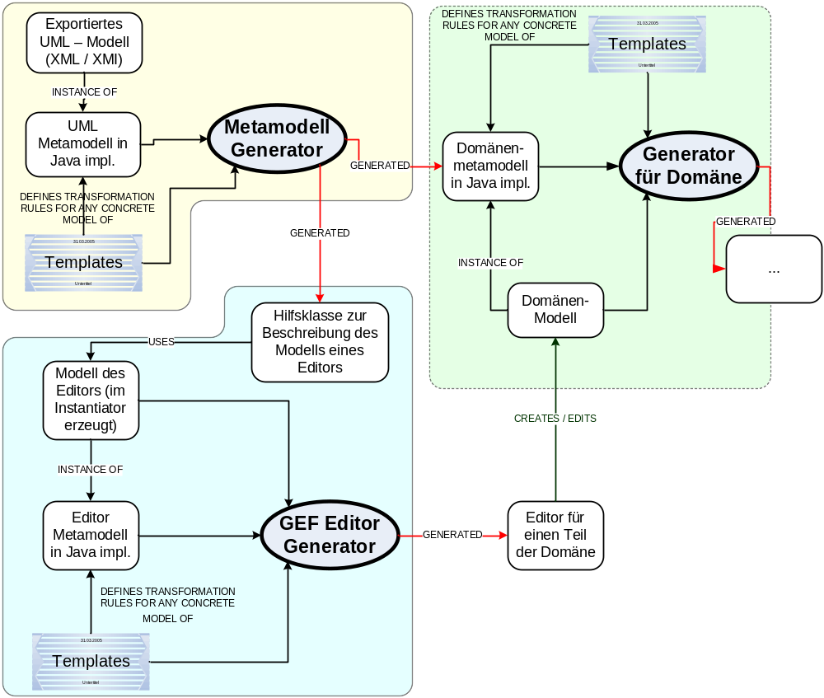
Using GEF for Custom Editors II

Slide 38
C O N T E N T S
What is MDSD - Brief Overview
Characteristics of (DS)-Languages
Example DSLs and their Metamodels
Editor Alternatives
  UML Tools
  Generic Drawing Tool
  Custom-Made Tools
Brief Intro to GEF
Using GEF for MDSD-Editors
Context: openArchitectureWare
Example
Related Stuff

Slide 39

openArchitectureWare Generator
Open Source, quite active project
http://www.openarchitectureware.org
Core Features:
  Can Read any model (XMI from various UML tools, UML, textual, JDBC, Java classes …)
  Can generate any kind of output
  Explicit Domain-Metamodel (implemented in Java)
  Semi-Declarative Metamodel Constraints, „Functional Programming“
  Simple, efficient template language
  Template Polymorphism and Template overwriting
  Multi-Model (Merging-Support)

Slide 40
Example Tool: openArchitectureWare Generator
Core Features cont‘d:
  Inter-Model References among various model syntaxes (i.e. UML to XML)
  Support for Aspects in the metamodel and in the templates
  Arbitrary Namespace Models can be supported
  Plugin-Based Generator configuration (ant-based)
Additional Features:
  Syntax-Highlighting Template Editor for Eclipse
  Metamodel can be generated from UML model, incl. DTD, HTML Docs, etc.
  Graphical GEF-Based Editors can be generated
  Dialog-Based Editors can be generated
  Framework for building IDEs based on this Generator
Future Features
  EMF Integration, Visio Integration

Slide 41
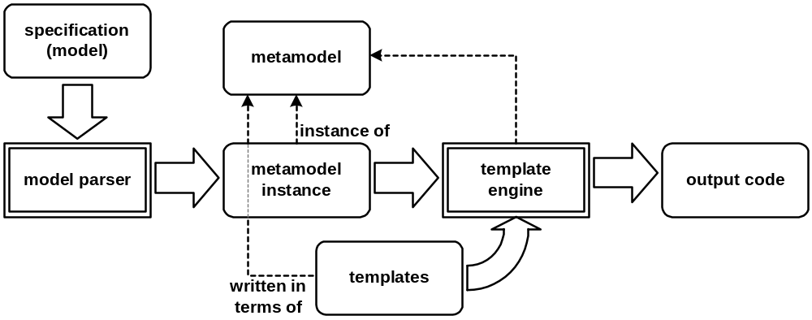
Example Tool: openArchitectureWare Generator
How it works:

Slide 42
Example Tool: openArchitectureWare Generator
Usage Examples
  Web Development (J2EE, Servlets, Struts)
    Banking, Insurances
  Mobile Phone Software (C++ + QT, J2ME + Java)
  Embedded Software (C, CANbus, Osek)
    Automotive Component Middleware
  (Interactive) Web sites
    Architectural Management, „Entertainment)
  Multi-Platform Middleware (XML, C++, Java, …)
    Radioastronomy

Slide 43
C O N T E N T S
What is MDSD - Brief Overview
Characteristics of (DS)-Languages
Example DSLs and their Metamodels
Editor Alternatives
  UML Tools
  Generic Drawing Tool
  Custom-Made Tools
Brief Intro to GEF
Using GEF for MDSD-Editors
Context: openArchitectureWare
Example
Related Stuff

Slide 44
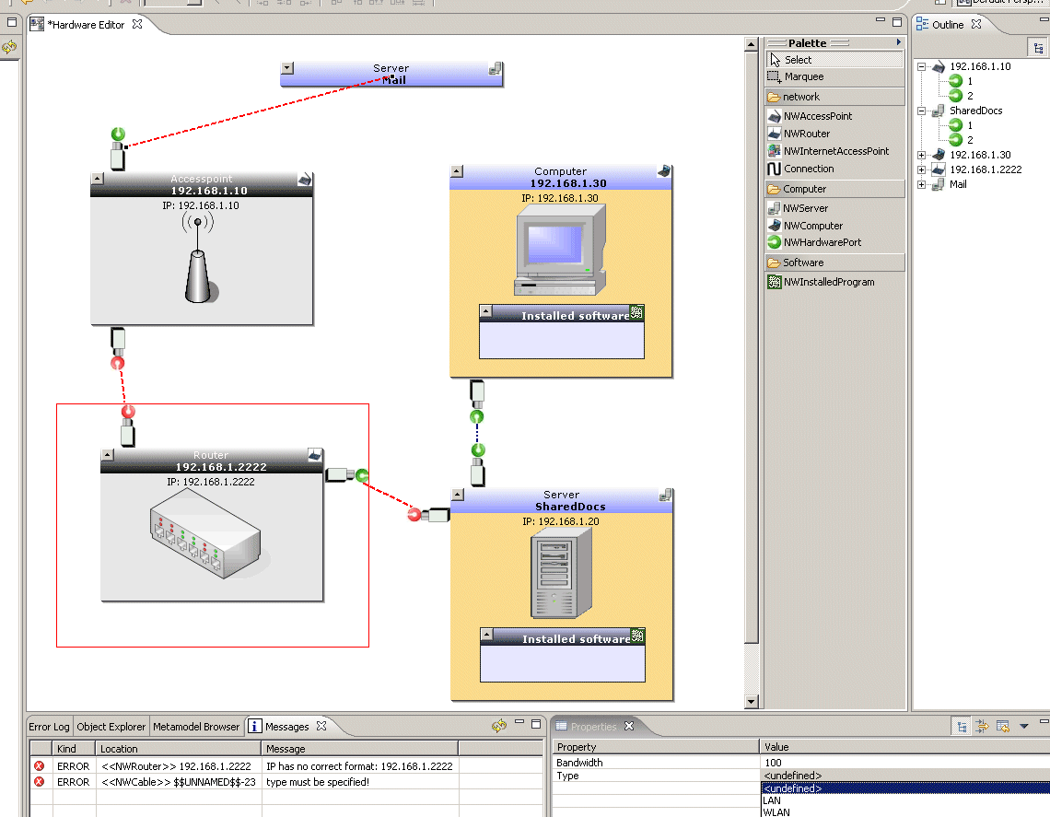
Example – How the Editor looks like
Palette
Outline -
View
Diagram
Figure representing
a model element

Slide 45
Example – the Editor Metamodel
Association
Palette
Containment
Model Element
Validation
Messages
Properties

Slide 46
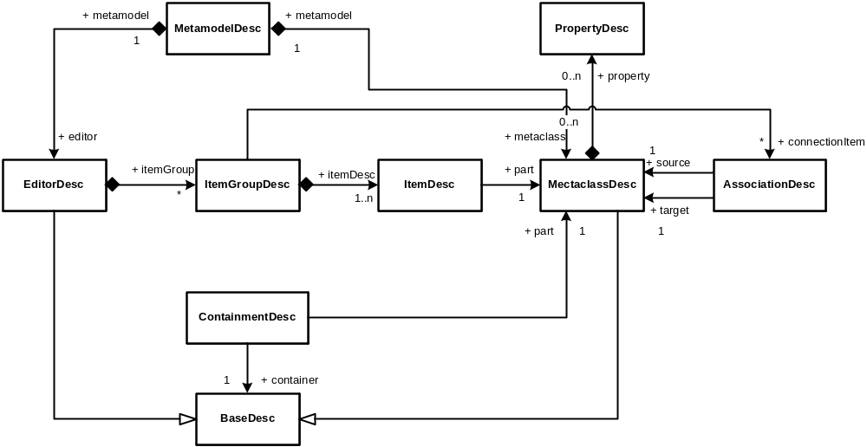
Example – the Editor Metamodel II

Slide 47
Example – the Editor Metamodel III
MetamodelDesc is a container for a
  editor description and
  a set of metaclass descriptions,
An EditorDesc is used for defining the palette.
  So it contains a set of ItemGroupDescs
  A ItemGroup points to a MetaclassDesc.
MetaclassDesc is a description for an element which can be visible on the diagram.
  This element may have a set of properties
  Relations between two elements on the diagram can either be associations or compositions.

Slide 48
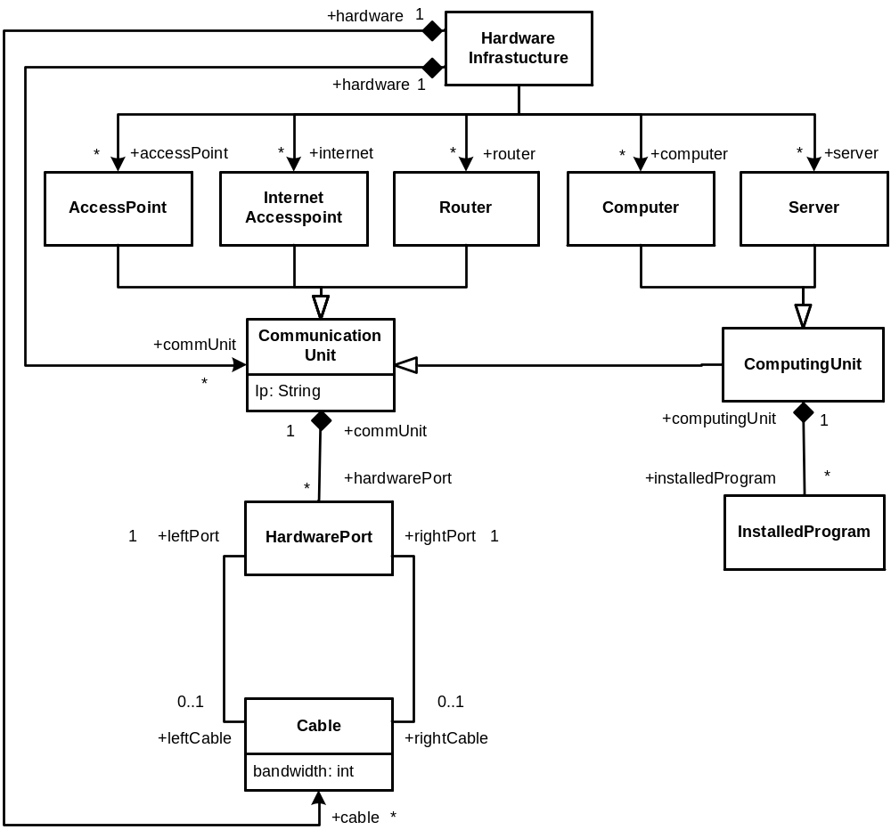
Example – Network Administration - Metamodel
Hardware Element:
Each is identified by an IP Address or an name
To connect to each other, they need Ports
Two ports can be connected via a cable.
  A cable has e.g. a bandwidth and is either wireless or via a real cable
Some of the hardware elements have software installed

Slide 49
Example – how could a DSL look like?
Hardware Elements (or Devices) will be displayed as a rectangles
Ports and installed software will be displayed as nested child elements.
Connections or cables can be shown as lines
Properties of a connection or a hardware element will be displayed in an separate view

Slide 50
Example – the generated Network Editor

Slide 51
Example – The Editor Description
With the metamodel a helper class is generated.
First of all this class must be initialized.
The parameter witch has to be passed
is a set of key-value-pairs.
These passed commands are “executed” when a association via a assocclass is created.
DEMO
HashMap connectcmds = new HashMap();
connectcmds.put( NWCable.class.getName(),
"de.kolbware.mddsample.network.gef.hardware." +"CableConnectCmd");
GefInstantiatorHelper.createAssocDescsAndMetaClassDescs(
metamodel, connectcmds);

Slide 52
Example – The Editor Description II
Here we are creating the descriptions for the metaclasses.
As seen before in the metamodel, each metaclass can have a set of properties.
Finally the created metaclass has to be added into the metamodel for which the editor is created.
accesspoint = GefInstantiatorHelper.getMetaClass(
NWAccessPoint.class);
accesspoint.addStringProperty("Ip");
accesspoint.addStringProperty("Name").
setVisibleInDiagram(true);
accesspoint.init();
metamodel.addMetaclass(accesspoint);

Slide 53
Example – The Editor Description III
Creating a Containment Description is rather easy.
Depending on cardinality you have to choose the correct class.
In the constructor you have to pass the parent, the child and the name of the setter-method on the parent for the child.
If you are using the generated helper class this is already done for you.
new OneToManyContainmentDesc(
accesspoint, hwport, "hardwarePort");

Slide 54
Example – The Editor Description IV
A Associtation Description is is a bit more difficult.
But also here the helper class is doing the job for you.
If the association is an instance of a metaclass you can again add properties as seen in the metaclassdesc.
assoc_HwPort2HwPort = GefInstantiatorHelper.assoc_NWCableBase;
assoc_HwPort2HwPort.addStringProperty("type",
new String[] { NWCable.LAN, NWCable.WLAN });
assoc_HwPort2HwPort.addIntProperty("bandwidth");
assoc_HwPort2HwPort.init();

Slide 55
Example – The Editor Description V
Finally you have to describe the palette.
Here you have to create the different groups and add the corresponding metaclass and connection items.
protected void setupEditor(
MetamodelDesc metamodel) {
EditorDesc ed = new EditorDesc();
ed.setName("HardwareEditor");
ItemGroupDesc network = new ItemGroupDesc();
ed.addItemGroup(network);
network.setName("network");
network.addItem(accesspoint, true);
// …
network.addConnectionItem(assoc_HwPt2HwPt);
// …
}

Slide 56
Example – Customizing the Editor
By passing names of hand-written classes into hooks
At runtime the code of the hand written class will be executed.
By passing a class name and a “method-chain”
Used for properties. At runtime all instances of this will be searched and on each of these instances the method-chain is called.
By serializing an object at generation time and deserilalizing it again at runtime. So the same object is available at both points in time.

Slide 57
Example – Integration with the IDE
Additionally, there is a framework for building a IDE for MDSD. It contains e.g.
  A project browser
  Model Browsers
  A spider view for a cellular view of the model
  A view which shows errors and warnings in the model
  …
DEMO

Slide 58
C O N T E N T S
What is MDSD - Brief Overview
Characteristics of (DS)-Languages
Example DSLs and their Metamodels
Editor Alternatives
  UML Tools
  Generic Drawing Tool
  Custom-Made Tools
Brief Intro to GEF
Using GEF for MDSD-Editors
Context: openArchitectureWare
Example
Related Stuff

Slide 59
Related Stuff
As part of the Eclipse project a new project is currently investigated: GMF, the graphical modelling framework.
  The idea is to generate graphical (GEF based) editors for EMF metamodels
Various other approaches at generating editors – Eclipse-based or not – are under way.
  Merlin
  DiaGen

Slide 60
C O N T E N T S
What is MDSD - Brief Overview
Characteristics of (DS)-Languages
Example DSLs and their Metamodels
Editor Alternatives
  UML Tools
  Generic Drawing Tool
  Custom-Made Tools
Brief Intro to GEF
Using GEF for MDSD-Editors
Context: openArchitectureWare
Example
Related Stuff
THE END.

