Slide 1
Metadata Transformer/Generator
“Transformation Model” approach to MDD

Slide 2
Background
Need for a practical, simplified approach to MDD that SMEs could take advantage of.
Requirement for a tool that would facilitate code generation from pre-defined “patterns”.
  Capability to combine and manage patterns to suit different application architectures
Requirement for a tool that could potentially use any metadata as input.
  Tool should minimize the need for the introduction of new skills.

Slide 3
Metadata Transformer/Generator
Transformation Model approach
  A way of organizing model transformations in a hierarchical manner
    Greater control over selections
    Better navigability
  “Decouples” input model/metadata from transformations
  “Decouples” model transformations from output generation.
  Uses “pluggable architecture”

Slide 4
MTG Pluggable Components
Model Builders
  Create the transformation model
  Decouple the model from transformations
  Automate transformation structures
Transformers
  Java classes that operate on the input model(s)
  OO capabilities, debugging
  Can take any number of parameters
Output generators
  Create files, merge with existing files
  Update configuration files, databases…

Slide 5
Metadata Transformer/Generator
Rose Model
EMF
Ecore Model
UML2 Model,
Other EMF models
1
creates
imports
XML Schema
2
traverses
Model Builder
Engine
3
4
loads, runs
creates
Transformation
Model
User
Model Builder
merges
5
customizes, selects
Model Builder
transforms model elements using transformers
6
loads, runs
Transformation
Engine
7
creates
Transformation
Output
Model Builder
8
Model Builder
Transformer
creates, appends, merges
Output
Generation
Engine
9
10
loads, runs
Writes, updates
Output File
11
Output Generator

Slide 6
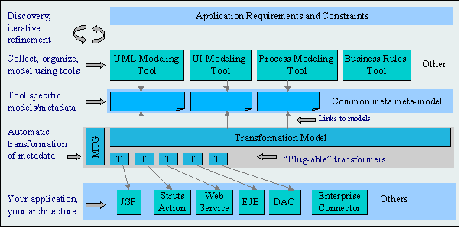
The MT Approach (Using MTG)

Slide 7
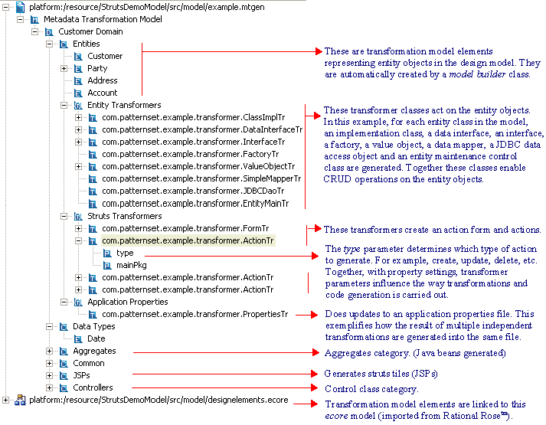
Transformation Model Example

Slide 8
MTG Advantages
It’s simple
  Just need to know Java and the meta-model of the input model
It’s flexible
  Potential to generate “anything” from “anything”
  Currently supports any EMF model as input (ecore, uml2)
It’s easy to use
  Standard cut-and-paste and drag-and-drop features
  Supports (re-usable) transformation model templates and “pre-defined” transformation models
  Supports standard Eclipse debugging
  Can work in any Java project (just add necessary dependencies). Wizards provided.

Slide 9
MTG & GMF Generator Requirements
Generation Model
  A generator model should allow for the definition of those code generation options supported, such as package namespace, RCP option, etc. [H] 
Generation of code from model definition(s) should maximize plug-in extensibility. [H] 
Generation option to target RCP application. [L] 
Utilize EMF.Edit commands (and others) to greatest extent possible. [H] 
Undo/Redo functionality should be respected. [H] 
Regeneration of code should not overwrite customizations. [H] 
Unit tests for the plug-in should be optionally generated. [L] ?
When working with domain models, the generation of EMF model, edit, and editor plug-ins should optionally accompany diagram plug-in generation. [L] ?
Method of generation should be flexible. [?] 
Default JET option. [H] x

Slide 10
MTG & GMF, more…
MTG can be used to generate components from the domain model (uml2)
Or from a graphical model (OMG DI)
Or both…

Slide 11
MTG – Current Status
US Patent application accepted
MTG 1.1.0 available
MTG 1.2.0 targeted for October
Working on IBM “Ready for Rational” Certification…
Working on UML2 modeling tools

