Slide 1


TIGER - Project
Generation of Eclipse Editor Plugins
based on Graph Transformation
Technical University of Berlin, Germany

Slide 2



Tiger Project Team
Gabriele Taentzer
Karsten Ehrig
Claudia Ermel
Stefan Hänsgen
Eduard Weiss

Slide 3
Contents
Overview: TIGER – Project
Example: Activity Diagrams
TIGER – Generator (First Release)

Slide 4
Approaches for Visual Editor Generation
VL definition by graph grammars
(Diagen, GenGED)
  Syntax-directed editing by rule applications
  Free-hand editing by parsing based on graph transformation
VL definition by textual grammars (VLCC)
VL definition by meta models
(AToM³, MetaDome)
  Free-hand editing with constraint checking

Slide 5
Tiger Project
Tiger (Transformation-based generation of modeling environments) http://tfs.cs.tu-berlin.de/tigerprj
combines the advantages of formal VL specification techniques with
Eclipse-GEF
Tiger uses the tool AGG (also developed at TU-Berlin) for graph transformation
http://tfs.cs.tu-berlin.de/agg

Slide 6
Why Graph transformation-based Generation of Visual Editors ?
Complete formal VL definition
  (high-level description of a VL)
  Complete Syntax Definition
  Complete Semantic Definition
Specification of syntax directed editing
  Editing operations are graph rules
  AGG provides the underlying editor model

Slide 7
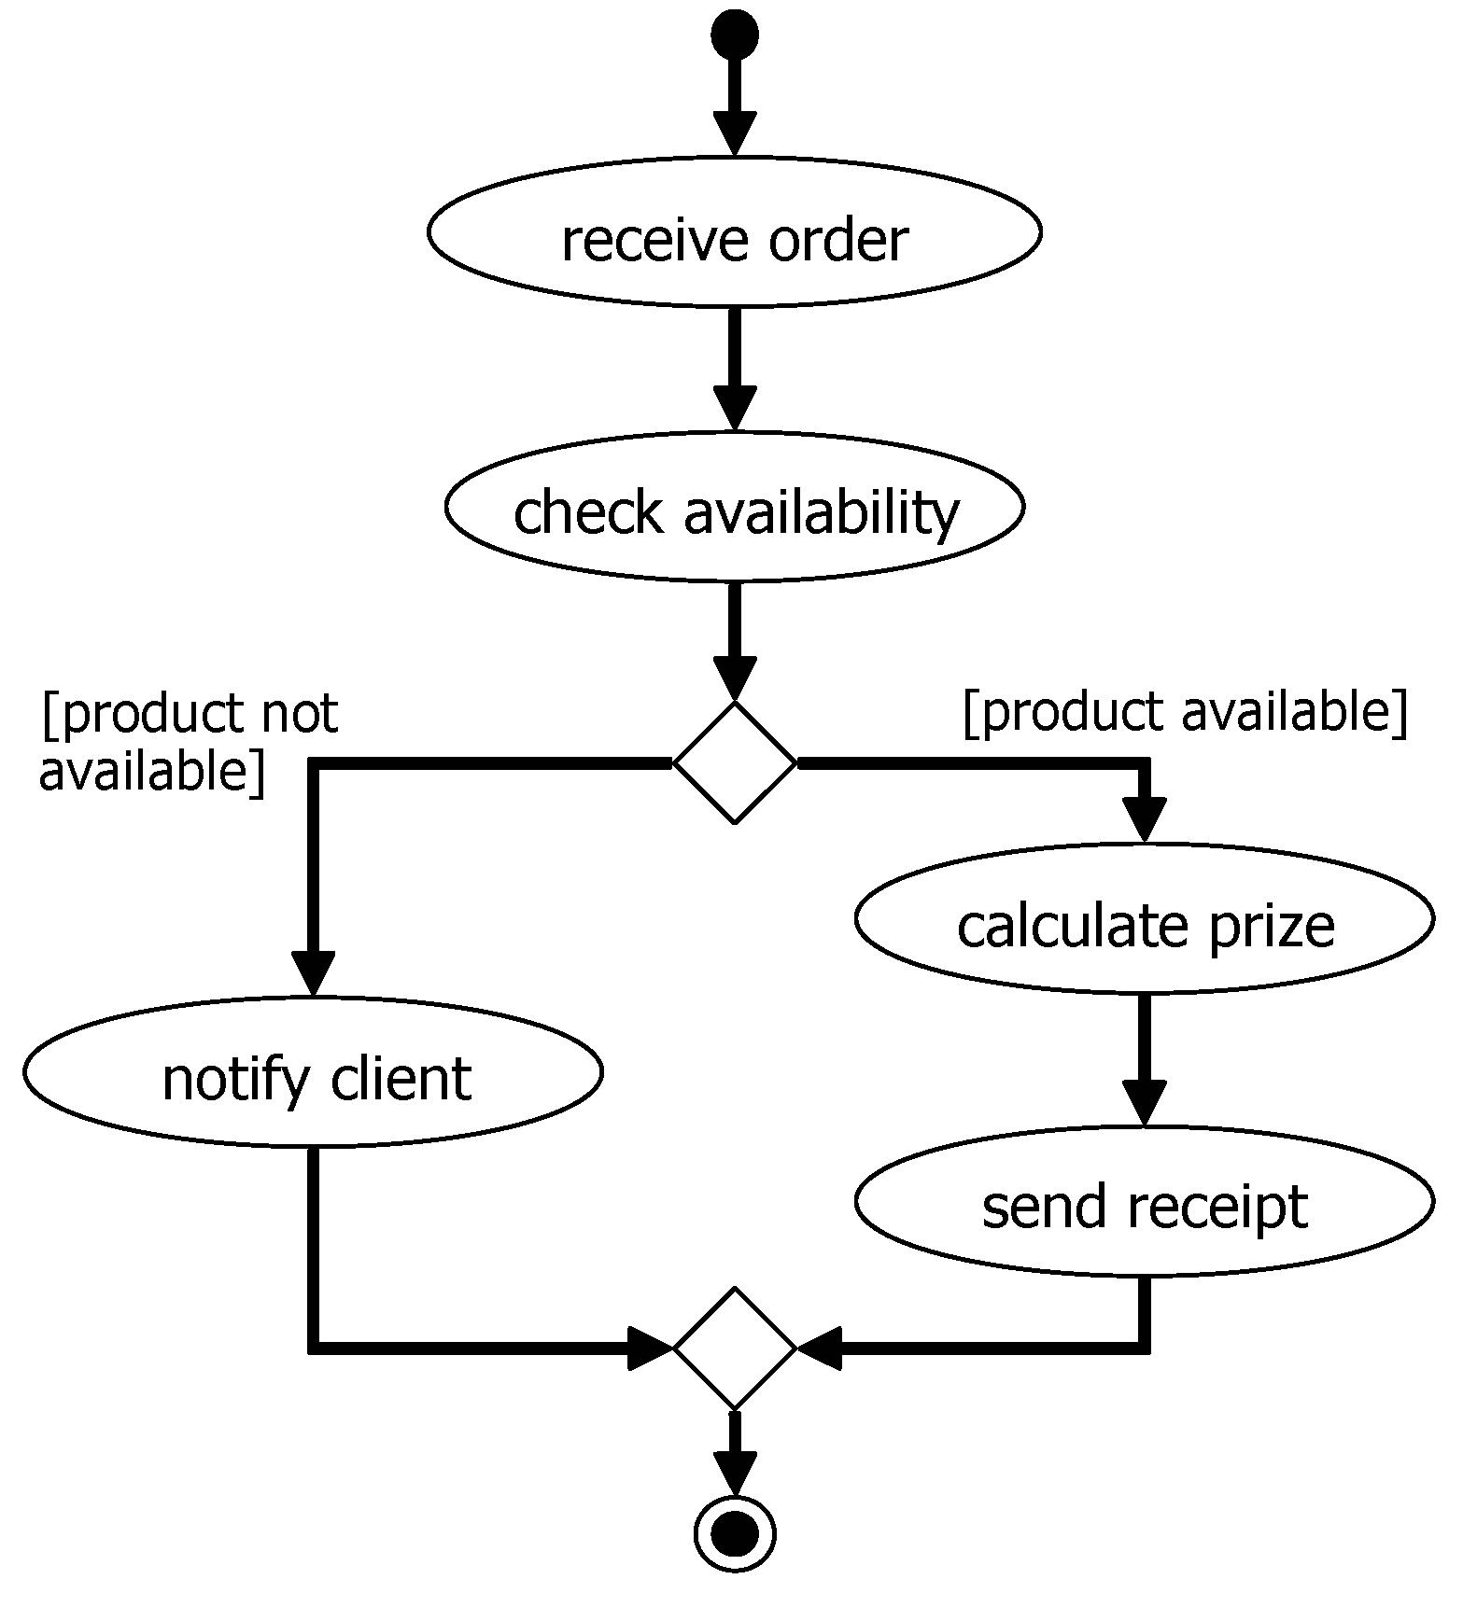
Example: Activity Diagrams
Kind of activities:
  Start
  Simple activities
  Decisions
  End
Control flow is described by arcs
  Could have annotated conditions
Only one start activity
Well-defined decision structures

Slide 8
Activity-Figure Concrete Layout
Activity
name
start
simple
decision
end

Slide 9
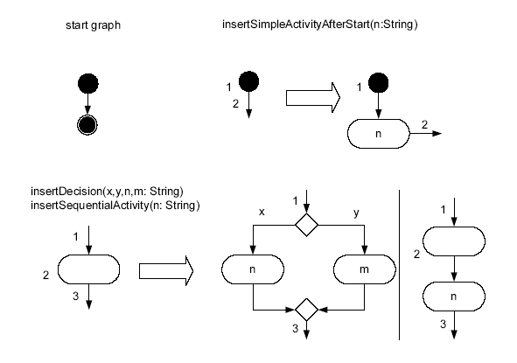
Activity Diagram Rules:
Concrete Syntax

Slide 10
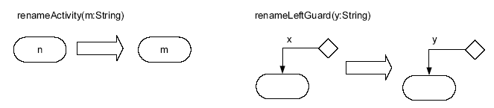
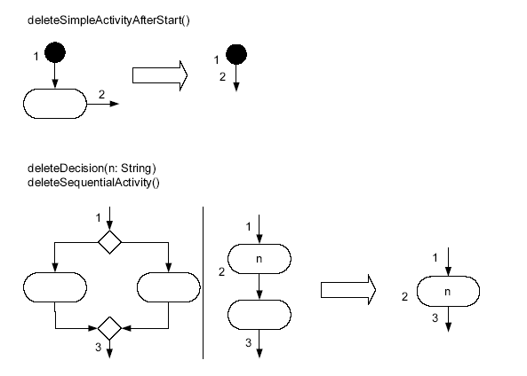
Activity Diagram Rules:
Concrete Syntax

Slide 11
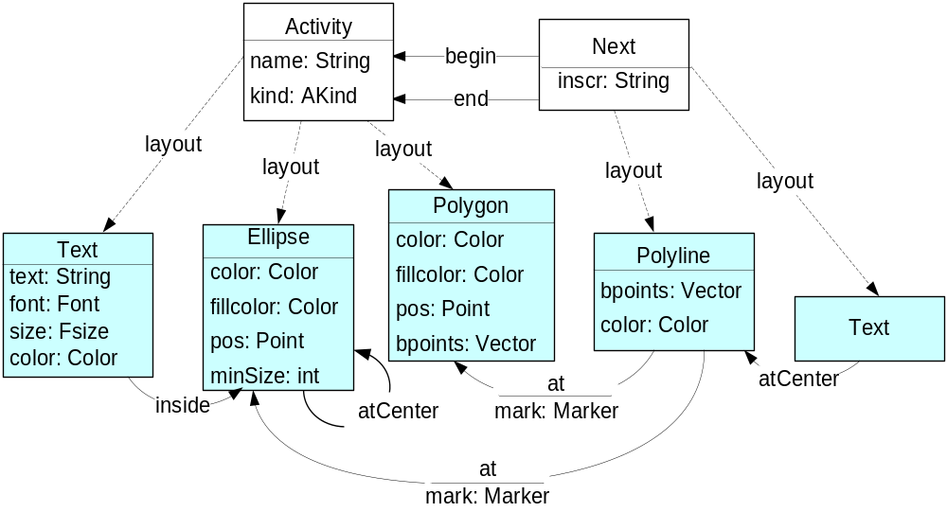
Activity Diagram: Abstract Syntax

Slide 12
Graph Transformation Step
insertSimpleActivity
afterStart(„firstAct“)
1
:
Activity
1
:
Activity
name
=
““
name
=
““
2
:
Next
kind
=
start
kind
=
start
begin
begin
begin
Activity
name
=
n
2
:
Next
Next
end
kind
=
simple
before
after
1
:
Activity
1
:
Activity
name
=
““
name
=
““
begin
Next
kind
=
start
kind
=
start
end
Activity
b
e
g
name
=
“firstAct“
i
n
kind
=
simple
Activity
Activity
begin
name
=
““
2
:
Next
name
=
““
kind
=
end
end
kind
=
end
end
2
:
Next

Slide 13
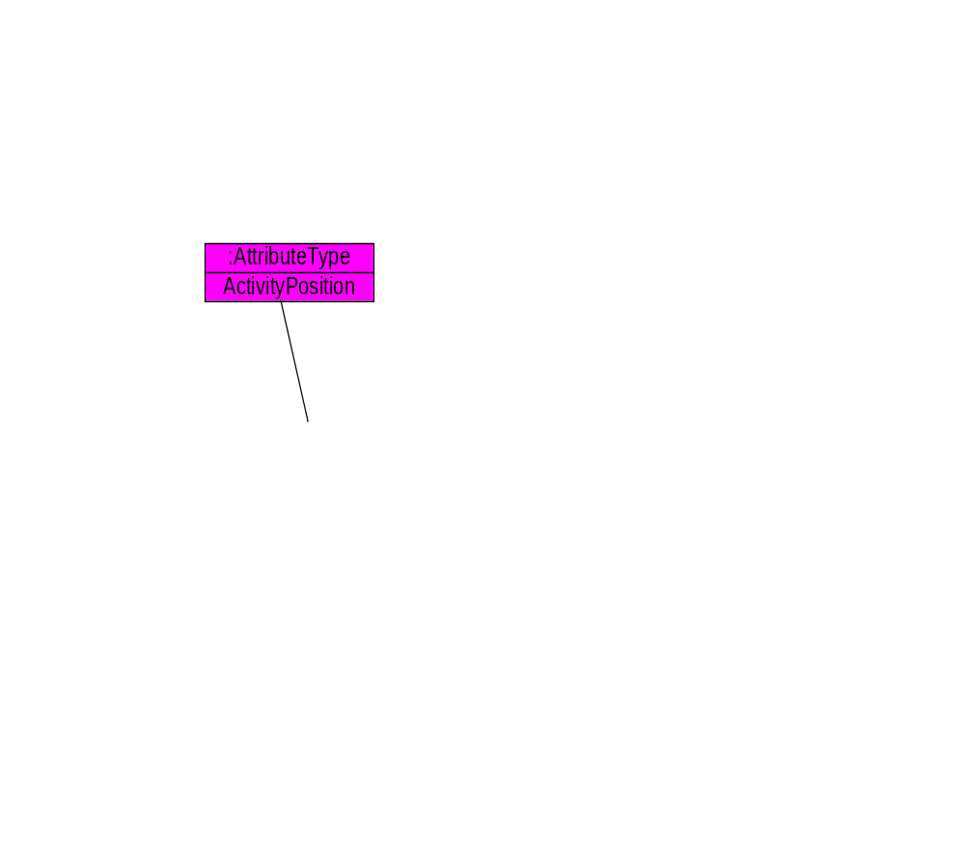
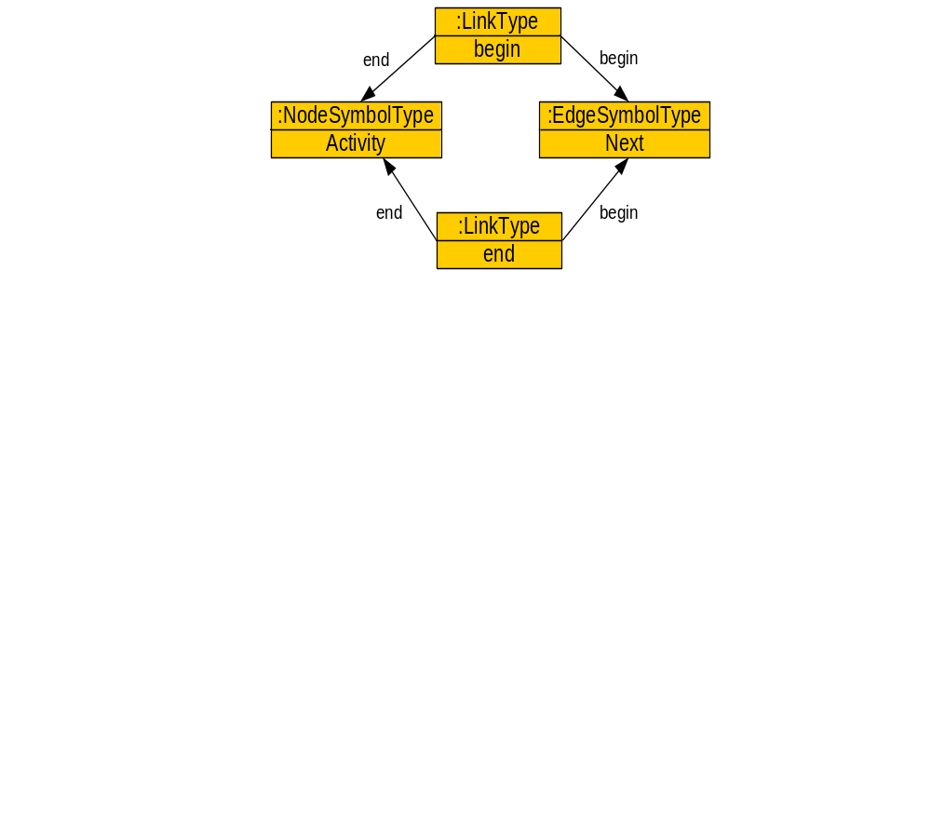
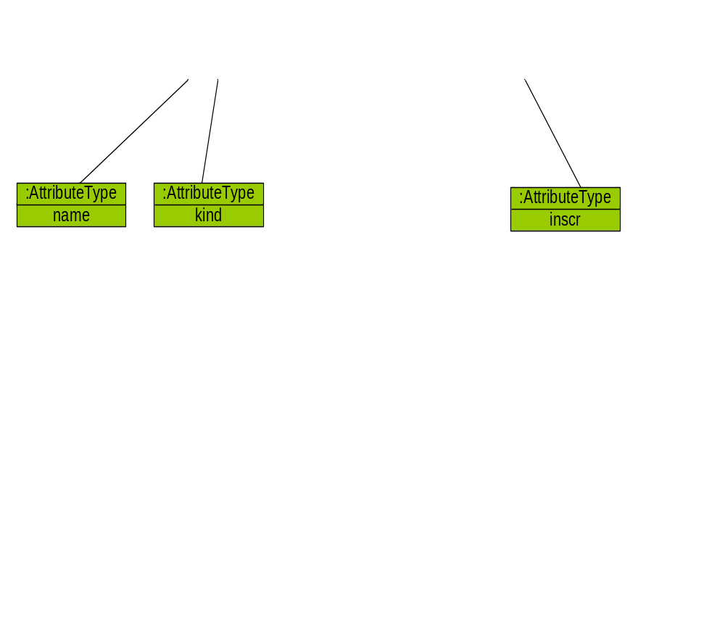
Activity Alphabet in Tiger:
Abstract Part

Slide 14
Activity Alphabet in Tiger:
Abstract and Concrete Part
second
LayoutConstraint
kind=„INSIDE“
second
first
LayoutConstraint
kind=„INSIDE“
first
TextFigure
name=„name“
TextFigure
name=„name“

Slide 15
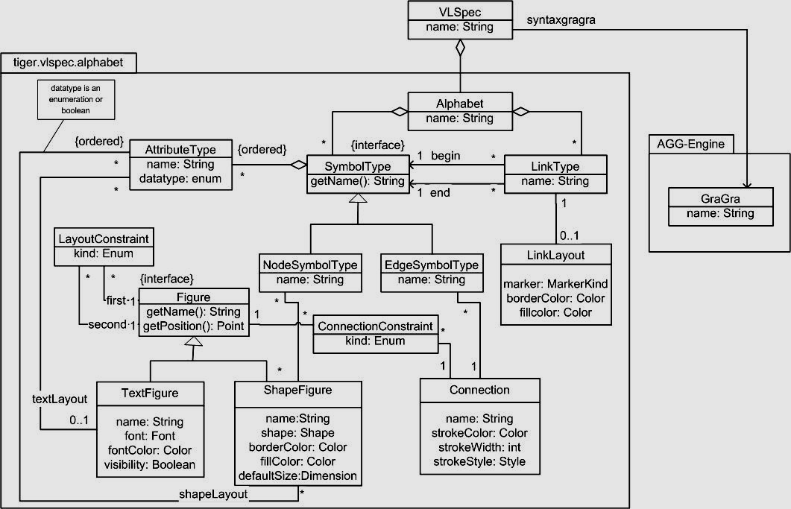
Tiger Alphabet: Class Diagram

Slide 16
Representation of a Diagram
Diagram
activity1
[next]
activity2
Concrete Syntax
Representation
NodeSymbol
EdgeSymbol
NodeSymbol
end
Link
begin
begin
Link
end
Abstract Syntax
Representation
in AGG
Node
target
Arc
source
Node
source
Arc
target
Node

Slide 17
Creation of a VL alphabet in Tiger
Up to now the VL alphabet has to be created by hand (coded in Java)
  Editing of graph transformation rules with the AGG GUI
Planned: Tiger Designer
  Eclipse editor plug-in for defining visual language environments
    Visual definition of VL alphabet
    Visual definition of grammar rules
    Exchange Format: Graph-Transformation-Exchange-Language (GTXL)
      http://tfs.cs.tu-berlin.de/projekte/gxl-gtxl.html

Slide 18
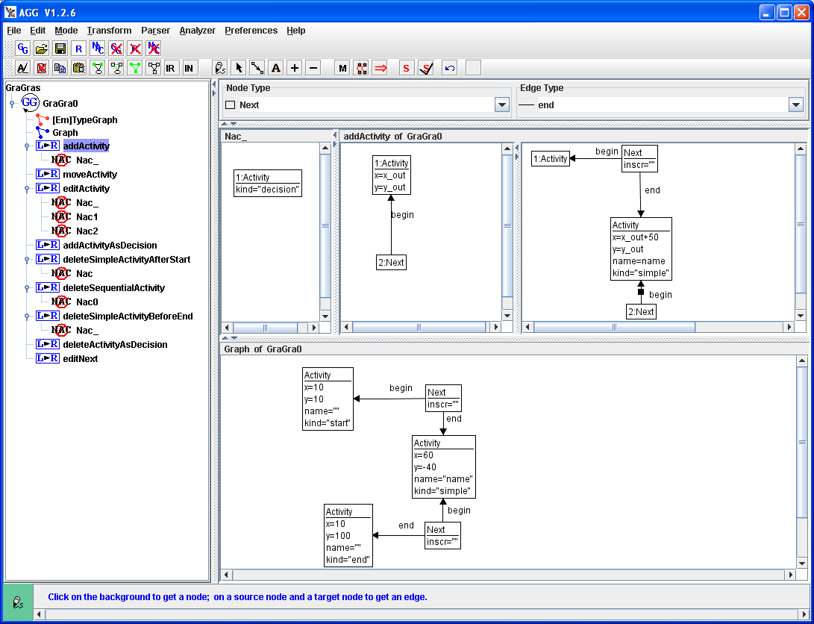
AGG
Activity Diagram Graph Grammar in AGG
Rule: addActivity
NAC
LHS
RHS
activity
graph grammar
tree view
instance graph

Slide 19
TIGER – Generator
Release 1.0.0
Available via Eclipse Software-Updates
  http://tfs.cs.tu-berlin.de/tigerprj/update
  Source-Code available via CVS-Webinterface
Requirements:
  Java Version 1.5
  Eclipse (Version 3.1M4, at least Version 3.0.2)
  GEF (Version 3.0.1)
  JET (EMF Version 2.0.1)

Slide 20
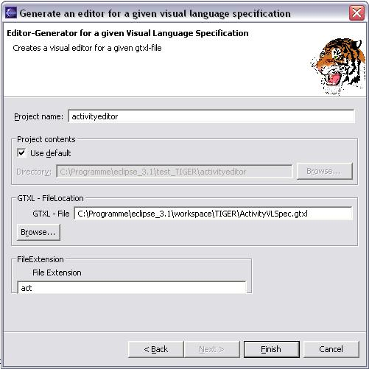
Generator Wizard
Menu: File > New > Other > Tiger Project – Editor Generation > generate an editor
Parameters:
  Project name
  VL-Specification (GTXL-File)
  File Extension

Slide 21
TIGER-Generator
GEF, Draw2d
Editor-Plugin
generate
VL-spec
Generator
calls
<alphabet>.gtxl
<grammar>.ggx
generate
JET, Eclipse
Diagram-File
typegraph , startgraph

Slide 22
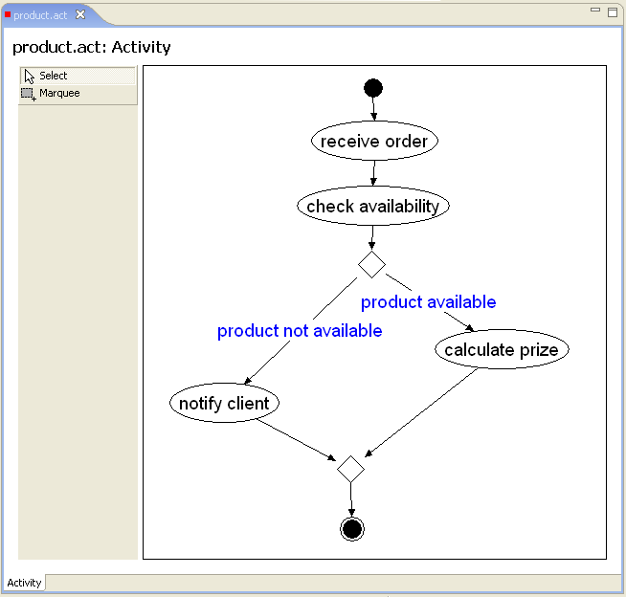
Generated Activity Diagram Editor

Slide 23
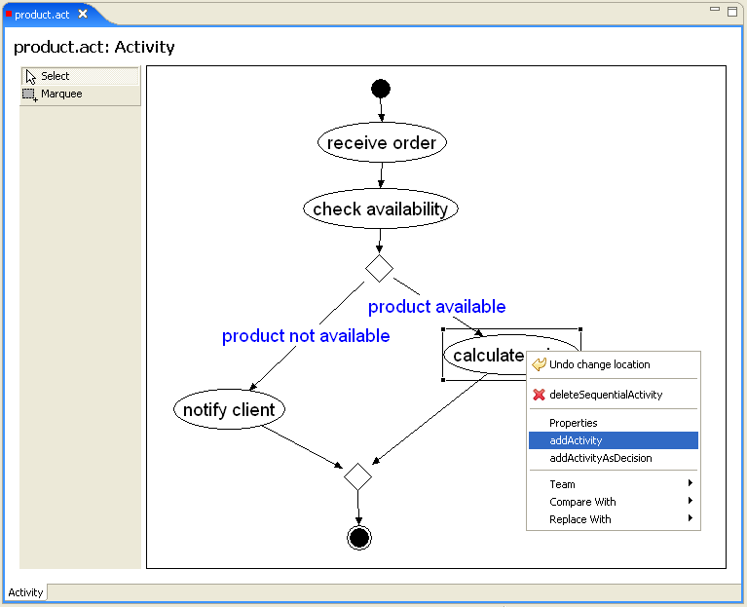
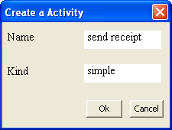
Generated Activity Diagram Editor:
Create a Simple Activity

Slide 24
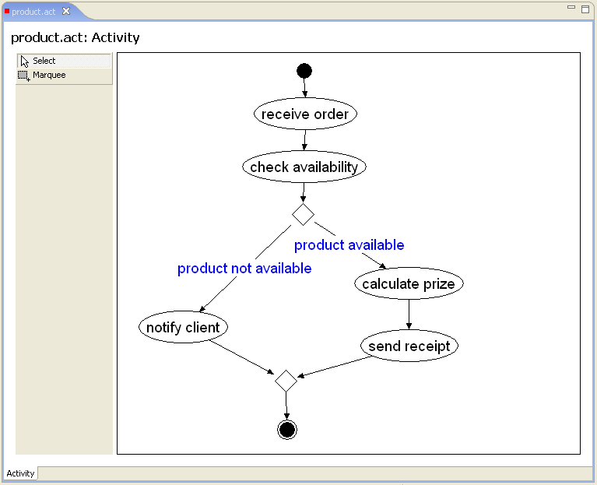
Generated Activity Diagram Editor:
After Creating a new Activity

Slide 25
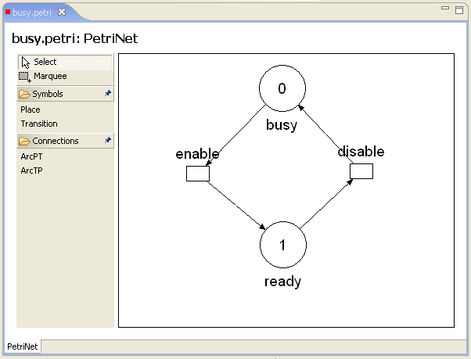
2nd Example:
Generated Petri Net Editor

Slide 26
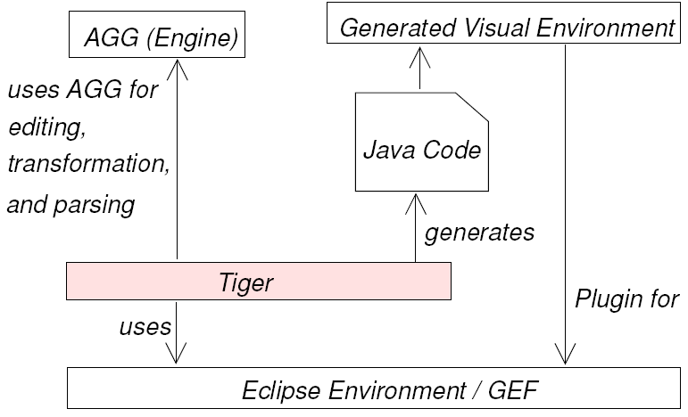
Tiger Architecture Overview

Slide 27
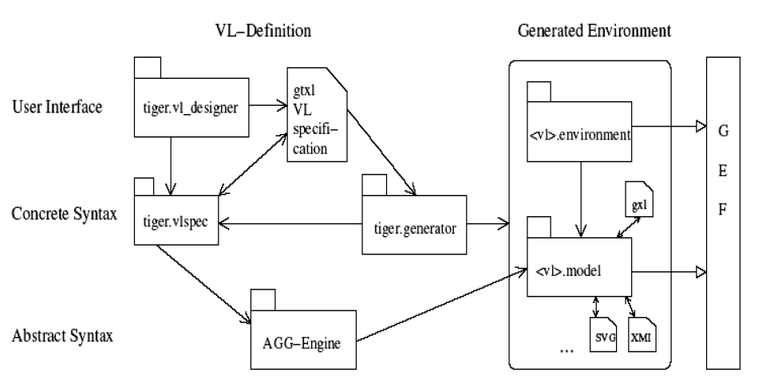
TIGER-Project Overview

Slide 28
First Development Step Completed
We generate diagram editor plug-ins
  We use the VL alphabet plus syntax grammar as VL specification
  We generate graph-transformation based editors
We allow graph-like languages (e.g. Activity diagrams, Petri nets) only.
  VL-Alphabet Restriction: NodeSymbolTypes could only be connected via EdgeSymbolTypes
We use Eclipse-JET for source code generation as part of Eclipse-EMF

Slide 29
Generating Visual Editors in Eclipse
JET compiler reads
  VL-specification
  Generator template files (which define the code generation skeleton with code placeholders)
JET replaces the placeholders with the specific code from the VL-specification
The generation process leads to a new generated Eclipse Editor Plug-in Project which could be directly executed in the Eclipse Runtime-Environment

Slide 30
Checking the Validity of Diagrams
1. Syntax-directed editing
  Guidance through the VL syntax
  Correct diagrams only
2. Free-hand editing
  Based on a given VL alphabet
  Constraint checking
  Advantage: editing of intermediate invalid diagrams is tolerated by the editor
3. Combination of both editing modes

Slide 31
Conclusion
Tiger combines
  Graph transformation offered by AGG
  Graphical editor development features offered by Eclipse-GEF
The generated modeling environments themselves are Eclipse plug-ins and hence are integrated in the Eclipse framework

Slide 32
Future Work
Second development step:
Extend the VL specification to include simulation and model transformation
Further development steps:
Allow more general kinds of diagrams instead of graph-like languages only

