Slide 1
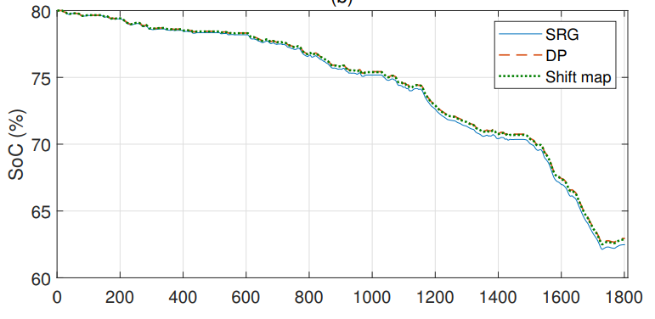
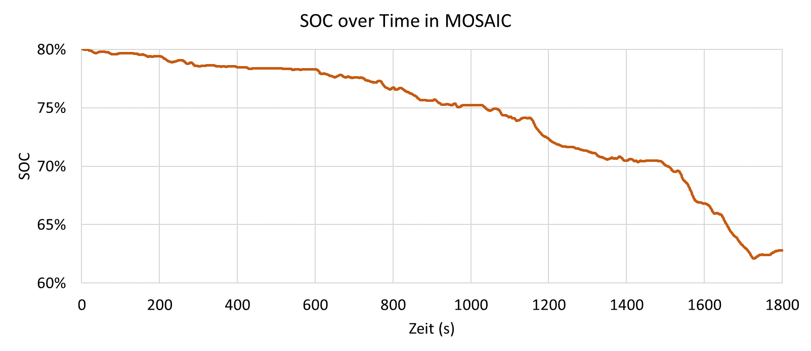
Validated Battery Model [1]
Eclipse MOSAIC Battery Model
SOC in %
SOC
Time in s
Time in s

