Slide 1
Mylar
A Task Focused UI for Eclipse
Programming Tasks
Task Contexts
Collaborative programming via Task Contexts
Robert Elves, committer
Notes:
Will make you more productive

Slide 2
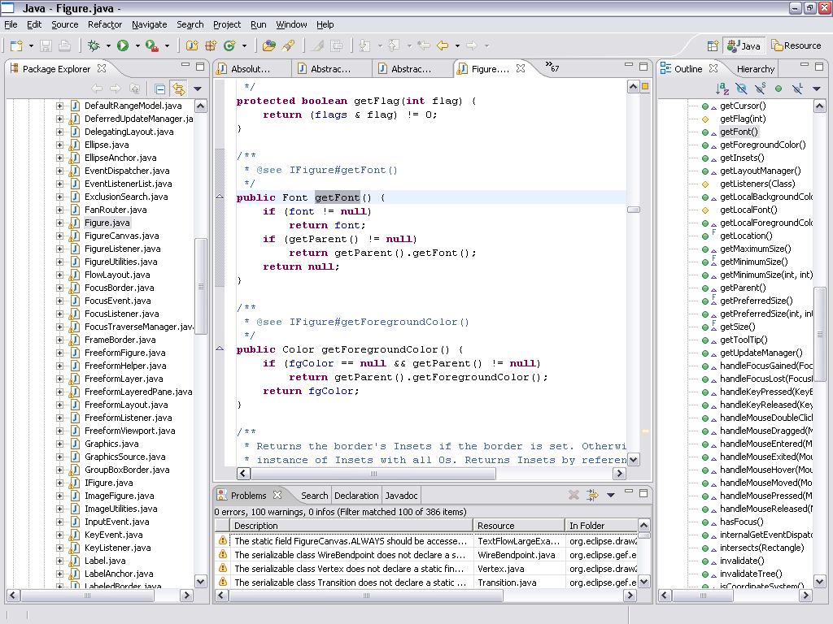
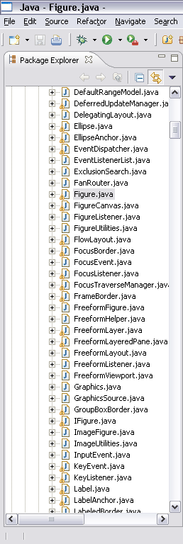
Information Overload
Hard to see the forest through the trees
Repetitive scrolling, searching, navigating
Notes:
But our systems have scaled, as has Eclipse’s performance
-

Slide 3
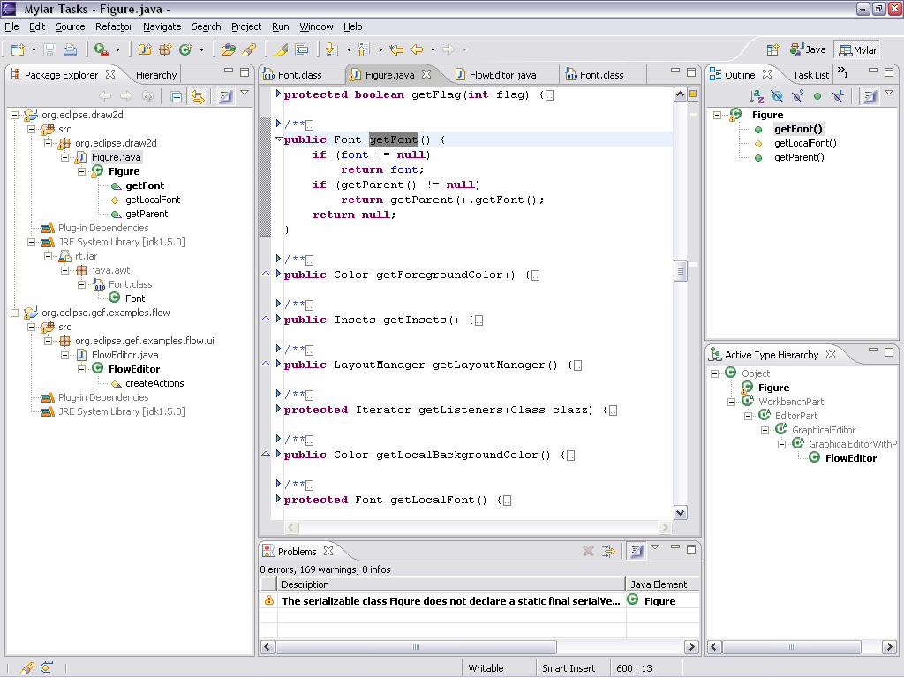
Mylar
see only what you’re working on
Aluminized film used to avoid blindness when staring at an eclipse
Task Focused UI to avoid information blindness when staring at Eclipse
Notes:
For any task that we work on, we only care about a
subset of the system
Mylar makes that subset explicit
All you need to do is indicate what task you’re working on
Via task management and issue tracker integration
Task context model is created automatically
Transparently monitors your programming activity
Filtered views show what you expect

Slide 4
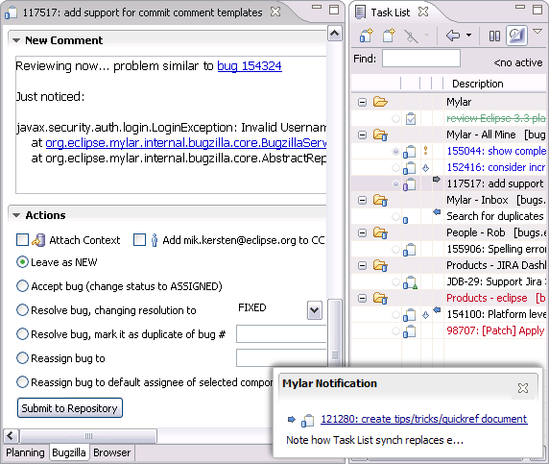
Tasks
  User-defined unit of work, e.g. bug report
  Focal point for communication
Notes:
open TaskListTableSorter (folding)
navigate to ViewerSorter (filtering)
SHOW PROBLEMS FILTERING
Show Alt+click: select compare(..), Alt+click on package
Other resources
Alt+click to show build.xml (outline filtering, Alt+clicking)
Show Navigator, Alt+click to show build-user.xml (generic file)
Editor management
Editor management: deactivate/reactivate (discuss decay)
Switch to big context (common not to see a scrollbar), Ctrl+E list, switch back

Slide 5
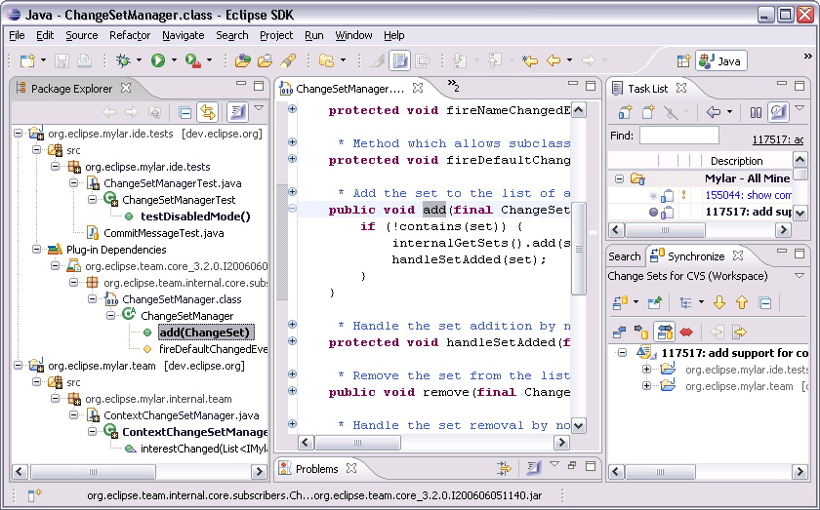
Task context
  Mylar monitors your interaction
  What you touch is in your context
  Stored and easy to recall
Notes:
open TaskListTableSorter (folding)
navigate to ViewerSorter (filtering)
SHOW PROBLEMS FILTERING
Show Alt+click: select compare(..), Alt+click on package
Other resources
Alt+click to show build.xml (outline filtering, Alt+clicking)
Show Navigator, Alt+click to show build-user.xml (generic file)
Editor management
Editor management: deactivate/reactivate (discuss decay)
Switch to big context (common not to see a scrollbar), Ctrl+E list, switch back

Slide 6

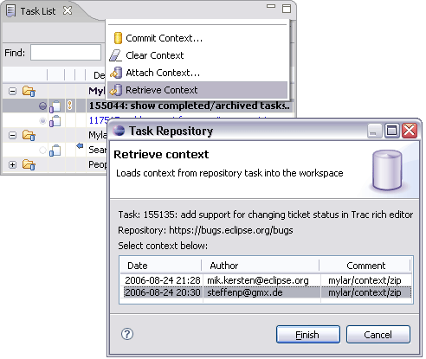
Sharing context
Connectors
  Similar to source repositories
  Bugs/issues/tasks from repository
  Support Bugzilla, Trac, JIRA
Collaboration!
  Patch review
  Pair programming
  Sharing expertise
  Historical
Notes:
Pair programming (Pick up where team member
left off)
Show Team Synchronizing perspective, New Wizard
Discuss queries, add: JIRA Dashboard Recent
Open report, mention offline persistence of queries
But all the context stuff works for JIRA reports
Open: “bugzilla.core should not”
Show query, existing context
Edit query
Editor: open Mylar bug report, make outgoing change, close and reopen
Status: show incoming notifications for inbox (less email)
Web drag URL from, not subject http://sourceforge.net/tracker/index.php?func=detail&aid=1012604&group_id=69326&atid=524147
Show “open in external”
Show Commit message
CVS history: drag AbstractRepositoryConnector, open task for rev 1.4
Show find for “hyperlink” tasks, discuss activity
Open 88293 hyperlink report then add reminder to past
Add note

Slide 7
Demonstration
Programming Tasks
Task Contexts
Collaborative programming via Task Contexts
Notes:
Will make you more productive

Slide 8





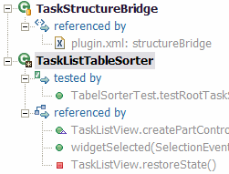
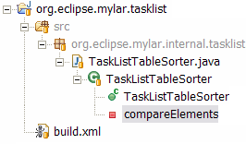
Mylar’s context model
Interaction history
  InteractionEvent stream
  Origin, handle, type, date
Context (Core)
  Degree-of-interest graph
  Degree-of-separation scope
  Scaling factors
Projections (UI)
  Views, editors, files
interest
Notes:
All the things you might want to do the architecture has flexibilty for

Slide 9
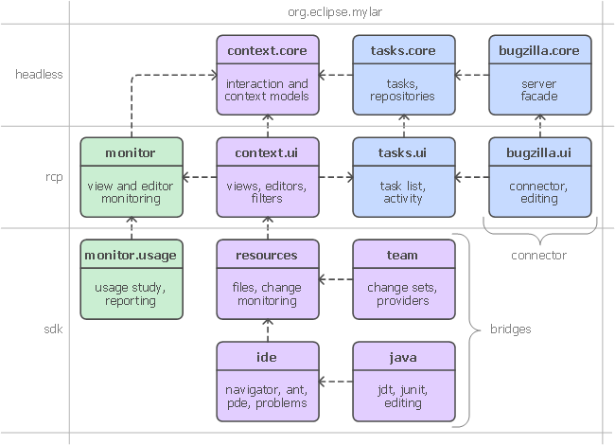
Extensible Frameworks

Slide 10
Changing how we work with Eclipse
What you need to do
  Buy into working with tasks
  Get Mylar 0.8 (1.0 release in December)
Once tasks are explicit
  Reduces information overload
  Information you need to get work done is at your finger tips
  Context switching and recalling old tasks become effortless
  UI automation (e.g. working sets, search, commit messages)
  UI for task management is consistent and integrated
  Keeps you in Eclipse and out of your browser and inbox
Notes:
[last year]
Showed that we can do this
Now: there is a framework
Not as much cut and pasting, back/forward nav, open type, search
Get interrupted by a patch, apply it, back where you left off
Without Mylar have to remember tons of structure (e.g. type names)
No more watching <component>-inbox [picture of toaster]
I have to remind myself to turn it off now and then
When not to use it
Reviewing package structure, comment clean-up
Now you might be wonder how we know this information..

Slide 12
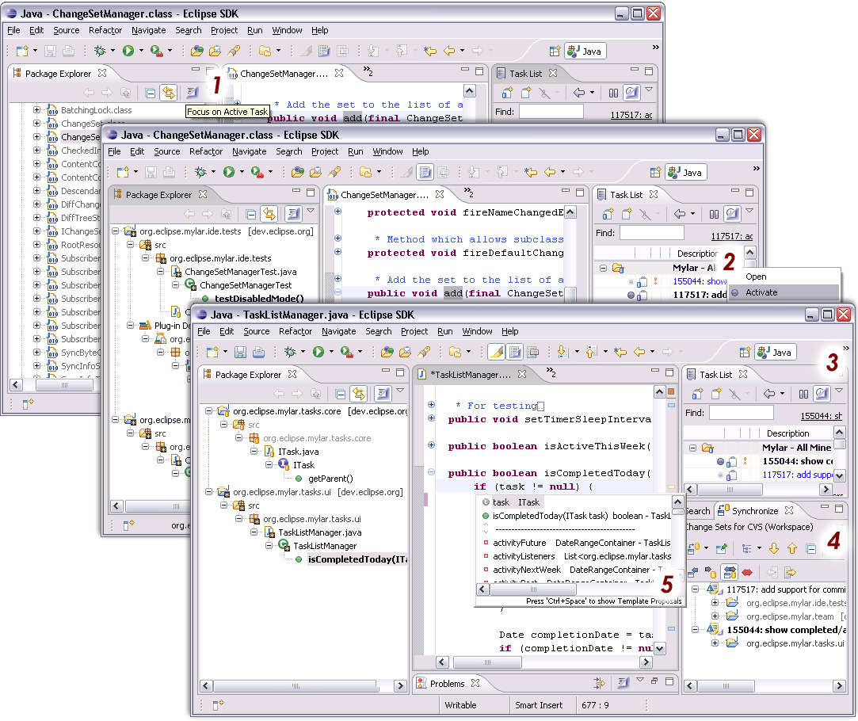
Multi-tasking
Notes:
Review of patches
Historical (stored in repository)

