Slide 1

Note: contains animations,
best viewed in slideshow mode
Using Task Context to
Improve Programmer Productivity
Mik Kersten
and Gail C. Murphy
Foundations of Software Engineering Conference, November 7, 2006
Notes:
Remove all:
- Bridge stuff, java stuff

Slide 2
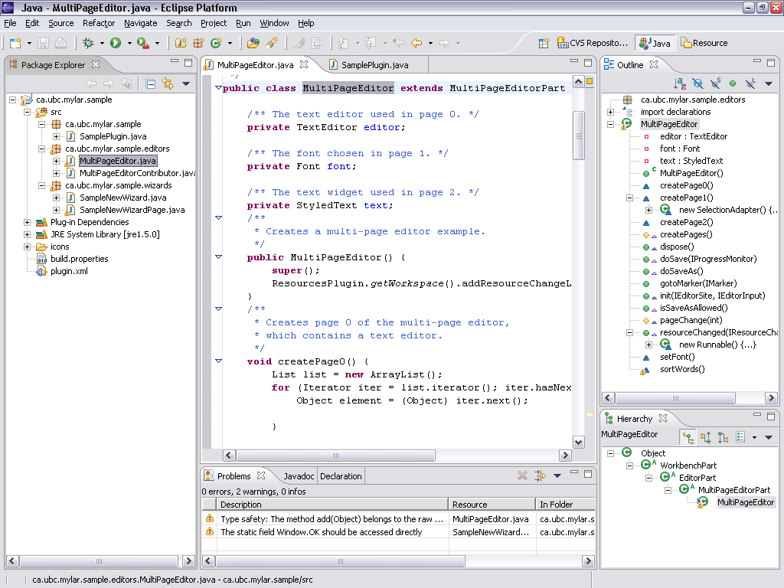
Notes:
Task also show structure of system
Careful about overloading word “structure”
IDEs make the structure of a system explicit,
easy to query, and to navigate

Slide 3
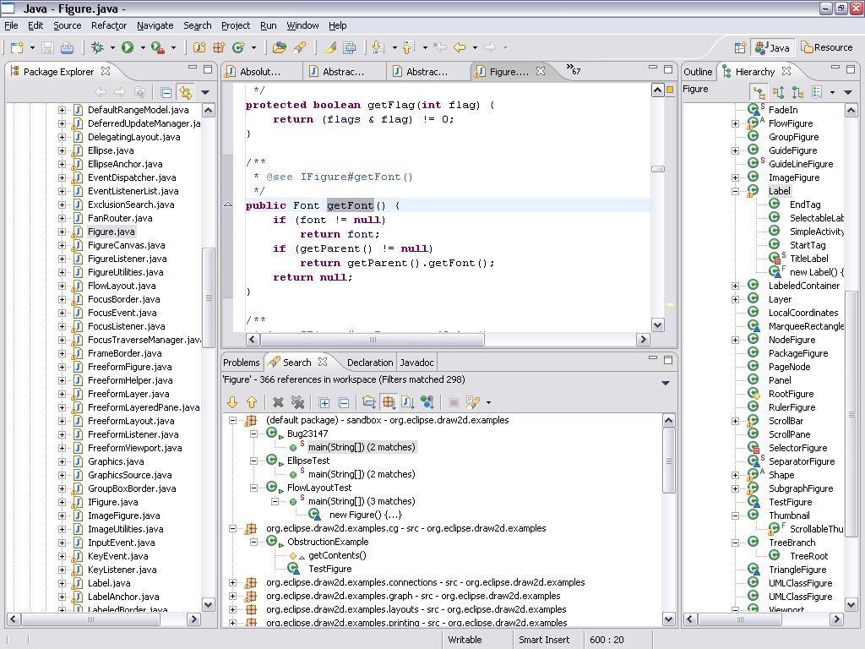
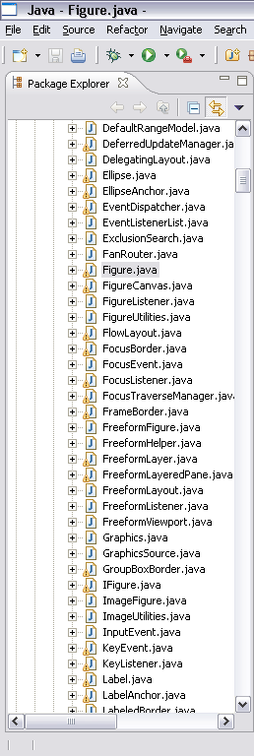

Slide 4
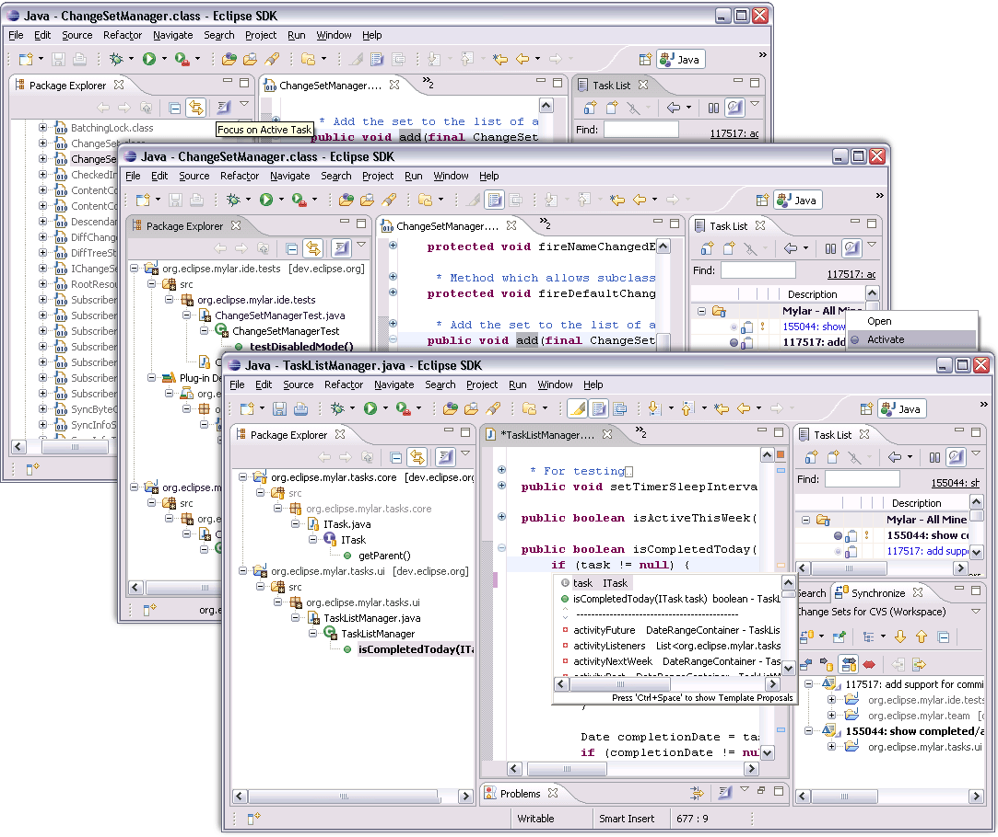
Mylar demo…

Slide 5
Model & Operations

Slide 6




Model
Interaction
Task context
Degree-of-interest (DOI) weighting
  Frequency and recency of interaction with element
  Both direct and indirect interaction
interest
Notes:
TODO: test case
Once task context is explicit…
Discuss scaling
Discuss relations
Gail: makes no sense, deg

Slide 7
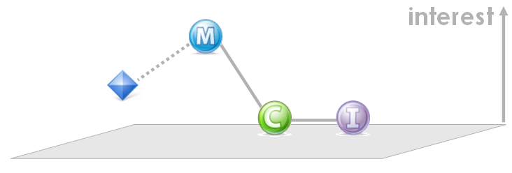
Topology
Task context graph
  Edges added for relations between elements
  Scaling factors determine shape, e.g. decay rate
Thresholds define interest levels
  [l, ∞] Landmark
  (0, ∞] Interesting
  [-∞, 0] Uninteresting

Slide 8
Operations
Once task context is explicit
  Can treat subsets relevant to the task as a unit
  Can project this subset onto the UI
  Perform operations on these subsets
Composition
  See context of two tasks
  simultaneously
Slicing
  Unit test suite can be slow to run on large project
  Find all interesting subtypes of TestCase
  Dynamically create test suite from this slice
c
c
d
a
b
b
T
T
Notes:
TODO: arrows

Slide 9
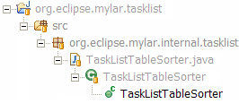
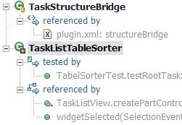
More operations
Propagation
  Interacting with method propagates
  to containing elements
Prediction
  Structurally related elements of potential
  interest automatically added to task context
Operations compose
  Context test suite will include
  predicted elements
Only interaction stored
Notes:
Sometimes the programmer has not interacted with the relevant information
It would be nice if we could base this only on the programmer’s interaction, but we have to take into account the structure of the system.

Slide 10
Validation

Slide 11
Field Study
Question
  Does task context make programmers more productive?
  Approximate productivity with edit ratio (edits /selections)
  Programmers are more productive when coding than when browsing, searching, scrolling, and navigating
Method and study framework
  Use interaction history to measure edit ratio
  User study framework sent interaction histories to UBC server
  Baseline period of 1500 events (approx 2 weeks)
  Treatment period of 3000 events, to address learning curve
Subjects
  Advertised study at EclipseCon 2005 conference
  99 registered, 16 passed treatment threshold
Notes:
Less time wasted looking for code

Slide 12
Results
Statistically significant increase in edit ratio
  Within-subjects paired t-test of edit ratio (p = 0.003)
Model accuracy
  84% of selections were of elements with a positive DOI
  5% predicted or propagated DOI
  2% negative DOI
Task activity
  Most subjects switched tasks regularly
Surprises
  Scaling factors roughly tuned for study, but still unchanged

Slide 13
Our approach
Memory
  Episodic memory: one-shot, only single exposure required
  Semantic memory: multiple exposures required
Our approach
  Leverage episodic memory, offload semantic memory
Tasks: episodes
Context: weighting of relevant semantics

Slide 14
Related Work
Memory
  Episodic memory: one-shot, only single exposure required
  Semantic memory: multiple exposures required
Our approach
  Leverage episodic memory, offload semantic memory
Tasks: episodes
  Explicit tasks (UMEA, TaskTracer): flat model, lack of
  fine-grained structure
Context: weighting of relevant semantics
  Slices (Weiser) and searches (MasterScope): structure only
  Interaction-based (Wear-based filtering): no explicit tasks

Slide 15
Summary
Current IDEs take compiler’s point of view
  This has not scaled
Task context takes programmer’s point of view
  Helps existing tools scale to very large systems
  Makes programmers more productive
Status
  Thousands of industry users
  Extensible open source framework
    U. of Victoria group extended task context to an ontology browser
    We have extended task context to other kinds of knowledge work
http://eclipse.org/mylar

