Slide 1



mylar
a degree-of-interest model for eclipse
Mik Kersten
University of British Columbia
IBM Toronto, July 2005

Slide 2
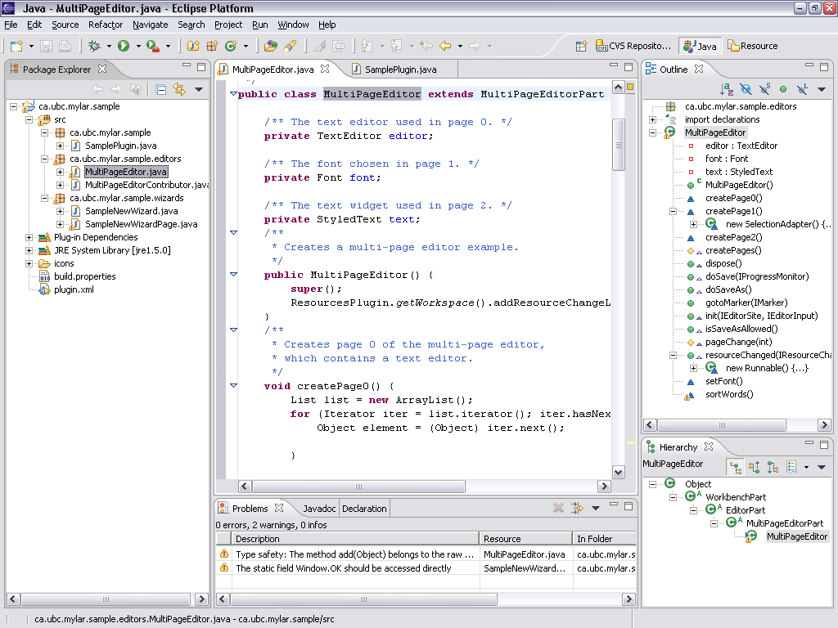

Slide 3
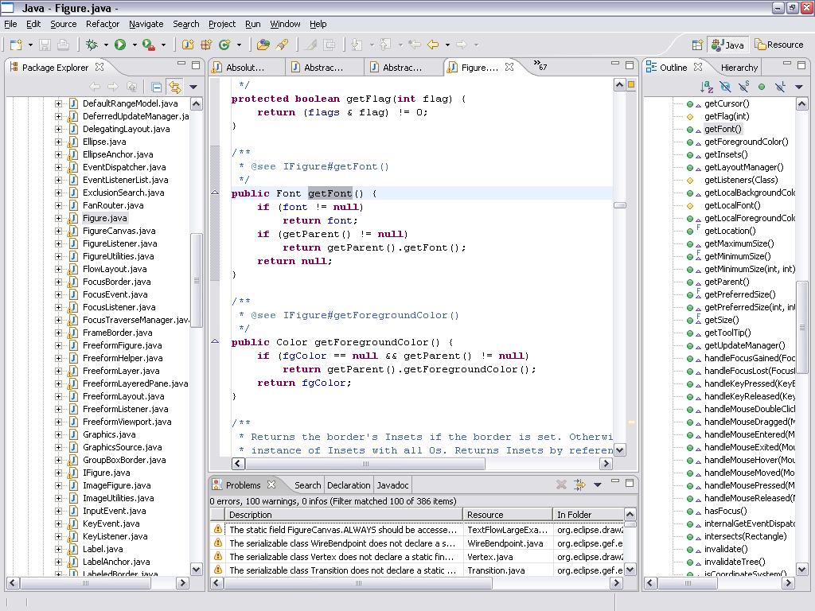
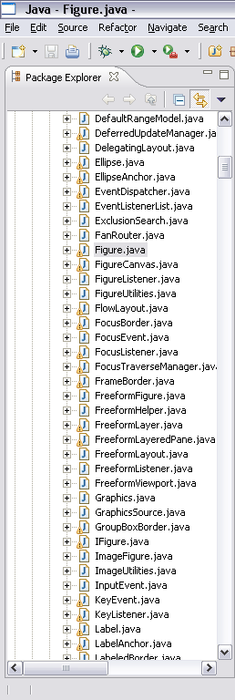

Slide 4
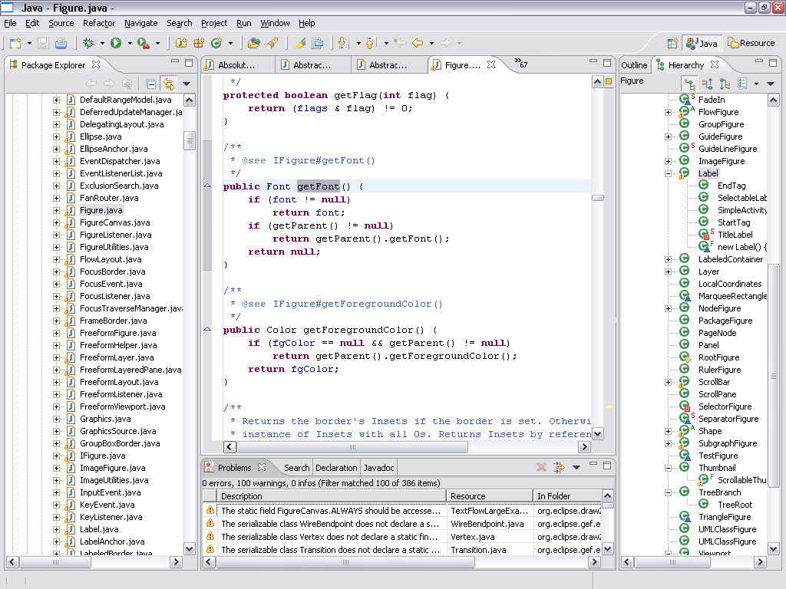
Notes:
Point to where type hierarchy will pop up

Slide 5
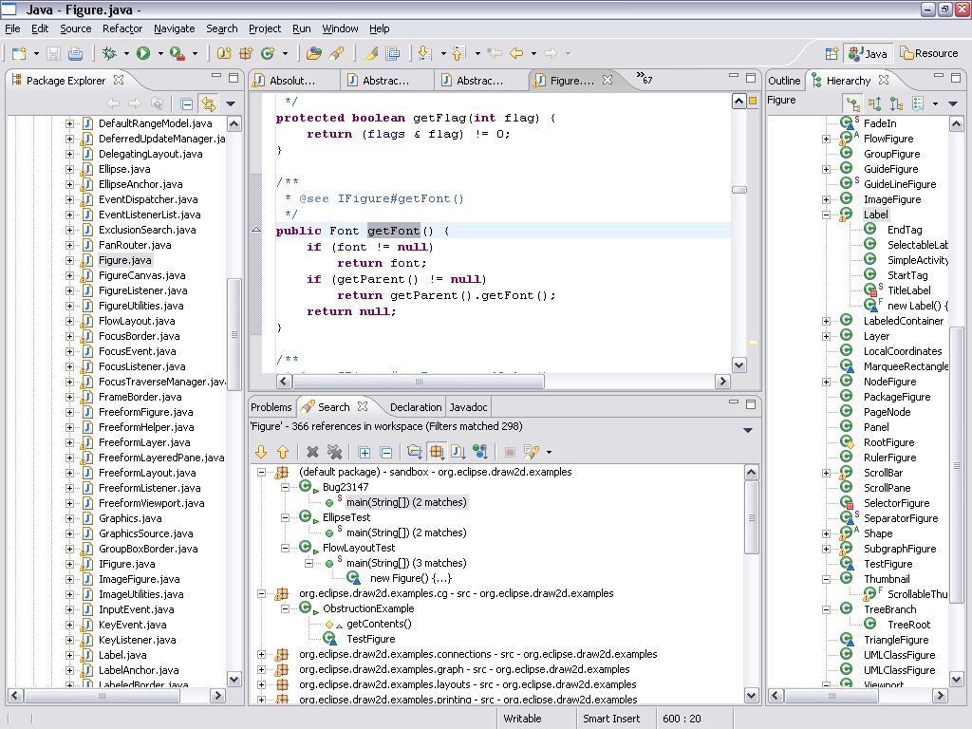
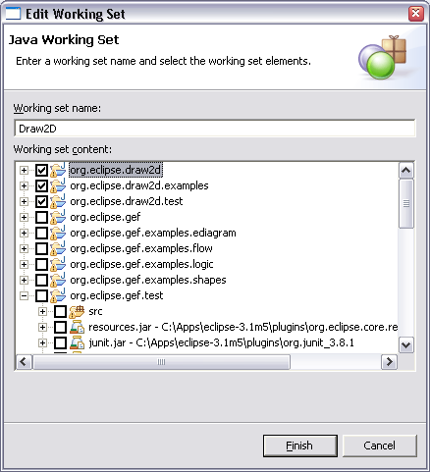

Slide 6
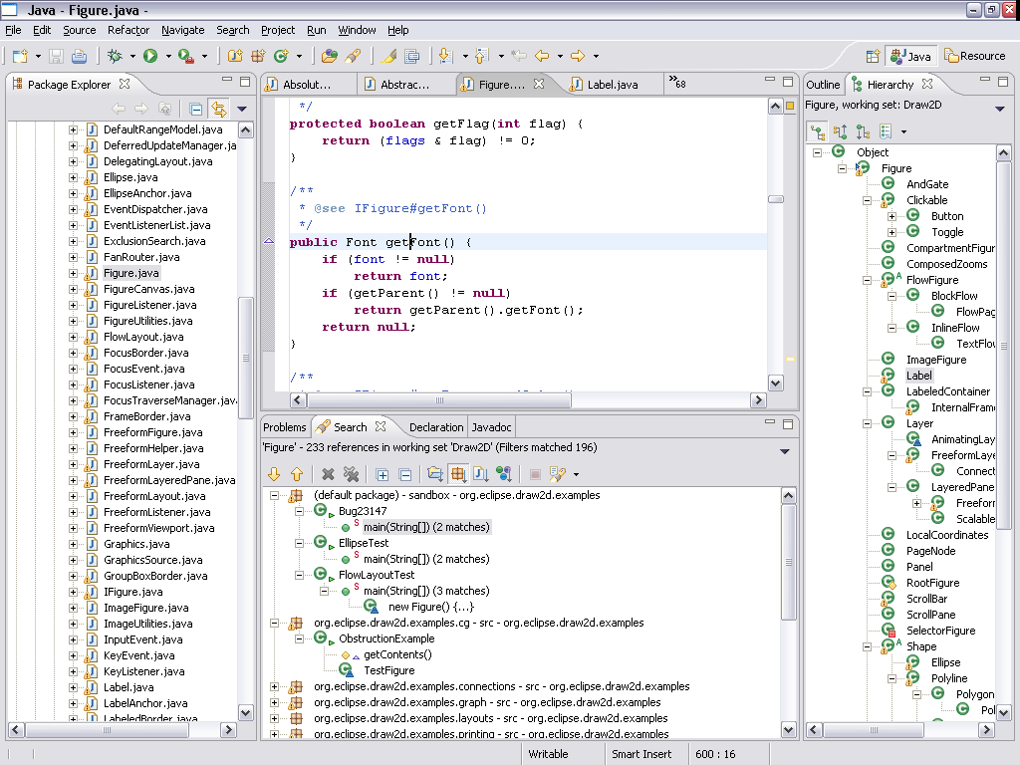

Slide 7
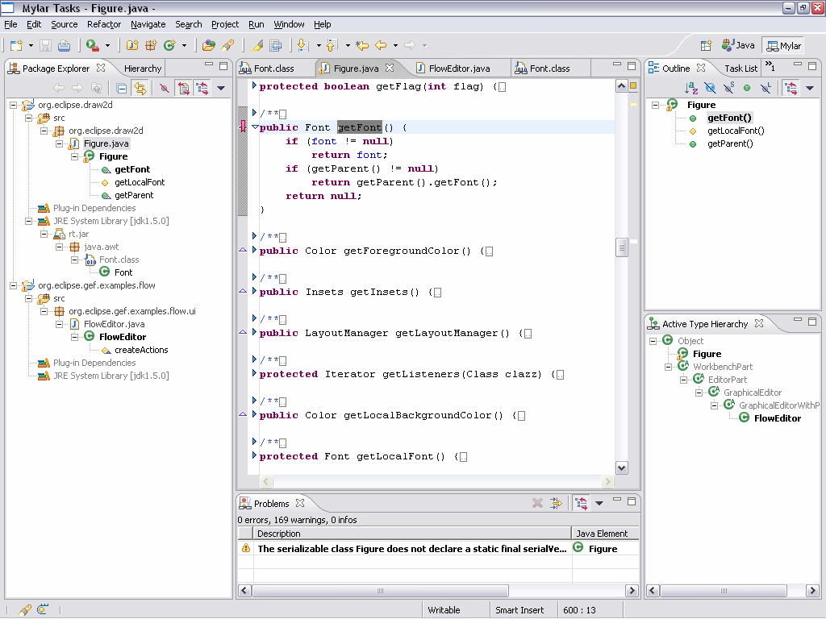
Mylar
shows you only what you’re working on
  1a. Aluminized film used to avoid blindness when staring at a solar eclipse
  1b. UI ‘skin’ used to avoid information blindness when staring at Eclipse
1

Slide 8
Mylar
How does it present what’s interesting?
How does it determine what’s interesting?
How does it support your work practice?

Slide 10
Mylar
How does it present what’s interesting?
  Bolding, automatic expansion and highlighting
  Collapses and filters uninteresting elements
How does it determine what’s interesting?
How does it support your work practice?

Slide 11
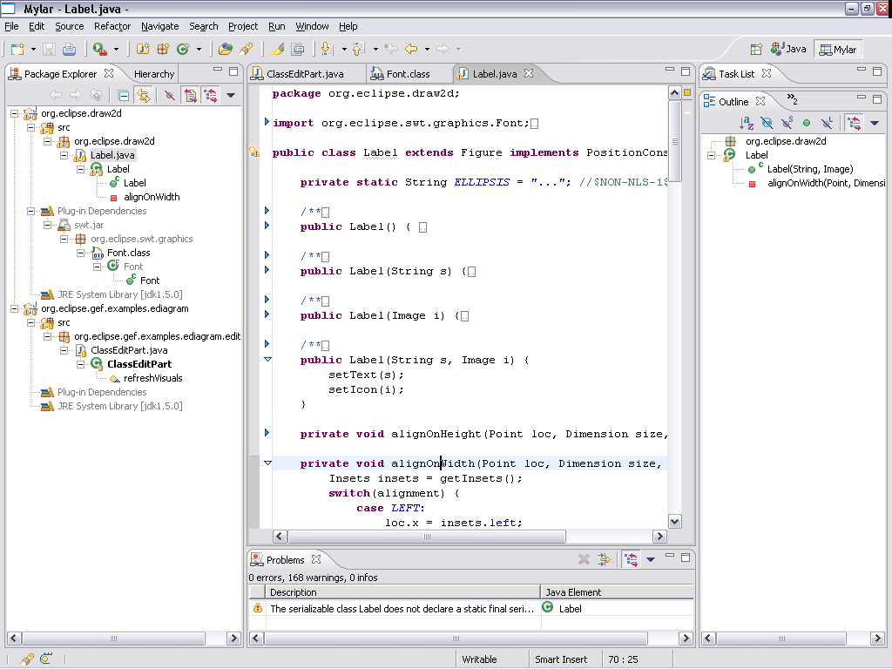
Demo 1
Setup
  Bug: 32618
  Search: bugzilla, java refs, xml
  Auto filtered
Look at ClassEditPart
Navigate to Font constructors
Navigate to Label
Toggle outline, editor folding
Show declarations on ClassEditPart

Slide 12
Mylar
How does it present what’s interesting?
  Bolding, automatic expansion and highlighting
  Collapses and filters uninteresting elements
How does it determine what’s interesting?
  Monitors editing and navigation
  Encodes degree of interest, periodic decay
How does it support your work practice?

Slide 13
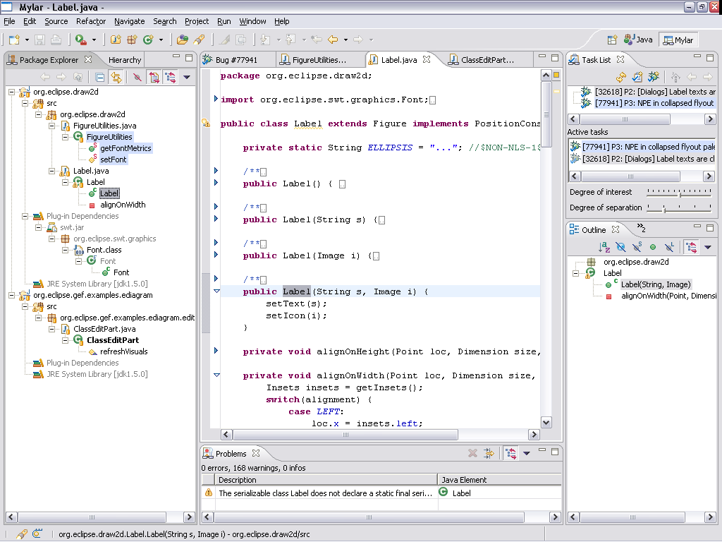
Demo 2
Show task list (been working on a bug report)
Deactivate, activate
Discuss a new bug report came in, looks related to current taks
Create new bugzilla report: 77941, activate
Navigate to FigureUtilities set/get Font
Toggle outline to show highlighter
Re-activate previous

Slide 14
Mylar
How does it present what’s interesting?
  Bolding, automatic expansion and highlighting
  Collapses and filters uninteresting elements
How does it determine what’s interesting?
  Monitors editing and navigation
  Encodes degree of interest, periodic decay
How does it support your work practice?
  Context is explicit, can be saved and restored
  Multiple tasks can be active
  Tasks can be linked to bug reports

Slide 15
Mylar
How does it present what’s interesting?
  Bolding, automatic expansion and highlighting
  Collapses and filters uninteresting elements
How does it determine what’s interesting?
  Monitors editing and navigation
  Encodes degree of interest, periodic decay
  Related elements can also be interesting
How does it support your work practice?
  Context is explicit, can be saved and restored
  Multiple tasks can be active
  Tasks can be linked to bug reports

Slide 16
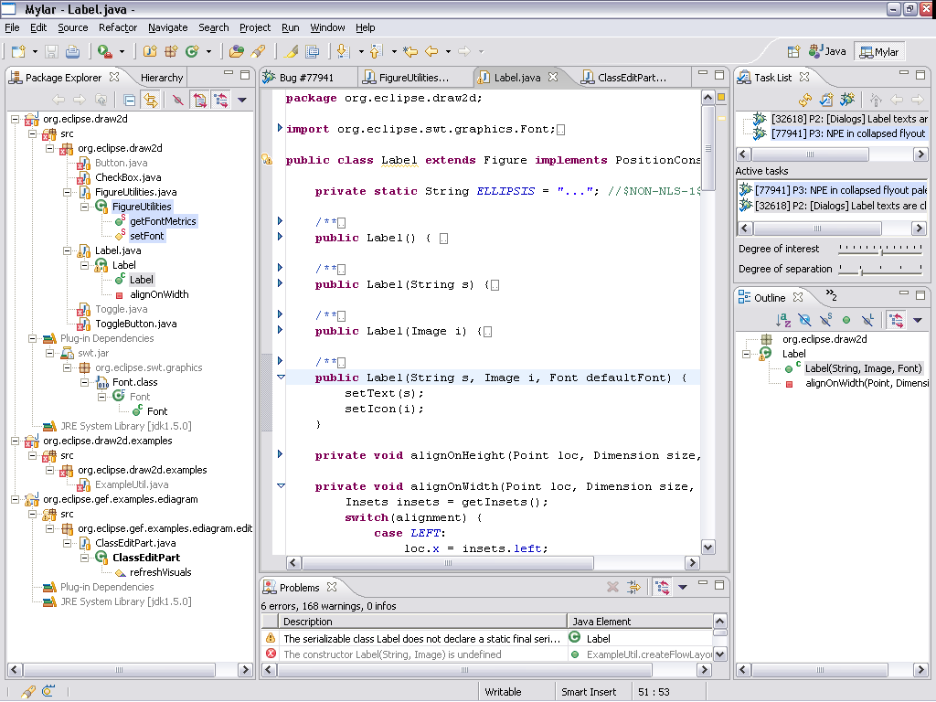
Demo 3
Browse to Label and add 3rd arg to constructor
Mention that errors only have transient interest
Discuss no more need of errors view

Slide 17
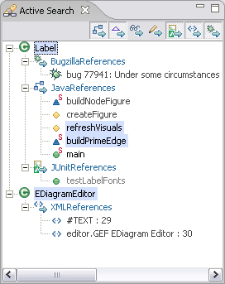
What about search?
Eclipse
  Invoke manually and inspect long list of results
Mylar
  Landmarks are the most interesting elements
  Active Search updates related elements eagerly
  in the background
  Results show interest level
Related elements
  References, implementors
  Read, write access
  Unit tests
  Bugzilla & XML references

Slide 18
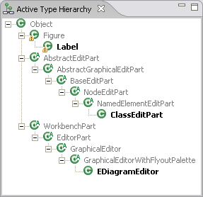
Type Hierarchy
Eclipse
  Invoke the hierarchy on an element, then wait
Mylar
  Active Type Hierarchy of landmarks is updated in the background
  Inheritance context of what you’re working on is always visible
Demo…

Slide 19
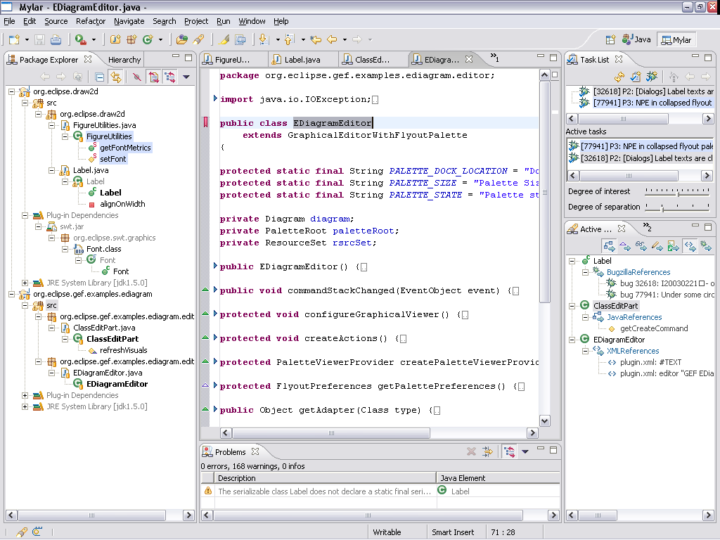
Demo 4
Show active search view
Toggle Java and other refs
Open EDiagramEditor and make it a landmark
  Make landmarks clear
Navigate to XML

Slide 20
What about search scope?
Degree of separation
  Distance of related elements from the current task context
E.g. for Java elements degrees are:
  Landmarks
  Interesting elements
  Interesting projects
  Project dependencies
  Workspace
Demo…

Slide 21
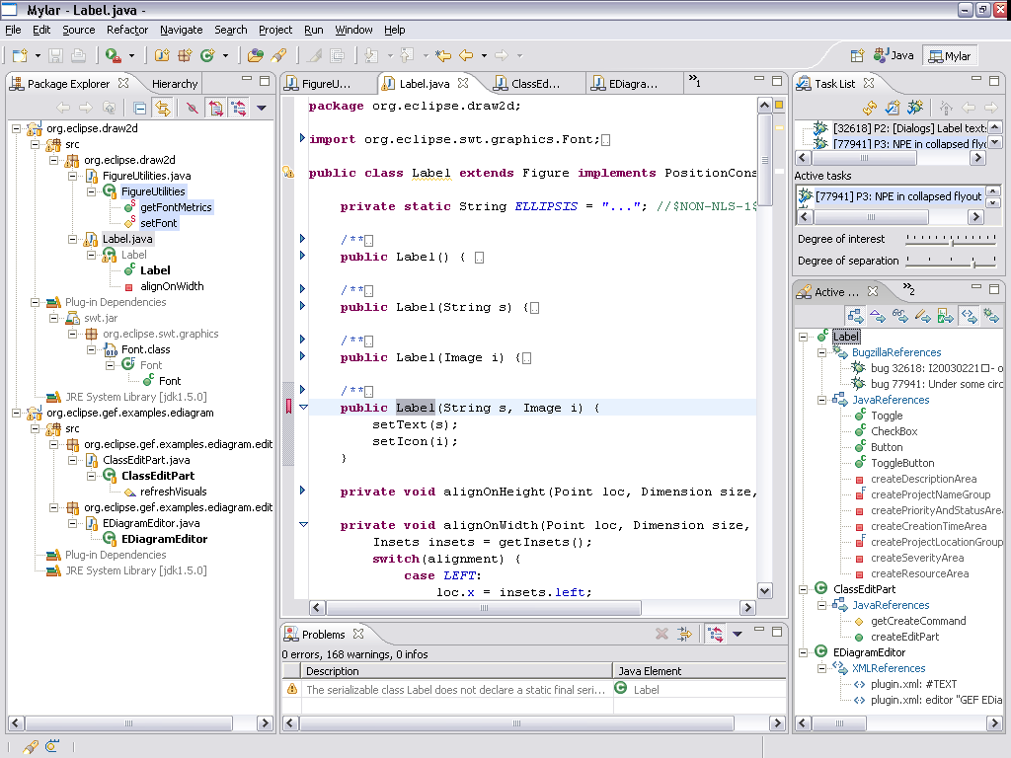
Demo 5
Degree of separation
  Discuss starting context vs. rich context
  Note that there are more bug reports
  More java elements
  Ranking
Bugzilla matches
  Separation is consistent for bug reports, first looks at only interesting reports, then repository
Scaling factor
  I never touched a scrollbar in this demo…
  First make it flash, then do slow and explain

Slide 22
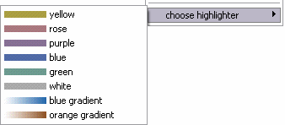
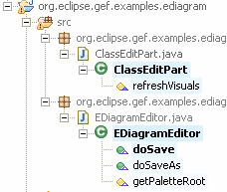
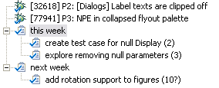
There’s more…
Presentation is configurable
  Highlighters, relative interest,
  intersection
  Landmark decorators
  In-place active views
Views
  Java Browsing, Resource,
  AspectJ
Task management
  Planning game tasks
  Offline editing of bug reports
Seamless integration
  Don’t lose anything: filters, decorators, sorters
  Adopt incrementally: pick and choose the features

Slide 23
breadth
under the hood

Slide 24
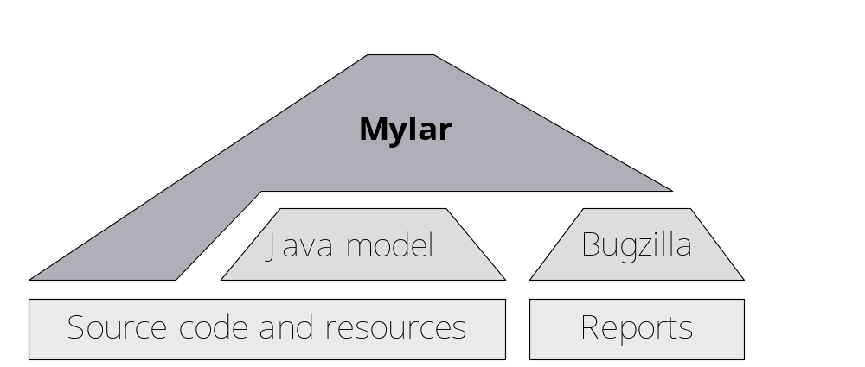
Under the hood
Interest updated as you work
  Periodic decay, active search in background
  Uninteresting files close automatically
Built on existing models
  Reuses Java, XML, and Bugzilla models and search facilities
  Inherently lightweight and lazy structure
Performance characteristics
  Reduces memory
  footprint by limiting
  view population

Slide 25
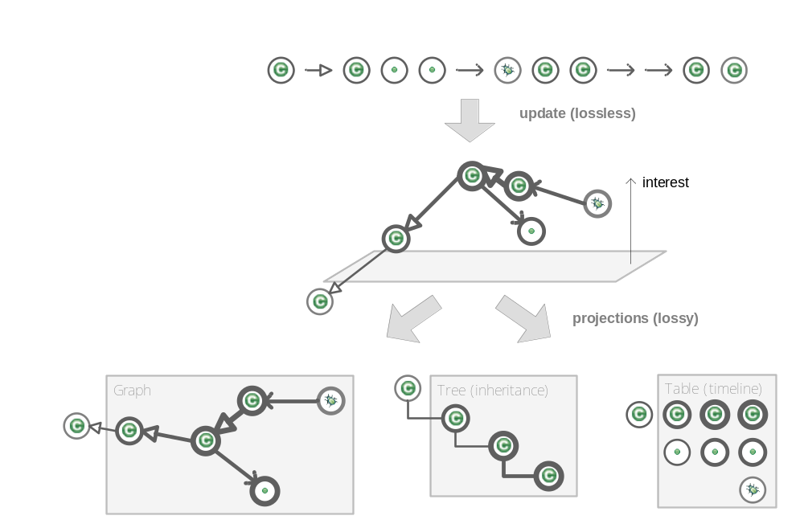
Task context
History
  Event stream
Task context model
  Height: interest of elements
  Arrangement in plane:
  interest of relations
Projections
Notes:
CAREFUL ABOUT HEIGHT, CORRELATING TENSION TO INTEREST
NO STRUCTURAL SEMANTICS IN A TASKSCAPE
TENSION = DOI, DISTANCES HAS NOTHING TO DO WITH STRUCTURAL RELATIONSHIPS…

Slide 26
Once context is explicit…
Treat parts of your system as a unit
Do operations on them
  Work with multiple tasks contexts
    Save and restore
    Union and intersect
  Predict interest of related elements
    API clients
    Overriding methods
    Advice
c
c
d
a
b
b
Notes:
BE MORE CLEAR ABOUT HEIGHT

Slide 27
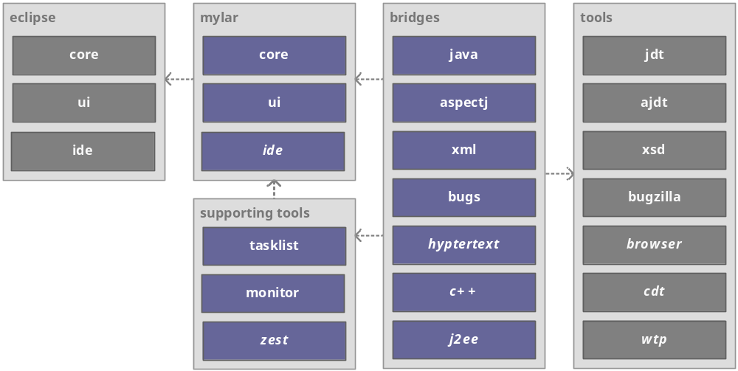
Architecture
Bridges map domain structure to Mylar model and UI
Future plug-ins are italicized

Slide 28
Development experiences
Good modularity in JDT made this possible
  Filters, sorters, content providers, label providers
  Able to subclass existing views and Java editor
  Drive folding, extend search
  Quality, consistency of the Java model was key
But..
  Extending internal APIs
  Overriding existing providers on initialization
  Not able to extend Outline view
  Had to create own in-place view, XML folding

Slide 29
Around the corner
Visualization
  Task context model via Zest (Peggy Storey, Ian Bull, Chris Callendar)
Workspace memory
  Composition and categorization of task contexts
Group memory
  Sharing task context via Bugzilla attachments
  Awareness of team members’ task context
Integration
  J2EE, CDT, web browsing, RCP apps

Slide 30
Summary
Mylar makes task context explicit
  Degree of interest: idea from focus+context views
  Degree of separation: inspired by Kevin Bacon
Makes working with very large projects as easy as it is to work with small projects
Credits
  Mylar Team: Mik Kersten, Shawn Minto, Gail Murphy, Ken Sueda
  Supported by IBM CAS, NSERC, UBC
eclipse.org/mylar questions: mylar-users@eclipse.org

