Slide 1
Mylar
A Task Focused UI for Eclipse
For Eclipse users
  Integrates task management
  Automates context management
For developers and integrators
  Provides framework for tasks and contexts
Mik Kersten, project lead
Eclipse.org Webinar, March 21, 2006, made available under the EPL v1.0
Notes:
Will make you more productive

Slide 2
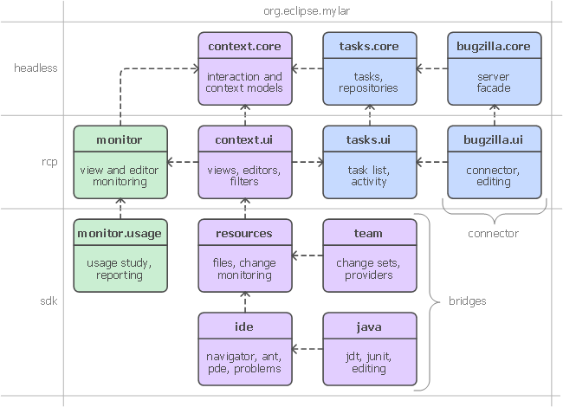
Extensibility

Slide 3
Mylar
Reducing information overload one task at a time
Committers
  Mik Kersten, Rob Elves, Steffen Pingel, Ian Bull, Gail Murphy
Contributors
  Eugene Kuleshov, Jeff Pound, Brock Janiczak, Willian Mitsuda, Nathan Hapke, Raphael Ackermann, Gunnar Wagenknecht, Shawn Minto, Ken Sueda, Wesley Coelho, Leah Findlater
More info
  http://eclipse.org/mylar/publications.php
Notes:
So what Mylar is all about
Bringing tasks and focus to Eclipse
Reducing information overload

