Slide 1
Exhibit A: programmer working in Eclipse
Notes:
Developer working with Eclipse
* This is what a lot of you work with every day
* Switch tasks and you can’t find it
---
Your Eclispe, and the applications you build on top of Eclipse, could look like this.
Mylar: a Task Focused UI for Eclipse

Slide 2
Task-focused programming with
Mylar
Tool
  Integrates task management
  Automates context management
  Reduces information overload
  Makes multi-tasking easy
Framework
  How to build on and integrate with Mylar
Integration
  Showcase of open source and proprietary tools
Mik Kersten and Rob Elves
EclipseCon, 2007 March 6, made available under the EPL v1.0
Notes:
Mylar: a Task Focused UI for Eclipse

Slide 3
Overview
Since last EclipseCon
  16 releases, 1415 bugs resolved, 199 via patches, reached 1.0
  Growing community of passionate users and contributors
Task-focused programming
  Highlights of key features, improved integration and additions
Demos
  Task management
  Task-focused UI
  Collaboration
  Planning
Notes:
Mylar: a Task Focused UI for Eclipse

Slide 4
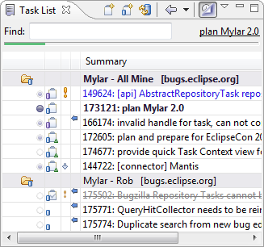

Task management
Before Mylar
  Scattered throughout web apps, code and pieces of paper
  No integration with IDE workflow
One task list
  Manage all your tasks in a single personalized view
  Eclipse’s rich searching, linking and editing facilities
Repository connectors
  Integrate web-based task repositories
  Offline editing and access
  Integrated change notifications
Demo
Notes:
Mylar: a Task Focused UI for Eclipse

Slide 5
Demo 1: Tasks
Task List
  Open “plan and prepare” task with incoming comment
  Make outgoing comment
  Show planning section, make note
  Drag-and-drop attachment
Queries and repositories
  Add query to Eclipse Outliner (non-existing repository)
  Show Browser tab, open query with browser
Integration
  Linking in task editor, in Java editor
  Open task dialog
  Search for all Mylar 2.0M2 bugs
  Create bug from error
Notes:
Mylar: a Task Focused UI for Eclipse

Slide 6
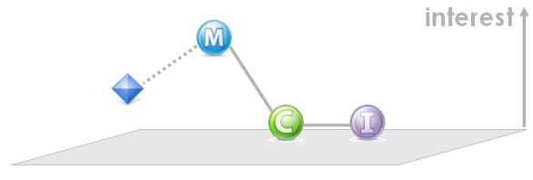
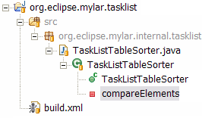

Task-focused UI
Information overload
  Time wasted scrolling, browsing and searching, tagging, filtering
  Constant multi-tasking causes context loss
Task context
  Mylar monitors your interaction
  Creates degree-of-interest model
  What you touch is in your context
  Actively managed as you work
Task-focused UI
  View filtering, element decoration
  Automatic folding, content assist ranking
  Editor and perspective management
  One-click task switching
Demo
Notes:
Mylar: a Task Focused UI for Eclipse

Slide 7
Demo 2: Task context
Activate task
  Unfilter Package Explorer, then Alt+click
  Open ContextCore plug-in
  Navigate to BundleContext, then back
  Ctrl+Space
  Unfilter, Alt+click
  Decay, make less interesting
  Deactivate, activate, editor management
  Open build.xml, filter Outline
Notes:
Mylar: a Task Focused UI for Eclipse

Slide 8
Collaboration
Before Mylar
  Manual management of change sets
  Email overload, interruption, difficulty sharing expertise
Change set management
  Changes are automatically grouped by task
  Commit messages are automatic
  Everything is linked
Task context sharing
  Expertise is captured and can be shared via repository
  Tasks are easy to recall, knowledge easy to share
Demo
Notes:
Mylar: a Task Focused UI for Eclipse

Slide 9
Demo 3: Collaboration
Change sets
  Multiple separate sets
  Commit messages, commit message templates
Linking
  Navigate from History view entry
Context sharing
  Activate a task with server context only
  Work on it, show Context tab, start upload
Notes:
Mylar: a Task Focused UI for Eclipse

Slide 10
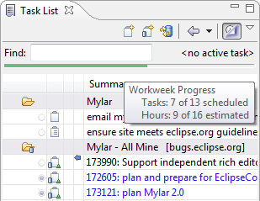
Planning
With Mylar
  Too many tasks end up in your Task List
Personal planning
  Meshes with team planning activities
  Can monitor components and collaborations
Focused workweek
  See only the tasks you need to work on
Demo
Notes:
Mylar: a Task Focused UI for Eclipse

Slide 11
Demo 4: Planning
Notes:
Mylar: a Task Focused UI for Eclipse

Slide 12
Mylar 2.0
Mylar 1.0
  Released in December, provides core integration
Mylar 2.0
  2.0M2 April 30th, 2.0 final with Europa
  Even deeper integration: debugging, XML folding
  More automation: workflow, content assist, streamlining
  Flexible task organization, planning tool integration
Notes:
Mylar: a Task Focused UI for Eclipse

Slide 13
Mylar
Framework
Notes:
Mylar: a Task Focused UI for Eclipse

Slide 14
Mylar Framework
Status
  Mylar 1.0 provided APIs that supported a core set of connectors
  Mylar 2.0 is evolving based on integrator feedback
APIs
  Tasks: task management
  Context: context management
  Team: team provider integration
  Monitor: workbench interaction monitoring
Notes:
Mylar: a Task Focused UI for Eclipse

Slide 15
Tasks API
Goal
  Bring your repositories’ tasks into Eclipse
  Streamline task management user experience across repositories
  Provide customizable behavior with consistent integration
Task repository connectors
  Core facilities: lifecycle, persistence, synchronization
  UI facilities: queries and task editing
  Decide on level of integration: queries only, rich editing
  Reference implementation is Bugzilla
Notes:
Mylar: a Task Focused UI for Eclipse

Slide 16
Context API
Goal
  Connect task context model to domain-specific artifacts
Task context bridges
  Structure bridges: map context to existing models: e.g. JavaModel
  UI bridges: selection/edit/refactoring capture, map to UI
  Reference implementation is Java
Notes:
Mylar: a Task Focused UI for Eclipse

Slide 17
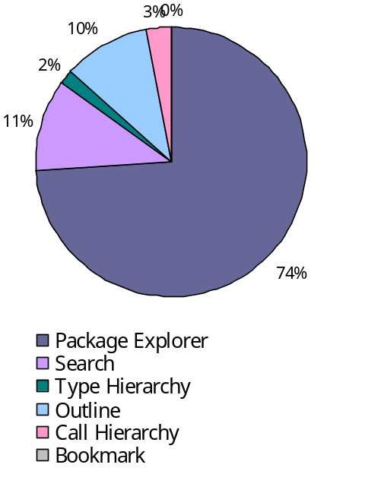
Team & Monitor APIs
Team API
  Provides change set integration, automatic commit messages
  Reference implementation is CVS
  See Eugene’s talk later today
Monitor API
  Captures user’s workbench interaction history
  Monitors views, editors, commands, preferences
  Provides privacy, obfuscation, reporting
  Reference implementation is user study example
Notes:
Mylar: a Task Focused UI for Eclipse

Slide 18
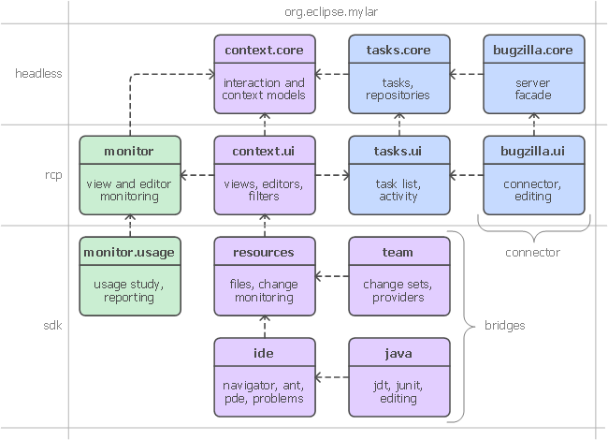
Framework
Notes:
Mylar: a Task Focused UI for Eclipse

Slide 19
Platform for task-focused interaction
Mylar project
  Making tasks the central point for interaction with the IDE
  Continuing to improve the integration of task context with workflow
Research projects
  Eclipse usability monitoring, interaction playback (UBC)
  Visualization and tagging (UVic)
Third parties
  Open source and extensions
  Vendor extensions and bundling
Notes:
Mylar: a Task Focused UI for Eclipse

Slide 20
Integration
Showcase
Notes:
Mylar: a Task Focused UI for Eclipse

Slide 21




Status
Tasks
IssueZilla
Context
CodeBeamer
XPlanner
Ruby
Team
JIRA
Ant
Trac
Java
SVN
Bugzilla
Files
CVS
Eclipse Mylar
Notes:
Build connections between Eclipse Mylar and their proprietary repositories.
We get lots of requests for integration
Some support from OSS community, commercial support is also key
Task context bridges
To come…
Team providers
Free: Subversive, Subclipse
Task repository connectors
Part of project: Bugzilla, JIRA, Trac, [XPlanner]
Free: CodeBeamer, ..
Commercial: CollabNet, Xplanner
Mylar is all about integration
But we spend a lot of time working with the OS…
Todo
What’s really neat about Mylar right now is that the community is growing in multiple directions
Have OSS groups that have provided this
Not always right to do this with open source
People can do this with other ways
Service on the open source, Tasktop helping develop custom solutions like CollabNet
Mylar: a Task Focused UI for Eclipse

Slide 22
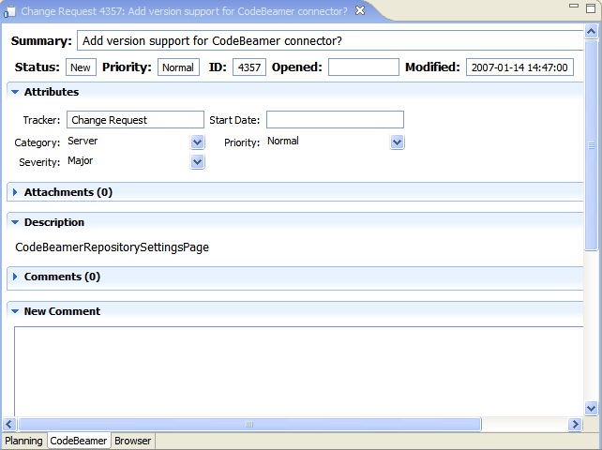
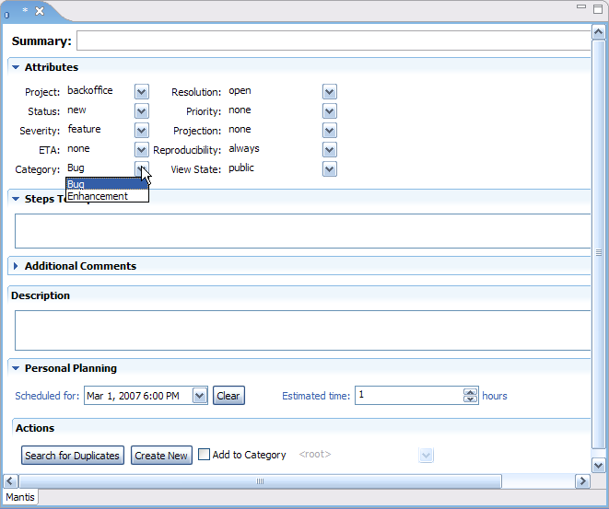
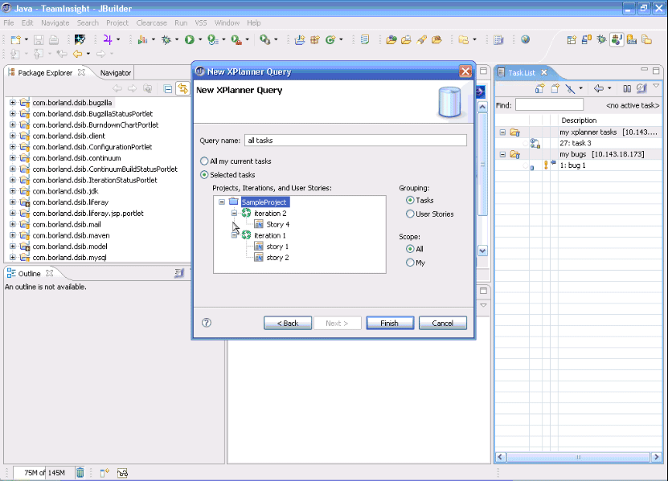
CodeBeamer
by Lubos Pochman
Mantis
by Chris Hane
XPlanner
by CodeGear
Demo

Slide 23
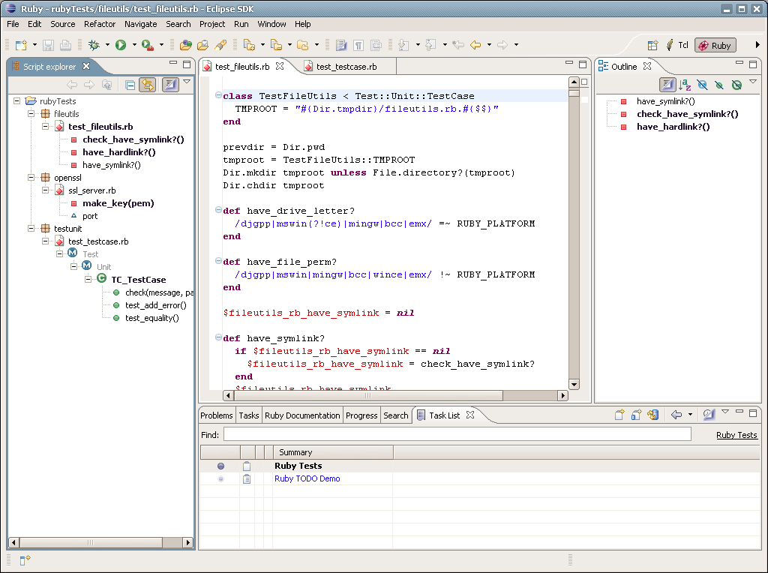
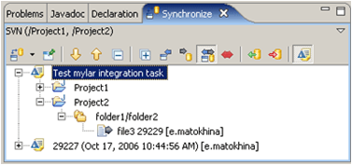
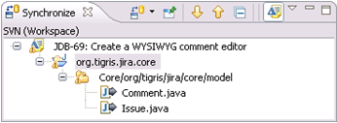
JavaScript
by eclipse.org/dltk
SVN
by Polarion
SVN
by Subcipse

Slide 24
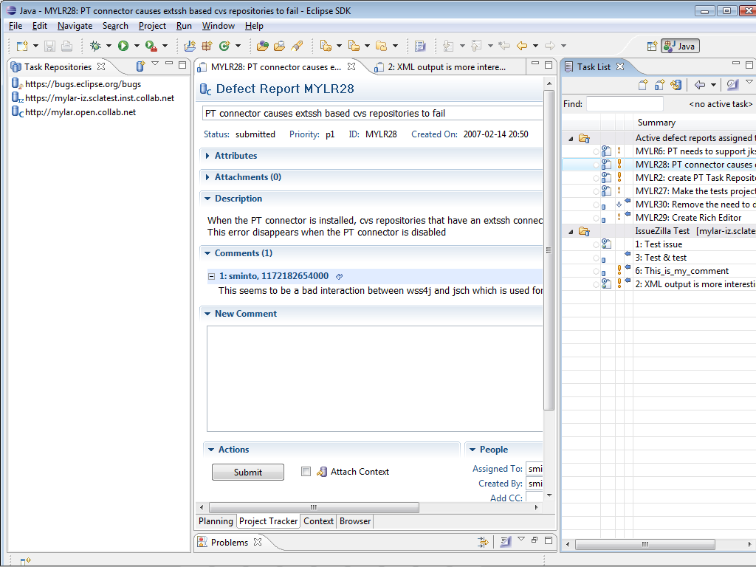
Demo 5: Integration
Project Tracker
  Download saved queries
IssueZilla
  Open query
Notes:
Mylar: a Task Focused UI for Eclipse

Slide 25


















Community needs
…
ScrumWorks
…
Tasks
Context
Team
Tasktop
CodeBeamer
C++
…
XPlanner
Ruby
ClearCase
JIRA
Ant
Perforce
Email
Trac
Java
SVN
Web
Bugzilla
Files
CVS
Desktop
Eclipse Mylar
Notes:
Previously volunteers
Company dedicated to the success of the project, 1/3 of our developers are committers, which ½ the project
Plug-ins that use the Mylar APIs
Mylar: a Task Focused UI for Eclipse

Slide 26
Demo 6: Tasktop
Email & windows
  Create task from “Eclipse Forum India” email
  Navigate to link, activate, deactivate
  Alt+click to find Talk Abstracts.doc
  Activate and deactivate
  Dock
Calendar
  Next event, planning
Browsing
  Click task in Thunderbird, opens via Mylar
Notes:
Mylar: a Task Focused UI for Eclipse

Slide 27
Changing how we work
Once tasks are explicit
  Dramatic reduction in information overload
  Information you need to get work done is at your finger tips
  Multitasking and recalling old tasks become effortless
  UI automation (e.g. working sets, search, commit messages)
  Keeps you in Eclipse and out of your browser and inbox
Validated technology
  Statistically significant increase in programmer productivity
  Task context model supports generic knowledge work
The framework is open and growing
  Mylar is all about integration
Notes:
Mylar: a Task Focused UI for Eclipse
[last year]
Showed that we can do this
Now: there is a framework
Not as much cut and pasting, back/forward nav, open type, search
Get interrupted by a patch, apply it, back where you left off
Without Mylar have to remember tons of structure (e.g. type names)
No more watching <component>-inbox [picture of toaster]
I have to remind myself to turn it off now and then
When not to use it
Reviewing package structure, comment clean-up
Now you might be wonder how we know this information..

Slide 28
Mylar
Talk to the committers
  Mik Kersten, Rob Elves, Steffen Pingel and Eugene Kuleshov
See the sessions
  Mylar, XPlanner and Scrum (Tue 13:40)
  Team version control mashup with Mylar (Tue. 17:00)
  The 2006 Google Summer of Code at Eclipse (Tue. 13:30)
  Mylar BOF (Tue. 19:30, room 206)
  Task-Focused Desktop BOF (Tue. 20:45, Theater)
  Collaboration through Task Contexts poster (Wed. 17:20)
Notes:
Mylar: a Task Focused UI for Eclipse

Slide 29

Notes:
Mylar: a Task Focused UI for Eclipse

Slide 30
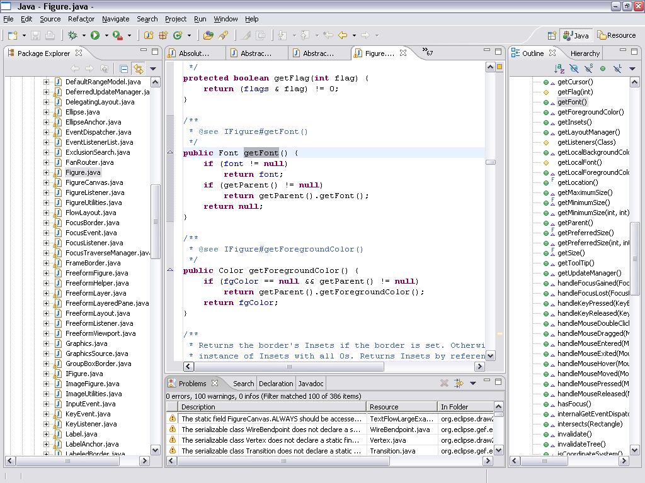
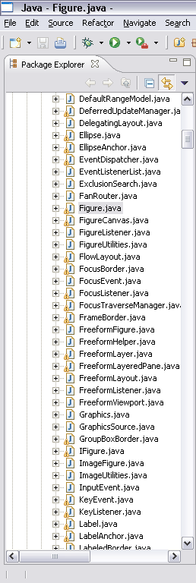
Information Overload
Hard to see the forest through the trees
Repetitive scrolling, searching, navigating
Notes:
Mylar: a Task Focused UI for Eclipse
But our systems have scaled, as has Eclipse’s performance
-

Slide 31
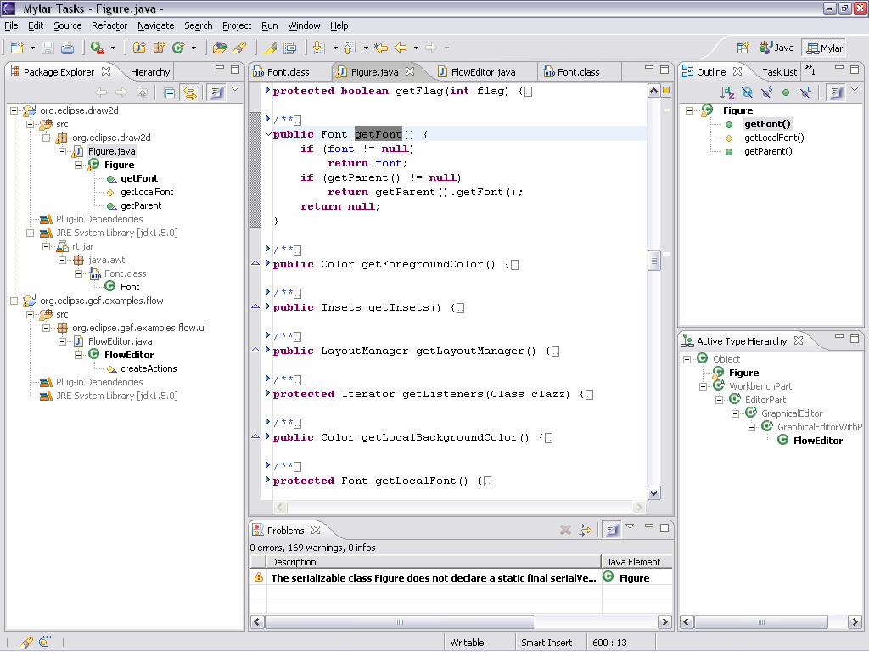
Mylar
see only what you’re working on
Aluminized film used to avoid blindness when staring at an eclipse
Task Focused UI to avoid information blindness when staring at Eclipse
Notes:
Mylar: a Task Focused UI for Eclipse
For any task that we work on, we only care about a
subset of the system
Mylar makes that subset explicit
All you need to do is indicate what task you’re working on
Via task management and issue tracker integration
Task context model is created automatically
Transparently monitors your programming activity
Filtered views show what you expect

Slide 32





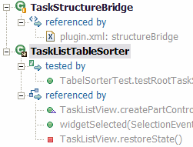
Task context model
Interaction history
  InteractionEvent stream
  Origin, handle, type, date
Context (Core)
  Degree-of-interest graph
  Degree-of-separation scope
Display (UI)
  Views, editors, files
interest
Notes:
Mylar: a Task Focused UI for Eclipse
All the things you might want to do the architecture has flexibilty for

