Slide 1
Mylyn 3.2 Release Review
Mik Kersten and Steffen Pingel
Planned Review Date: June 10, 2009, 8am PT
Communication Channel: mylyn-dev@eclipse.org
Notes:
Mylyn Release Review

Slide 2
Introduction
The first goal of Mylyn is to make task and context management seamlessly integrated with the Eclipse Platform by providing rich and extensible frameworks for task repository connectors, structure bridges and team support.
The second goal is to provide a reference implementation of the Task-Focused UI for the Eclipse SDK. This includes structure bridges for the artifacts supported by the SDK which include Java, PDE, Ant and generic files. It also includes the Bugzilla Connector as the reference task repository implementation, and CVS integration as the reference team support. Additional features can be considered based on the availability community contributions and resources.
Notes:
Mylyn Release Review

Slide 3
Main Features added since 3.0
WikiText provides an integrated source editor for authoring files containing wiki markup. The editor provides content assist, validation, folding, source formatting, an integrated preview, structured outline and a markup cheat-sheet. It is aware of 5 markup languages and is capable of supporting others via the common WikiText parsing framework.
WikiText can convert lightweight markup to other formats including Eclipse Help, HTML, DocBook and DITA. Conversion may be performed within Eclipse or from Ant.
Access to the Mylyn Connector Discovery Portal is provided on Eclipse 3.5 when creating task repositories. Selected extensions are available for installation through a wizard based work-flow that drives P2.
The integrated bug reporting has an extension point for specifying support providers and supported products. The extensions are used to guide the user when bugs are reported from error log entries.
Help content that is generated from the Wiki using WikiText is available in the Eclipse help system.
Notes:
Mylyn Release Review

Slide 4
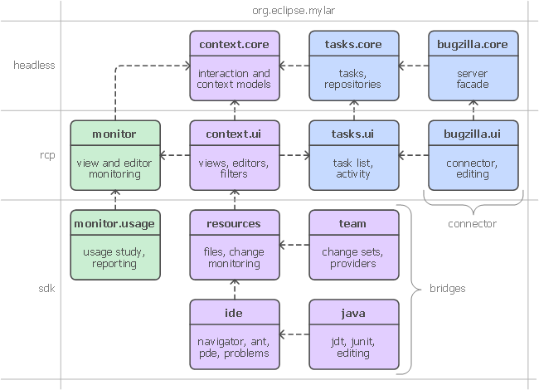
APIs
No breaking API changes from 3.0
APIs are consumed by 3rd parties who provide regular feedback
All API changes are tracked in Bugzilla on bugs tagged as [api]
  Notes on API additions since Mylyn 3.0: http://wiki.eclipse.org/Mylyn/Porting_Guide
Frameworks:
  Commons API
  Context API
  Tasks API
  Monitor API
  Team API
  WikiText API
Notes:
Mylyn Release Review

