Slide 1
Mylyn 3.8 Release Review
Mylyn Builds, Mylyn Reviews, Mylyn Versions Graduation Review
Planned Review Date: June 13, 2012
Communication Channel: mylyn-dev@eclipse.org
Notes:
Mylyn Release Review
Mylyn Release Review
Mylyn Release Review

Slide 2
Introduction
The Mylyn Application Lifecycle Tools Top-Level Project is an open source collaborative software development project dedicated to providing an extensible, standards-based platform to address a broad range of needs of accessing task and application lifecycle management tools and services using the Eclipse platform.
The mission of the project is to provide:
  Frameworks and APIs for Eclipse-based task and Application Lifecycle Management (ALM)
  Exemplary tools for task-focused programming within the Eclipse IDE.
  Reference implementations for open source ALM tools used by the Eclipse community and for open ALM standards such as OSLC
Notes:
Mylyn Release Review
Mylyn Release Review
Mylyn Release Review

Slide 3
Overview
The Mylyn project was created in 2005 as a Technology project and moved to the Tools top-level project in 2007. Mylyn was restructured and promoted to a top-level project in 2010.
In order to keep up with its rate of adoption, the Mylyn project is continuing to evolve APIs for Application Lifecycle Management (ALM) tools. Since its inception, Mylyn has released multiple times per annual release cycle, and is continuing to do that for Juno.
Notes:
Mylyn Release Review
Mylyn Release Review
Mylyn Release Review

Slide 4
Graduation
The following sub-projects are releasing a 1.0 version and are graduating as part of the Mylyn 3.8 release:
  Mylyn Builds
  Mylyn Reviews
  Mylyn Versions
The Mylyn Reviews project was created in 2009. The Mylyn Builds and Mylyn Versions projects were created in 2010 as part of the Mylyn top-level restructuring.
Notes:
Mylyn Release Review
Mylyn Release Review
Mylyn Release Review

Slide 5
Graduation: Code Base
All three sub-projects, Mylyn Builds, Mylyn Reviews and Mylyn Versions, have released three major versions, 0.7, 0.8 and 0.9, so far in addition to intermediate service releases. Each project provides a framework and one or more reference implementations which are listed on the release slides.
The APIs and frameworks have been validated and evolved through community feedback. The projects are using the Eclipse.org Gerrit to facilitate code reviews and contributions.
The coding guidelines are consistent with other Mylyn sub-projects and requirements for the Eclipse release train have been implemented.
Notes:
Mylyn Release Review
Mylyn Release Review
Mylyn Release Review

Slide 6
Graduation: Community
All development is transparently tracked in Bugzilla. Each sub-project has a mailing list for developer communication in addition to the weekly Mylyn conference call.
The user and adopter communities regularly provide feedback through Bugzilla and other support channels such as the Mylyn news group.
Project plans are linked from the website of each project and are updated regularly. Release plans are aligned with the Mylyn top-level plan which aggregates all Mylyn sub-projects in a Mylyn release train.
Notes:
Mylyn Release Review
Mylyn Release Review
Mylyn Release Review

Slide 7
Graduation: Adoption
The framework and reference implementations are being adopted by the community within and outside of Eclipse.org.
  The Hudson/Jenkins connector is included in the Java and RCP EPP packages and shipped in commercial products.
  The Mylyn Builds framework is extended by the Redhat Koji connector which is hosted outside of Eclipse.org.
  The Gerrit connector is included in RCP EPP package.
  The Mylyn Reviews framework is extended by the ReviewBoard connector which is hosted outside of Eclipse.org.
  The EGit connector is included in the Java and RCP EPP packages.
Notes:
Mylyn Release Review
Mylyn Release Review
Mylyn Release Review

Slide 8
Release
The Mylyn 3.8 release is contributed to the Eclipse Juno release and includes the following sub-projects:
  Mylyn Builds
  Mylyn Commons
  Mylyn Context
  Mylyn Docs
  Mylyn Reviews
  Mylyn Tasks
  Mylyn Versions
Project Plan:
  http://eclipse.org/projects/project-plan.php?projectid=mylyn
New Features
  http://eclipse.org/mylyn/new/weekly.php
Notes:
Mylyn Release Review
Mylyn Release Review
Mylyn Release Review

Slide 9
Mylyn Builds
Deliverables included in Mylyn Builds 1.0:
  Builds Framework
  Hudson/Jenkins Connector
Project Plan:
  http://eclipse.org/projects/project-plan.php?projectid=mylyn.builds
Supported Build Servers:
  Hudson 2.2.1
  Jenkins 1.427.1
New Features:
  Hudson 3.0 M2 is supported.
Notes:
Mylyn Release Review
Mylyn Release Review
Mylyn Release Review

Slide 10
Mylyn Commons
Deliverables included in Mylyn Commons 3.8:
  Discovery Framework
  Identity Framework
  Interaction Monitoring Framework
  Notification Framework
  Repository Framework
  Transport Framework
  HTTP Transport
  SOAP Transport
  XML-RPC Transport
  UI Toolkit
Project Plan:
  http://eclipse.org/projects/project-plan.php?projectid=mylyn.commons
Notes:
Mylyn Release Review
Mylyn Release Review
Mylyn Release Review

Slide 11
Mylyn Commons
New Features:
  Deprecated internal provisional classes have been removed.
Notes:
Mylyn Release Review
Mylyn Release Review
Mylyn Release Review

Slide 12
Mylyn Context
Deliverables included in Mylyn Context 3.8:
  Context Framework
  Java Bridge
  C/C++ Bridge
  PDE Bridge
  Resource Bridge
  IDE Integration
Project Plan:
  http://eclipse.org/projects/project-plan.php?projectid=mylyn.context
New Features:
  Compatibility issues with Code Recommenders have been addressed.
Notes:
Mylyn Release Review
Mylyn Release Review
Mylyn Release Review

Slide 13
Mylyn Docs
Deliverables included in Mylyn Docs 1.7:
  EPUB
  HtmlText
  WikiText
Project Plan:
  http://eclipse.org/projects/project-plan.php?projectid=mylyn.docs
Supported markup languages:
  Creole, Confluence, MediaWiki, Textile, TracWiki and Twiki.
New Features:
  EPUB support has been added to the distribution.
Notes:
Mylyn Release Review
Mylyn Release Review
Mylyn Release Review

Slide 14
Mylyn Incubator
Mylyn Incubator does not do releases by definition and does not participate in Mylyn releases.
Notes:
Mylyn Release Review
Mylyn Release Review
Mylyn Release Review

Slide 15
Mylyn Reviews
Deliverables included in Mylyn Reviews 1.0:
  Gerrit Connector
  Reviews Framework
Project Plan:
  http://eclipse.org/projects/project-plan.php?projectid=mylyn.reviews
Supported Review Systems:
  Gerrit 2.3, 2.4
New Features:
  Gerrit 2.3 and 2.4 are supported.
Notes:
Mylyn Release Review
Mylyn Release Review
Mylyn Release Review

Slide 16
Mylyn Tasks
Deliverables included in Mylyn Tasks 3.8:
  Bugzilla Connector
  Tasks Framework
  Trac Connector
Project Plan:
  http://eclipse.org/projects/project-plan.php?projectid=mylyn.tasks
Supported Task Repositories:
  Bugzilla 3.6.9, 4.0.6, 4.2.1
  Trac 0.11.7, 0.12.3
New Features
  Support for Eclipse 4.2 has been improved.
  Provisional classes have been promoted to API.
Notes:
Mylyn Release Review
Mylyn Release Review
Mylyn Release Review

Slide 17
Mylyn Versions
Deliverables included in Mylyn Versions 1.0:
  CVS Connector
  Git Connector
  Subclipse Connector
Project Plan:
  http://eclipse.org/projects/project-plan.php?projectid=mylyn.versions
New Features:
  The Subclipse connector has been added to the distribution.
Notes:
Mylyn Release Review
Mylyn Release Review
Mylyn Release Review

Slide 18
Non-code aspects(1)
Localization/externalization
  The code base has been externalized for Mylyn 3.1.
  Mylyn is now available for translation via Eclipse Babel.
User documentation
  Eclipse help content that is generated from the Wiki has been added for Mylyn 3.1.
  The webinar on Mylyn 3.0 is the most viewed webinar on Eclipse Live.
  The web site has been restructured for easier access to Downloads, Support and Getting Started documentation.
Developer documentation
  Wiki-based Contributors Guide
  Wiki-based Integrators Guide
Notes:
Mylyn Release Review
Mylyn Release Review
Mylyn Release Review

Slide 19
Non-code aspects(2)
Release Engineering
  The build system is based on Maven Tycho.
Continuous Integration
  Tests are executed on a regular schedule on the Eclipse.org Hudson instance
  Test results and build artifacts are available to anyone.
Notes:
Mylyn Release Review
Mylyn Release Review
Mylyn Release Review

Slide 20
APIs
No breaking API changes from 3.0
API tooling is used to verify that binary backwards compatibility is maintained and no API regressions are introduced.
APIs are consumed by 3rd parties who provide regular feedback
All API changes are tracked in Bugzilla on bugs tagged as [api]
  Notes on API additions since Mylyn 3.0: http://wiki.eclipse.org/Mylyn/Porting_Guide
Connector core APIs are available to standalone environments and do not require an OSGi container
Notes:
Mylyn Release Review
Mylyn Release Review
Mylyn Release Review

Slide 21
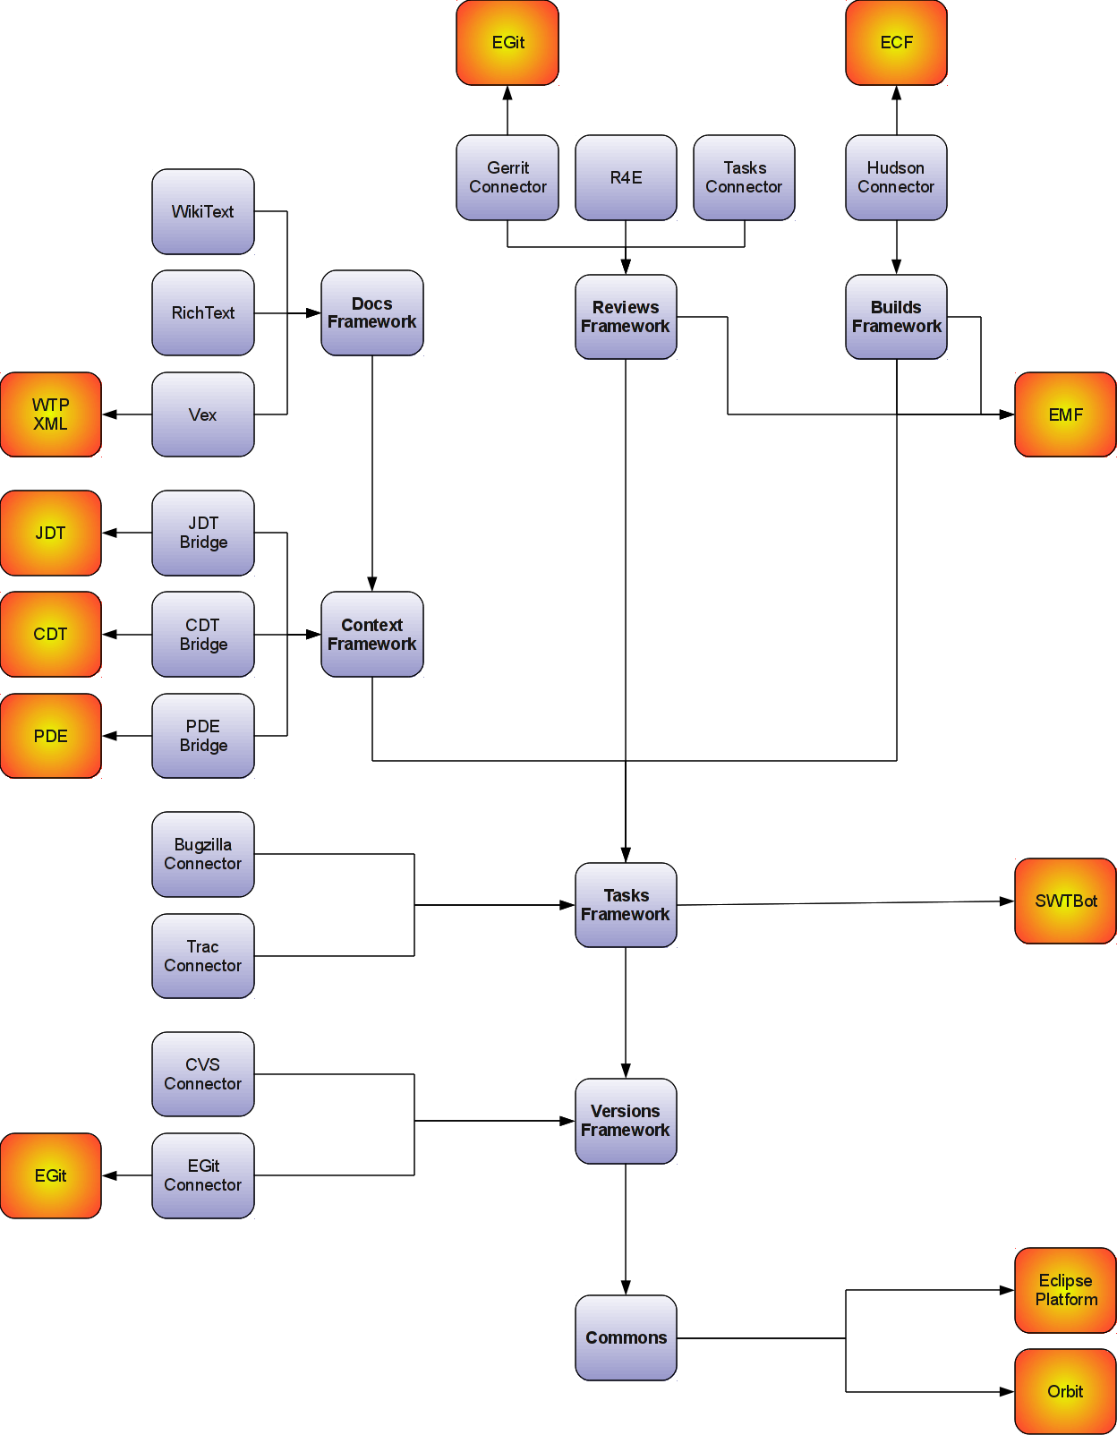
Frameworks
  Builds API
  Commons API
    Repository API
    Identity API
    Monitor API
  Context API
  Reviews API
  Tasks API
    Team API
  Versions API
  WikiText API
Notes:
Mylyn Release Review
Mylyn Release Review
Mylyn Release Review

Slide 22
Architectural Issues
  Components in Mylyn Commons were restructured and provisional packages were promoted to API. Consumers are strongly encouraged to consume the new APIs for Mylyn 3.7 based extensions. The Porting Guide at http://wiki.eclipse.org/Mylyn/Porting_Guide#Mylyn_Commons has more details.
  Internal provisional packages that were deprecated in Mylyn 3.7 were removed in Mylyn 3.8.
Notes:
Mylyn Release Review
Mylyn Release Review
Mylyn Release Review

Slide 23
Tool Usability (Unchanged since 3.0)‏
Maturity
  Constant stream of stable releases
  Bundled as part of EPP distributions
  Committers work from HEAD, contributors from weekly builds, community from milestone releases
User feedback says it best
  "..arguably the most productivity-enhancing idea since background compilation and all of the things that enables (namely refactoring and syntax highlighting). I just don't know how I ever was able to read and understand the Eclipse sources (or the sources of other large projects I've worked on) before Mylar, it's just that good.“ (David Orme)‏
  “I would like to commend you on this very good tool. It has increased my productivity by 3 folds - no kidding...” (Deepak Devje)‏
Notes:
Mylyn Release Review
Mylyn Release Review
Mylyn Release Review

Slide 24
End-of-Life
Active Streams:
Mylyn 3.8 supports Eclipse 4.2, 3.8 and 3.7
End-of-Live Streams:
Mylyn 3.7 supports Eclipse 3.8, 3.7, and 3.6
Notes:
Mylyn Release Review
Mylyn Release Review
Mylyn Release Review

Slide 25
Bugzilla
Bugs resolved
  Mylyn 3.8 (June 27, 2012): 77 (as of June 5, 2012)
  Mylyn 3.7 (March 21, 2012): 341
  Mylyn 3.6 (June 22, 2011): 91
  Mylyn 3.5 (March 16, 2011): 324
  Mylyn 3.4 (June 23, 2010): 171
  Mylyn 3.3 (Oct. 26th, 2009): 166
  Mylyn 3.2 (June 24, 2009): 333‏
  Mylyn 3.1 (March 4, 2009): 431
  Mylyn 3.0 (June 25, 2008): 493
Notes:
Mylyn Release Review
Mylyn Release Review
Mylyn Release Review

Slide 26
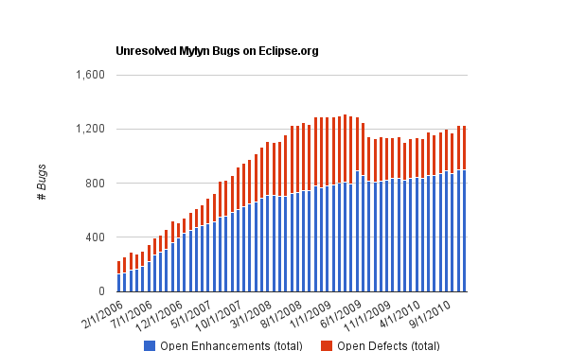
Community
Notes:
Mylyn Release Review
Mylyn Release Review

Slide 27
Standards (Unchanged since 3.1)‏
Mylyn requires J2SE 1.5, provides warning if installed on 1.4
  Key driver for using1.5 was the benefits of generics-aware APIs
Notes:
Mylyn Release Review
Mylyn Release Review
Mylyn Release Review

Slide 28
UI Usability (Unchanged since 2.1)‏
Accessibility
  No review for this release, but following accessibility guidelines
  http://www.eclipse.org/articles/Article-Accessibility/index.html
Follow the User Interface Guidelines
  Focus on consistent visual design, UI elements, icons
  http://wiki.eclipse.org/index.php/User_Interface_Guidelines
Validated UI usability with field study
  For details see:
  http://kerstens.org/mik/publications/2006-11-mylar-fse.pdf
  Mylyn Monitor is being used to gather usage feedback: http://mylyn.eclipse.org/monitor/upload/UsageAnalysisServlet
Notes:
Mylyn Release Review
Mylyn Release Review
Mylyn Release Review

Slide 29
Schedule
Project plan: http://www.eclipse.org/projects/project-plan.php?projectid=mylyn
Release | Date | Platform Release | Notes
Mylyn 3.7 | March 21, 2012 | Eclipse 3.6.2, 3.7.2, 3.8M6 | Juno M6
Mylyn 3.7.1 | April 25, 2012 | Eclipse 3.6.2, 3.7.2, 3.8M6
Mylyn 3.8 | June 27, 2012 | Eclipse 4.2, 3.8.2, 3.7.2 | Juno
Mylyn 3.8.1 | July 29, 2012 | Eclipse 4.2, 3.8.2, 3.7.2
Mylyn 3.8.2 | September 28, 2012 | Eclipse 4.2.1, 3.8.2, 3.7.2 | Juno SR1
Mylyn 3.8.3 | February 22, 2013 | Eclipse 4.2.2, 3.8.2, 3.7.2 | Juno SR2
Notes:
Mylyn Release Review
Mylyn Release Review
Mylyn Release Review

Slide 30
Communities
Users
  Lively community on newsgroup and bug reports
  Articles and blogs by community members
Developers
  Contributor documentation on Eclipsepedia
  Lively community on mylyn-dev and bug reports
Integrators
  Integrator documentation on Eclipsepedia
  Separate mylyn-integrators mailing list removes need for integrators to watch the higher-traffic mylyn-dev
  Specific discussions on “[connector]” and “[bridge]” bug reports, as well as “manage integration with Foobar” bug reports
Notes:
Mylyn Release Review
Mylyn Release Review
Mylyn Release Review

Slide 31
Projects and Committers
Torkild U. Resheim has joined the Mylyn Docs project as a committer.
The R4E component which was part of the Mylyn Reviews has project has been promoted to a sub-sub-project.
The Vex and Mylyn Intent projects have been created under Mylyn Docs.
The Model Focusing Tools project has been created under Mylyn Context.
Sam Davis and David Green have joined the Mylyn Tasks project as committers.
Notes:
Mylyn Release Review
Mylyn Release Review
Mylyn Release Review

Slide 32
IP Log
Contributions are tracked in Git commits through setting the commit author accordingly or flagged as +iplog as they are applied.
Aggregated IP log:
  http://eclipse.org/projects/ip_log.php?projectid=mylyn,mylyn.builds,mylyn.commons,mylyn.context,mylyn.docs,mylyn.reviews,mylyn.tasks,mylyn.versions
Sub-project IP logs:
  Mylyn Builds: http://eclipse.org/projects/ip_log.php?projectid=mylyn.builds
  Mylyn Commons: http://eclipse.org/projects/ip_log.php?projectid=mylyn.commons
  Mylyn Context: http://eclipse.org/projects/ip_log.php?projectid=mylyn.context
  Mylyn Docs: http://eclipse.org/projects/ip_log.php?projectid=mylyn.docs
  Mylyn Reviews: http://eclipse.org/projects/ip_log.php?projectid=mylyn.reviews
  Mylyn Tasks: http://eclipse.org/projects/ip_log.php?projectid=mylyn.tasks
  Mylyn Versions: http://eclipse.org/projects/ip_log.php?projectid=mylyn.versions
Notes:
Mylyn Release Review
Mylyn Release Review
Mylyn Release Review

Slide 33
IP Log(2)
Mylyn Commons, Mylyn Context, Mylyn Docs, and Mylyn Tasks ship code that was migrated from the Mylyn tools project for which contributions were tracked in a CSV file located at http://www.eclipse.org/mylyn/doc/mylyn-iplog.csv.
Since the 3.4.3 release contributions are tracked through the automatic IP log but contributions applied in earlier releases are listed in the CSV file. It is planned to flag contributions listed in the IP log for a future release to fully migrate to the automatic IP log.
Notes:
Mylyn Release Review
Mylyn Release Review
Mylyn Release Review

Slide 34
IP Issues
None.
Notes:
Mylyn Release Review
Mylyn Release Review
Mylyn Release Review

Slide 35
Release review version
These slides are based on the following version of the Release review document
  Version 032 – January 15, 2006
Notes:
Mylyn Release Review
Mylyn Release Review
Mylyn Release Review

