Slide 1
Mylar a Task Focused UI for Eclipse
talk overview only
Mik Kersten
University of British Columbia
Mylar Project Lead

Slide 2
Mylar
What is it?
  A new UI technology that focuses Eclipse on the task at hand
Why do I care?
  Eclipse users
    It makes you more productive when programming
    Tasks become explicit and easy to work with
  Eclipse developers and integrators
    Does for tasks and contexts what the SDK does for resources: makes them first class entities that you can build on

Slide 3
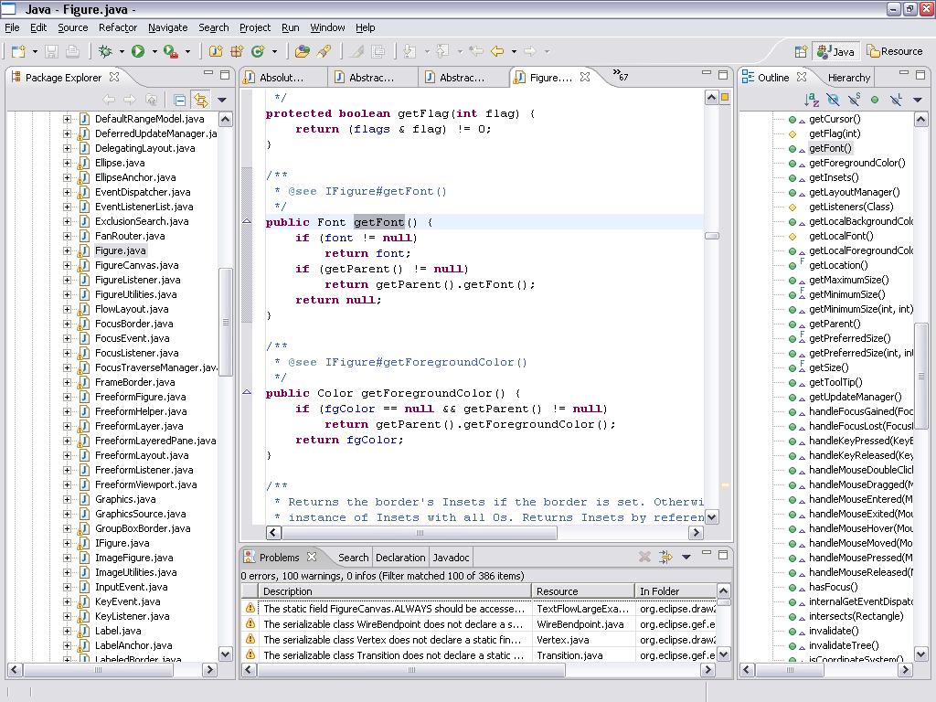
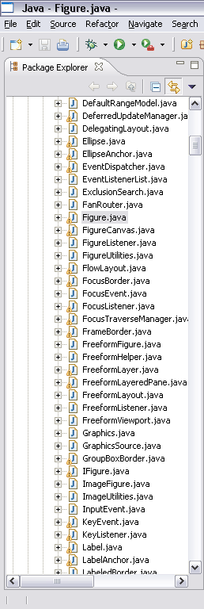
Without Mylar - information overload
With large workspaces, Eclipse views can fail to show the
forest for the trees
  Structure related to
  the task at hand
  is not explicit
  Time wasted
    Scrolling
    Searching
    Navigating

Slide 4
With Mylar - see just the information you need
For any task that we work on, we only care about a
subset of the system
  Mylar makes that subset explicit
All you need to do is indicate what task you’re working on
  Via task management and issue tracker integration
Task context model is created automatically
  Transparently monitors your programming activity
  Filtered views show what you expect

Slide 5
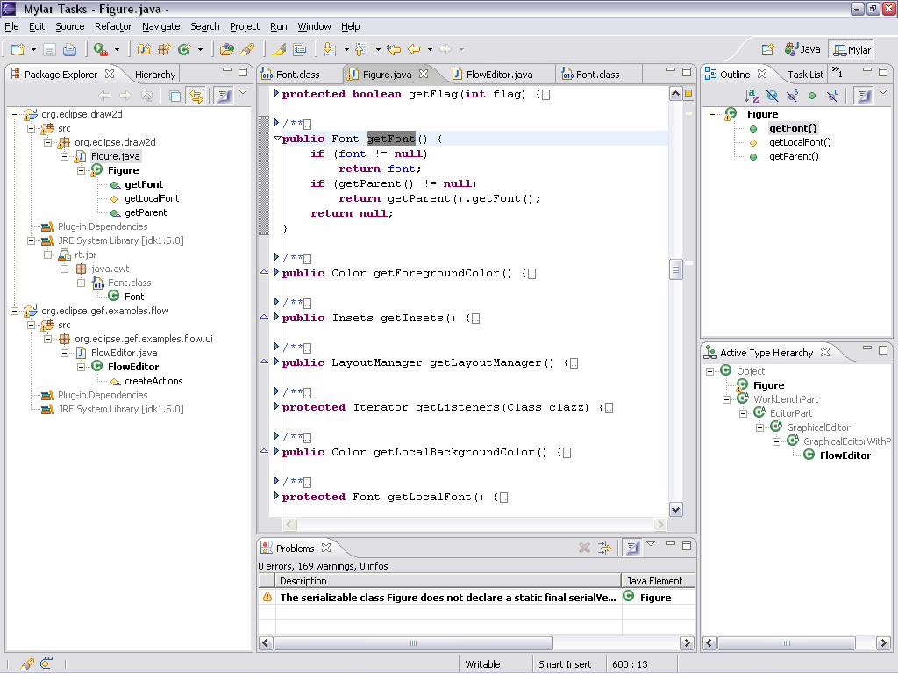
Mylar shows you only what you are working on

Slide 6
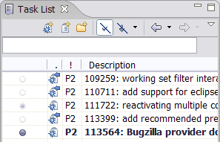
Talk will be about
Working with Mylar
  Makes working with tasks easy
    Personal tasks and planning
    Repository integration (Bugzilla, JIRA)
  Focuses the Eclipse UI on your task
    Views show only the elements relevant to the task-at-hand
    Java editor automatically folds away uninteresting elements
    Active Search shows related elements Java and XML files
    JUnit integration maintains a suite for your current context
    CVS integration enables synchronizing only the relevant resources
Building on Mylar
  Repository integration: connectors API
  Structure integration: bridges API
  UI integration: managed views and editors

Slide 7
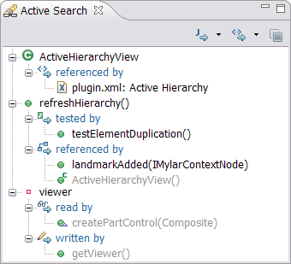
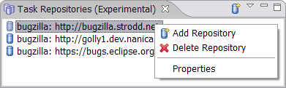
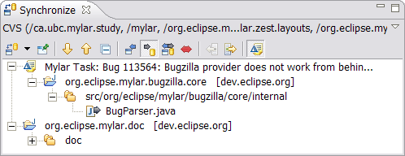
Demos
Views and editors
  Focusing JDT/SDK views, editor management, active views
  Working with Java, XML, and resources
Managing tasks
  Queries, categories, filtering, editing, web
Repository integration,
  Bugzilla, JIRA, web tasks
Working with contexts
  Recalling contexts, history,
  progress, planning
Team support
  Change sets, patching, pair
  programming, reporting

Slide 8
Under the hood
Concepts
  Mylar monitors your activity to encode an interaction history
  Uses this history to form a context for a task
  Context assigns a degree of interest to every element and relation
Implementation
  Structure bridges integrate context with existing models (e.g. Java)
  UI facilities: filters, decorators, managed views and editors,
  interest projection
  Task abstractions
  Mylar monitor

Slide 9
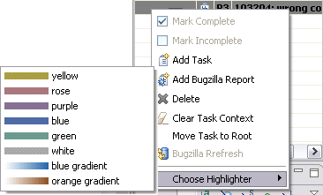
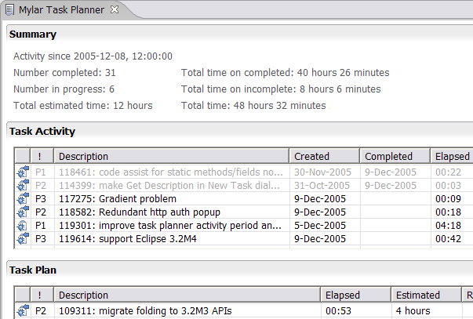
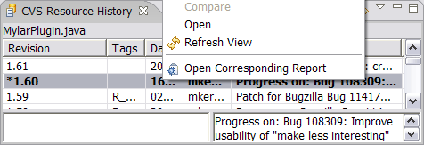
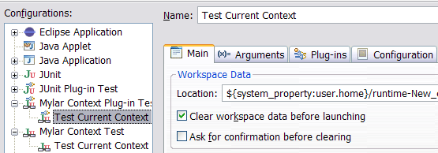
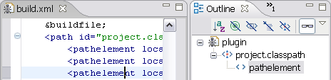
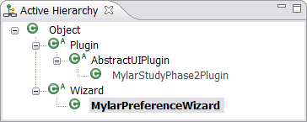
Lot’s more…
Come to the presentation to see the rest!

