Slide 1
Mylyn 2.1 Release Review
Mylyn Move Review
Mik Kersten
November 7, 2007
Notes:
Mylyn Release Review

Slide 2
Move from Tools to Technology
In December Mylyn had a successful 1.0 release and left incubation status
Communities have grown rapidly since, included with EPP as part of 2.0 release
Best home was determined to be the Tools project
  http://dev.eclipse.org/mhonarc/lists/tools-pmc/msg00158.html
Move was done as part of the Mylar to Mylyn rename
Notes:
Mylyn Release Review

Slide 3
Features (unchanged from 2.0)
Task List (org.eclipse.mylyn.tasks.*)
  Integrated tasks management for Eclipse (required)
  Task management view, rich editing, offline support
Task-Focused UI (org.eclipse.mylyn.context.*)
  Automated context management (optional)
Bugzilla Connector (org.eclipse.mylyn.bugzilla.*)
  Integrates Task List with Bugzilla repository (optional)
JIRA Connector (org.eclipse.mylyn.jira.*)
  Integrates Task List with JIRA repository (optional)
Trac Connector (org.eclipse.mylyn.trac.*)
  Integrates Task List with Trac repository (optional)
Notes:
Mylyn Release Review

Slide 4
Non-code aspects (unchanged from 2.0)
User documentation
  Considerable body of user documentation
  Wiki-based FAQ, User Guide, and Tips & Tricks
  Web site: getting started, articles, flash videos, webinar
Developer documentation
  Wiki-based Contributors Guide
  Wik-based Integrators Guide
Localization/externalization
  In spite of large adoption by non-English countries, still no requests or votes for alternate languages, so postponed post 2.0
Notes:
Mylyn Release Review

Slide 5
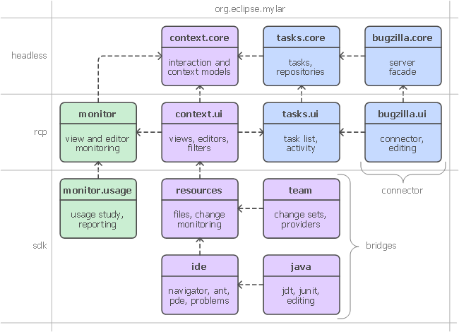
APIs
Details in porting guide: http://wiki.eclipse.org/Mylyn_Porting_Guide
No breaking changes
Three frameworks
  Tasks
  Context
  Monitor
  Team
  (not visible)
  Each has
  multiple
  clients
Notes:
Mylyn Release Review

Slide 6
Tool Usability
Maturity
  Constant stream of stable releases, part of Europa release train
  Bundled as part of EPP
  Committers work from HEAD, contributors from weekly builds, community from milestone releases
User feedback says it best
  "..arguably the most productivity-enhancing idea since background compilation and all of the things that enables (namely refactoring and syntax hilighting). I just don't know how I ever was able to read and understand the Eclipse sources (or the sources of other large projects I've worked on) before Mylar, it's just that good.“ (David Orme)
  “I would like to commend you on this very good tool. It has increased my productivity by 3 folds - no kidding...” (Deepak Devje)
Notes:
Mylyn Release Review

Slide 7
Architectural Issues
No changes since 2.0
Notes:
Mylyn Release Review

Slide 8
End-of-Life
No changes since 2.0
Notes:
Mylyn Release Review

Slide 9
Bugzilla
462 bugs resolved since 2.0
Notes:
Mylyn Release Review

Slide 10
Standards (no changes since 2.0)
Mylyn requires J2SE 1.5, provides warning if installed on 1.4
  Key driver for using1.5 was the benefits of generics-aware APIs
Notes:
Mylyn Release Review

Slide 11
UI Usability (no changes since 2.0)
Accessibility
  No review for this release, but following accessibility guidelines
  http://www.eclipse.org/articles/Article-Accessibility/index.html
Follow the User Interface Guidelines
  Focus on consistent visual design, UI elements, icons
  http://wiki.eclipse.org/index.php/User_Interface_Guidelines
Validated UI usability with field study
  For details see:
  http://kerstens.org/mik/publications/2006-11-mylar-fse.pdf
  Mylyn Monitor is being used to gather usage feedback: http://mylyn.eclipse.org/monitor/upload/UsageAnalysisServlet
Notes:
Mylyn Release Review

Slide 12
Schedule
Release | Date | Platform Release | Notes
Mylyn 2.1M | August 27, 2007 | Eclipse 3.3.0 and 3.4M1
Mylyn 2.1 | September 26, 2007 | Eclipse 3.3.1 and 3.4M2 | Europa Fall Maintenance
Mylyn 2.2M | November 7, 2007 | Eclipse 3.3.1 and 3.4M3
Mylyn 2.2 | December 19, 2007 | Eclipse 3.3.1 and 3.4M4
Mylyn 2.3M | February 13, 2008 | Eclipse 3.3.1 and 3.4M5
Mylyn 2.3 | February 27, 2008 | Eclipse 3.3.2 and 3.4M5eh | Europa Winter Maintenance
Mylyn 3.0RC0 | May 7, 2008 | Eclipse 3.3.2 and 3.4RC | Mylyn APIs revised
Mylyn 3.0RC1 | June 4, 2008 | Eclipse 3.3.2 and 3.4RC | Mylyn APIs frozen
Mylyn 3.0RC2 | June 18, 2008 | Eclipse 3.3.2 and 3.4RC
Mylyn 3.0 | Jun 30, 2008 | Eclipse 3.3.2 and 3.4.0 | Ganymede Release
Notes:
Mylyn Release Review

Slide 13
Process
Open, transparent, permeable, and inclusive
  All discussions in Bugzilla, mailing list, newsgroup, and open developer conference calls
  76 bugs resolved via one or more contributor patches since 2.0
Notes:
Mylyn Release Review

Slide 14
Communities (unchanged since 2.0)
Users
  Lively community on newsgroup and bug reports
  Articles and blogs by community members
Developers
  Contributor documentation on Eclipsepedia
  Lively community on mylyn-dev and bug reports
Integrators
  Integrator documentation on Eclipsepedia
  New mylyn-integrators mailing list will remove need for integrators to watch the higher-traffic mylyn-dev
  Specific discussions on “[connector]” and “[bridge]” bug reports, as well as “manage integration with Foobar” bug reports
Notes:
Mylyn Release Review

Slide 15
Intellectual Property
IP process followed
  No new CQs since 2.0
Up-to-date IP Log
  http://www.eclipse.org/mylyn/doc/mylyn-iplog.csv
Notes:
Mylyn Release Review

Slide 16
Project plan
Covered on “Schedule” slide
Notes:
Mylyn Release Review

Slide 17
Release review version
These slides are based on the following version of the Release review document
  Version 032 – January 15, 2006
Notes:
Mylyn Release Review

