Slide 1
Mylyn 3.1 Release Review
Mik Kersten
Planned Review Date: March 25, 2009, 8am PT
Notes:
Mylyn Release Review

Slide 2
Introduction
The first goal of Mylyn is to make task and context management seamlessly integrated with the Eclipse Platform by providing rich and extensible frameworks for task repository connectors, structure bridges and team support. The second goal is to provide a reference implementation of the Task-Focused UI for the Eclipse SDK. This includes structure bridges for the artifacts supported by the SDK which include Java, PDE, Ant and generic files. It also includes the Bugzilla Connector as the reference task repository implementation, and CVS integration as the reference team support. Additional features can be considered based on the availability community contributions and resources.
Notes:
Mylyn Release Review

Slide 3
Features
Features added since Mylyn 3.0
[major features]
[n&n]
Notes:
Mylyn Release Review

Slide 4
Non-code aspects
Localization/externalization
  The code base has been externalized for Mylyn 3.1.
  Mylyn is now available for translation via Eclipse Babel.
User documentation
  Eclipse help content that is generated from the Wiki has been added for Mylyn 3.1.
  The webinar on Mylyn 3.0 is the most viewed Webinar on Eclipse Live.
  The web site has been restructured for easier access to Downloads, Support and Getting Started documentation.
Developer documentation
  Wiki-based Contributors Guide
  Wiki-based Integrators Guide
Notes:
Mylyn Release Review

Slide 5
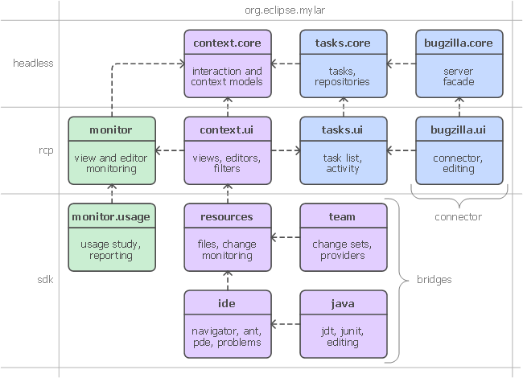
APIs
APIs are consumed by 3rd parties who provide regular feedback
All API changes are tracked in Bugzilla on bugs tagged as [api]
  Notes on API additions since Mylyn 3.0: http://wiki.eclipse.org/Mylyn/Porting_Guide
Frameworks:
  Commons API
  Context API
  Tasks API
  Monitor API
  Team API
Notes:
Mylyn Release Review

Slide 6
Architectural Issues
[concurrency]
For Mylyn 3.0 API tooling was adopted and API baselines have been made available for download.
For Mylyn 2.3 a new kind of bundle activator for the Task-Focused UI was created and all known issues with startup concurrency, performance and laziness were addressed.
Notes:
Mylyn Release Review

Slide 7
Tool Usability (unchanged since 3.0)‏
Maturity
  Constant stream of stable releases
  Bundled as part of EPP distributions
  Committers work from HEAD, contributors from weekly builds, community from milestone releases
User feedback says it best
  "..arguably the most productivity-enhancing idea since background compilation and all of the things that enables (namely refactoring and syntax highlighting). I just don't know how I ever was able to read and understand the Eclipse sources (or the sources of other large projects I've worked on) before Mylar, it's just that good.“ (David Orme)‏
  “I would like to commend you on this very good tool. It has increased my productivity by 3 folds - no kidding...” (Deepak Devje)‏
Notes:
Mylyn Release Review

Slide 8
End-of-Life
Mylyn 3.1 supports Eclipse 3.5 from HEAD and Eclipse 3.4 and 3.3 via separate branches.
Mylyn 3.0 is in maintenance and supports Eclipse 3.4 and 3.3 via separate branches.
All Mylyn 2.0 streams have reached end-of-life.
Notes:
Mylyn Release Review

Slide 9
Bugzilla
Bugs resolved
  Mylyn 3.1 (March 4, 2009): 351
  Mylyn 3.0 (June 25, 2008): 489
  Mylyn 2.3 (Feb. 27, 2008): 158
  Mylyn 2.2 (Dec. 19, 2007): 201
  Mylyn 2.1 (Sep. 28, 2007): 120
Contributions
  Mylyn receives 25 patches / month on average
  Over 130 contributions were merged for 3.1
Notes:
Mylyn Release Review

Slide 10
Community
1.0
2.0
3.0
2.1
2.2
2.3
3.0.1
Dec
2006
Jun
2007
Jun
2008
3.0.2

Slide 11
Standards
Mylyn requires J2SE 1.5, provides warning if installed on 1.4
  Key driver for using1.5 was the benefits of generics-aware APIs
Mylyn WikiText supports the following markup languages: Confluence, MediaWiki, Textile, TracWiki and Twiki.
Notes:
Mylyn Release Review

Slide 12
UI Usability (no changes since 2.1)‏
Accessibility
  No review for this release, but following accessibility guidelines
  http://www.eclipse.org/articles/Article-Accessibility/index.html
Follow the User Interface Guidelines
  Focus on consistent visual design, UI elements, icons
  http://wiki.eclipse.org/index.php/User_Interface_Guidelines
Validated UI usability with field study
  For details see:
  http://kerstens.org/mik/publications/2006-11-mylar-fse.pdf
  Mylyn Monitor is being used to gather usage feedback: http://mylyn.eclipse.org/monitor/upload/UsageAnalysisServlet
Notes:
Mylyn Release Review

Slide 13
Schedule
Release
Date
Platform Release
Notes
Mylyn 3.0
June 25, 2008
Eclipse 3.3.2 and 3.4.0
Ganymede
Mylyn 3.0.1
July 21, 2008
Eclipse 3.3.2 and 3.4.0
Mylyn 3.0.2
September 18, 2008
Eclipse 3.3.2 and 3.4.1
Ganymede SR1
Mylyn 3.0.3
October 15, 2008
Eclipse 3.3.2 and 3.4.1
Mylyn 3.0.4
January 28, 2009
Eclipse 3.3.2 and 3.4.1
Mylyn 3.0.5
February 18, 2009
Eclipse 3.3.2 and 3.4.2
Ganymede SR2
Mylyn 3.1
March 4, 2009
Eclipse 3.3.2, 3.4.2 and 3.5M5
Mylyn 3.2
June 25, 2009
Eclipse 3.3.2, 3.4.2 and 3.5.0
Galileo
Project plan
  http://www.eclipse.org/projects/project-plan.php?projectid=tools.mylyn
Notes:
Mylyn Release Review

Slide 14
Communities (unchanged since 2.0)‏
Users
  Lively community on newsgroup and bug reports
  Articles and blogs by community members
Developers
  Contributor documentation on Eclipsepedia
  Lively community on mylyn-dev and bug reports
Integrators
  Integrator documentation on Eclipsepedia
  New mylyn-integrators mailing list will remove need for integrators to watch the higher-traffic mylyn-dev
  Specific discussions on “[connector]” and “[bridge]” bug reports, as well as “manage integration with Foobar” bug reports
Notes:
Mylyn Release Review

Slide 15
IP Log
The IP Log is kept updated by committer as contributions are applied.
  http://www.eclipse.org/mylyn/doc/mylyn-iplog.csv
Adoption of the automatic IP log is planned for 3.2
Notes:
Mylyn Release Review

Slide 16
IP Issues
None.
Notes:
Mylyn Release Review

Slide 17
Release review version
These slides are based on the following version of the Release review document
  Version 032 – January 15, 2006
Notes:
Mylyn Release Review

