Slide 1

mylar
a degree-of-interest model for IDEs
Mik Kersten
Gail Murphy
University of British Columbia
AOSD 2005

Slide 2
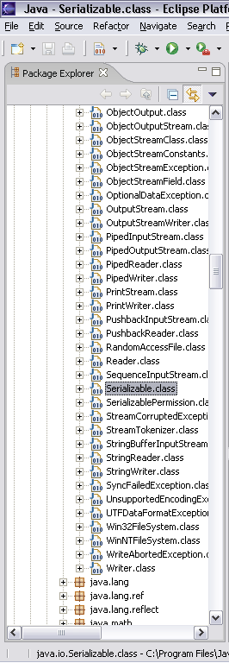
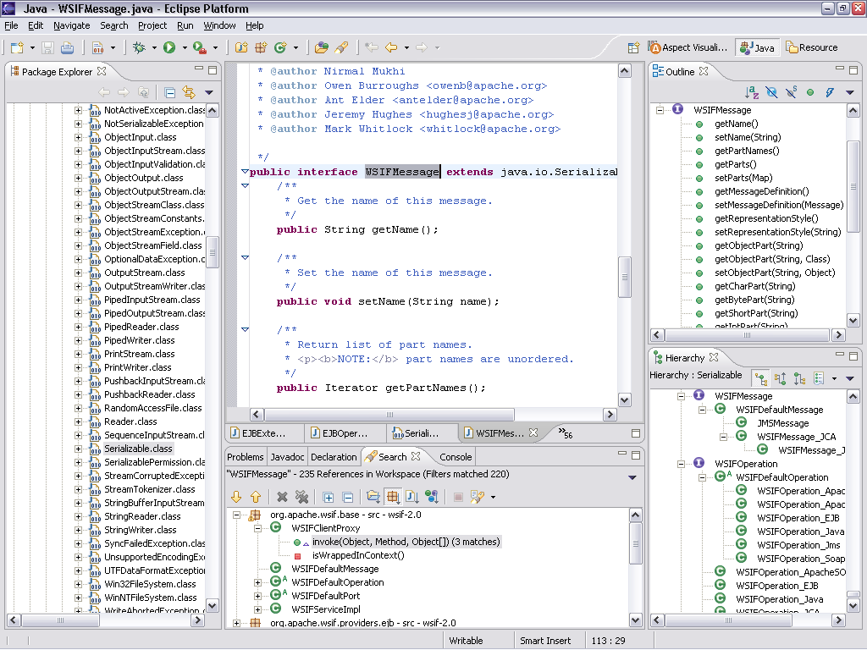
  Programming tasks crosscut modularity
  - IDEs only show system-wide slices of modularity
  - The larger the system is the worse it gets
What if improve the modularity of the program?

Slide 3
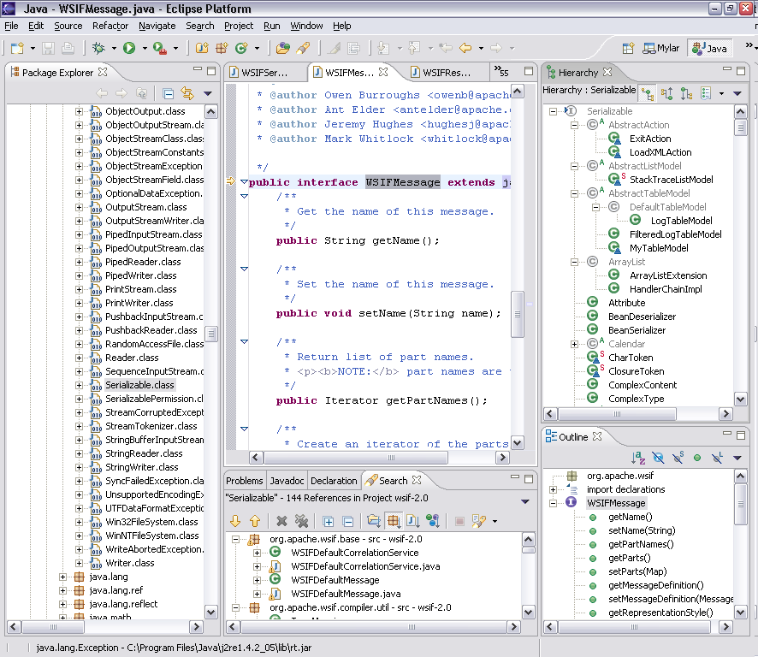
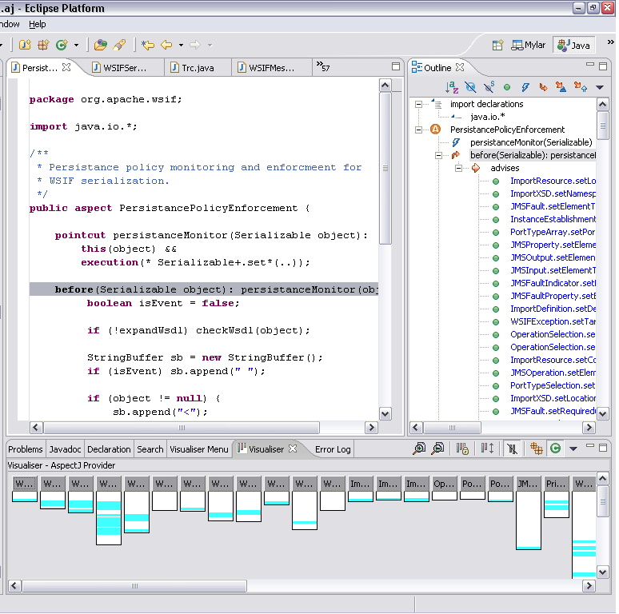

Slide 4
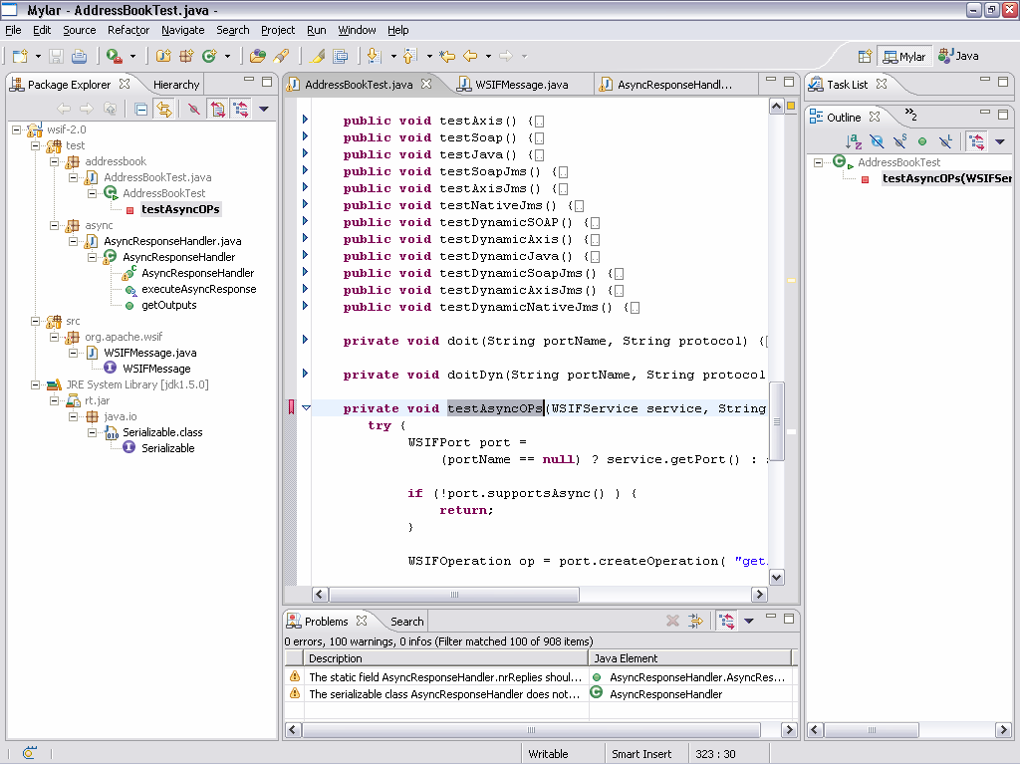
Mylar
shows you only what you’re working on
  1a. Aluminized film used to avoid blindness when staring at a solar eclipse
  1b. UI ‘skin’ used to avoid information blindness when staring at Eclipse
1

Slide 5
Mylar
Short demo
Degree of interest model
Validation
Discussion

Slide 6
Demo 1
Setup
  AddressBookTest. testAsyncOPs
Here we are with same task
Navigate to WSIFMessage, then back
Navigate to AsyncResponseHandler, show model
Toggle outline, raise children
  Just to remind you what the problem is
Show declarations on AsyncResponseHandler
Message
  You had to do this stuff explicitly before
  Same features as user study +folding

Slide 7
Mylar
Short demo
  Task context is explicit, surfaced in IDE views
Degree of interest model
Validation
Discussion

Slide 8
Degree of interest model
Inspired by Stu Card’s tree visualization
  Interest function defines which nodes are hidden
Mylar
  Interest is associated with program elements
  Interest is a function of interaction history
    Each navigation and edit increment interest
    After each event interest decays

Slide 9
How does it work?
DOI(e) =
A*(e.selections) + B*(e.edits) – C*(e.decay)
public WSIFMessage[] getOutputs() {
return outputs;
}
public WSIFMessage[] getOutputs()
…
return verify(outputs);
selections | edits | decay | DOI A=1, B=.2, C=.1
1 |  | 1 | .9
 | 8 | 1 | 2.4
 |  | 1 | 2.3

Slide 10
How is this implemented?
Interest stored for each element
  Index of handles to structure nodes
Performance
  Inherently lazy and lightweight structure
  Reduces footprint by limiting view population
Model lifecycle
  Scaling factors determine stability
  Thresholds: interesting, very interesting, purge
Simple kernel
  Easy to build on and extend

Slide 11
Mylar
Example and short demo
  Task context is explicit, surfaced in IDE views
Degree of interest model
  Represents relevance of elements to task
  Determined through interaction history
Validation
Discussion

Slide 12
Validating the interest model
Making task context explicit
  Can it be extracted and surfaced effectively?
  Does it make programmers more productive?
Bigger systems mean worse overload
  Needed real developers working on big systems
Diary study
  6 senior IBM enterprise app developers used Mylar for their daily work
  Qualitative data: daily survey, interviews
  Quantitative data: usage statistics
  3 days baseline, 5 days Mylar
  Not forced to use Mylar
Notes:
Using this technique from HCI

Slide 13
Usage statistics
Mylar views were used more than the standard Eclipse views
  Outline was not initially turned on by all, once turned on used instead of standard Outline
1121
750
564
selections
323
56
101
Package Explorer
Problems List
Outline

Slide 14
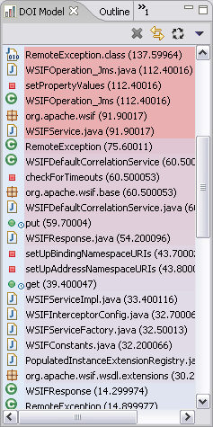
Feedback
All reported that Mylar accurately represented task context
  Some disliked the highlighting scheme
Liked drastic reduction in scrolling
Key shortcoming was inability to understand task switching
  Erase model when starting on a new task
But did it make the programmers more productive?

Slide 15
Results: edit ratio
Edit ratio = keystrokes / selections
Higher ratio implies more time working on task and less time looking for information needed for task
  Less browsing elements and scrolling
  Less search invocation and result selection
Improvement across users was 15%
  Conservative due to different tasks in baseline and study
One programmer had 40% of logged usage
  Her edit ratio improved 49%
Results are not conclusive, but promising
  All perceived a significant improvement in their edit ratio

Slide 16
Mylar
Example and short demo
  Task context is explicit, surfaced in IDE views
Degree of interest model
  Encoding of interaction history
  Represents relevance of elements to task
Validation
  Task context can be extracted and exposed
  Promising for increasing productivity
Discussion

Slide 17
Once task context is explicit…
Treat parts of your system as a unit
Do operations on them
  Work with multiple tasks contexts
    Save and restore
    Union and intersect
  Predict interest of related elements
    API clients
    Overriding methods
    Advice
c
c
d
a
b
b

Slide 18
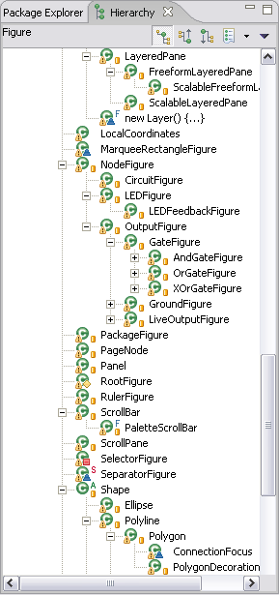
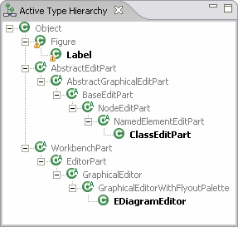
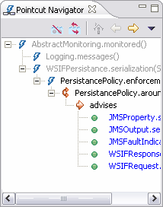
Inheritance and crosscutting context
Inheritance context
  Eclipse shows hierarchy for
  single type, invoke and wait
  Active Type Hierarchy shows inheritance modularity for a task, eagerly populated
Crosscutting context
  Standard view shows all the crosscutting declarations and relationships in a system
  Mylar shows the crosscutting modularity for a task

Slide 19
Related approaches
Previous efforts have all focused on the programmer saying what their context is
  Query tools such as FEAT and JQuery
Mylar determines task context
  By monitoring developer activity
  Creating a degree-of-interest model

Slide 20
Summary
Task context crosscuts system structure
  Causes IDE views to become overloaded
Can be extracted from the interaction history
  Can operate on the task context
  Make it explicit in IDE views to reduce information overload
Funded by IBM CAS, NSERC, UBC
www.cs.ubc.ca/~mylar
or Google: “mylar eclipse”

Slide 22
Project status
v0.1: august ‘04 user study
  What we saw today
v0.2: now
  Tasks, relation interest, other resources
v0.3: june ’05 user study
  50+ people have signed up
v0.5: first public release
  Continue collecting statistics and studying usage

Slide 23
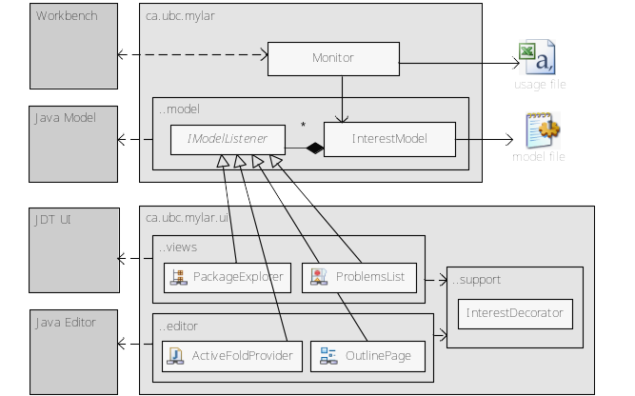
Under the hood

Slide 24

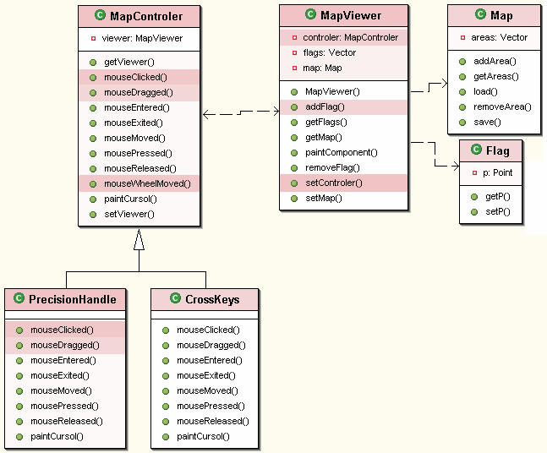
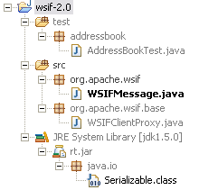
Visualizing the model
File chart was the first attempt
  Replaced by “filter declarations” button
Currently working on 2D layouts

Slide 25
Around the corner
Collaborative support
  Sharing task context via Bugzilla attachments
  Awareness of team members’ task context
Applies other views
  E.g. Debugger thread tree, help documentation
  Goal is always seamless integration
Reusable monitor
  Can be used directly for collecting usage data
  Can be extended for extracting additional information
  Provides reporting facilities
Extensible model
  Any structured element can be added, must provide unique handles, decorators, relationships and search
  Easy to create new views

Slide 26
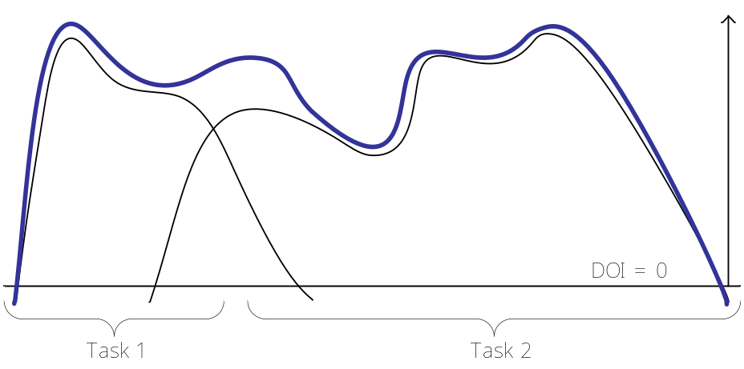
Template compliance
  Footer, logo
Intro
  Arrows bigger and solid
  Don’t ‘mention visualiser

Slide 27
Once task context is explicit…
Treat parts of your system as a unit
Do operations on them
  Work with multiple tasks contexts
    Save, restore, union, intersect
  Predict interest of related elements
    Overriding methods, API clients, advice

