Slide 1
Mylyn 3.0 Release Review
Mik Kersten
June 4, 2008
Notes:
Mylyn Release Review

Slide 2
Features
Features added since Mylyn 2.0 are blue
Task List (org.eclipse.mylyn.tasks.*)
  Integrated tasks management for Eclipse (required)
  Task management view, rich editing, offline support
Task-Focused UI (org.eclipse.mylyn.context.*)
  Automated context management (optional)
IDE (org.eclipse.mylyn.ide.ui.*)
  Ant, CVS, Bug reporting
PDE (org.eclipse.mylyn.pde.ui.*)
  Ant, CVS, Bug reporting
Team (org.eclipse.mylyn.team.*)
  Team APIs
Bugzilla Connector (org.eclipse.mylyn.bugzilla.*)
  Integrates Task List with Bugzilla repository (optional)
JIRA Connector (org.eclipse.mylyn.jira.*)
  Integrates Task List with JIRA repository (optional)
Trac Connector (org.eclipse.mylyn.trac.*)
  Integrates Task List with Trac repository (optional)
Notes:
Mylyn Release Review

Slide 3
Non-code aspects
User documentation
  New webinar on Mylyn 2.2, most viewed on Eclipse Live
  Wiki-based FAQ, User Guide, and Tips & Tricks
  Web site: getting started, articles, flash videos, webinar
Developer documentation
  Wiki-based Contributors Guide
  Wiki-based Integrators Guide
Localization/externalization
  We now have requests for this, hoping to do for 3.0
IP Log
  http://www.eclipse.org/mylyn/doc/mylyn-iplog.csv
Notes:
Mylyn Release Review

Slide 4
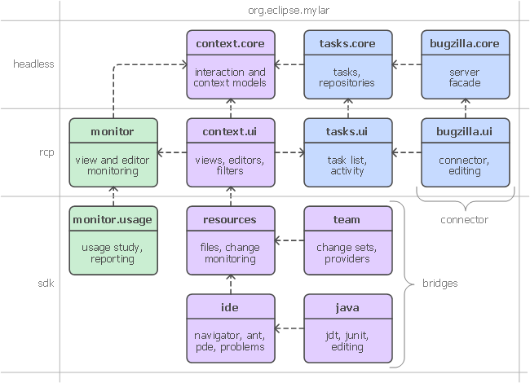
APIs
Breaking API changes since Mylyn 2.3:
  See: http://wiki.eclipse.org/Mylyn_Porting_Guide
Frameworks:
  Commons API
  Context API
  Tasks API
  Monitor API
  Team API
Notes:
Mylyn Release Review

Slide 5
Tool Usability (unchanged since 2.3)
Maturity
  Constant stream of stable releases
  Bundled as part of EPP distributions
  Committers work from HEAD, contributors from weekly builds, community from milestone releases
User feedback says it best
  "..arguably the most productivity-enhancing idea since background compilation and all of the things that enables (namely refactoring and syntax highlighting). I just don't know how I ever was able to read and understand the Eclipse sources (or the sources of other large projects I've worked on) before Mylar, it's just that good.“ (David Orme)
  “I would like to commend you on this very good tool. It has increased my productivity by 3 folds - no kidding...” (Deepak Devje)
Notes:
Mylyn Release Review

Slide 6
Architectural Issues
For Mylyn 3.0 we adopted the API tooling and re-architected the core APIs to remove the need for most clients to use internals (both our own features and external clients). We also took this opportunity to remove internals that had leaked into the API.
For Mylyn 2.3 we created a new kind of bundle activator for the Task-Focused UI and have finally addressed all known issues with startup concurrency, performance and laziness.
Through Mylyn 2.2 we had some challenging startup problems having to do with the way that Mylyn extends the eclipse UI as a whole, and the fact that Mylyn needs to lazy load.
Notes:
Mylyn Release Review

Slide 7
End-of-Life
All Mylyn 2.0 streams have reached end-of-life.
Mylyn 3.0 supports both Eclipse 3.4 and Eclipse 3.3 via separate branches.
Notes:
Mylyn Release Review

Slide 8
Bugzilla
Bugs resolved
  Mylyn 3.0 (June 25, 2008): 315
  Mylyn 2.3 (Feb. 27, 2008): 276
  Mylyn 2.2 (Dec. 19, 2007): 384
  Mylyn 2.1 (Sep. 28, 2007): 462
Notes:
Mylyn Release Review

Slide 9
Standards (no changes since 2.1)
Mylyn requires J2SE 1.5, provides warning if installed on 1.4
  Key driver for using1.5 was the benefits of generics-aware APIs
Notes:
Mylyn Release Review

Slide 10
UI Usability (no changes since 2.1)
Accessibility
  No review for this release, but following accessibility guidelines
  http://www.eclipse.org/articles/Article-Accessibility/index.html
Follow the User Interface Guidelines
  Focus on consistent visual design, UI elements, icons
  http://wiki.eclipse.org/index.php/User_Interface_Guidelines
Validated UI usability with field study
  For details see:
  http://kerstens.org/mik/publications/2006-11-mylar-fse.pdf
  Mylyn Monitor is being used to gather usage feedback: http://mylyn.eclipse.org/monitor/upload/UsageAnalysisServlet
Notes:
Mylyn Release Review

Slide 11
Schedule (minor RC adjustments since 2.1)
Release | Date | Platform Release | Notes
Mylyn 2.1M | August 27, 2007 | Eclipse 3.3.0 and 3.4M1 | Ganymede Milestone
Mylyn 2.1 | September 26, 2007 | Eclipse 3.3.1 and 3.4M2 | Europa Fall Maintenance
Mylyn 2.2M | November 7, 2007 | Eclipse 3.3.1 and 3.4M3 | Ganymede Milestone
Mylyn 2.2 | December 19, 2007 | Eclipse 3.3.1 and 3.4M4
Mylyn 2.3M | February 11, 2008 | Eclipse 3.3.1 and 3.4M5 | Ganymede Milestone
Mylyn 2.3 | February 27, 2008 | Eclipse 3.3.2 and 3.4M5eh | Europa Winter Maintenance (Feb 29)
Mylyn 3.0RC1 | May 21, 2008 | Eclipse 3.4RC1 | Reference implementations ported
Mylyn 3.0RC2 | May 28, 2008 | Eclipse 3.3.2 and 3.4RC2
Mylyn 3.0RC3 | June 4, 2008 | Eclipse 3.3.2 and 3.4RC3 | API frozen
Mylyn 3.0RC4 | June 11, 2008 | Eclipse 3.3.2 and 3.4RC4
Mylyn 3.0 | Jun 25, 2008 | Eclipse 3.3.2 and 3.4.0 | Ganymede Release
Notes:
Mylyn Release Review

Slide 12
Process
Open, transparent, permeable, and inclusive
  228 bugs resolved via one or more contributor patches since 2.0
  All discussions in Bugzilla, mailing list, newsgroup, and open developer conference calls
Notes:
Mylyn Release Review

Slide 13
Communities (unchanged since 2.0)
Users
  Lively community on newsgroup and bug reports
  Articles and blogs by community members
Developers
  Contributor documentation on Eclipsepedia
  Lively community on mylyn-dev and bug reports
Integrators
  Integrator documentation on Eclipsepedia
  New mylyn-integrators mailing list will remove need for integrators to watch the higher-traffic mylyn-dev
  Specific discussions on “[connector]” and “[bridge]” bug reports, as well as “manage integration with Foobar” bug reports
Notes:
Mylyn Release Review

Slide 14
Project plan
Covered on “Schedule” slide
Notes:
Mylyn Release Review

Slide 15
Release review version
These slides are based on the following version of the Release review document
  Version 032 – January 15, 2006
Notes:
Mylyn Release Review

