Slide 1

Mylar
a Task Focused UI for Eclipse
For Eclipse users
  Reduces information overload
For developers and integrators
  Provides framework for tasks and contexts
Mik Kersten, project lead
EclipseCon, Santa Clara USA, © March 21, 2006 by UBC, made available under the EPL v1.0
Notes:
Will make you more productive

Slide 2
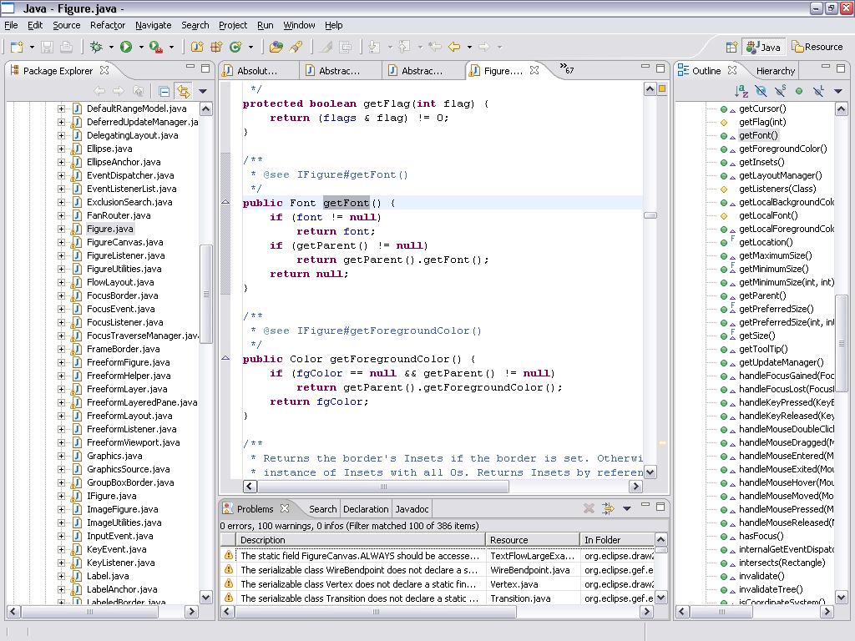
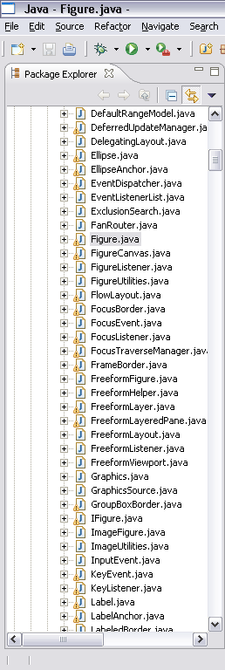
Information Overload
Hard to see the forest through the trees
Repetitive scrolling, searching, navigating
Notes:
But our systems have scaled, as has Eclipse’s performance
-

Slide 3
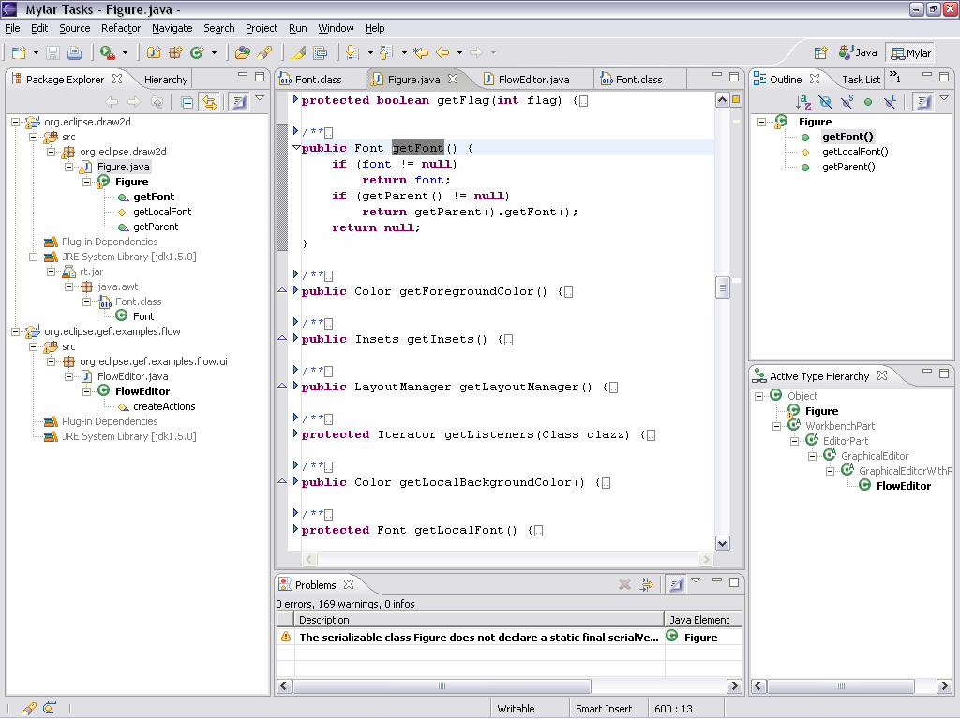
Mylar
shows you only what you’re working on
Aluminized film used to avoid blindness when staring at an eclipse
Focused UI to avoid information blindness when staring at Eclipse
Notes:
For any task that we work on, we only care about a
subset of the system
Mylar makes that subset explicit
All you need to do is indicate what task you’re working on
Via task management and issue tracker integration
Task context model is created automatically
Transparently monitors your programming activity
Filtered views show what you expect

Slide 4
Talk will be about
Working with Mylar (demos)
  Task context changes how we work with Eclipse
  Seamlessly integrated into Eclipse editors and views (SDK)
  Tasks are explicit and easy to manage (Bugzilla, JIRA)
Where are you losing time?
  Navigating through very large workspaces
  Working with issue trackers, cumbersome Web UIs
  [Your work day, what changes, what you get for free]
Building on Mylar
  Internals & architecture
  Framework & APIs
Notes:
Demo setup:
Web browser at: http://sourceforge.net/tracker/index.php?func=detail&aid=1012604&group_id=69326&atid=524147
Activate active search
Demo config:
Filtered to Very High
Delete JIRA query
Hyperlink bug: remove note, remove reminder
Context cleared on active task

Slide 5
Demo 1: context
Concepts
  Workspace is overloaded
  Mylar monitors your activity
  Context becomes explicit
  Can easily switch between tasks
  Recall previous contexts

Slide 6
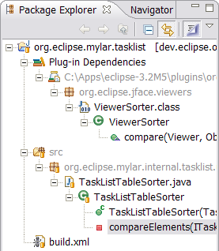
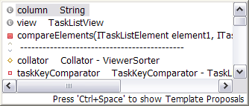
Demo 1: context
Tasks
  User-defined unit of work, e.g. bug report
Context
  Mylar monitors your interaction
  Creates degree-of-interest model
  What you touch is in your context
  Actively managed as you work
  Can be stored and recalled
Focused UI
  Views: filtering, decoration
  Editors: folding, content assist
  Context switching, editor management
Notes:
open TaskListTableSorter (folding)
navigate to ViewerSorter (filtering)
SHOW PROBLEMS FILTERING
Show Alt+click: select compare(..), Alt+click on package
Other resources
Alt+click to show build.xml (outline filtering, Alt+clicking)
Show Navigator, Alt+click to show build-user.xml (generic file)
Editor management
Editor management: deactivate/reactivate (discuss decay)
Switch to big context (common not to see a scrollbar), Ctrl+E list, switch back

Slide 7
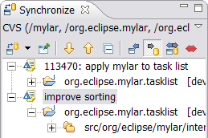
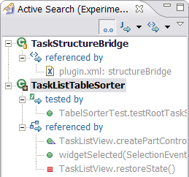
Demo 2: integration
Active change sets
  Commit just a piece of what you’ve changed
  Automatically managed with tasks
  Resources in context mapped to change set
Notes:
Ranking
Invoke content assist on constructor (or compare(..)?)
Invoke Open Type, start typing, mention you don’t need to use it as much
Mention switching contexts
Synchronize
Don’t have to manage manually like working sets
Change sets: open synchronize view, make modification, commit
Discuss: aren’t used often, but now don’t have to be managed manually

Slide 8
Demo 2: integration
Concepts
  Simple picture, build up
Last year
  I showed you the idea
  Idea of what it is for the user to have a tool like Mylar
  2nd part: we now have an architecture that can cover all kinds of things that can happen on the Eclipse platform

Slide 9
Demo 3: operations
Active search
  Can manipulate context directly
  Very interesting elements are landmarks
  Related elements become interesting
Notes:
Because we have this information we can now do more with it TO PUT THE INFORMATION YOU NEED AT YOUR FINGERTIPS
Make TaskListTableSorter a landmark
Open Active Search view
Discuss passive awareness
Discuss Degree of Separation
[Make TaskListView a landmark to show XML matches, then Mark Less Interesting, then close]
So you can see the way this context is built up implicitly, and how we integrate
Let’s put those ideas together
Active test suite

Slide 10
Concepts
  CVS repository view
    Multiple places you store files
    Multiple places for tasks
      Local
      Jira
      Bug

Slide 11

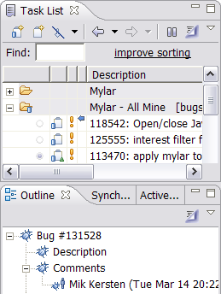
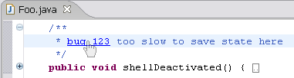
Demo 4: repositories
Connectors
  Similar to source repositories
  Support Bugzilla and JIRA
Integration
  Web linked tasks
  Repository Query integration
  Authoring, offline editing, notification
Tasks and contexts
  Navigate between Java and tasks
  Attach contexts to bugzilla reports
Notes:
Show Team Synchronizing perspective, New Wizard
Discuss queries, add: JIRA Dashboard Recent
Open report, mention offline persistence of queries
But all the context stuff works for JIRA reports
Open: “bugzilla.core should not”
Show query, existing context
Edit query
Editor: open Mylar bug report, make outgoing change, close and reopen
Status: show incoming notifications for inbox (less email)
Web drag URL from, not subject http://sourceforge.net/tracker/index.php?func=detail&aid=1012604&group_id=69326&atid=524147
Show “open in external”
Show Commit message
CVS history: drag AbstractRepositoryConnector, open task for rev 1.4

Slide 12
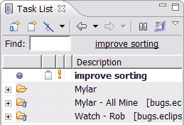

Demo 5: task management
So it’s all about tasks
  How do you manage these things
Task list
  Personal view on tasks of interest
  Notes, reminders, filtering
Notes:
Show find for “hyperlink” tasks, discuss activity
Open 88293 hyperlink report then add reminder to past
Add note
Now that we have this abstraction, we can build things on top of it
Click hyperlink back to “improve” report, show elapsed time
Switch to Planning perspective
XP planning facilities for our development
Drag overdue task to next week

Slide 13
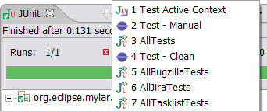
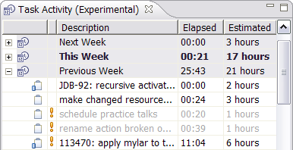
There’s more
Saving time
  Predicted interest for errors
  Active test suite
Everything is linked
  Tasks to sources to context, long term benefits
And we can build on this stuff
  Making task management easier
  E.g. task activity/planning
What changes
  Not as much cut and pasting, back/forward nav, open type, search
  Get interrupted by a patch, apply it, back where you left off
Long term benefits
  Everything is linked (e.g. tasks to source repository, contexts)

Slide 14
Changing how we work with Eclipse
Once tasks are explicit
  Reduces information overload
  Information you need is at your finger tips
  Context switching and recall become effortless
  UI automation (e.g. working sets, search, commit messages)
  Queries, editing, offline support, integration
  Keeps you in Eclipse and out of your email inbox
[Adoption]
  [Have to buy into working with tasks]
  New technology (0.5), have to activate tasks
  But all the features are optional
[last year]
  Showed that we can do this
  Now: there is a framework
Notes:
Without Mylar have to remember tons of structure (e.g. type names)
No more watching <component>-inbox [picture of toaster]
I have to remind myself to turn it off now and then
When not to use it
Reviewing package structure, comment clean-up
Now you might be wonder how we know this information..

Slide 15
under the hood

Slide 16





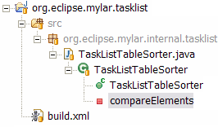
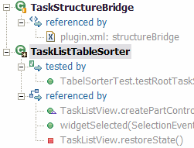

interest
Notes:
All the things you might want to do the architecture has flexibilty for

Slide 17
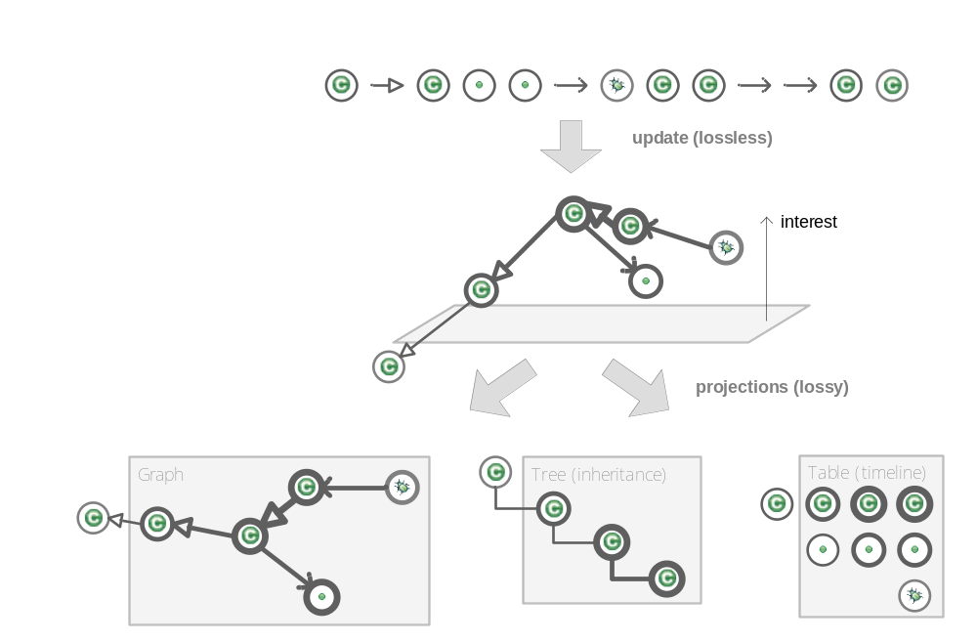
Encoding context
Interaction History
  Event stream
  (Mylar Monitor)
    Selections, edits,
    preferences. commands
Context
  Degree-of-interest graph
  of elements and relations
  (Mylar Core)
Projections
  Views, editors
  (Mylar UI)
Notes:
We don’t persist the Mylar model—while it has been changing the interaction history data structure hasn’t changed since may 2005
No AI here, nothing magical
Performance story
This is the roundy picture, now I’ll show you the square picture

Slide 18
Architecture: context
Mylar Core
  Degree of interest
    Ranking of elements and relations
  Degree of separation
    Context-centric search scope and input
Structure bridges
  Integrate context with existing models
    E.g. Java, XML, Resources
  Related element providers
    E.g. Java inheritance, JUnit refs
Mylar UI
  Filters, decorators, managed views
  and editors, interest projection
UI bridges
  Mappings to views, editors (e.g. MDD)
[Performance story]
Notes:
DESIGNED TO INTEGRATE
So it can deal with all the different kinds of things
All the different kinds of ways of interacting with elements

Slide 19
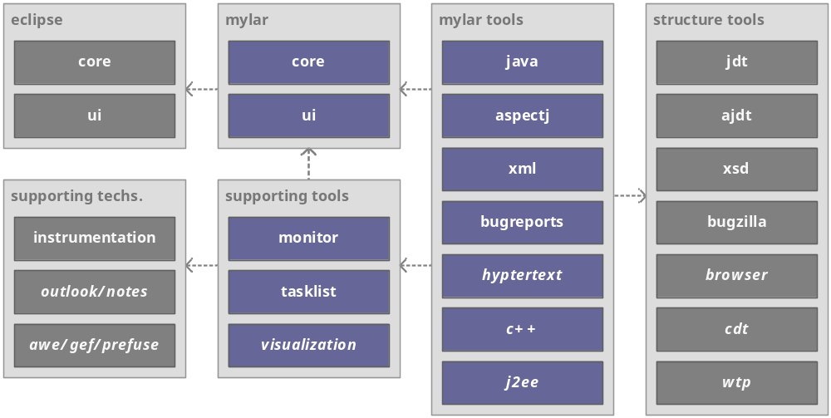
Architecture – context 2

Slide 20
Validated technology
  Spend more time coding, less searching and navigating

Slide 21
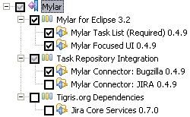
Architecture: task management
Framework for task management
  Similar to SDK’s abstractions for resources
  Lifecycle, persistence, diff, notifications
Repository connectors
  Extensibility for task/bug/issue trackers/repositories
  UI and persistence provided
  JIRA connector
    Only 500 lines of code
    Bridges to JIRA Core Services
Notes:
JIRA provider is ~500 lines of code
Experience judging jolt awards, we all know better: Eclipse integration is key

Slide 22
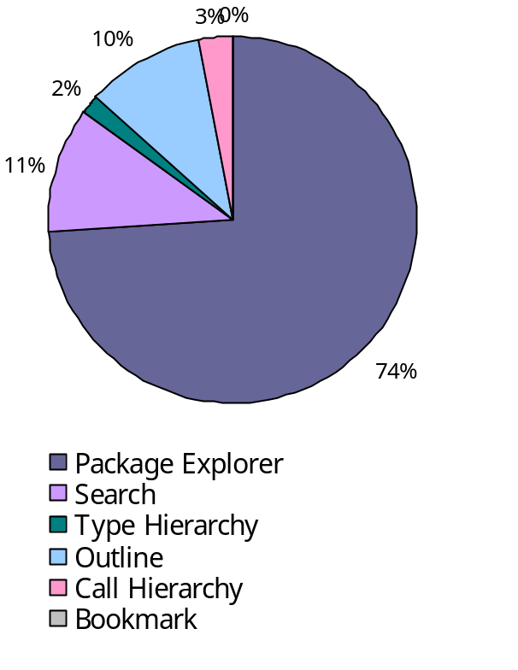
Extensibility status
Tasks and context a first class part of Eclipse
  Made possible by Eclipse’s modularity and extensibility
  All APIs and extension points currently provisional
Monitor API
  [Our user study, privacy, obfuscation, offline analysis]
  Used by 2 other academic usage studies (UBC, UVic)
Context API
  Has been stable, but revision coming
  Extensible to other kinds of resources (e.g. PhP, Ruby, C++)
Tasks API
  Connectors for Bugzilla and JIRA
  Extensible to other kinds of trackers and repositories

Slide 23
Project status
Plans
  2005-Q3: 0.3 user study release
    Monitored 100+ developers voluntarily using Mylar in late 2005
  2005-Q4: 0.4 public release
  2006-Q1: 0.5
    Get it next week
  2006-Q2: 0.6 provisional APIs ready
    Making context more first class
    Easier sharing and reuse of expertise
  2007: 1.0 tools project quality and API contract
Community
  Users: 1-2K installs of each 0.4.0-9 release and growing
  Developers: dozens of patches
  Integrators: soon ready for first adopters
Notes:
“I think your work is going to be a real breakthrough and at least in my group, when it will be stable enough to be spread across all developers, it will be a real revolution in the way we work.”
No matter what the size of display, we know what to show (what the focus is, what the context)
[picture of large display?]
The more screen real-estate you have, the more context it gives you—current Eclipse views don’t scale that way

Slide 24
Mylar
Reducing information overload one task at a time
Committers
  Mik Kersten, Gail Murphy, Robert Elves
Contributors
  [..]
More
  http://eclipse.org/mylar
BOF tonight at 8:30pm
Notes:
So what Mylar is all about
Bringing tasks and focus to Eclipse
Reducing information overload

Slide 26
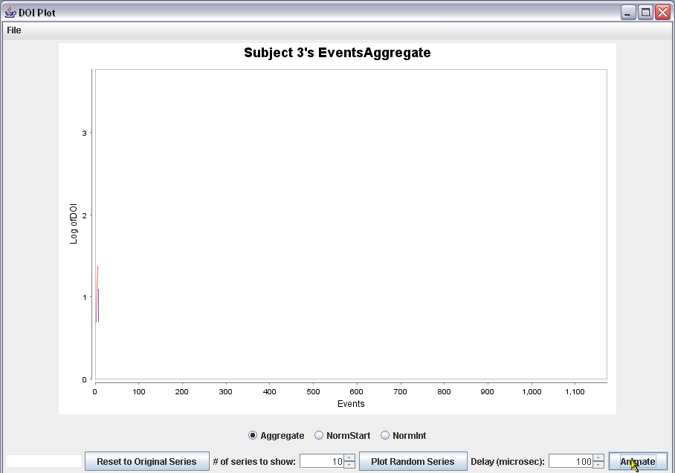
Example: interaction history

Slide 27
Conclusion
The more time we spend in Eclipse the more productive we are
  Need consistency, offline access, personal planning
  Web UIs don’t offer this, integrated Eclipse UI does
  Dozens of different task/bug/issue management UIs
Projects need flexibility, additional reporting offered by custom UIs
  We need to work together on this
  Mylar can provide initial APIs

Slide 28
Encoding interaction history
Mylar Monitor
  Selections, edits, commands, preferences
  Produces a stream of Interaction Events
    Origin (e.g. org.eclipse.jdt.ui.PackageExplorer)
    Handle (project/src/foo/bar/Baz/method)
    Content type (e.g. java)
    Date
Interaction analysis
  Usage data collection
  41 developers
  Preserve privacy, anonymity
Notes:
Across set of 41 accepted developers
Anonymous, obvfuscated

Slide 29
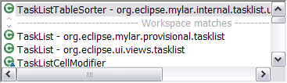

scratch
InteractionEvent
Origin (e.g. org.eclipse.jdt.ui.PackageExplorer)
Handle (project/src/foo/bar/Baz/method)
Content type (e.g. java)
Date

