Slide 1
Mylyn 3.5 Release Review
Mik Kersten and Steffen Pingel
Planned Review Date: March 2011
Communication Channel: mylyn-dev@eclipse.org
Notes:
Mylyn Release Review
Mylyn Release Review
Mylyn Release Review

Slide 2
Introduction
In order to keep up with its rate of adoption, the Mylyn project is continuing to evolve APIs for Application Lifecycle Management (ALM) tools. Since its inception, Mylyn has released multiple times per annual release cycle, and is continuing to do that for Indigo.
Notes:
Mylyn Release Review
Mylyn Release Review
Mylyn Release Review

Slide 3
Mylyn
The Mylyn 3.5 release includes the following sub-projects:
  Mylyn Builds
  Mylyn Commons
  Mylyn Context
  Mylyn Docs
  Mylyn Reviews
  Mylyn Tasks
  Mylyn Versions
Project Plan:
  http://eclipse.org/projects/project-plan.php?projectid=mylyn
New Features
  http://eclipse.org/mylyn/new/
Notes:
Mylyn Release Review
Mylyn Release Review
Mylyn Release Review

Slide 4
Mylyn Builds
Mylyn Builds contributes its initial 0.7 release which includes these deliverables:
  Builds Framework
  Hudson Connector
Project Plan:
  http://eclipse.org/projects/project-plan.php?projectid=mylyn.builds
New Features
  The Builds view lists status of monitored builds.
  Builds open in a rich editor that provides access to tests results, console output, generated artifacts and changes.
  Previously executed builds is available from the History view.
  The Hudson connector integrates with Hudson 1.367 or later and Jenkins 1.367 or later
Notes:
Mylyn Release Review
Mylyn Release Review
Mylyn Release Review

Slide 5
Mylyn Commons
Mylyn Commons contributes its 3.5 release which includes these deliverables:
  Commons Framework
Project Plan:
  http://eclipse.org/projects/project-plan.php?projectid=mylyn.commons
New Features
  The Team Repositories view provides an extensible navigator for managing task repositories, build servers and other team repositories.
  A reusable screen shot capturing component has been added.
Notes:
Mylyn Release Review
Mylyn Release Review
Mylyn Release Review

Slide 6
Mylyn Context
Mylyn Context contributes its 3.5 release which includes these deliverables:
  Context Framework
  Java Bridge
  C/C++ Bridge
  PDE Bridge
  Resource Bridge
  IDE Integration
Project Plan
  http://eclipse.org/projects/project-plan.php?projectid=mylyn.context
New Features
  Focused navigator views show a hover affordance that replaces Alt+click.
Notes:
Mylyn Release Review
Mylyn Release Review
Mylyn Release Review

Slide 7
Mylyn Docs
Mylyn Docs contributes its 1.4 release which includes these deliverables:
  HtmlText
  WikiText
Project Plan
  http://eclipse.org/projects/project-plan.php?projectid=mylyn.docs
New Features
  The HtmlText component provides rich HTML editing capabilities.
Notes:
Mylyn Release Review
Mylyn Release Review
Mylyn Release Review

Slide 8
Mylyn Incubator
Mylyn Incubator does not do releases by definition and does not participate in Mylyn releases.
Notes:
Mylyn Release Review
Mylyn Release Review
Mylyn Release Review

Slide 9
Mylyn Reviews
Mylyn Reviews contributes its initial 0.7 release which includes these deliverables:
  Gerrit Connector
  Reviews Framework
Project Plan:
  http://eclipse.org/projects/project-plan.php?projectid=mylyn.reviews
New Features
  The Gerrit connector integrates with Gerrit 2.1.5 and later.
  Gerrit reviews are displayed as tasks in the Task List.
  Gerrit reviews open in a rich editor that provides access comments, votes and patch sets.
Notes:
Mylyn Release Review
Mylyn Release Review
Mylyn Release Review

Slide 10
Mylyn Tasks
Mylyn Tasks contributes its 3.5 release which includes these deliverables:
  Bugzilla Connector
  Tasks Framework
  Trac Connector
Project Plan
  http://eclipse.org/projects/project-plan.php?projectid=mylyn.tasks
New Features
  The active task is displayed on the window trim.
  Bugzilla 4.0 is supported.
  The Bugzilla connector task search supports boolean charts.
Notes:
Mylyn Release Review
Mylyn Release Review
Mylyn Release Review

Slide 11
Mylyn Versions
Mylyn Versions contributes its initial 0.7 release which includes these deliverables:
  CVS Connector
  Git Connector
Project Plan:
  http://eclipse.org/projects/project-plan.php?projectid=mylyn.versions
New Features
  The Git connector provides API for accessing Git change sets.
Notes:
Mylyn Release Review
Mylyn Release Review
Mylyn Release Review

Slide 12
Non-code aspects(1)
Localization/externalization
  The code base has been externalized for Mylyn 3.1.
  Mylyn is now available for translation via Eclipse Babel.
User documentation
  Eclipse help content that is generated from the Wiki has been added for Mylyn 3.1.
  The webinar on Mylyn 3.0 is the most viewed webinar on Eclipse Live.
  The web site has been restructured for easier access to Downloads, Support and Getting Started documentation.
Developer documentation
  Wiki-based Contributors Guide
  Wiki-based Integrators Guide
Notes:
Mylyn Release Review
Mylyn Release Review
Mylyn Release Review

Slide 13
Non-code aspects(2)
Release Engineering
  The build system is based on Maven Tycho.
Continuous Integration
  Tests are executed on a regular schedule on the Eclipse.org Hudson instance
  Test results and build artifacts are available to anyone.
Notes:
Mylyn Release Review
Mylyn Release Review
Mylyn Release Review

Slide 14
APIs
No breaking API changes from 3.0
API tooling is used verify that binary backwards compatibility is maintained and no API regressions are introduced.
APIs are consumed by 3rd parties who provide regular feedback
All API changes are tracked in Bugzilla on bugs tagged as [api]
  Notes on API additions since Mylyn 3.0: http://wiki.eclipse.org/Mylyn/Porting_Guide
Connector core APIs are available to standalone environments and do not require an OSGi container
Notes:
Mylyn Release Review
Mylyn Release Review
Mylyn Release Review

Slide 15
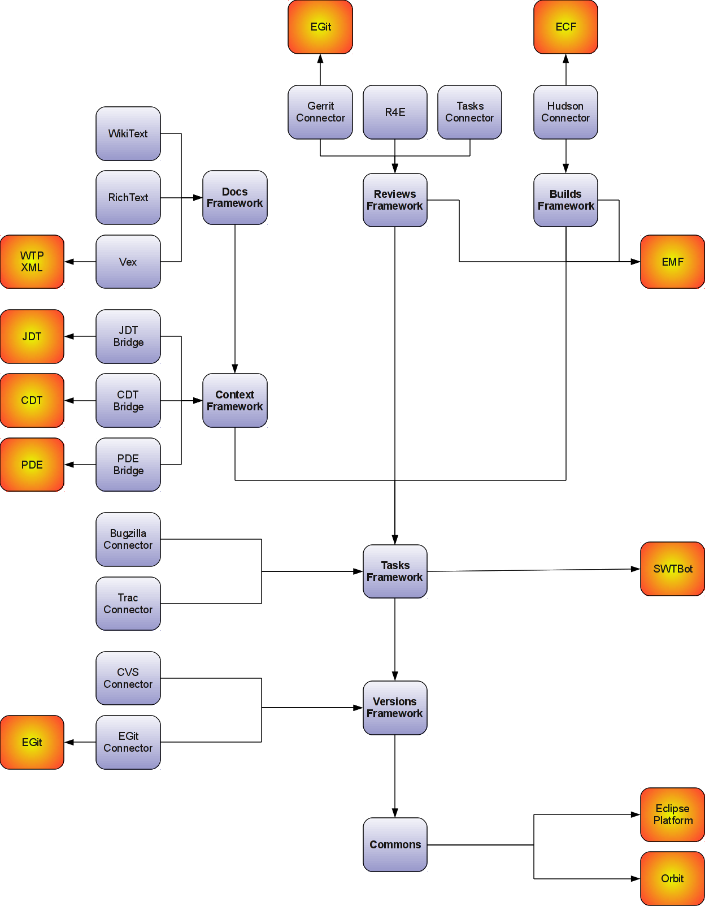
Frameworks
  Builds API
  Commons API
    Monitor API
  Context API
  Reviews API
  Tasks API
    Team API
  Versions API
  WikiText API
Notes:
Mylyn Release Review
Mylyn Release Review
Mylyn Release Review

Slide 16
Architectural Issues‏ (Unchanged since 3.3)
For Mylyn 3.3 pooling of network connections has been fixed which uncovered connection leaks in several connector implementations.
For Mylyn 3.1 processing of resource change events has been optimized to avoid a negative impact on performance when rebuilding large workspace while a task is active.
For Mylyn 3.1 scheduling rules and locking for concurrently running jobs have been reviewed and problems were addressed.
For Mylyn 3.0 API tooling was adopted and API baselines have been made available for download.
For Mylyn 2.3 a new kind of bundle activator for the Task-Focused UI was created and all known issues with startup concurrency, performance and laziness were addressed.
Notes:
Mylyn Release Review
Mylyn Release Review
Mylyn Release Review

Slide 17
Tool Usability (Unchanged since 3.0)‏
Maturity
  Constant stream of stable releases
  Bundled as part of EPP distributions
  Committers work from HEAD, contributors from weekly builds, community from milestone releases
User feedback says it best
  "..arguably the most productivity-enhancing idea since background compilation and all of the things that enables (namely refactoring and syntax highlighting). I just don't know how I ever was able to read and understand the Eclipse sources (or the sources of other large projects I've worked on) before Mylar, it's just that good.“ (David Orme)‏
  “I would like to commend you on this very good tool. It has increased my productivity by 3 folds - no kidding...” (Deepak Devje)‏
Notes:
Mylyn Release Review
Mylyn Release Review
Mylyn Release Review

Slide 18
End-of-Life
Mylyn 3.5 support Eclipse 3.7M6, 3.6, and 3.5 from HEAD.
  The XPlanner Component has been archived.
Mylyn 3.4 support Eclipse 3.6, 3.5 and 3.4 from HEAD.
  The JIRA Component has moved to Atlassian.
Mylyn 3.3 supports Eclipse 3.6M2, 3.5 and 3.4 from HEAD. Support for Eclipse 3.3 has ended.
Mylyn 3.2 supports Eclipse 3.5 and 3.4 from HEAD and Eclipse 3.3 via a separate branch.
Mylyn 3.1 is in maintenance and supports Eclipse 3.4 and 3.3 via separate branches.
All Mylyn 3.0 streams have reached end-of-life
All Mylyn 2.0 streams have reached end-of-life.
Notes:
Mylyn Release Review
Mylyn Release Review
Mylyn Release Review

Slide 19
Bugzilla
Bugs resolved
  Mylyn 3.5 (March 16, 2011): 285 (as of Feb 24, 2011)
  Mylyn 3.4 (June 23, 2010): 171
  Mylyn 3.3 (Oct. 26th, 2009): 166
  Mylyn 3.2 (June 24, 2009): 333‏
  Mylyn 3.1 (March 4, 2009): 431
  Mylyn 3.0 (June 25, 2008): 493
  Mylyn 2.3 (Feb. 27, 2008): 158
  Mylyn 2.2 (Dec. 19, 2007): 201
  Mylyn 2.1 (Sep. 28, 2007): 120
Notes:
Mylyn Release Review
Mylyn Release Review
Mylyn Release Review

Slide 20
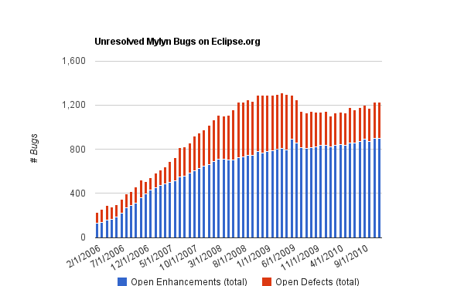
Community
Notes:
Mylyn Release Review
Mylyn Release Review

Slide 21
Standards (Unchanged since 3.1)‏
Mylyn requires J2SE 1.5, provides warning if installed on 1.4
  Key driver for using1.5 was the benefits of generics-aware APIs
Mylyn WikiText supports the following markup languages: Confluence, MediaWiki, Textile, TracWiki and Twiki.
Notes:
Mylyn Release Review
Mylyn Release Review
Mylyn Release Review

Slide 22
UI Usability (Unchanged since 2.1)‏
Accessibility
  No review for this release, but following accessibility guidelines
  http://www.eclipse.org/articles/Article-Accessibility/index.html
Follow the User Interface Guidelines
  Focus on consistent visual design, UI elements, icons
  http://wiki.eclipse.org/index.php/User_Interface_Guidelines
Validated UI usability with field study
  For details see:
  http://kerstens.org/mik/publications/2006-11-mylar-fse.pdf
  Mylyn Monitor is being used to gather usage feedback: http://mylyn.eclipse.org/monitor/upload/UsageAnalysisServlet
Notes:
Mylyn Release Review
Mylyn Release Review
Mylyn Release Review

Slide 23
Schedule
Project plan: http://www.eclipse.org/projects/project-plan.php?projectid=tools.mylyn
Release
Date
Platform Release
Notes
Mylyn 3.4
June 23, 2010
Eclipse 3.4.2, 3.5.2 and 3.6
Mylyn 3.4.1
August 4, 2010
Eclipse 3.4.2, 3.5.2 and 3.6.1
Helios SR1
Mylyn 3.4.2
September 24, 2010
Eclipse 3.4.2, 3.5.2 and 3.6.1
Mylyn 3.4.3
February 25, 2011
Eclipse 3.4.2, 3.5.2 and 3.6.2
Helios SR2
Mylyn 3.5
March 16, 2011
Eclipse 3.5.2, 3.6.2 and 3.7M6
Mylyn 3.6
June 22, 2011
Eclipse 3.5.2, 3.6.2 and 3.7
Indigo
Notes:
Mylyn Release Review
Mylyn Release Review
Mylyn Release Review

Slide 24
Communities(1)
Users
  Lively community on newsgroup and bug reports
  Articles and blogs by community members
Developers
  Contributor documentation on Eclipsepedia
  Lively community on mylyn-dev and bug reports
Integrators
  Integrator documentation on Eclipsepedia
  Separate mylyn-integrators mailing list removes need for integrators to watch the higher-traffic mylyn-dev
  Specific discussions on “[connector]” and “[bridge]” bug reports, as well as “manage integration with Foobar” bug reports
Notes:
Mylyn Release Review
Mylyn Release Review
Mylyn Release Review

Slide 25
Communities‏ (2)‏
Committers
  19 new committers since June 2009
Summer of Code
  Mylyn participated in Summer of Code 2009
  Steffen Pingel mentored Markus Knittig who implented a Hudson integration.
Notes:
Mylyn Release Review
Mylyn Release Review
Mylyn Release Review

Slide 26
IP Log
Contributions are flagged as +iplog as they are applied.
Aggregated IP log:
  http://eclipse.org/projects/ip_log.php?projectid=mylyn,mylyn.builds,mylyn.commons,mylyn.context,mylyn.docs,mylyn.reviews,mylyn.tasks,mylyn.versions
Sub-project IP logs:
  Mylyn Builds: http://eclipse.org/projects/ip_log.php?projectid=mylyn.builds
  Mylyn Commons: http://eclipse.org/projects/ip_log.php?projectid=mylyn.commons
  Mylyn Context: http://eclipse.org/projects/ip_log.php?projectid=mylyn.context
  Mylyn Docs: http://eclipse.org/projects/ip_log.php?projectid=mylyn.docs
  Mylyn Reviews: http://eclipse.org/projects/ip_log.php?projectid=mylyn.reviews
  Mylyn Tasks: http://eclipse.org/projects/ip_log.php?projectid=mylyn.tasks
  Mylyn Versions: http://eclipse.org/projects/ip_log.php?projectid=mylyn.versions
Notes:
Mylyn Release Review
Mylyn Release Review
Mylyn Release Review

Slide 27
IP Log(2)
Mylyn Commons, Mylyn Context, Mylyn Docs, and Mylyn Tasks ship code that was migrated from the Mylyn tools project for which contributions were tracked in a CSV file located at http://www.eclipse.org/mylyn/doc/mylyn-iplog.csv.
Since the 3.4.3 release contributions are tracked through the automatic IP log but contributions applied in earlier releases are listed in the CSV file. It is planned to flag contributions listed in the IP log for a future release to fully migrate to the automatic IP log.
Notes:
Mylyn Release Review
Mylyn Release Review
Mylyn Release Review

Slide 28
IP Issues
None.
Notes:
Mylyn Release Review
Mylyn Release Review
Mylyn Release Review

Slide 29
Release review version
These slides are based on the following version of the Release review document
  Version 032 – January 15, 2006
Notes:
Mylyn Release Review
Mylyn Release Review
Mylyn Release Review

