Slide 1
Mylyn 2.0 Release Review
Mik Kersten
June 18, 2007
Notes:
Mylyn Release Review

Slide 2
Features
Task List (org.eclipse.mylyn.tasks.*)
  Integrated tasks management for Eclipse (required)
  Task management view, rich editing, offline support
Task-Focused UI (org.eclipse.mylyn.context.*)
  Automated context management (optional)
Bugzilla Connector (org.eclipse.mylyn.bugzilla.*)
  Integrates Task List with Bugzilla repository (optional)
JIRA Connector (org.eclipse.mylyn.jira.*)
  Integrates Task List with JIRA repository (optional)
Trac Connector (org.eclipse.mylyn.trac.*)
  Integrates Task List with Trac repository (optional)
Notes:
Mylyn Release Review

Slide 3
Non-code aspects
User documentation
  Considerable body of user documentation
  Wiki-based FAQ, User Guide, and Tips & Tricks
  Web site: getting started, articles, flash videos, webinar
Developer documentation
  Wiki-based Contributors Guide
  Wik-based Integrators Guide
Localization/externalization
  In spite of large adoption by non-English countries, still no requests or votes for alternate languages, so postponed post 2.0
Notes:
Mylyn Release Review

Slide 4
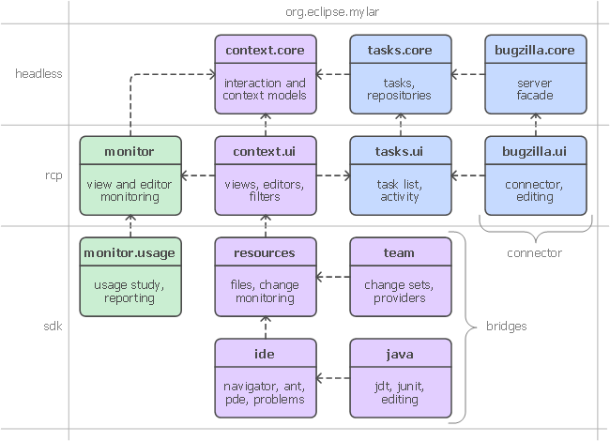
APIs
Three frameworks
  Tasks
  Context
  Monitor
  Team
  (not visible)
  Each has
  multiple
  clients
Notes:
Mylyn Release Review

Slide 5
Tool Usability
Notes:
Mylyn Release Review

Slide 6
Tool Usability
Maturity
  Constant stream of stable releases, part of Europa release train
  Committers work from HEAD, contributors from weekly builds, community from milestone releases
Adoption
  2007 stats to date
    52,871 update site downloads
    15,055 zip/redistributable site downloads
    Redistributed by 4rd parties (e.g. JBuilder 2007, Yoxos)
  User feedback says it best
    "..arguably the most productivity-enhancing idea since background compilation and all of the things that enables (namely refactoring and syntax hilighting). I just don't know how I ever was able to read and understand the Eclipse sources (or the sources of other large projects I've worked on) before Mylar, it's just that good.“ (David Orme)
    “I would like to commend you on this very good tool. It has increased my productivity by 3 folds - no kidding...” (Deepak Devje)
Notes:
Mylyn Release Review

Slide 7
Architectural Issues
APIs have matured considerably since 1.0 thanks to integrator feedback.
  Tasks API is most challenging due to the rich UI facilities it provides, but also most mature
  Team API is lean and has been stable since 1.0
  Context API has been relatively stable since 1.0, still requires more integrator feedback
  Monitor API is lean and relatively stable since 1.0
Tools and UI
  Focus on integrating as seamless with SDK as possible while ensuring tasks are a first-class part of the IDE experience
  Tradeoffs discussed: http://dev.eclipse.org/mhonarc/lists/cross-project-issues-dev/msg01185.html
Notes:
Mylyn Release Review

Slide 8
End-of-Life
Mylar 1.0 APIs have reached end-of-life
  http://wiki.eclipse.org/index.php/Mylar_Porting_Guide
Project has been renamed to Mylyn, all plug-ins containing org.eclipse.mylar.* have to be updated to org.eclipse.mylyn.*
Notes:
Mylyn Release Review

Slide 9
Bugzilla
Stats since Mylyn 1.0.1 (2006-12-22 to 2007-06-11)
  528 reports opened
  720 resolved
  Most open bugs are feature or integration enhancement requests
Notes:
Mylyn Release Review

Slide 10
Standards
Mylyn requires J2SE 1.5, provides warning if installed on 1.4
  Key driver for using1.5 was the benefits of generics-aware APIs
Notes:
Mylyn Release Review

Slide 11
UI Usability
Accessibility
  No review for this release, but following accessibility guidelines
  http://www.eclipse.org/articles/Article-Accessibility/index.html
Follow the User Interface Guidelines
  Focus on consistent visual design, UI elements, icons
  http://wiki.eclipse.org/index.php/User_Interface_Guidelines
Validated UI usability with field study
  For details see:
  http://kerstens.org/mik/publications/2006-11-mylar-fse.pdf
  Mylyn Monitor is being used to gather usage feedback: http://mylyn.eclipse.org/monitor/upload/UsageAnalysisServlet
Notes:
Mylyn Release Review

Slide 12
Schedule
Release scheduled for January 29th
Notes:
Mylyn Release Review

Slide 13
Process
Open, transparent, permeable, and inclusive
  All discussions in Bugzilla, mailing list, newsgroup, and open developer conference calls
  83 bugs resolved via one or more contributor patches
Notes:
Mylyn Release Review

Slide 14
Communities
Users
  Lively community on newsgroup and bug reports
  Articles and blogs by community members
Developers
  Contributor documentation on Eclipsepedia
  Lively community on mylyn-dev and bug reports
Integrators
  Integrator documentation on Eclipsepedia
  New mylyn-integrators mailing list will remove need for integrators to watch the higher-traffic mylyn-dev
  Specific discussions on “[connector]” and “[bridge]” bug reports, as well as “manage integration with Foobar” bug reports
Notes:
Mylyn Release Review

Slide 15
Intellectual Property
IP process followed
  All approvals received
Up-to-date IP Log
  http://www.eclipse.org/mylyn/doc/mylyn-iplog.csv
Notes:
Mylyn Release Review

Slide 16
Project plan
Learned from 1.0 to 2.0
  Need to reduce burden on integrators by minimizing API changes while incorporating key feedback and extensibility needs.
  Also need to make it easier for the user community to adopt our regular releases instead of waiting a year to move.
Proposed 3.0 plan and schedule
  Week 6: Mylyn 2.1M
  Week 12: Mylyn 2.1 (API additions only)
  Week 18: Mylyn 2.2M
  Week 24: Mylyn 2.2
  …
  Week 46: Mylyn 3.0RC0 (incorporate key API changes)
  Week 52: Mylyn 3.0
Notes:
Mylyn Release Review

Slide 17
Release review version
These slides are based on the following version of the Release review document
  Version 032 – January 15, 2006
Notes:
Mylyn Release Review

