Slide 1
Mylyn 3.7 Release Review
DRAFT
Planned Review Date: March 14, 2012
Communication Channel: mylyn-dev@eclipse.org
Notes:
Mylyn Release Review
Mylyn Release Review
Mylyn Release Review

Slide 2
Introduction
The Mylyn Application Lifecycle Tools Top-Level Project is an open source collaborative software development project dedicated to providing an extensible, standards-based platform to address a broad range of needs of accessing task and application lifecycle management tools and services using the Eclipse platform.
The mission of the project is to provide:
  Frameworks and APIs for Eclipse-based task and Application Lifecycle Management (ALM)
  Exemplary tools for task-focused programming within the Eclipse IDE.
  Reference implementations for open source ALM tools used by the Eclipse community and for open ALM standards such as OSLC
Notes:
Mylyn Release Review
Mylyn Release Review
Mylyn Release Review

Slide 3
Overview
The Mylyn project was created in 2005 as a Technology project and moved to the Tools top-level project in 2007. Mylyn was restructured and promoted to a top-level project in 2010.
In order to keep up with its rate of adoption, the Mylyn project is continuing to evolve APIs for Application Lifecycle Management (ALM) tools. Since its inception, Mylyn has released multiple times per annual release cycle, and is continuing to do that for Juno.
Notes:
Mylyn Release Review
Mylyn Release Review
Mylyn Release Review

Slide 4
Mylyn
The Mylyn 3.7 release includes the following sub-projects:
  Mylyn Builds
  Mylyn Commons
  Mylyn Context
  Mylyn Docs
  Mylyn Reviews
  Mylyn Tasks
  Mylyn Versions
Project Plan:
  http://eclipse.org/projects/project-plan.php?projectid=mylyn
New Features
  http://eclipse.org/mylyn/new/weekly.php
Notes:
Mylyn Release Review
Mylyn Release Review
Mylyn Release Review

Slide 5
Mylyn Builds
Deliverables included in Mylyn Builds 0.9:
  Builds Framework
  Hudson/Jenkins Connector
Project Plan:
  http://eclipse.org/projects/project-plan.php?projectid=mylyn.builds
Supported Build Servers:
  Hudson 2.1, 2.2
  Jenkins 1.427 and later
New Features:
  The builds editor shows a hierarchical list of artifacts.
  The Hudson connector supports form-based, HTTP and certificate authentication.
Notes:
Mylyn Release Review
Mylyn Release Review
Mylyn Release Review

Slide 6
Mylyn Commons
Deliverables included in Mylyn Commons 3.7:
  Discovery Framework
  Identity Framework
  Interaction Monitoring Framework
  Notification Framework
  Repository Framework
  Transport Framework
  HTTP Transport
  SOAP Transport
  XML-RPC Transport
  UI Toolkit
Project Plan:
  http://eclipse.org/projects/project-plan.php?projectid=mylyn.commons
Notes:
Mylyn Release Review
Mylyn Release Review
Mylyn Release Review

Slide 7
Mylyn Commons
New Features:
  Components were restructured and provisional packages were promoted to API.
  An extension point is provided for opening URLs in rich editors.
  An transport layer based on Apache HttpComponents HttpCore and HttpClient has been added.
Notes:
Mylyn Release Review
Mylyn Release Review
Mylyn Release Review

Slide 8
Mylyn Context
Deliverables included in Mylyn Context 3.7:
  Context Framework
  Java Bridge
  C/C++ Bridge
  PDE Bridge
  Resource Bridge
  IDE Integration
Project Plan:
  http://eclipse.org/projects/project-plan.php?projectid=mylyn.context
New Features:
  Editor mementos are stored in the file system rather than in the preferences store.
  Dependencies on Mylyn Tasks have been moved to a new component to improve reuse.
Notes:
Mylyn Release Review
Mylyn Release Review
Mylyn Release Review

Slide 9
Mylyn Docs
Deliverables included in Mylyn Docs 1.6:
  HtmlText
  WikiText
Project Plan:
  http://eclipse.org/projects/project-plan.php?projectid=mylyn.docs
Supported markup languages:
  Creole, Confluence, MediaWiki, Textile, TracWiki and Twiki.
New Features:
  WikiText supports the Creole markup language.
  An ANT task for converting wiki markup to the EPub format has been added.
Notes:
Mylyn Release Review
Mylyn Release Review
Mylyn Release Review

Slide 10
Mylyn Incubator
Mylyn Incubator does not do releases by definition and does not participate in Mylyn releases.
Notes:
Mylyn Release Review
Mylyn Release Review
Mylyn Release Review

Slide 11
Mylyn Reviews
Deliverables included in Mylyn Reviews 0.9:
  Gerrit Connector
  Reviews Framework
Project Plan:
  http://eclipse.org/projects/project-plan.php?projectid=mylyn.reviews
Supported Review Systems:
  Gerrit 2.2.1, 2.2.2
New Features:
  Open ID authentication is supported.
  Comparing patch sets is support.
  The EGit import wizard shows Git repositories from configured Gerrit servers.
  Gerrit change IDs and comment link patterns are hyperlinked in the task editor and short links are supported.
Notes:
Mylyn Release Review
Mylyn Release Review
Mylyn Release Review

Slide 12
Mylyn Tasks
Deliverable included in Mylyn Tasks 3.7:
  Bugzilla Connector
  Tasks Framework
  Trac Connector
Project Plan:
  http://eclipse.org/projects/project-plan.php?projectid=mylyn.tasks
Supported Task Repositories:
  Bugzilla 3.6.8, 4.0.5, 4.2.0
  Trac 0.10.5, 0.11.7, 0.12.3
New Features
  A Lucence based index has been implemented for the Task List.
  The query page API has been extended to support configuration refresh and clearing of input fields.
  Extension points for monitoring task activation and task submission have been added.
Notes:
Mylyn Release Review
Mylyn Release Review
Mylyn Release Review

Slide 13
Mylyn Versions
Deliverables included in Mylyn Versions 0.9:
  CVS Connector
  Git Connector
Project Plan:
  http://eclipse.org/projects/project-plan.php?projectid=mylyn.versions
New Features:
  A connector for Subversion based on Subclipse has been added.
Notes:
Mylyn Release Review
Mylyn Release Review
Mylyn Release Review

Slide 14
Non-code aspects(1)
Localization/externalization
  The code base has been externalized for Mylyn 3.1.
  Mylyn is now available for translation via Eclipse Babel.
User documentation
  Eclipse help content that is generated from the Wiki has been added for Mylyn 3.1.
  The webinar on Mylyn 3.0 is the most viewed webinar on Eclipse Live.
  The web site has been restructured for easier access to Downloads, Support and Getting Started documentation.
Developer documentation
  Wiki-based Contributors Guide
  Wiki-based Integrators Guide
Notes:
Mylyn Release Review
Mylyn Release Review
Mylyn Release Review

Slide 15
Non-code aspects(2)
Release Engineering
  The build system is based on Maven Tycho.
Continuous Integration
  Tests are executed on a regular schedule on the Eclipse.org Hudson instance
  Test results and build artifacts are available to anyone.
Notes:
Mylyn Release Review
Mylyn Release Review
Mylyn Release Review

Slide 16
APIs
No breaking API changes from 3.0
API tooling is used verify that binary backwards compatibility is maintained and no API regressions are introduced.
APIs are consumed by 3rd parties who provide regular feedback
All API changes are tracked in Bugzilla on bugs tagged as [api]
  Notes on API additions since Mylyn 3.0: http://wiki.eclipse.org/Mylyn/Porting_Guide
Connector core APIs are available to standalone environments and do not require an OSGi container
Notes:
Mylyn Release Review
Mylyn Release Review
Mylyn Release Review

Slide 17
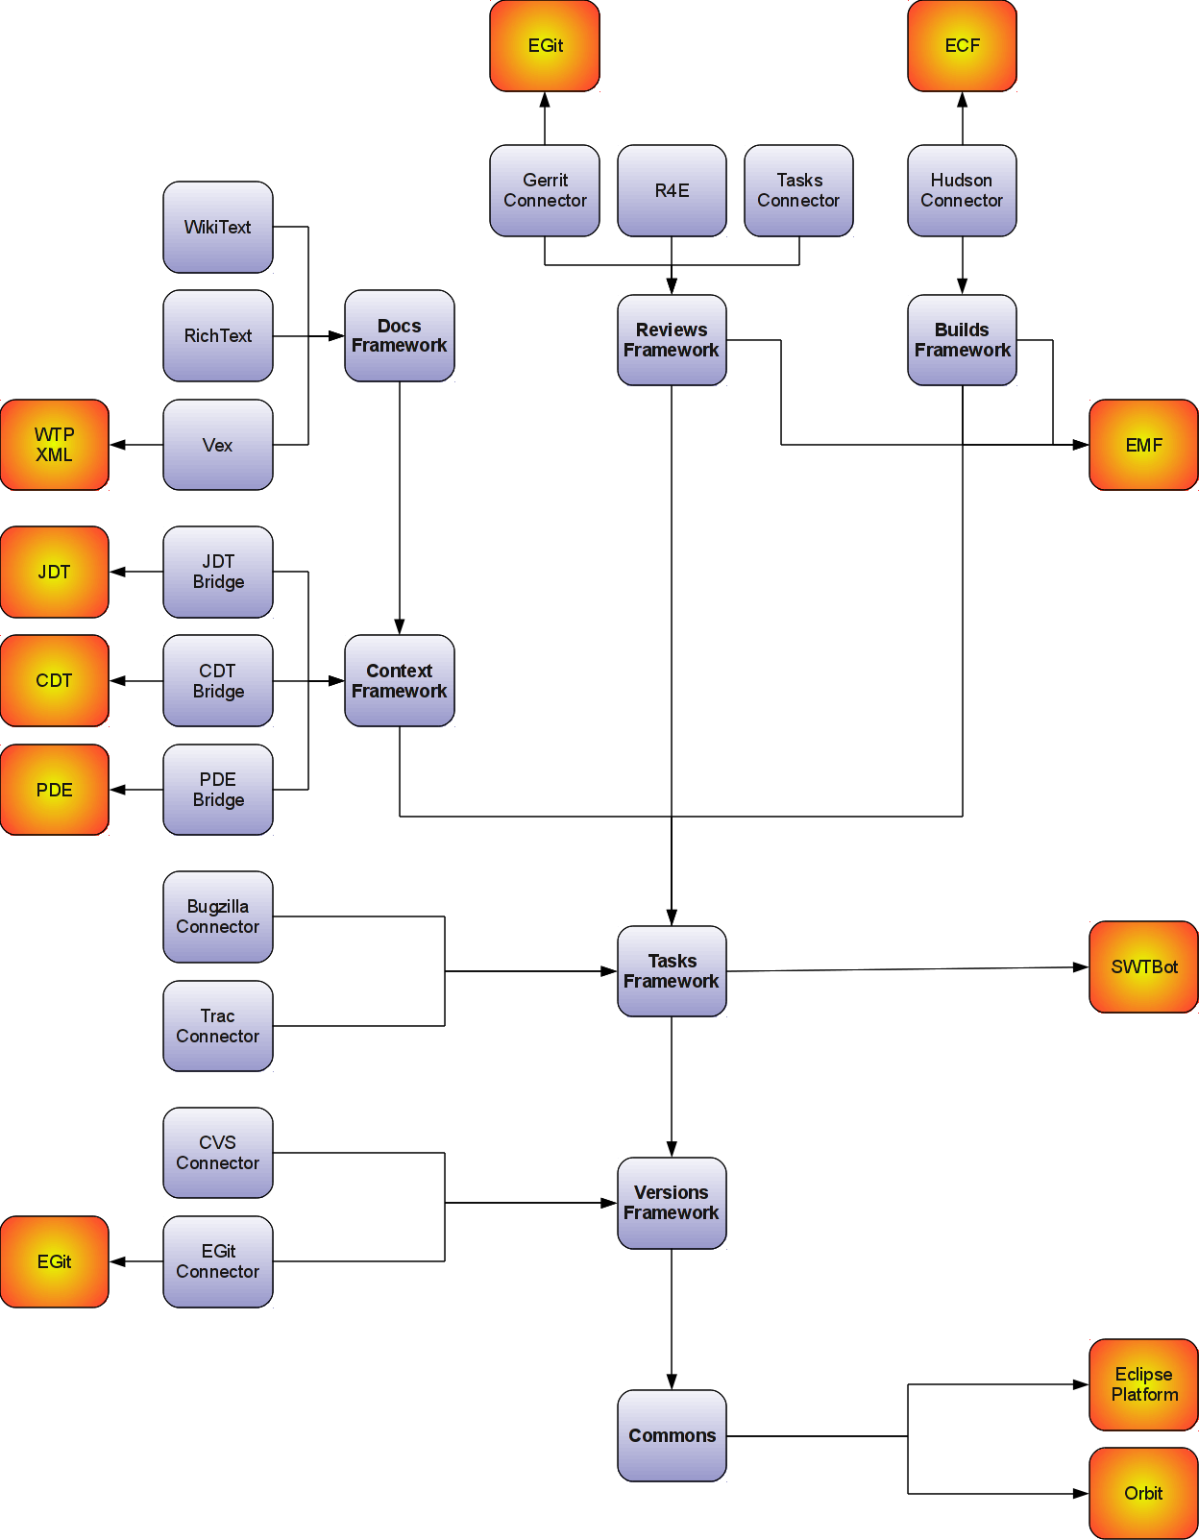
Frameworks
  Builds API
  Commons API
    Repository API
    Identity API
    Monitor API
  Context API
  Reviews API
  Tasks API
    Team API
  Versions API
  WikiText API
Notes:
Mylyn Release Review
Mylyn Release Review
Mylyn Release Review

Slide 18
Architectural Issues
  Components in Mylyn Commons were restructured and provisional packages were promoted to API. Consumers are strongly encouraged to consume the new APIs for Mylyn 3.7 based extensions. The Porting Guide at http://wiki.eclipse.org/Mylyn/Porting_Guide#Mylyn_Commons has more details.
Notes:
Mylyn Release Review
Mylyn Release Review
Mylyn Release Review

Slide 19
Tool Usability (Unchanged since 3.0)‏
Maturity
  Constant stream of stable releases
  Bundled as part of EPP distributions
  Committers work from HEAD, contributors from weekly builds, community from milestone releases
User feedback says it best
  "..arguably the most productivity-enhancing idea since background compilation and all of the things that enables (namely refactoring and syntax highlighting). I just don't know how I ever was able to read and understand the Eclipse sources (or the sources of other large projects I've worked on) before Mylar, it's just that good.“ (David Orme)‏
  “I would like to commend you on this very good tool. It has increased my productivity by 3 folds - no kidding...” (Deepak Devje)‏
Notes:
Mylyn Release Review
Mylyn Release Review
Mylyn Release Review

Slide 20
End-of-Life
Active Streams:
Mylyn 3.7 supports Eclipse 4.2, 3.8, 3.7, and 3.6.
End-of-Live Streams:
Mylyn 3.6 support Eclipse 3.7, 3.6 and 3.5.
Notes:
Mylyn Release Review
Mylyn Release Review
Mylyn Release Review

Slide 21
Bugzilla
Bugs resolved
  Mylyn 3.7 (March 21, 2012): 347 (as of February 27, 2012)
  Mylyn 3.6 (June 22, 2011): 93 (as of May 30, 2011)
  Mylyn 3.5 (March 16, 2011): 324
  Mylyn 3.4 (June 23, 2010): 171
  Mylyn 3.3 (Oct. 26th, 2009): 166
  Mylyn 3.2 (June 24, 2009): 333‏
  Mylyn 3.1 (March 4, 2009): 431
  Mylyn 3.0 (June 25, 2008): 493
Notes:
Mylyn Release Review
Mylyn Release Review
Mylyn Release Review

Slide 22
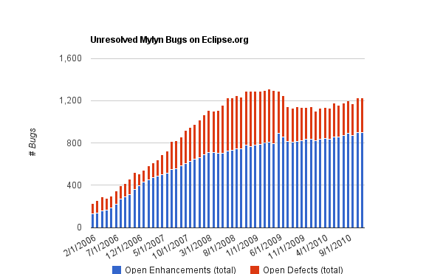
Community
Notes:
Mylyn Release Review
Mylyn Release Review

Slide 23
Standards (Unchanged since 3.1)‏
Mylyn requires J2SE 1.5, provides warning if installed on 1.4
  Key driver for using1.5 was the benefits of generics-aware APIs
Notes:
Mylyn Release Review
Mylyn Release Review
Mylyn Release Review

Slide 24
UI Usability (Unchanged since 2.1)‏
Accessibility
  No review for this release, but following accessibility guidelines
  http://www.eclipse.org/articles/Article-Accessibility/index.html
Follow the User Interface Guidelines
  Focus on consistent visual design, UI elements, icons
  http://wiki.eclipse.org/index.php/User_Interface_Guidelines
Validated UI usability with field study
  For details see:
  http://kerstens.org/mik/publications/2006-11-mylar-fse.pdf
  Mylyn Monitor is being used to gather usage feedback: http://mylyn.eclipse.org/monitor/upload/UsageAnalysisServlet
Notes:
Mylyn Release Review
Mylyn Release Review
Mylyn Release Review

Slide 25
Schedule
Project plan: http://www.eclipse.org/projects/project-plan.php?projectid=mylyn
Release
Date
Platform Release
Notes
Mylyn 3.6
June 22, 2011
Eclipse 3.6.2 and 3.7
Indigo
Mylyn 3.6.1
August 9, 2011
Eclipse 3.6.2 and 3.7
Mylyn 3.6.2
September 23, 2011
Eclipse 3.6.2 and 3.7
Indigo SR1
Mylyn 3.6.3
October 26, 2011
Eclipse 3.6.2 and 3.7.1
Mylyn 3.6.4
November 18, 2011
Eclipse 3.6.2 and 3.7.1
Mylyn 3.6.5
February 24, 2012
Eclipse 3.6.2 and 3.7.2
Indigo SR2
Mylyn 3.7
March 21, 2012
Eclipse 3.6.2, 3.7.2, 3.8M6 and 4.2M6
Juno M6
Mylyn 3.8
June 27, 2012
Eclipse 3.6.2, 3.7.2, 3.8 and 4.2
Juno
Notes:
Mylyn Release Review
Mylyn Release Review
Mylyn Release Review

Slide 26
Communities
Users
  Lively community on newsgroup and bug reports
  Articles and blogs by community members
Developers
  Contributor documentation on Eclipsepedia
  Lively community on mylyn-dev and bug reports
Integrators
  Integrator documentation on Eclipsepedia
  Separate mylyn-integrators mailing list removes need for integrators to watch the higher-traffic mylyn-dev
  Specific discussions on “[connector]” and “[bridge]” bug reports, as well as “manage integration with Foobar” bug reports
Notes:
Mylyn Release Review
Mylyn Release Review
Mylyn Release Review

Slide 27
Projects and Committers
The R4E component which was part of the Mylyn Reviews has project has been promoted to a sub-sub-project.
The Vex and Mylyn Intent projects have been created under Mylyn Docs.
The Model Focusing Tools project has been created under Mylyn Context.
Sam Davis has joined the Mylyn Tasks project as a committer.
Notes:
Mylyn Release Review
Mylyn Release Review
Mylyn Release Review

Slide 28
IP Log
Contributions are tracked in Git commits through setting the commit author accordingly or flagged as +iplog as they are applied.
Aggregated IP log:
  http://eclipse.org/projects/ip_log.php?projectid=mylyn,mylyn.builds,mylyn.commons,mylyn.context,mylyn.docs,mylyn.reviews,mylyn.tasks,mylyn.versions
Sub-project IP logs:
  Mylyn Builds: http://eclipse.org/projects/ip_log.php?projectid=mylyn.builds
  Mylyn Commons: http://eclipse.org/projects/ip_log.php?projectid=mylyn.commons
  Mylyn Context: http://eclipse.org/projects/ip_log.php?projectid=mylyn.context
  Mylyn Docs: http://eclipse.org/projects/ip_log.php?projectid=mylyn.docs
  Mylyn Reviews: http://eclipse.org/projects/ip_log.php?projectid=mylyn.reviews
  Mylyn Tasks: http://eclipse.org/projects/ip_log.php?projectid=mylyn.tasks
  Mylyn Versions: http://eclipse.org/projects/ip_log.php?projectid=mylyn.versions
Notes:
Mylyn Release Review
Mylyn Release Review
Mylyn Release Review

Slide 29
IP Log(2)
Mylyn Commons, Mylyn Context, Mylyn Docs, and Mylyn Tasks ship code that was migrated from the Mylyn tools project for which contributions were tracked in a CSV file located at http://www.eclipse.org/mylyn/doc/mylyn-iplog.csv.
Since the 3.4.3 release contributions are tracked through the automatic IP log but contributions applied in earlier releases are listed in the CSV file. It is planned to flag contributions listed in the IP log for a future release to fully migrate to the automatic IP log.
Notes:
Mylyn Release Review
Mylyn Release Review
Mylyn Release Review

Slide 30
IP Issues
None.
Notes:
Mylyn Release Review
Mylyn Release Review
Mylyn Release Review

Slide 31
Release review version
These slides are based on the following version of the Release review document
  Version 032 – January 15, 2006
Notes:
Mylyn Release Review
Mylyn Release Review
Mylyn Release Review

