Slide 1
mylar
project creation review
may 9, 2005

Slide 2
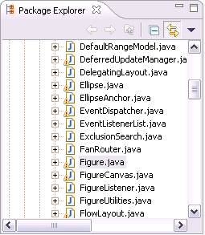
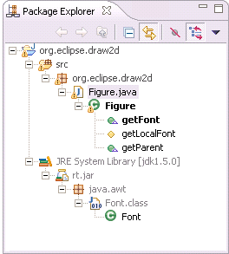
Overview
Eclipse views get overloaded when working on large systems
Current Mylar prototype makes working with large Java projects as easy as it is to work with small projects
Shows developers only what they are working on
  Encodes a degree of interest model by monitoring developers’ work
  Provides standard Eclipse views with features such as interest-based filtering, highlighting, folding
vs.

Slide 3
Scope
Demonstrate that modeling task context is a core concern of the IDE platform, and that it can be seamlessly integrated into Eclipse to better support developers working with large workspaces.
Build the core models, infrastructure, and UI components required to model and expose task context. The reference implementation will be tools for Java and Eclipse plug-in development.
Solicit contributions to extend the interest model to additional Eclipse development platforms as C/C++ and J2EE, and to additional tools such as those for task management and information visualization.
Provide a platform for ideas and prototypes that help scale the Eclipse user interface to very large systems.

Slide 4
Participants
Initial committers (UBC)
  Mik Kersten: project lead
  Gail Murphy: project manager
  Shawn Minto: committer, component owner of Bugzilla and XML support plug-ins
Interested parties
  CHISEL lab (UVic): Margaret-Anne Storey
  JDT (IBM): Philippe Mulet
  AspectJ/AJDT (IBM Hursley): Adrian Colyer
  CDT (Texas Instruments Canada): Winnie Lai
  Rational (IBM): Jin Li
Goal is to make it easy and worthwhile to contribute extensions, ideas and implementation
  Engage early and engage often
  Initial developer community will include interested parties and individuals who have expressed interest in extending Mylar

Slide 5
Community
Will encourage contributions in forms other than source
  Ideas, guidance, discussions, publications
  Current interest from Imperial College of London, Chinese University of Hong Kong
Initial user community
  87 people have signed up for the pre-release
Responses to the project
  EclipseCon 2005: I thought Mylar was the most exciting technology I saw at the conference (including all the commercial vendor offerings)!" [Sean Woodhouse, Technical Director of Verasta]
  Blogs
    The coolest plug-in you’re not using (eclipsepowered.org)
    Mylar: eclipse plugin to avoid information blindness (jroller.com/page/werner)

Slide 6
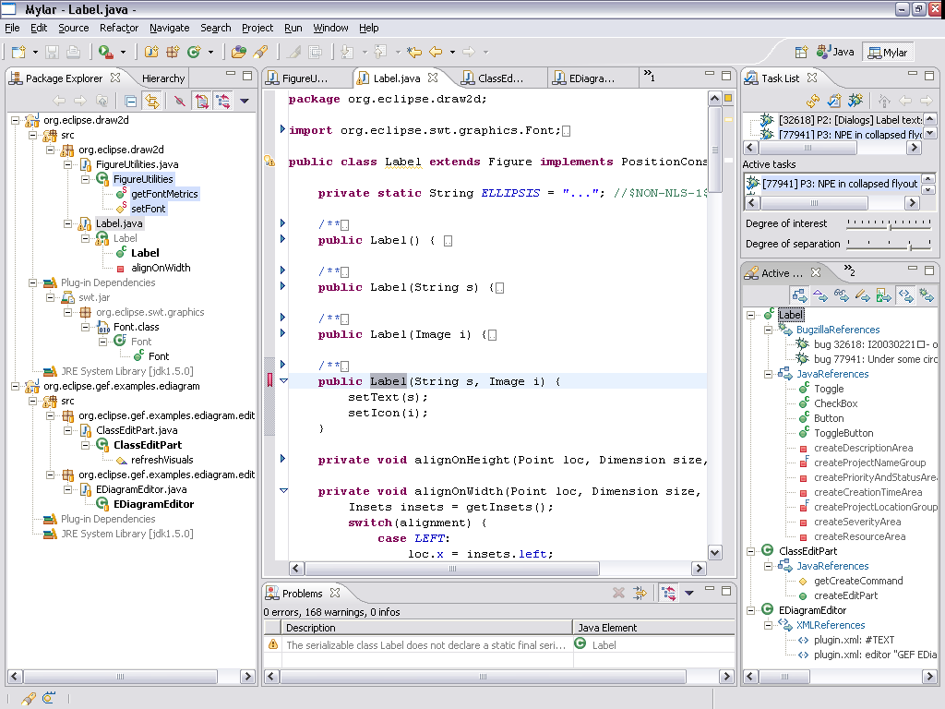
Implementation
Mylar core
  Model APIs: degree-of-interest, degree-of-separation
  UI: interest filters, highlighters, sorters, folding, actions
Mylar tools
  Map domain structure
  to interest model
  Provide search
  facilities
  Extend views and
  editors
Supporting tools
  Monitor: user studies
  Task list: task
  management
  integration

Slide 7
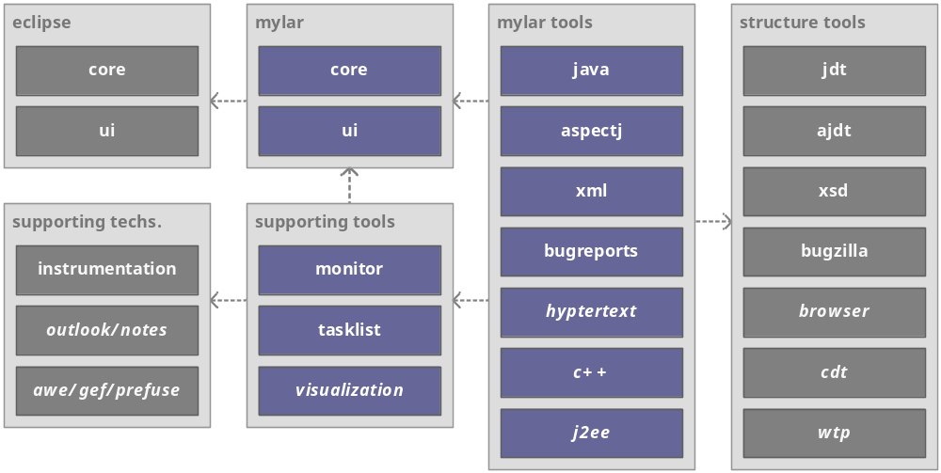
Architecture
Mylar tools depend on existing eclipse.org projects and components
No coupling between the tools so they can be used independently
Future plug-ins and dependencies are italicized

Slide 8
Plan
2005-Q2
  Complete preview release of Java and plug-in development support
2005-Q3
  Conduct large user study on the effectiveness of the model and UIs
  Harden model based on study data
  Create APIs for integrating Mylar with additional development tools
  Engage and support contributions and extensions
2006
  Extend support to J2EE, C++, hypertext documents, RCP
2007
  Demonstrate that modeling task context is a core concern of the Eclipse platform and UI
  If successful, graduate the core technology and implementation out of the Eclipse Technology Project; if not, review charter and purpose

