Slide 1
Mylyn 3.0 Release Review
Mik Kersten
June 4, 2008
Notes:
Mylyn Release Review

Slide 2
Schedule
Release | Date | Platform Release | Notes
Mylyn 2.1M | August 27, 2007 | Eclipse 3.3.0 and 3.4M1
Mylyn 2.1 | September 26, 2007 | Eclipse 3.3.1 and 3.4M2 | Europa Fall Maintenance
Mylyn 2.2M | November 7, 2007 | Eclipse 3.3.1 and 3.4M3
Mylyn 2.2 | December 19, 2007 | Eclipse 3.3.1 and 3.4M4
Mylyn 2.3M | February 11, 2008 | Eclipse 3.3.1 and 3.4M5
Mylyn 2.3 | February 27, 2008 | Eclipse 3.3.2 and 3.4M5eh | Europa Winter Maintenance (Feb 29)
Mylyn 3.0RC1 | May 21, 2008 | Eclipse 3.4RC1
Mylyn 3.0RC2 | May 28, 2008 | Eclipse 3.3.2 and 3.4RC2
Mylyn 3.0RC3 | June 4, 2008 | Eclipse 3.3.2 and 3.4RC3
Mylyn 3.0RC4 | June 11, 2008 | Eclipse 3.3.2 and 3.4RC4
Mylyn 3.0 | Jun 25, 2008 | Eclipse 3.3.2 and 3.4.0 | Ganymede Release
Notes:
Mylyn Release Review

Slide 3
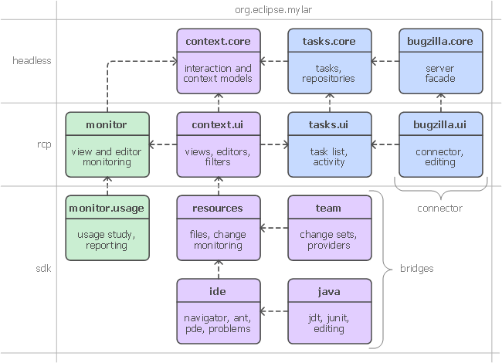
APIs
Breaking API changes since Mylyn 2.3:
  See: http://wiki.eclipse.org/Mylyn_Porting_Guide
  Mylyn 2.3 supports Eclipse 3.4 and 3.3 (via separate streams)
Frameworks:
  Commons API
  Context API
  Tasks API
  Monitor API
  Team API
Requires J2SE 1.5
Notes:
Mylyn Release Review

Slide 4
Bugzilla
Bugs resolved
  Mylyn 3.0 (June 25, 2008): 315
  Mylyn 2.3 (Feb. 27, 2008): 276
  Mylyn 2.2 (Dec. 19, 2007): 384
  Mylyn 2.1 (Sep. 28, 2007): 462
  228 bugs resolved via one or more contributor patches since 2.0
Notes:
Mylyn Release Review

