Slide 1

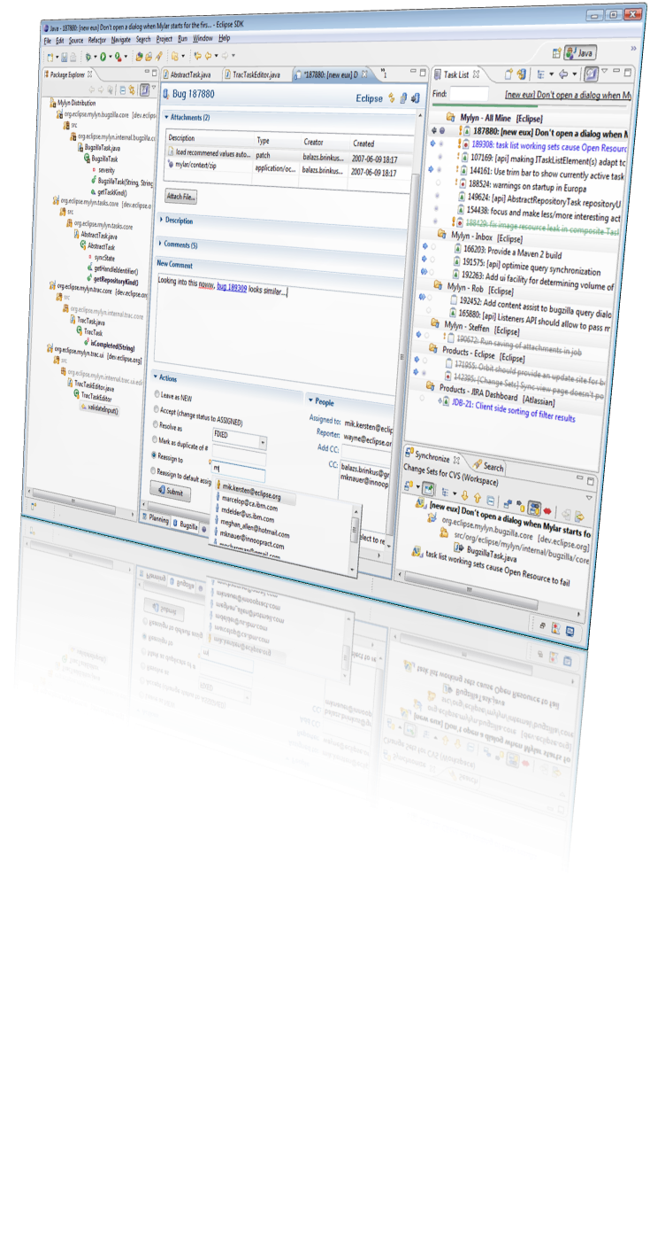
Eclipse 3.3
and
Mylyn 2.0
Mik Kersten
Mylyn Project Lead, Tasktop President & CTO
BZ Media Webinar, July 11 2007, made available under the EPL v1.0
Notes:
Mylar: a Task Focused UI for Eclipse

Slide 2
The state of the art
Modern Java™ IDEs
  Reduce friction with refactoring, content assist, DWIM editing
  Feature sets are comparable
Eclipse 3.3
  All the features and streamlining you expect and more
  Features are extensible thanks to the quality of the Platform
Mylyn 2.0
  Seamless integration of a new way of working
  Exemplifies the extensibility of Eclipse
This talk highlights
  Key Eclipse & Mylyn features via a Task-Focused walk-through
Notes:
Mylyn: a Task Focused UI for Eclipse

Slide 3
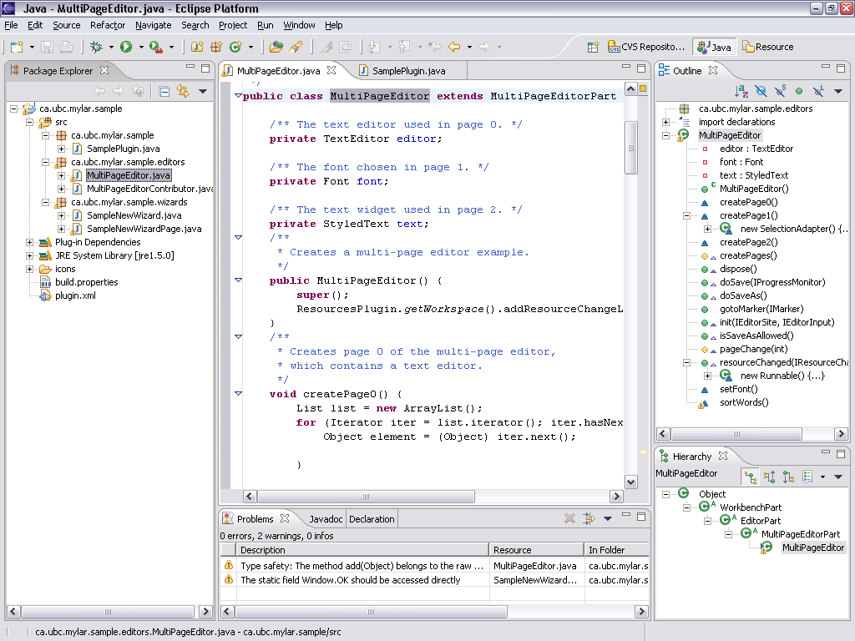
Notes:
Mylar: a Task Focused UI for Eclipse
Task also show structure of system
Careful about overloading word “structure”
IDEs make the structure of a system explicit,
easy to query, and to navigate

Slide 4
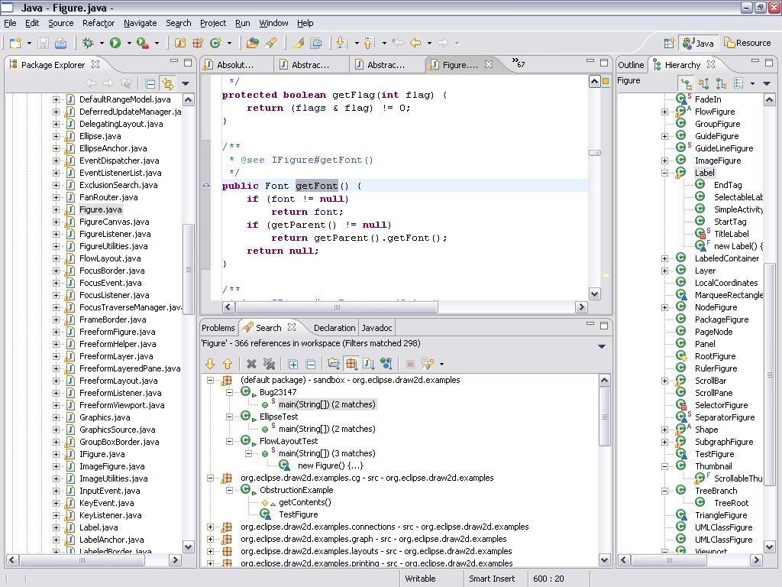
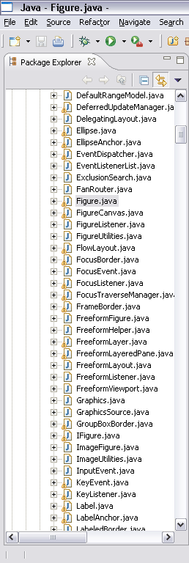
Information overload
Context loss when multi-tasking
Notes:
Mylar: a Task Focused UI for Eclipse

Slide 5
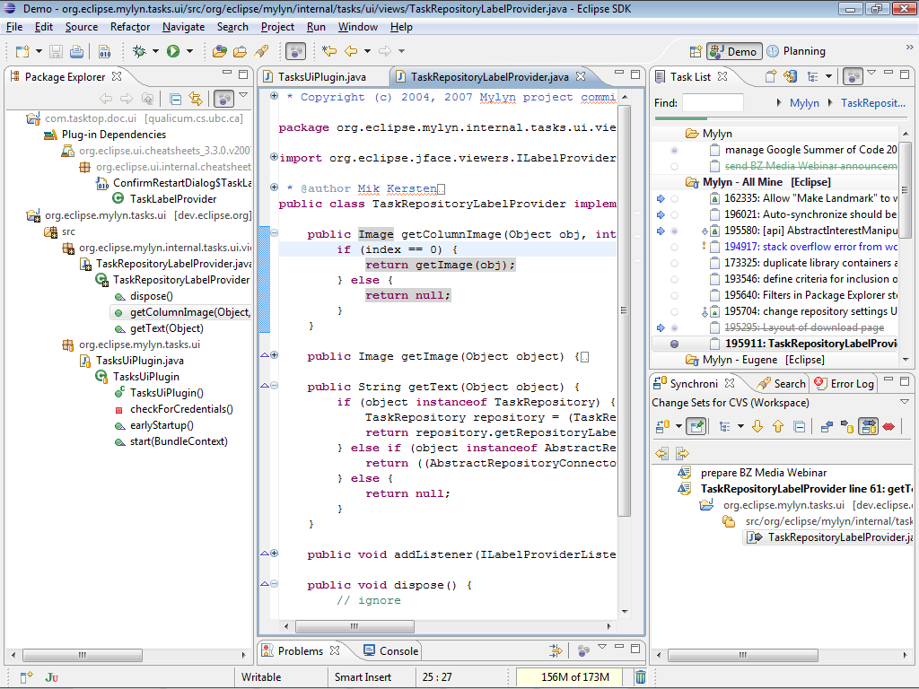
With Mylyn
Tasks are integrated
See only what you are working on
Notes:
Mylar: a Task Focused UI for Eclipse

Slide 6
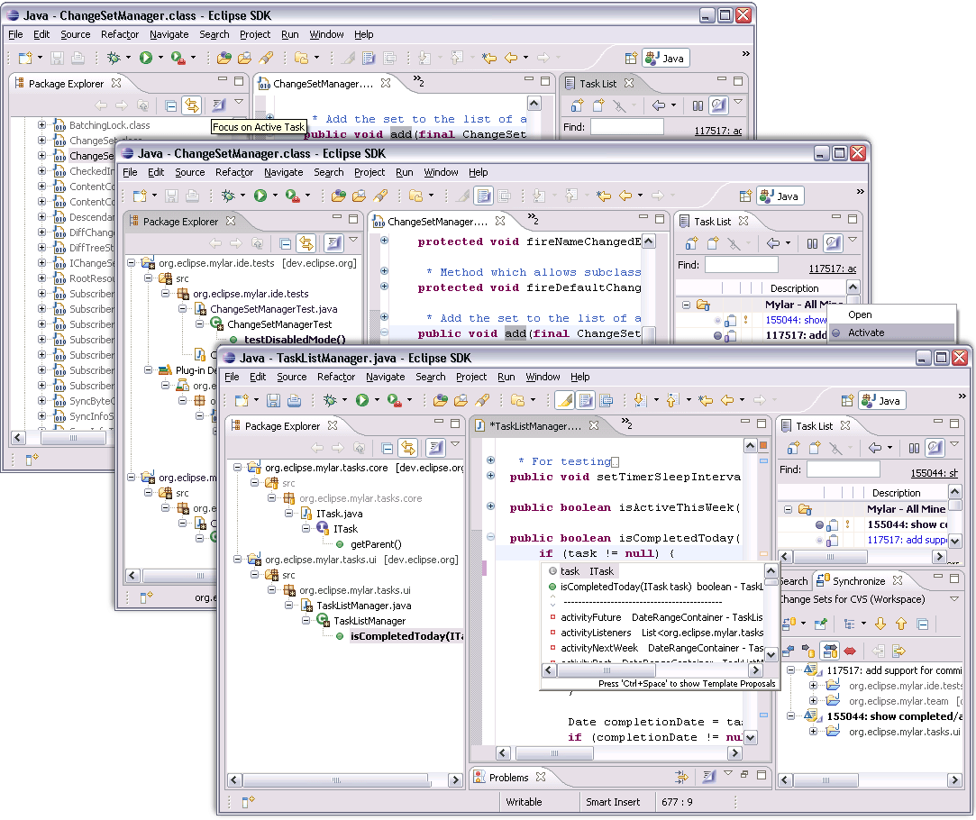
Demo 0
Notes:
Mylar: a Task Focused UI for Eclipse

Slide 7
Overview
Demos of the Task-Focused UI
  Integrated task management
  Automated context management
  Collaboration
  Planning
Highlights of key Eclipse features
  Good coverage of the 3.3 New & noteworthy
  Summary of remaining highlights at the end
Conclusion
  Extensibility and ecosystem
Notes:
Mylar: a Task Focused UI for Eclipse

Slide 8
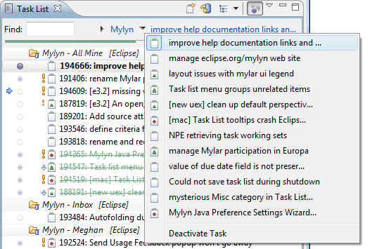

Task management
Before Mylyn
  Scattered throughout web apps, code and pieces of paper
  No integration with IDE workflow
One task list
  Manage all your tasks in a single personalized view
  Eclipse’s rich searching, linking and editing facilities
Repository connectors
  Integrate issue trackers and
  project management tools
  Offline editing and access
  Integrated change notifications
Demo
Notes:
Mylar: a Task Focused UI for Eclipse

Slide 9
Demo 1: Tasks
Task List
  Open “plan and prepare” task with incoming comment
  Make outgoing comment
  Show planning section, make note
  Drag-and-drop attachment
Queries and repositories
  Add query to Eclipse Outliner (non-existing repository)
  Show Browser tab, open query with browser
Integration
  Linking in task editor, in Java editor
  Open task dialog
  Search for all Mylyn 2.0M2 bugs
  Create bug from error
Notes:
Mylar: a Task Focused UI for Eclipse

Slide 10
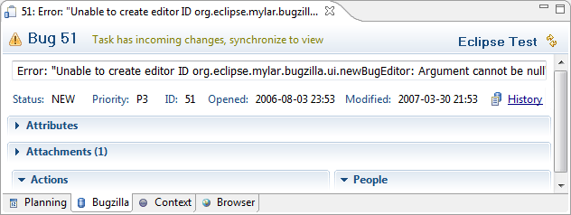
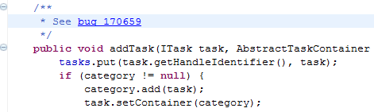
New in Eclipse 3.3
Features
  Pervasive spell checking
  Pervasive hyperlink detection
Experience
  Welcome improvements
  Global proxy settings
  Forms error messages and progress
Finesse
  Forms look and feel enhancements
  SWT: native widgets for Find and date picker, Vista
  JFace: owner draw for customized UIs
Notes:
Mylyn: a Task Focused UI for Eclipse

Slide 11
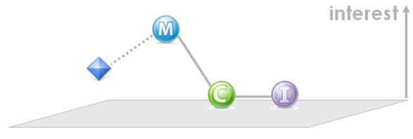
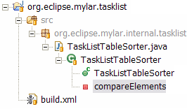

Task-focused UI
Information overload
  Time wasted scrolling, browsing and searching, tagging, filtering
  Constant multi-tasking causes context loss
Task context
  Mylyn monitors your interaction
  Creates degree-of-interest model
  What you touch is in your context
  Actively managed as you work
Task-focused UI
  View filtering, element decoration
  Automatic folding, content assist ranking
  Editor and perspective management
  One-click task switching
Demo
Notes:
Mylar: a Task Focused UI for Eclipse

Slide 12
Demo 2: Task context
Activate task
  Unfilter Package Explorer, then Alt+click
  Open ContextCore plug-in
  Navigate to BundleContext, then back
  Ctrl+Space
  Unfilter, Alt+click
  Decay, make less interesting
  Deactivate, activate, editor management
  Open build.xml, filter Outline
Notes:
Mylar: a Task Focused UI for Eclipse

Slide 13
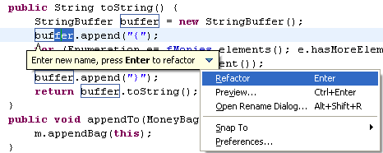
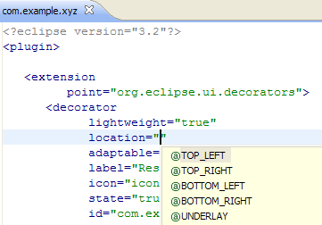
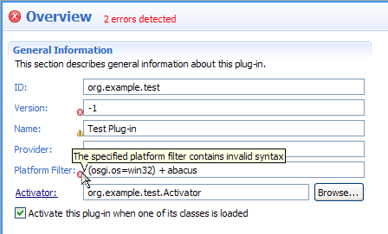
New in Eclipse 3.3
Features
  Refactoring happens directly in editor
  Content assist: annotations,
  generics, unresolved names
  Quick assist: show conversions,
  e.g. anonymous to local, get/set
Experience
  Thorough consistency, e.g. structured
  drag-and-drop, Undo, Paste
Finesse
  Plug-in and resource refactoring
  Content assist is pervasive
  Validation inline with forms
Notes:
Mylyn: a Task Focused UI for Eclipse

Slide 14
Collaboration
Before Mylyn
  Manual management of change sets
  Email overload, interruption, difficulty sharing expertise
Change set management
  Changes are automatically grouped by task
  Commit messages are automatic
  Everything is linked
Task context sharing
  Expertise is captured and can be shared via repository
  Tasks are easy to recall, knowledge easy to share
Demo
Notes:
Mylar: a Task Focused UI for Eclipse

Slide 15
Demo 3: Collaboration
Change sets
  Multiple separate sets
  Commit messages, commit message templates
Linking
  Navigate from History view entry
Context sharing
  Activate a task with server context only
  Work on it, show Context tab, start upload
Working sets
  Demonstrate switching
Notes:
Mylar: a Task Focused UI for Eclipse

Slide 16
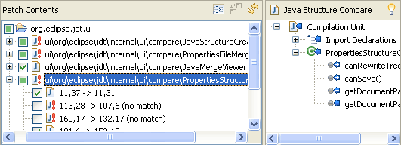
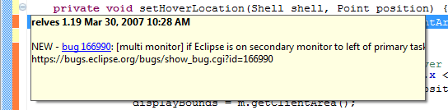
New in Eclipse 3.3
Features
  Patch wizard improvements: easier to mange conflicts
Experience
  Team Annotations: new
  options, show authors
Finesse
  Compare editor: better UI,
  quicker diffs
Notes:
Mylyn: a Task Focused UI for Eclipse

Slide 17
Planning
With Mylyn
  Too many tasks end up in your Task List
Personal planning
  Meshes with team planning activities
  Can monitor components and collaborations
Focused workweek
  See only the tasks you need to work on
Working sets
  Manage groups of projects
Demo
Notes:
Mylar: a Task Focused UI for Eclipse

Slide 18
Demo 4: Planning
Notes:
Mylar: a Task Focused UI for Eclipse

Slide 19
More new in Eclipse 3.3
Java developers
  Better code analysis
  Lots of debugging improvements
  Code clean-up options and usability improvements
Platform UI
  Trim improvements, user assistance, text editing, launching
  Working set improvements
PDE, RCP, SWT
  Extensibility, robustness, Platform and browser integration
  Tons of improvements for RCP and Plug-in app developers
See
  http://eclipse.org/downloads
Notes:
Mylyn: a Task Focused UI for Eclipse

Slide 20
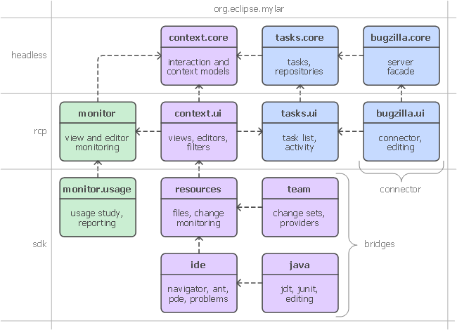
Extensibility
Notes:
Mylar: a Task Focused UI for Eclipse

Slide 21
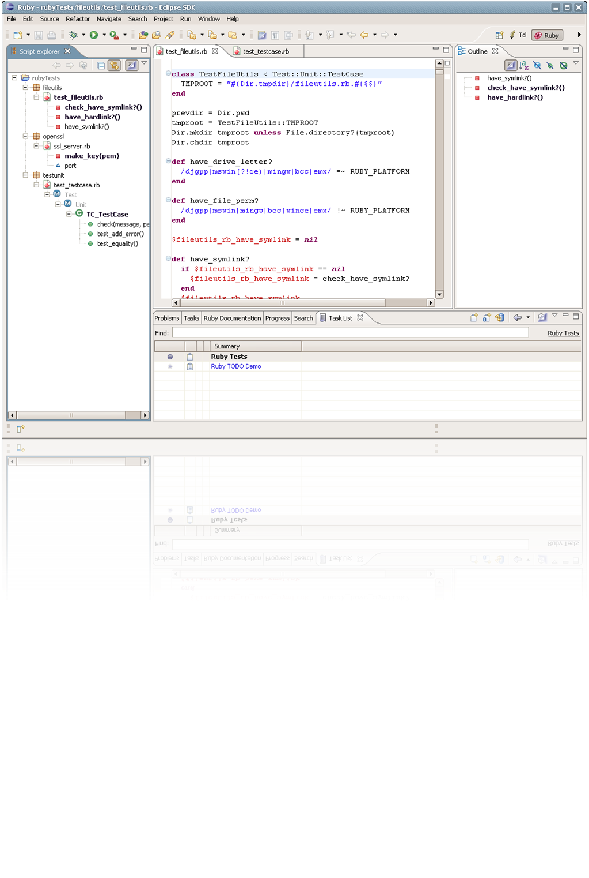
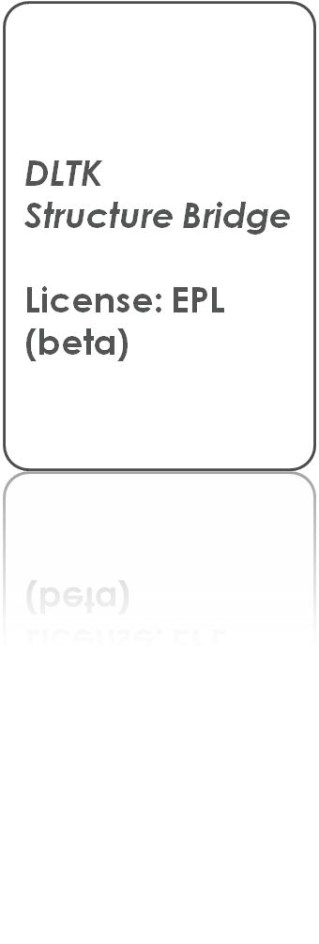

Slide 22
Changing the way we work
Tasks become explicit
  Dramatic reduction in information overload
  Information you need to get work done is at your finger tips
  Multitasking and recalling old tasks become effortless
  UI automation (e.g. working sets, search, commit messages)
  Keeps you in Eclipse and out of your browser and inbox
Validated technology
  Statistically significant increase in programmer productivity
  Task context model supports generic knowledge work
The frameworks are open and growing
  Eclipse and Mylyn are all about integration
Notes:
Mylar: a Task Focused UI for Eclipse

Slide 23
Questions?
Credits
  Mylyn Team: http://eclipse.org/mylyn/team
  Eclipse SDK Teams: http://eclipse.org/platform
Links
  Download Eclipse: http://eclipse.org/downloads
  Learn more about Mylyn: http://eclipse.org/mylyn/start
Notes:
Mylar: a Task Focused UI for Eclipse

