Slide 1
Mylar 1.0 Release Review
Mik Kersten
Rob Elves
November 22, 2006

Slide 2
Features
Task List (..mylar.tasks.*)
  Integrated tasks management for Eclipse (required)
  Task management view, rich editing, offline support
Task-Focused UI (..mylar.context.*)
  Automated context management (optional)
Bugzilla Connector (..mylar.bugzilla.*)
  Integrates Task List with Bugzilla repository (optional)
JIRA Connector (..mylar.jira.*)
  Integrates Task List with JIRA repository (optional)
Trac Connector (..mylar.trac.*)
  Integrates Task List with Trac repository (optional)
Notes:
Demo setup:
Activate active search
Demo config:
Filtered to Very High
Hyperlink bug: remove note, remove reminder
Context cleared on active task

Slide 3
Non-code aspects
User documentation
  Considerable body of user documentation
  Wiki-based FAQ, User Guide, and Tips & Tricks
  Web site: getting started, articles, flash videos, webinar
Developer documentation
  Wiki-based Contributors Guide
  Wik-based Integrators Guide
Localization/externalization
  In spite of large adoption by non-English countries, still no requests or votes for alternate languages, so postponed to Europa release

Slide 4
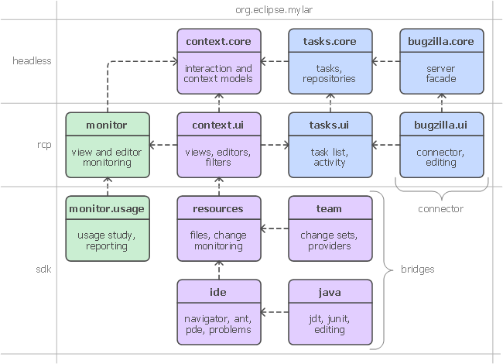
APIs
Three frameworks
  Tasks
  Context
  Monitor
  Each has
  multiple
  clients
  Some
  provisional
  and internal

Slide 5
Tool Usability
Maturity
  Constant stream of stable releases
  Started with weekly cycles, currently monthly releases and weekly developer builds
  All committers work bootstrapped from HEAD
Adoption
  Used by thousands in a production environments
  User feedback says it best: http://www.eclipse.org/mylar/archive.php

Slide 6
Architectural Issues
Tasks framework
  Supports several clients excluding the 3 internal ones
  1.0 is a point of stability but framework evolution will continue
  Breaking changes will be done in the Mylar 2.0 stream
Context framework
  Only one know extern clients currently extending
  Ready for early adopters of this API
Monitor framework
  Less mature, but several external clients extending it

Slide 7
End-of-Life
n/a, this is a 1.0 release

Slide 8
Bugzilla
Stats since Mylar 0.3
  2063 reports opened
  1579 resolved
  Most open bugs are feature or integration enhancement requests
  4 blocker/critical bugs left, will be resolved by 1.0 release
  For per-release bugs stats see http://www.eclipse.org/mylar/doc/new.php

Slide 9
Standards
Mylar runs on J2SE 1.5

Slide 10
UI Usability
Accessibility
  No review for this release, but follow guidelines
Follow the User Interface Guidelines
  All icons and graphical elements follow Eclipse conventions
Validated UI usability with field study
  http://kerstens.org/mik/publications/2006-11-mylar-fse.pdf

Slide 11
Schedule
Release scheduled for December 8th

Slide 12
Process
Open, transparent, permeable, and inclusive
  Evidenced by the very large number of community contributions
  All discussions in Bugzilla, mailing list, newsgroup, and open developer conference calls

Slide 13
Communities
Users
  Lively community on newsgroup and bug reports
  Articles and blogs by community members
Developers
  Lively community on mylar-dev and bug reports
Integrators
  Integrator wiki
  Discussions on [connector] and [bridge] bug reports
  Discussions on mylar-dev
  In future might need an integrator-specific forum, but current forums fine for now

Slide 14
IP Issues
IP process followed
  Still awaiting approval of Http Client 3.0
IP Log
  http://www.eclipse.org/mylar/doc/mylar-iplog.csv
Release under EPL

Slide 15
Project plan
Project plan
  Continue weekly developer releases for Eclipse 3.3 stream
  Follow Europa release schedule + 1 for Eclipse 3.2 and 3.3
  Eclipse 3.1 support is deprecated, but can do maintenance build if sufficient community interest

Slide 16
Release review version
These slides are based on the following version of the Release review document
  Version 032 – January 15, 2006

