Slide 1
Mylar a Task Focused UI for Eclipse
draft
Mik Kersten
University of British Columbia
Mylar Project Lead

Slide 2
Mylar
What is it?
  A new UI technology that focuses Eclipse on the task at hand
Why do I care?
  Eclipse users
    It makes you more productive when programming
    Tasks become explicit and easy to work with
  Eclipse developers and integrators
    Does for tasks and contexts what the SDK does for resources: makes them first class entities that you can build on

Slide 3
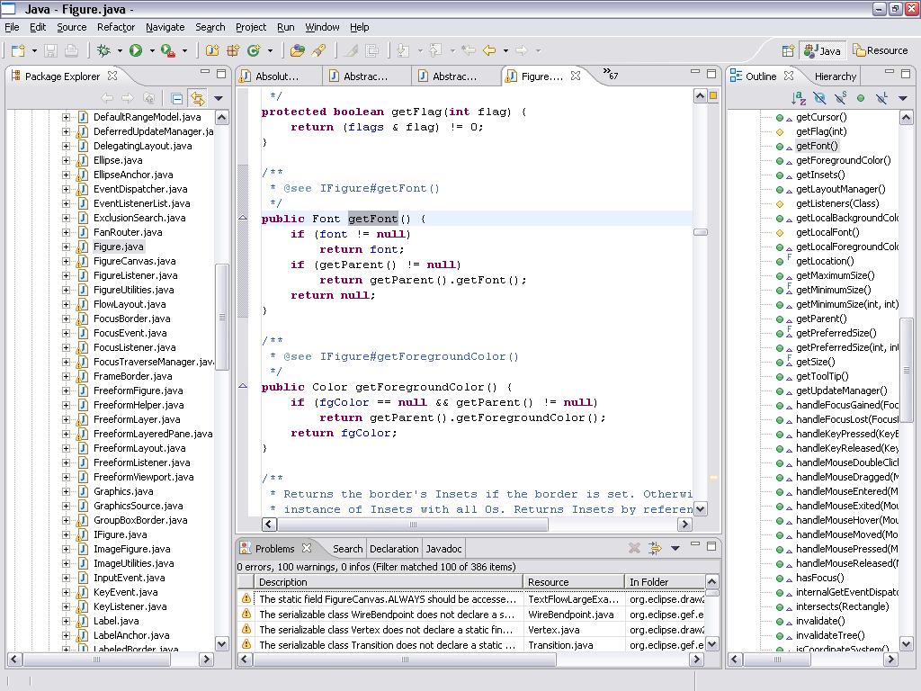
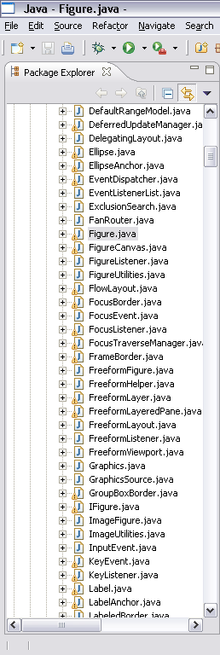
Without Mylar - information overload
With large workspaces, Eclipse views can fail to show the
forest for the trees
  Structure related to
  the task at hand
  is not explicit
  Time wasted
    Scrolling
    Searching
    Navigating

Slide 4
With Mylar - see just the information you need
For any task that we work on, we only care about a
subset of the system
  Mylar makes that subset explicit
All you need to do is indicate what task you’re working on
  Via task management and issue tracker integration
Task context model is created automatically
  Transparently monitors your programming activity
  Filtered views show what you expect

Slide 5
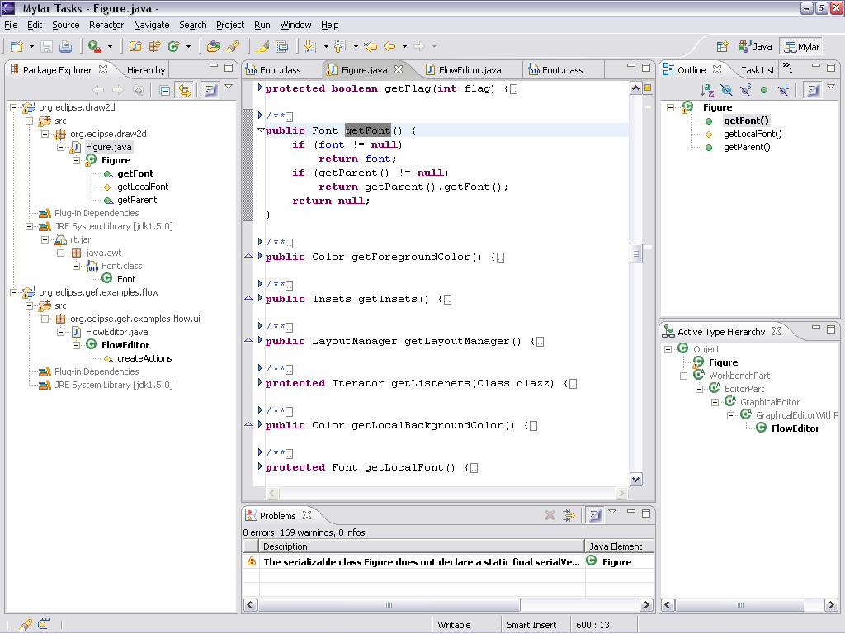
Mylar shows you only what you are working on

Slide 6
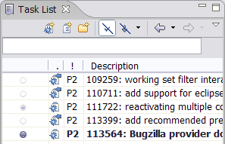
Talk will be about
Working with Mylar
  Makes working with tasks easy
    Personal tasks and planning
    Repository integration (Bugzilla, JIRA)
  Focuses the Eclipse UI on your task
    Views show only the elements relevant to the task-at-hand
    Java editor automatically folds away uninteresting elements
    Active Search shows related elements Java and XML files
    JUnit integration maintains a suite for your current context
    CVS integration enables synchronizing only the relevant resources
Building on Mylar
  Repository integration: connectors API
  Structure integration: bridges API
  UI integration: managed views and editors

Slide 7
Demos
Eclipse puts of what we need at our finger tips
  But we have to remember what it is (e.g. type names, resources, methods)
  Mylar reduces friction, repetitiveness
  When not to use Mylar
    Turn it off now and then to review package structure/API, clean up commented regions in editor
Task Repositories
  Full integration
    Reports to code: stack trace links
    Reports to context: auto populate from stack
    Code to reports: hyperlinks
    Reports to reports: bug links
    History view to reports

Slide 8
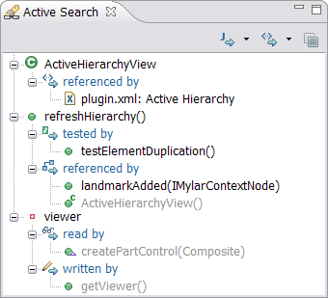
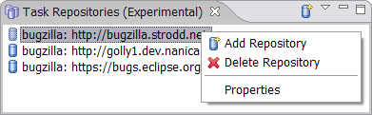
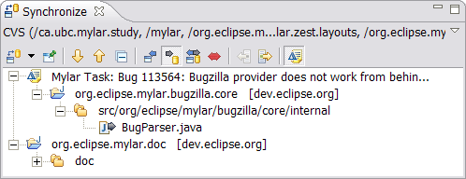
Demos
Views and editors
  Focusing JDT/SDK views, editor management, active views
  Working with Java, XML, and resources
Managing tasks
  Queries, categories, filtering, editing, web
Repository integration,
  Bugzilla, JIRA, web tasks
Working with contexts
  Recalling contexts, history,
  progress, planning
Team support
  Change sets, patching, pair
  programming, reporting

Slide 9
Vision
Idea: the more time we spend in Eclipse the more productive we are
  Email is not a good mechanism for task awareness
  The set of integrated authoring tools is growing
Tasks and contexts are a key part of that story
  Connect resources and communication
Stop overloading your inbox
  No more watching <component>-inbox
  Now (or soon) you will be able to turn off Bugzilla email notifications

Slide 10
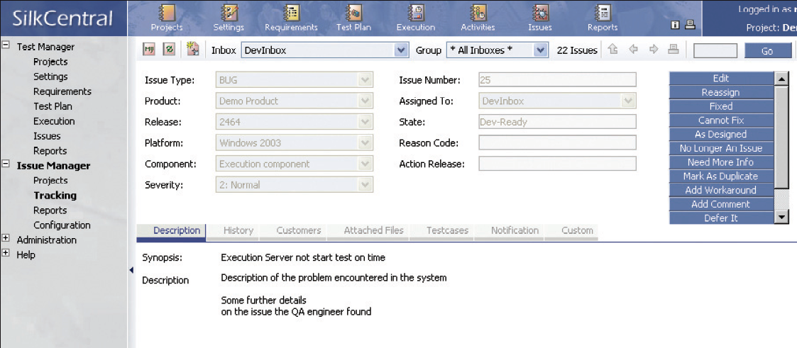
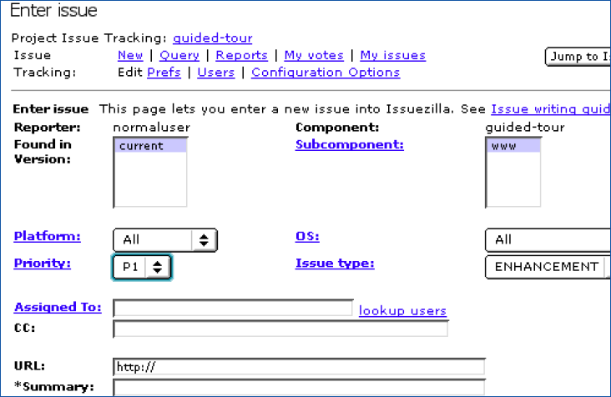
Unified UI for personal task management
Users need consistency, offline access, personal planning
  Web UIs don’t offer this, integrated Eclipse UI does
  Dozens of different task/bug/issue management UIs
Projects need flexibility, additional reporting offered by custom UIs
We need to work together on this

Slide 11
Under the hood
Concepts
  Mylar monitors your activity to encode an interaction history
  Uses this history to form a context for a task
  Context assigns a degree of interest to every element and relation
Implementation
  Structure bridges integrate context with existing models (e.g. Java)
  UI facilities: filters, decorators, managed views and editors,
  interest projection
  Task abstractions
  Mylar monitor

Slide 12
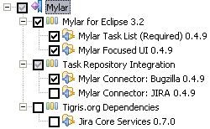
APIs and extension points
Provisional, for early API adopters only
  1.0 release will mark public APIs that follow Eclipse contract
Status
  Context stuff is mostly working
  Updates on the horizon
    Bridge
      Resources, XML
    Model
      Cross-task contexts
      Predicted interest

Slide 13
Status
What’s not quite there yet
  Effectively eusing others’ expertise

Slide 14
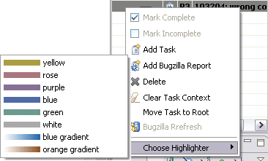
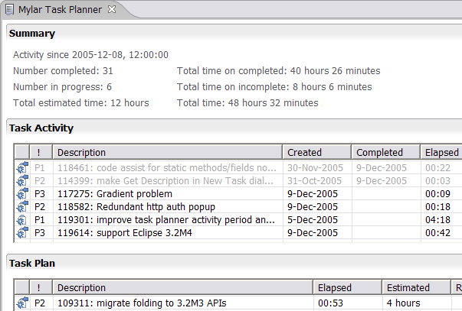
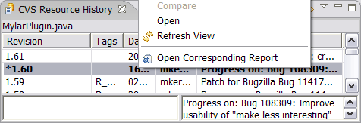
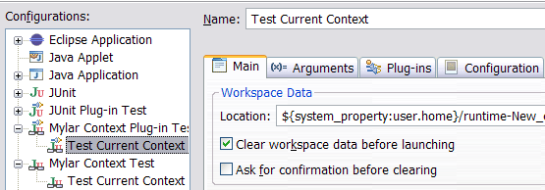
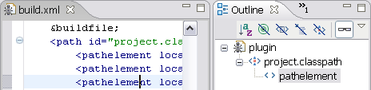
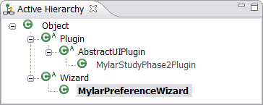
Lot’s more…
Come to the presentation to see the rest!

