Slide 1
Mylyn Tutorial
Mik Kersten
Copyright 2007 Tasktop Technologies
Notes:
Mylyn: a Task Focused UI for Eclipse

Slide 2
Overview
NOTE: these slides will change before the tutorial and additional introductory material from the Mylyn Eclipse Forum India talk will be used.
Overview
  Mastery of concepts
  Breadth of Mylyn tool knowledge
  Depth of knowledge of key features
Cover concepts
  Bugzilla as connector example
  Java as bridge example
  CVS as team provider example
Notes:
Mylyn: a Task Focused UI for Eclipse

Slide 3
Contents
1. Setup
2. Task Repositories
3. Task List
4. Personal Planning
5. Task Editing
6. Focused UI
7. Team Support
8. Best Practices
Notes:
Mylyn: a Task Focused UI for Eclipse

Slide 4
Setup
1
Notes:
Mylyn: a Task Focused UI for Eclipse

Slide 5
Download
Update site install
  Select Help->Software Updates->Find and Install.
  Select Search for new features to install and select Next.
  Select New Remote Site.
  Enter "Mylyn" for the name and insert the download site
  Make sure there is a check in the Mylyn box, and select Finish.
  Select the desired features
  Read the license agreements, accept or decline as appropriate, and either select Next (if you accept) or Cancel (if you do not accept).
  You will see a list of features and where to install them. If the default installation directory is fine, select Finish.
Install from Zip
  Unzip and copy plugins and features directories
Notes:
Mylyn: a Task Focused UI for Eclipse

Slide 6
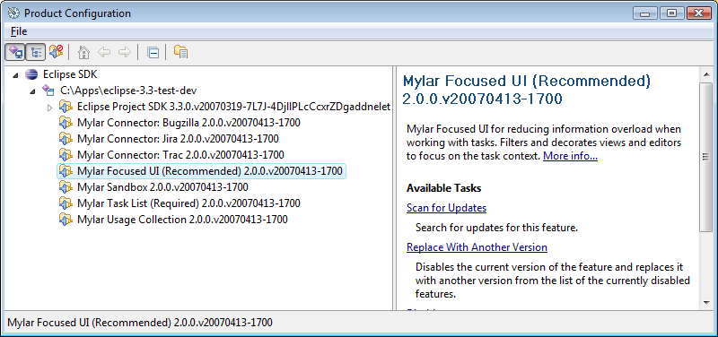
Installation
Typical install
  Task List
  Focused UI
  Connectors
Notes:
Mylyn: a Task Focused UI for Eclipse

Slide 7

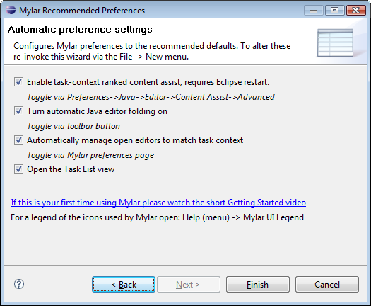
Configuration
Notes:
Mylyn: a Task Focused UI for Eclipse

Slide 8
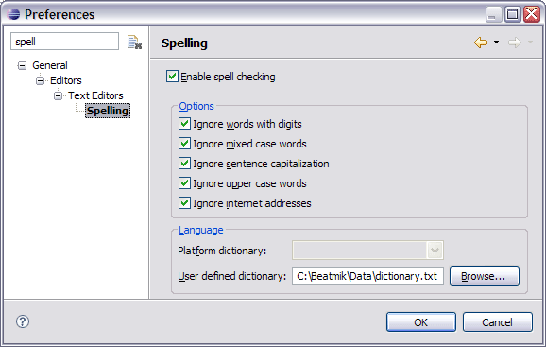
Dictionary
Configuring (3.2 only)
  Required for spell checking
  Download from: http://wordlist.sourceforge.net
Notes:
Mylyn: a Task Focused UI for Eclipse

Slide 9
Task Repositories
2
Notes:
Mylyn: a Task Focused UI for Eclipse

Slide 10
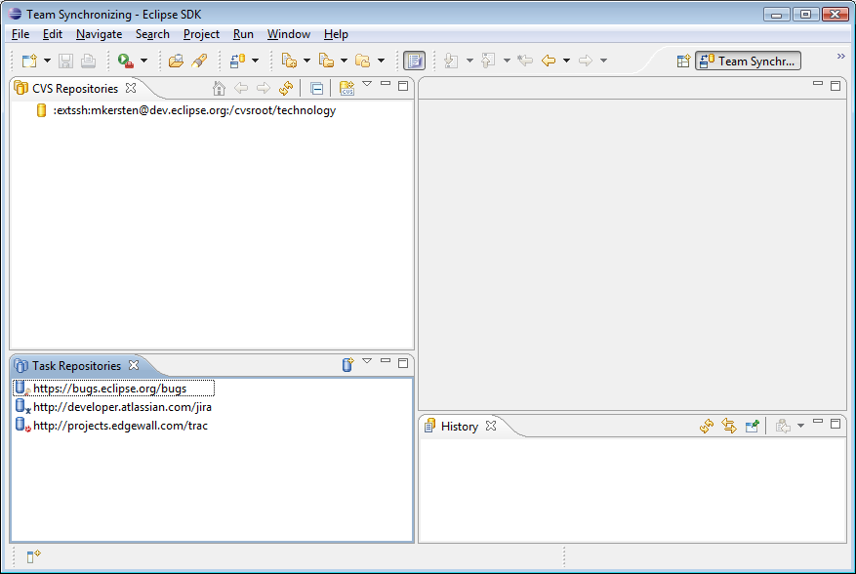
Perspective
Notes:
Mylyn: a Task Focused UI for Eclipse

Slide 11
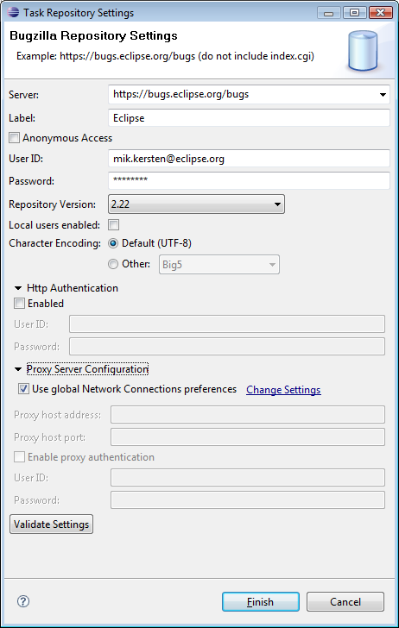
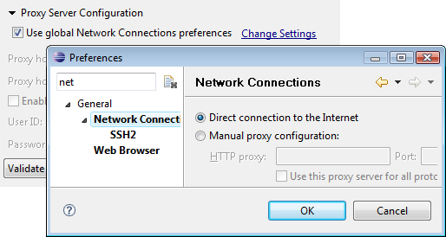
Adding a repository
Configuration
  Network settings are tricky
  Validation is key
Notes:
Mylyn: a Task Focused UI for Eclipse

Slide 12
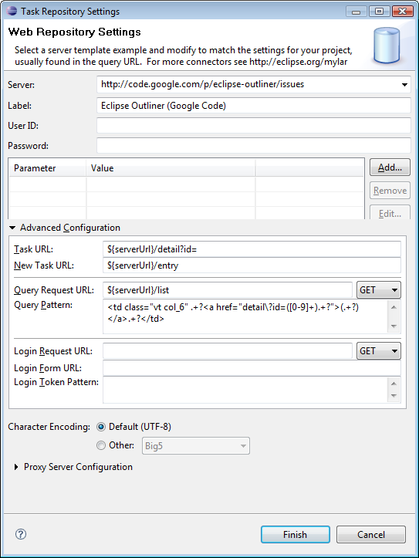
Generic Web Repository Connector
Notes:
Mylyn: a Task Focused UI for Eclipse

Slide 13
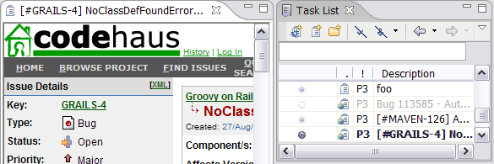
Working without a repository
Personal tasks
Drag-and-drop of URLs
  Hold Ctrl when dragging from Internet Explorer
Notes:
Mylyn: a Task Focused UI for Eclipse

Slide 14
Task List
3
Notes:
Mylyn: a Task Focused UI for Eclipse

Slide 15
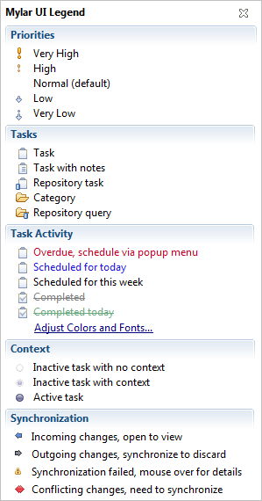
Concepts
Tasks
  Local
  Repository
Activity
  Scheduling
Context
  Activation
  Sharing
Synchronization
  Offline
Notes:
Mylyn: a Task Focused UI for Eclipse

Slide 16
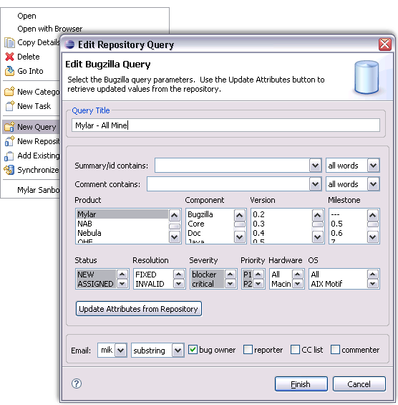
Queries & Categories
Notes:
Mylyn: a Task Focused UI for Eclipse

Slide 17
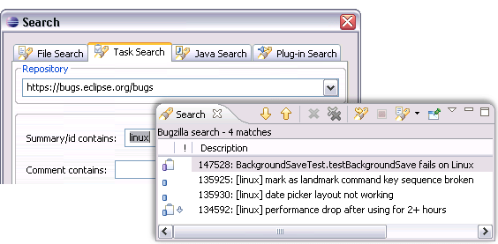
Search
Search uses the query editor/dialog
Notes:
Mylyn: a Task Focused UI for Eclipse

Slide 18
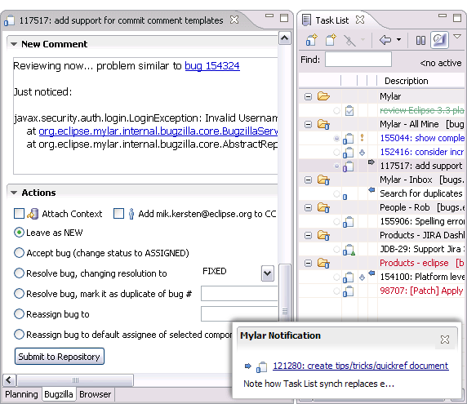
Synchronization
Notes:
Mylyn: a Task Focused UI for Eclipse

Slide 19
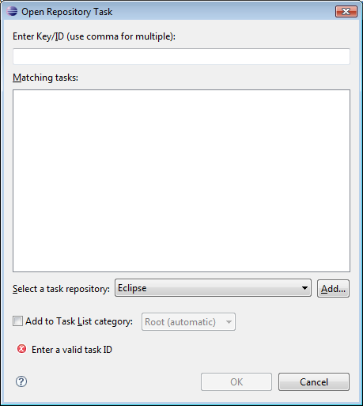
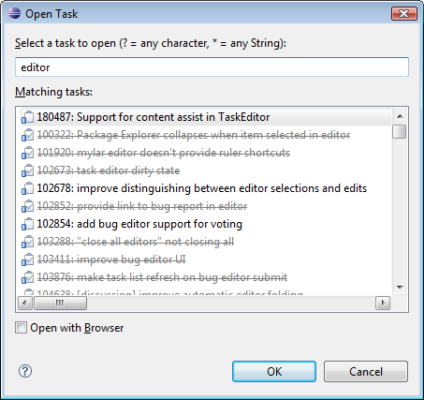
Task Navigation
Notes:
Mylyn: a Task Focused UI for Eclipse

Slide 20
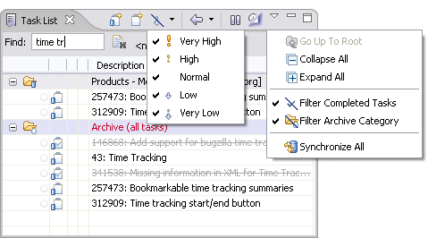
Manual Management
Manual filtering
Manual sorting
Notes:
Mylyn: a Task Focused UI for Eclipse

Slide 21
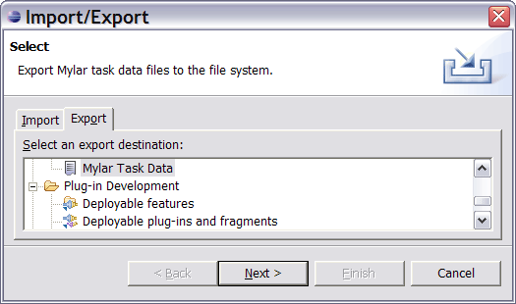
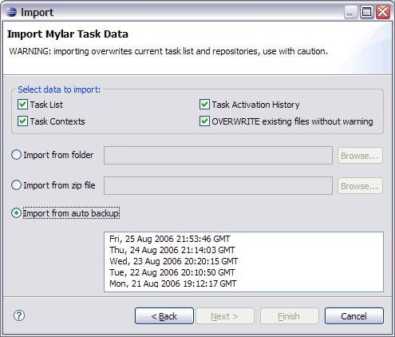
Import, export and restore
Notes:
Mylyn: a Task Focused UI for Eclipse

Slide 22
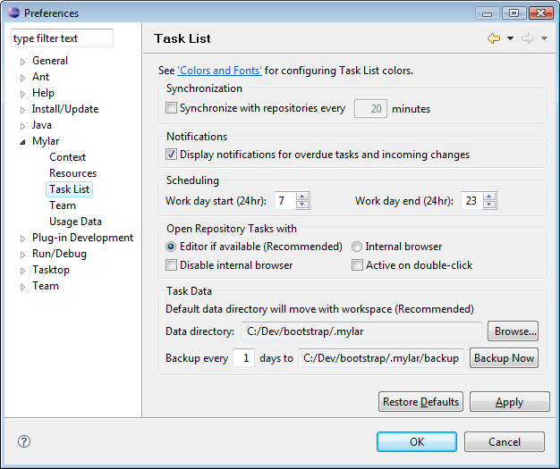
Preferences
Notes:
Mylyn: a Task Focused UI for Eclipse

Slide 23
Personal Planning
4
Notes:
Mylyn: a Task Focused UI for Eclipse

Slide 24
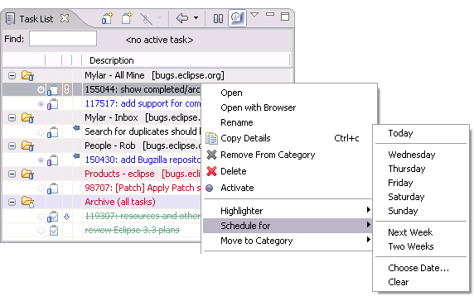
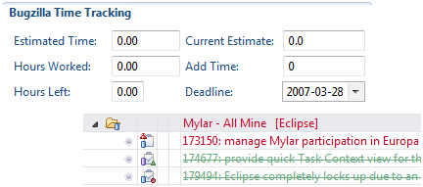
Scheduling and due dates
Notes:
Mylyn: a Task Focused UI for Eclipse

Slide 25
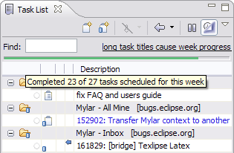
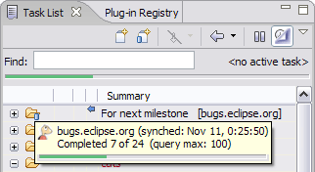
Progress
Notes:
Mylyn: a Task Focused UI for Eclipse

Slide 26
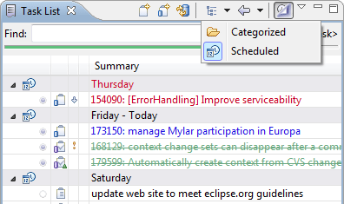
Scheduled presentation
Categorized
  Use when incoming tasks should be seen
Scheduled
  Use to focus on priorities
Notes:
Mylyn: a Task Focused UI for Eclipse

Slide 27
Task Editing
5
Notes:
Mylyn: a Task Focused UI for Eclipse

Slide 28
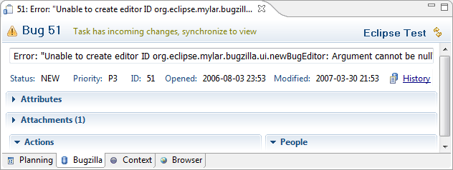
Concepts
Rich editing
  Attributes
  Attachments
  Comments
Synchronization
  Transparent offline support, Incoming changes
Notes:
Mylyn: a Task Focused UI for Eclipse

Slide 29
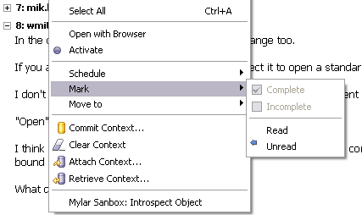
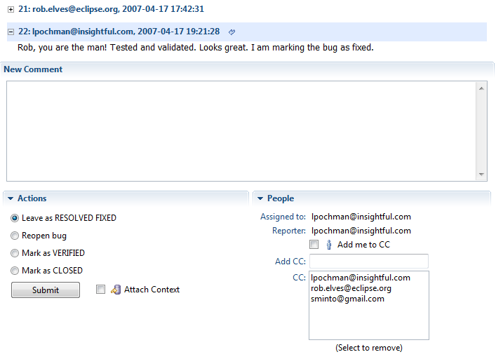
Reading tasks
Notes:
Mylyn: a Task Focused UI for Eclipse

Slide 30
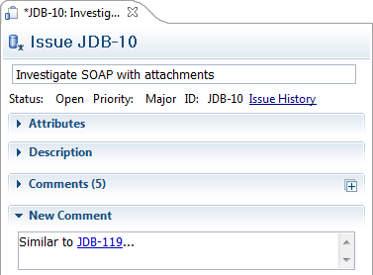
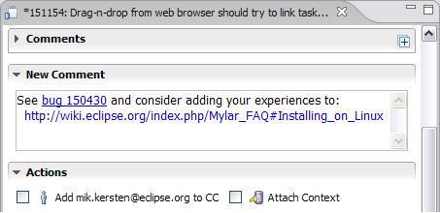
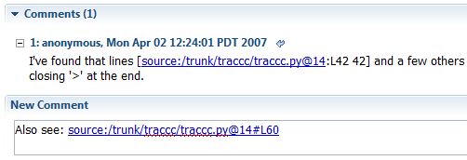
Task editor hyperlinks
Notes:
Mylyn: a Task Focused UI for Eclipse

Slide 31
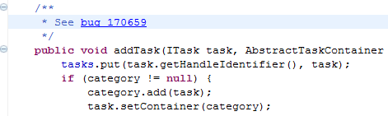
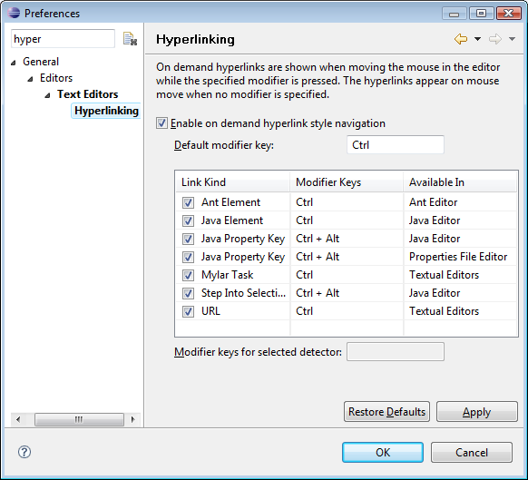
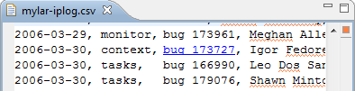
Textual editor hyperlinks
Available from any text editor
Syntax specific to connector
Notes:
Mylyn: a Task Focused UI for Eclipse

Slide 32
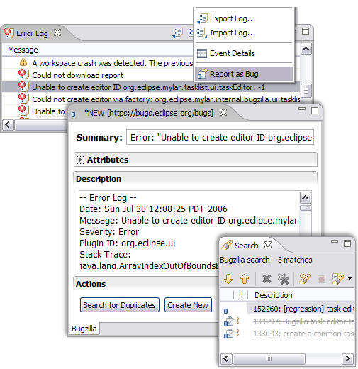
Bug reporting
Notes:
Mylyn: a Task Focused UI for Eclipse

Slide 33
Focused UI
6
Notes:
Mylyn: a Task Focused UI for Eclipse

Slide 34
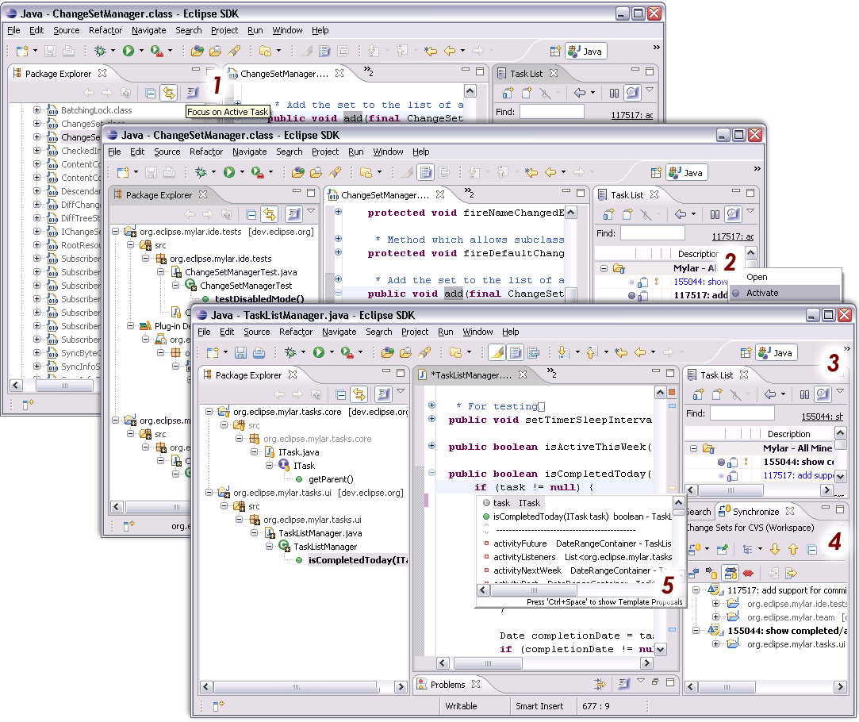
Overview
Notes:
Mylyn: a Task Focused UI for Eclipse

Slide 35
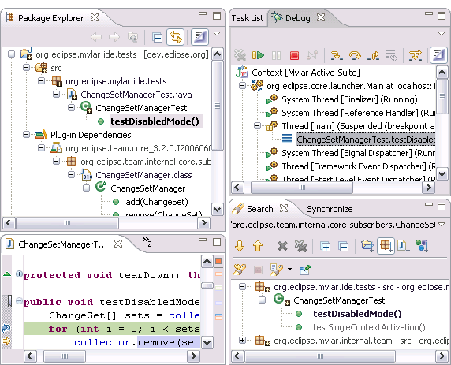
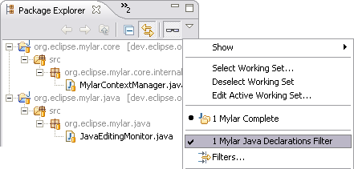
Java Views
Notes:
Mylyn: a Task Focused UI for Eclipse

Slide 36
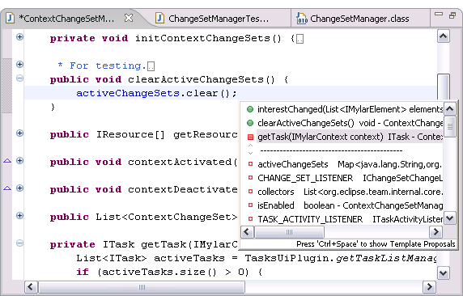
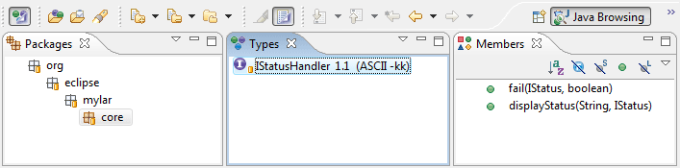
Java Editor and Browsing Perspective
Notes:
Mylyn: a Task Focused UI for Eclipse

Slide 37
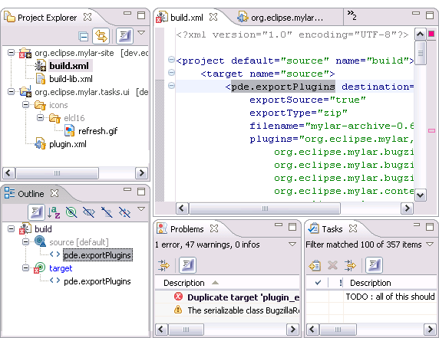
Ant and generic files
Notes:
Mylyn: a Task Focused UI for Eclipse

Slide 38
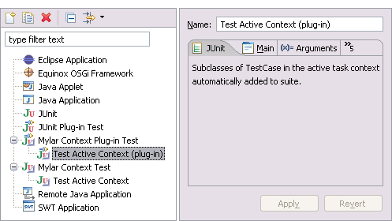
Task context test suite
Dynamically created test suite
  Tests every interesting type in the task context
Notes:
Mylyn: a Task Focused UI for Eclipse

Slide 39
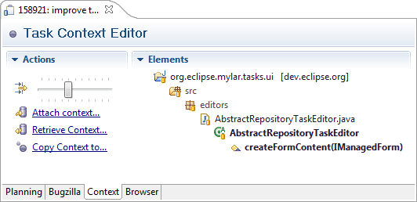
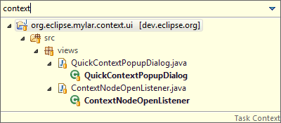
Context editor and quick view
Notes:
Mylyn: a Task Focused UI for Eclipse

Slide 40
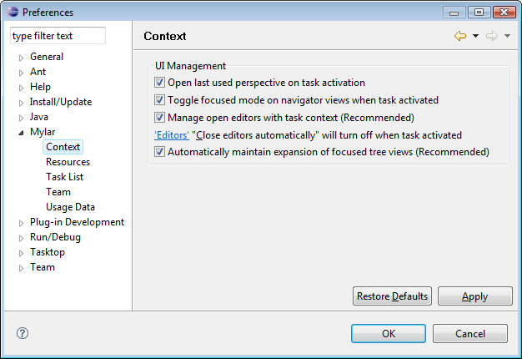
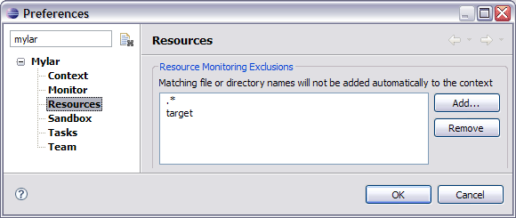
Preferences
Notes:
Mylyn: a Task Focused UI for Eclipse

Slide 41
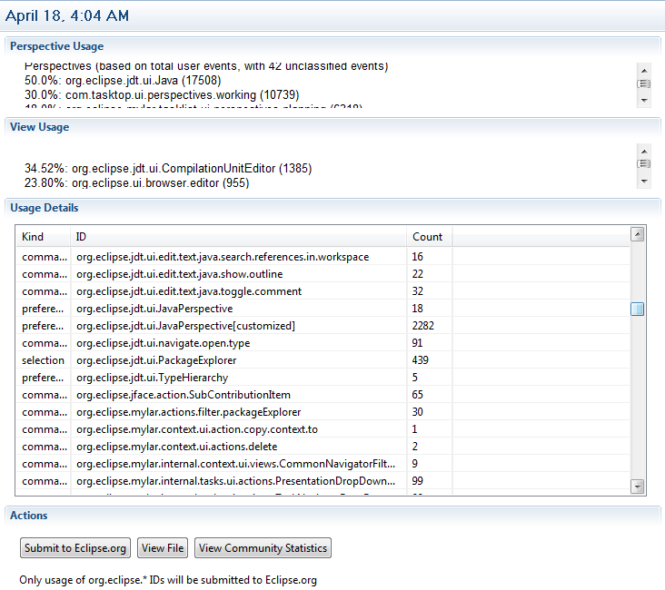
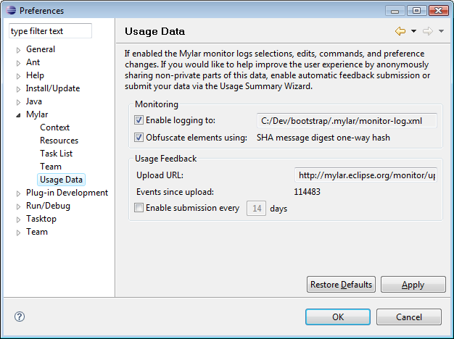
Usage Reporting
Notes:
Mylyn: a Task Focused UI for Eclipse

Slide 42
Team Support
7
Notes:
Mylyn: a Task Focused UI for Eclipse

Slide 43
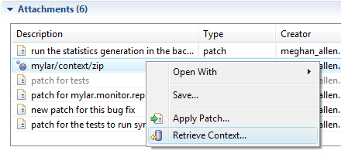
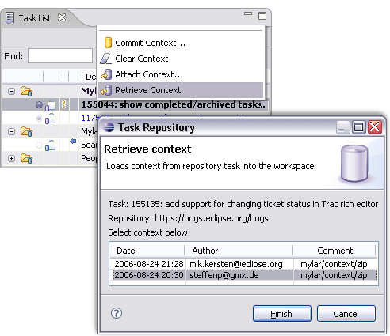
Task context sharing
Notes:
Mylyn: a Task Focused UI for Eclipse

Slide 44
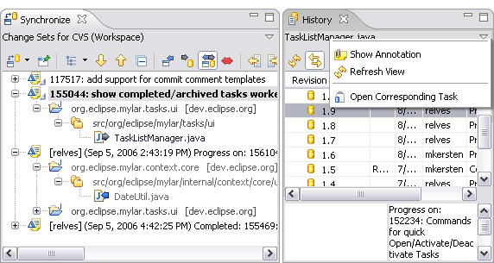
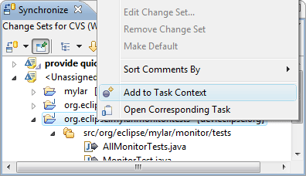
Automatic change set management
Notes:
Mylyn: a Task Focused UI for Eclipse

Slide 45


Automatic commit messages
Notes:
Mylyn: a Task Focused UI for Eclipse

Slide 46

Project Associations
Associations
  Configured via project properties
  Enable hyperlinking and opening of tasks corresponding to resources
Notes:
Mylyn: a Task Focused UI for Eclipse

Slide 47
Best Practices
8
Notes:
Mylyn: a Task Focused UI for Eclipse

Slide 48

Task-Focused Workspace
Notes:
Mylyn: a Task Focused UI for Eclipse

Slide 49
Recommended Eclipse settings
Package Explorer
  Use flat layout in the Package Explorer
  Link the Package Explorer with the editor
  Deselect the Referenced Libraries filter
  Leave the General -> Appearance -> Label Decorations -> Java Type Indicator off
Editors
  Turn comment folding on to reduce clutter when using auto folding
  Turn off or increase the number of editors to leave open
  The Outline view can be closed or made a fast view
Team
  Set Synchronize view to Change Sets mode
  Use graphical CVS decorators only
Notes:
Mylyn: a Task Focused UI for Eclipse

Slide 50
Workspace configuration
Working with a single workspace
  Create a Working Set for each project/product that you have checked out.
  Set the Package Explorer to show Working Sets as the top-level elements.
  Set the Problems view to filter out warnings from any Working Sets that you do not contribute to.
  Set the File Search scope to only include Working Sets that you contribute to.
Notes:
Mylyn: a Task Focused UI for Eclipse

Slide 51
Task List configuration
Recommended query setup
  Set up a single query for all tasks assigned to you.
  Set up another query for all bugs that you have reported, commented on, or been copied on. Do this for every repository of interest.
  If you mentor, manage, or pair-program with others, set up a query for the tasks assigned to each person.
  If you triage bugs, set up a separate query for the inbox account so that you can monitor incoming reports.
Name queries according to nesting
  For example, prefixing with product names
  (Working set support coming in Mylyn 2.0)
Notes:
Mylyn: a Task Focused UI for Eclipse

Slide 52
Task creation
Naming
  Make the start of the task be a verb representing the action, e.g. "prepare IBM talk"
Priorities
  Use the priority level for your own personal prioritization. When in Schedule mode the Task List will sort tasks to be done today by priority.
Notes:
Mylyn: a Task Focused UI for Eclipse

Slide 53
Task management
Daily
  Use the Focus on Workweek mode.
  First go through all incomings and do a first round of deferring and triage in Categories mode, there should be no red left.
  Then put the Task List into Scheduled mode, set priorities for the day, and defer anything that you won't be able to complete today.
  When wanting to catch up on incomings during the day go back into Categories mode.
Weekly
  When completing the Daily process on Monday make sure that the work week is realistic by deferring to future weeks.
  Check the calendar for any tasks due for this week.
  Turn off the Focus on Workweek mode and make sure that you have not overloaded Next Week too much.
Notes:
Mylyn: a Task Focused UI for Eclipse

Slide 54
Conclusion
Notes:
Mylyn: a Task Focused UI for Eclipse

Slide 55
Resources
Pitfalls and problem diagnosis
  http://wiki.eclipse.org/index.php/Mylyn_FAQ
User Guide
  http://wiki.eclipse.org/index.php/Mylyn_User_Guide
Developer resources
  http://wiki.eclipse.org/index.php/Mylyn
Notes:
Mylyn: a Task Focused UI for Eclipse

Slide 56
Mylyn
Committers
  Mik Kersten, Rob Elves, Steffen Pingel and Eugene Kuleshov
Key contributions by
  Gail Murphy, Shawn Minto, Willian Mitsuda, Brock Janiczak, Meghan Allen, Nathan Hapke, Raphael Ackermann, Ken Sueda, Jeff Pound, Wesley Coelho and Leah Findlater
Notes:
Mylyn: a Task Focused UI for Eclipse

