Slide 1
Mylar
A Task Focused UI for Eclipse
For Eclipse users
  Integrates task management
  Automates context management
For developers and integrators
  Provides framework for tasks and contexts
Mik Kersten, project lead
Eclipse.org Webinar, October, 2006, made available under the EPL v1.0
Notes:
Will make you more productive

Slide 2
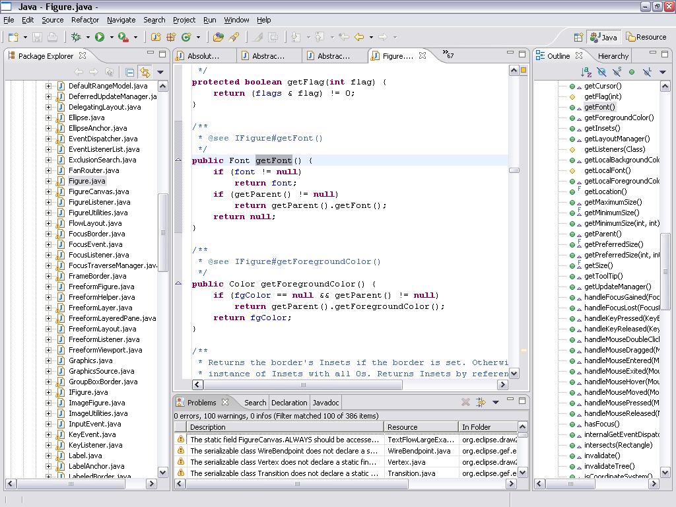
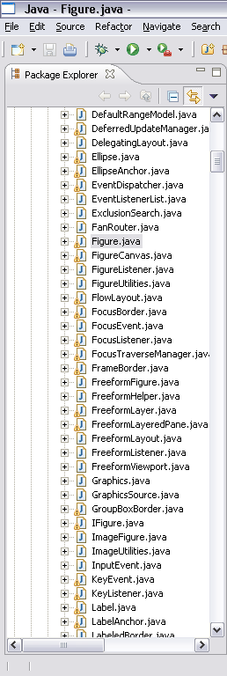
Information Overload
Hard to see the forest through the trees
Repetitive scrolling, searching, navigating
Notes:
But our systems have scaled, as has Eclipse’s performance
-

Slide 3
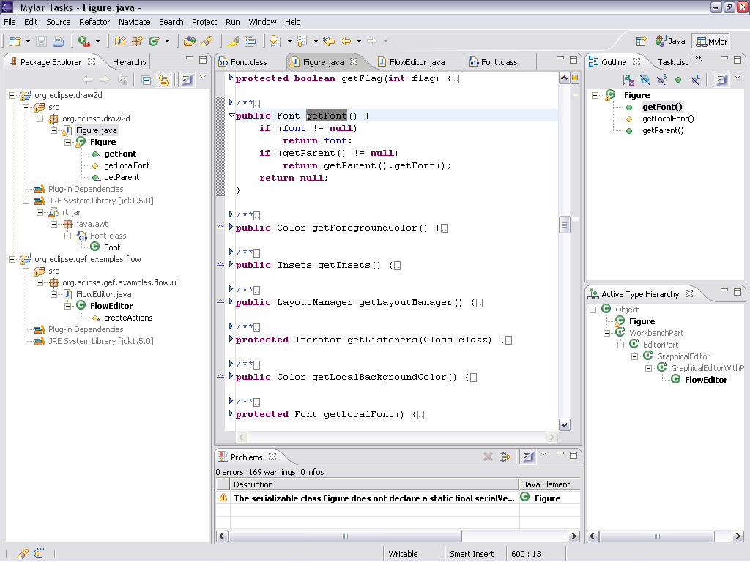
Mylar
see only what you’re working on
Aluminized film used to avoid blindness when staring at an eclipse
Task Focused UI to avoid information blindness when staring at Eclipse
Notes:
For any task that we work on, we only care about a
subset of the system
Mylar makes that subset explicit
All you need to do is indicate what task you’re working on
Via task management and issue tracker integration
Task context model is created automatically
Transparently monitors your programming activity
Filtered views show what you expect

Slide 4
Overview
Working with Mylar
  Tasks and contexts make working with large systems easier
  Bugs/issues/tickets/tasks are integrated and easy to manage
Demos highlighting key features
  Working with task context
  Eclipse integration (SDK)
  Repository integration (Bugzilla)
Building on Mylar
  Internals & architecture
  Framework & APIs
Notes:
Demo setup:
Activate active search
Demo config:
Filtered to Very High
Hyperlink bug: remove note, remove reminder
Context cleared on active task

Slide 5
Demo 1: Tasks
Without Mylar
  Work with various web UIs to manage bugs/issues/tasks
With Mylar
  Task management is integrated
  Similar to source repositories
  Get persistence, offline editing, notifications
Notes:
Create “explore mylar code”
Open “Add double-click..”, explore, add new comment
Add note to repository task
Open Task Repositories, add Trac query, add show New Query wizard
Show search integration
Show hyperlinking to bug 63692

Slide 6

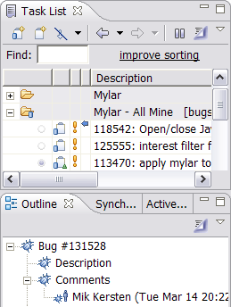

Tasks
Connectors
  Similar to source repositories
  Support Bugzilla JIRA and Trac
Tasks
  Local
  Web linked
  Repository queries
  Authoring, offline editing
One integrated task list
  Personalized notes, reminders
  Archive, filters, notifications

Slide 7
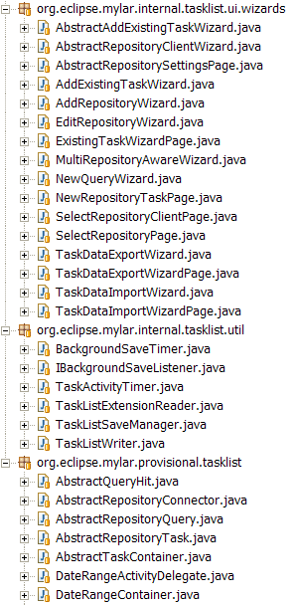
Demo 2: Task context
Without Mylar
  Manually manage context
  Use working sets, filters
With Mylar
  Indicate what task you’re working on
  Programming activity forms context
  for that task
  Context becomes explicit in the UI
Notes:
Open ContextCore plug-in
Navigate to BundleContext, then back
Ctrl+Space
Unfilter, Alt+click
Decay, make less interesting
Deactivate, activate, editor management
Open build.xml, filter Outline

Slide 8
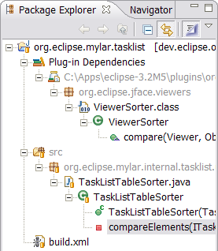
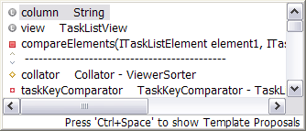
Task context
Tasks
  User-defined unit of work, e.g. bug report
Context
  Mylar monitors your interaction
  Creates degree-of-interest model
  What you touch is in your context
  Actively managed as you work
  Stored and easy to recall
Focused UI
  Views: filtering, decoration
  Editors: folding, content assist
  Context switching, editor management

Slide 9
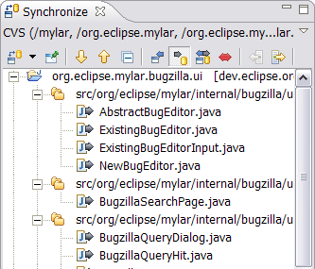
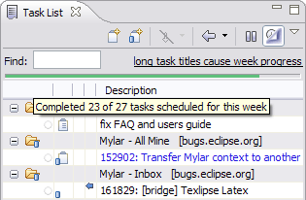
Demo 3: Integration
Automatic change sets
  Sometimes you only want to commit
  or update a subset
Sharing context
  Attaching and retrieving context
Focusing the task list
  Scheduling, planning, progress
Notes:
Make change in “expore” task
Activate “add double click…”
Retrieve context
Make change
Override previous
Show commit message
Find: “explore”
Unfocus task list
Defer a task to next week
Mark a task complete

Slide 10
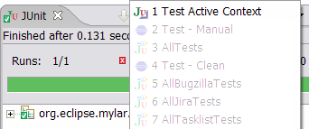
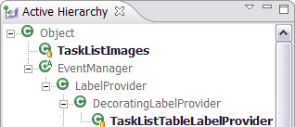
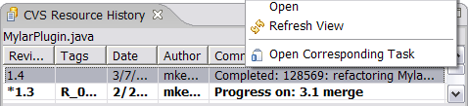
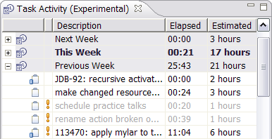
There’s more…
Automation
  Testing context via Active Test Suite
Context views
  Active Type Hierarchy, Active Search
Everything is linked
  Tasks to context to resources
Easy to build on
  XP planning via Task Activity View

Slide 11
Changing how we work with Eclipse
What you need to do
  Buy into working with tasks
Once tasks are explicit
  Dramatic reduction in information overload
  Information you need to get work done is at your finger tips
  Multi-tasking and recalling old tasks become effortless
  UI automation (e.g. working sets, search, commit messages)
  UI for task management is consistent and integrated
  Keeps you in Eclipse and out of your browser and inbox
Notes:
[last year]
Showed that we can do this
Now: there is a framework
Not as much cut and pasting, back/forward nav, open type, search
Get interrupted by a patch, apply it, back where you left off
Without Mylar have to remember tons of structure (e.g. type names)
No more watching <component>-inbox [picture of toaster]
I have to remind myself to turn it off now and then
When not to use it
Reviewing package structure, comment clean-up
Now you might be wonder how we know this information..

Slide 12
under the hood

Slide 13





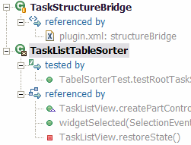
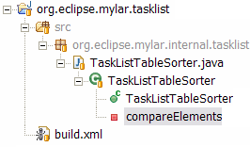
Mylar’s context model
Interaction history
  InteractionEvent stream
  Origin, handle, type, date
Context (Core)
  Degree-of-interest graph
  Degree-of-separation scope
Display (UI)
  Views, editors, files
interest
Notes:
All the things you might want to do the architecture has flexibilty for

Slide 14
Frameworks
Tasks
  Core facilities: lifecycle, persistence, synchronization
  UI facilities: editing, diffs, notifications
  UI and persistence provided
  Developers access multiple issue trackers
  Provide customizable behavior with consistent integration
Context
  Generic model, context management, persistence
  Structure bridges: map context to existing models: e.g. JavaModel
  UI bridges: selection/edit/refactoring capture, map to UI
  Model scales with interaction, not with workspace size
  Facilitated by Eclipse’s modularity and component model
Notes:
JIRA provider is ~500 lines of code
Experience judging jolt awards, we all know better: Eclipse integration is key

Slide 15
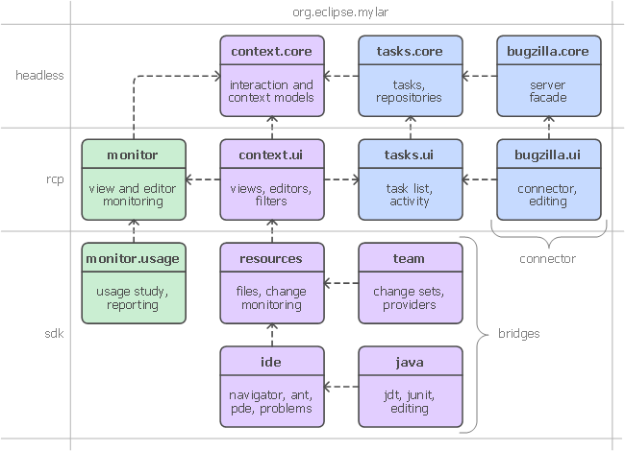
Extensibility

Slide 16
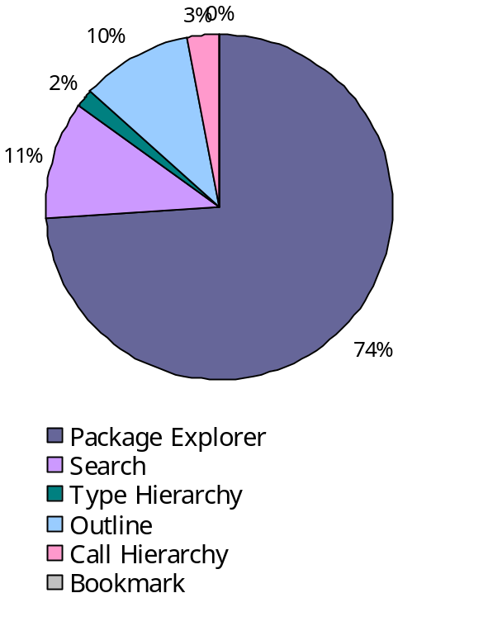
Provisional APIs
Tasks API
  Currently supports three connectors: Bugzilla, JIRA and Trac
  Extensible to other kinds of trackers and repositories
Context API
  Currently supports: Resources, JDT, PDE, Ant
  Has been stable, but revision coming
Monitor API
  Usage monitoring based on interaction history
  Studied ~100 developers voluntarily using Mylar
  Privacy, obfuscation, reporting

Slide 17
Questions
Status
  1.0 planned for Dec 8th, UI streamlining and other improvements
  Thriving on community feedback on contributions
Questions?
Notes:
135 Bugzilla reports from most active user
“I think your work is going to be a real breakthrough and at least in my group, when it will be stable enough to be spread across all developers, it will be a real revolution in the way we work.”
No matter what the size of display, we know what to show (what the focus is, what the context)
[picture of large display?]
The more screen real-estate you have, the more context it gives you—current Eclipse views don’t scale that way

Slide 18
Mylar
Reducing information overload one task at a time
Committers
  Mik Kersten, Rob Elves, Steffen Pingel, Ian Bull, Gail Murphy
Contributors
  Eugene Kuleshov, Jeff Pound, Brock Janiczak, Willian Mitsuda, Nathan Hapke, Raphael Ackermann, Gunnar Wagenknecht, Shawn Minto, Ken Sueda, Wesley Coelho, Leah Findlater
More info
  http://eclipse.org/mylar/publications.php
Notes:
So what Mylar is all about
Bringing tasks and focus to Eclipse
Reducing information overload

