Slide 1
Mylar
A Task-Focused UI for Eclipse
For Eclipse users
  Integrates task management
  Automates context management
For developers and integrators
  Provides framework for tasks and context
Mik Kersten, project lead
Eclipse.org Members’ Meeting, December 5, 2006, made available under the EPL v1.0
Notes:
Will make you more productive

Slide 2
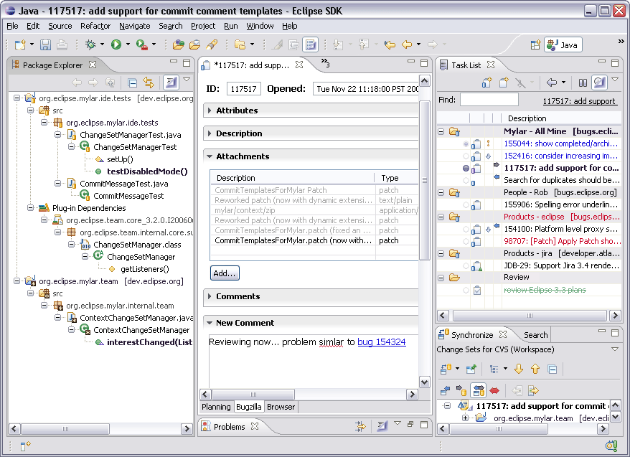
Overview

Slide 3
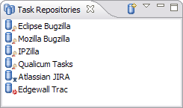
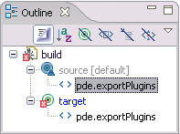
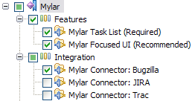
Engaging
Task repository providers
  Bug/task/issue/project trackers can add connectors
Tool providers
  Languages and domain-specific tools can add bridges
Bundling
  Features can be redistributed separately
Getting involved
  eclipse.technology.mylar newsgroup for general questions
  mylar-dev@eclipse.org for integration questions
  Project lead: mik.kersten@eclipse.org
  File bug reports for integration-specific discussion
  Project is very transparent and permeable

Slide 4
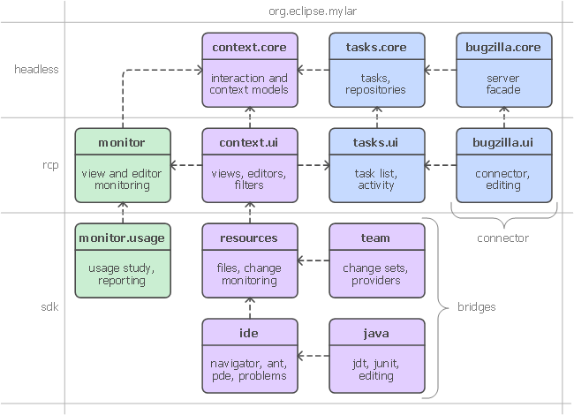
Frameworks

Slide 5
Status
Releases
  2005-Q2: 0.3 validation & user study release
  2005-Q4: 0.4 first public release
  2006-Q2: 0.6 for Callisto
  2006-Q4: 1.0
  2007-Q2: 2.0 for Europa
Stats
  2063 bugs opened, 1579 resolved (total)
  Over 200 bugs resolved via patches (2006)
  27K update manager installs, 7K redistributable site downloads (2006)
Feedback
  “Revolutionize your productivity with Eclipse Mylar” (Riyad Kalla)
  "..arguably the most productivity-enhancing idea since background compilation and all of the things that enables (namely refactoring and syntax hilighting).” (David Orme)

Slide 6
Summary
Once tasks are explicit
  Dramatic reduction in information overload
  Multi-tasking and recalling old tasks become effortless
  UI automation (e.g. perspectives, change sets, commit messages)
Leveraging Eclipse’s extensibility
  Hard to impossible to do this without openness and modularity
  Keeps developers in Eclipse and out of the browser and inbox
Changing how we use the IDE
  Statistically significant improvement in developer productivity
Notes:
[last year]
Showed that we can do this
Now: there is a framework
Not as much cut and pasting, back/forward nav, open type, search
Get interrupted by a patch, apply it, back where you left off
Without Mylar have to remember tons of structure (e.g. type names)
No more watching <component>-inbox [picture of toaster]
I have to remind myself to turn it off now and then
When not to use it
Reviewing package structure, comment clean-up
Now you might be wonder how we know this information..

