Slide 1
Mylyn 3.4 Release Review
Mik Kersten and Steffen Pingel
Planned Review Date: June 11, 2010, 8am PT
Communication Channel: mylyn-dev@eclipse.org
Notes:
Mylyn Release Review
Mylyn Release Review
Mylyn Release Review

Slide 2
Introduction
In order to keep up with its rate of adoption, the Mylyn project is continuing to evolve APIs for Application Lifecycle Management (ALM) tools. Since its inception, Mylyn has released multiple times per annual release cycle, and is continuing to do that for Indigo.
The first goal of Mylyn is to make task and context management seamlessly integrated with the Eclipse Platform by providing rich and extensible frameworks for task repository connectors, structure bridges and team support. The second goal is to provide a reference implementation of the Task-Focused UI for the Eclipse SDK. This includes structure bridges for the artifacts supported by the SDK which include Java, PDE, Ant and generic files. It also includes the Bugzilla Connector as the reference task repository implementation, and CVS integration as the reference team support. Additional features can be considered based on the availability community contributions and resources.
Note that Mylyn is undergoing a restructuring process that will take effect post-Helios. For details see bug 304957.
Notes:
Mylyn Release Review
Mylyn Release Review
Mylyn Release Review

Slide 3
New Framework Features
Task Editor
  The integration for opening attachments in the workbench has been improved.
  The editor has a quick outline for quick keyboard navigation.
Task-Focused Interface
  Resource exclusion filtering now supports ant patterns and ignores resource changes based on modification times.
Task List
  The scheduled presentation now shows incoming and outgoing tasks.
Discovery
  The discovery component has moved to the p2 project.
WikiText
  WikiText generates integrated Eclipse Help from a set of MediaWiki pages, enabling a crowdsourcing approach to documenting Eclipse features.
Notes:
Mylyn Release Review
Mylyn Release Review
Mylyn Release Review

Slide 4
New Connector Features
Bugzilla
  Bugzilla 3.6 is supported.
  Hyperlink detection has been extended to support additional patterns.
  Attachment flags can be modified from the Task Editor.
Notes:
Mylyn Release Review
Mylyn Release Review
Mylyn Release Review

Slide 5
Non-code aspects (Unchanged since 3.1)‏
Localization/externalization
  The code base has been externalized for Mylyn 3.1.
  Mylyn is now available for translation via Eclipse Babel.
User documentation
  Eclipse help content that is generated from the Wiki has been added for Mylyn 3.1.
  The webinar on Mylyn 3.0 is the most viewed webinar on Eclipse Live.
  The web site has been restructured for easier access to Downloads, Support and Getting Started documentation.
Developer documentation
  Wiki-based Contributors Guide
  Wiki-based Integrators Guide
Notes:
Mylyn Release Review
Mylyn Release Review
Mylyn Release Review

Slide 6
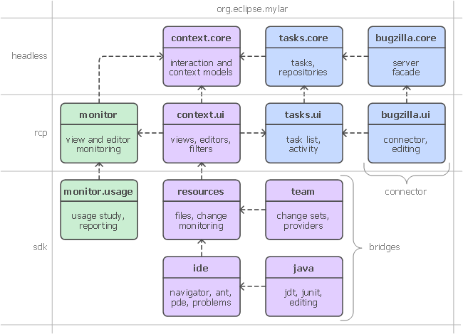
APIs (Unchanged since 3.2)‏
No breaking API changes from 3.0
APIs are consumed by 3rd parties who provide regular feedback
All API changes are tracked in Bugzilla on bugs tagged as [api]
  Notes on API additions since Mylyn 3.0: http://wiki.eclipse.org/Mylyn/Porting_Guide
Frameworks:
  Commons API
  Context API
  Tasks API
  Monitor API
  Team API
  WikiText API
Notes:
Mylyn Release Review
Mylyn Release Review
Mylyn Release Review

Slide 7
Architectural Issues‏ (Unchanged since 3.3)
For Mylyn 3.3 pooling of network connections has been fixed which uncovered connection leaks in several connector implementations.
For Mylyn 3.1 processing of resource change events has been optimized to avoid a negative impact on performance when rebuilding large workspace while a task is active.
For Mylyn 3.1 scheduling rules and locking for concurrently running jobs have been reviewed and problems were addressed.
For Mylyn 3.0 API tooling was adopted and API baselines have been made available for download.
For Mylyn 2.3 a new kind of bundle activator for the Task-Focused UI was created and all known issues with startup concurrency, performance and laziness were addressed.
Notes:
Mylyn Release Review
Mylyn Release Review
Mylyn Release Review

Slide 8
Tool Usability (Unchanged since 3.0)‏
Maturity
  Constant stream of stable releases
  Bundled as part of EPP distributions
  Committers work from HEAD, contributors from weekly builds, community from milestone releases
User feedback says it best
  "..arguably the most productivity-enhancing idea since background compilation and all of the things that enables (namely refactoring and syntax highlighting). I just don't know how I ever was able to read and understand the Eclipse sources (or the sources of other large projects I've worked on) before Mylar, it's just that good.“ (David Orme)‏
  “I would like to commend you on this very good tool. It has increased my productivity by 3 folds - no kidding...” (Deepak Devje)‏
Notes:
Mylyn Release Review
Mylyn Release Review
Mylyn Release Review

Slide 9
End-of-Life
Mylyn 3.4 support Eclipse 3.6, 3.5 and 3.4 from HEAD.
  The JIRA Component has moved to Atlassian.
Mylyn 3.3 supports Eclipse 3.6M2, 3.5 and 3.4 from HEAD. Support for Eclipse 3.3 has ended.
Mylyn 3.2 supports Eclipse 3.5 and 3.4 from HEAD and Eclipse 3.3 via a separate branch.
Mylyn 3.1 is in maintenance and supports Eclipse 3.4 and 3.3 via separate branches.
All Mylyn 3.0 streams have reached end-of-life
All Mylyn 2.0 streams have reached end-of-life.
Notes:
Mylyn Release Review
Mylyn Release Review
Mylyn Release Review

Slide 10
Bugzilla
Bugs resolved
  Mylyn 3.4 (June 23, 2010): 165 (as of May 28, 2010)
  Mylyn 3.3 (Oct. 26th, 2009): 166
  Mylyn 3.2 (June 24, 2009): 333‏
  Mylyn 3.1 (March 4, 2009): 431
  Mylyn 3.0 (June 25, 2008): 493
  Mylyn 2.3 (Feb. 27, 2008): 158
  Mylyn 2.2 (Dec. 19, 2007): 201
  Mylyn 2.1 (Sep. 28, 2007): 120
Contributions
  15 contributions were merged for Mylyn 3.4
Notes:
Mylyn Release Review
Mylyn Release Review
Mylyn Release Review

Slide 11
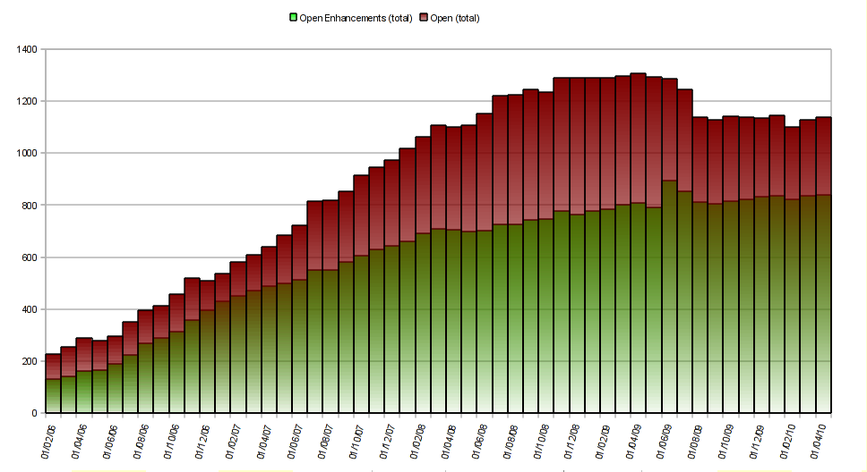
Community
Notes:
Mylyn Release Review
Mylyn Release Review

Slide 12
Standards (Unchanged since 3.1)‏
Mylyn requires J2SE 1.5, provides warning if installed on 1.4
  Key driver for using1.5 was the benefits of generics-aware APIs
Mylyn WikiText supports the following markup languages: Confluence, MediaWiki, Textile, TracWiki and Twiki.
Notes:
Mylyn Release Review
Mylyn Release Review
Mylyn Release Review

Slide 13
UI Usability (Unchanged since 2.1)‏
Accessibility
  No review for this release, but following accessibility guidelines
  http://www.eclipse.org/articles/Article-Accessibility/index.html
Follow the User Interface Guidelines
  Focus on consistent visual design, UI elements, icons
  http://wiki.eclipse.org/index.php/User_Interface_Guidelines
Validated UI usability with field study
  For details see:
  http://kerstens.org/mik/publications/2006-11-mylar-fse.pdf
  Mylyn Monitor is being used to gather usage feedback: http://mylyn.eclipse.org/monitor/upload/UsageAnalysisServlet
Notes:
Mylyn Release Review
Mylyn Release Review
Mylyn Release Review

Slide 14
Schedule
Project plan: http://www.eclipse.org/projects/project-plan.php?projectid=tools.mylyn
Release
Date
Platform Release
Notes
Mylyn 3.4
June 23, 2010
Eclipse 3.4.2, 3.5.2 and 3.6
Mylyn 3.4.1
September 25, 2010
Eclipse 3.4.2, 3.5.2 and 3.6.1
Helios SR1
Mylyn 3.5
October, 2011 (tentative)
Eclipse 3.5.2, 3.6.1 and 3.7M2
Mylyn 3.4.2
February 25, 2011
Eclipse 3.4.2, 3.5.2 and 3.6.2
Helios SR2
Mylyn 3.6
June, 2011 (tentative)‏
Eclipse 3.5.2, 3.6.2 and 3.7
Notes:
Mylyn Release Review
Mylyn Release Review
Mylyn Release Review

Slide 15
Communities‏ (1)‏ (Unchanged since 3.1)‏
Users
  Lively community on newsgroup and bug reports
  Articles and blogs by community members
Developers
  Contributor documentation on Eclipsepedia
  Lively community on mylyn-dev and bug reports
Integrators
  Integrator documentation on Eclipsepedia
  Separate mylyn-integrators mailing list removes need for integrators to watch the higher-traffic mylyn-dev
  Specific discussions on “[connector]” and “[bridge]” bug reports, as well as “manage integration with Foobar” bug reports
Notes:
Mylyn Release Review
Mylyn Release Review
Mylyn Release Review

Slide 16
Communities‏ (2)‏ (Unchanged since 3.1)‏
Committers
  3 new committers since June 2008
Summer of Code
  Mylyn participated in Summer of Code 2008
  Steffen Pingel mentored Jingwen Ou who integrated rich wiki markup editing with the Task Editor.
Notes:
Mylyn Release Review
Mylyn Release Review
Mylyn Release Review

Slide 17
IP Log
The IP Log is kept updated by committers as contributions are applied.
  http://www.eclipse.org/mylyn/doc/mylyn-iplog.csv
The adoption of the automatic IP log has been postponed until the move review has been completed.
Notes:
Mylyn Release Review
Mylyn Release Review
Mylyn Release Review

Slide 18
IP Issues
None.
Notes:
Mylyn Release Review
Mylyn Release Review
Mylyn Release Review

Slide 19
Release review version
These slides are based on the following version of the Release review document
  Version 032 – January 15, 2006
Notes:
Mylyn Release Review
Mylyn Release Review
Mylyn Release Review

