Slide 1
Deterministic Lazy Mutable
OCL Collections
Edward Willink
Willink Transformations Ltd
Eclipse Foundation
MMT Component co-Lead
OCL Project Lead
QVTd Project Lead
QVTo Committer
OMG (Model Driven Solutions)
OCL 2.3, 2.4, 2.5 RTF Chair
QVT 1.2, 1.3, 1.4 RTF Chair
OCL 2017 @ STAF 2017
20th July 2017

Slide 2



Overview
Collection performance
New Collection implementation
    bypass/reconsider specification obstacles
  unify Bag, OrderedSet, Sequence, Set
    fewer conversions
  deterministic - predictable, debuggable
    Sequence - same size/speed
    Set - 13% larger, faster/slower
  lazy - usually smaller, slower
  lazy+partial - usually smaller, faster
  mutable/cached - quadratic => linear, smaller, faster

Slide 3
Specification obstacles
is OCL deterministic?
no partial Collection evaluation
no Collection mutation

Slide 4
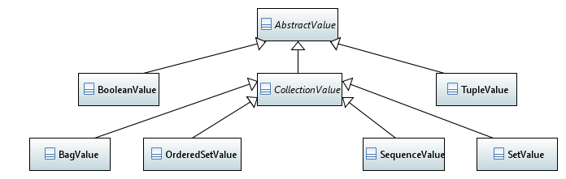
Traditional Collection Value Classes
Distinct Bag/OrderedSet/Sequence/Set classes

Slide 5
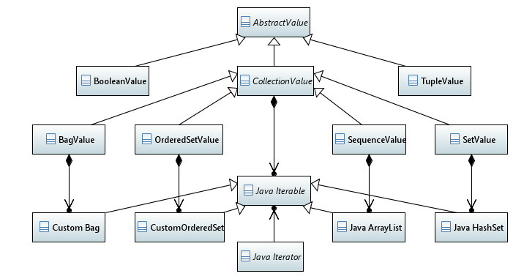
Traditional Collection Implementation
Delegate from OCL to Java semantics

Slide 6
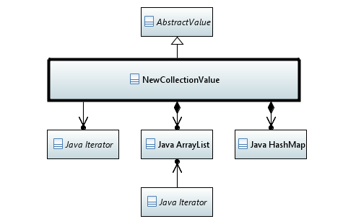
New Collection Implementation
Single OCL class
  Bag/OrderedSet/Sequence/Set
'Two' Java collections
  ArrayList<T>
    deterministic iteration
  HashMap<T,Integer>
    unique-element
    => repeat count
One lazy loading Iterator
Many accessing Iterators

Slide 7
Size
 | list | map | new vs old
Sequence | ordered elements | null | no change
Set | ordered unique elements | unique element => 1 | 13% larger
OrderedSet | ordered unique elements | unique element => 1 | 13% larger
Bag | ordered unique elements | unique element => count | 13% larger
64 bit machine
  list element pointer - 8 bytes
  set/map node + pointers - 60 bytes
  map + list - 68 bytes => +13%
  ?? custom combined implementation ??

Slide 8
Bag-aware iteration
OrderedSet, Sequence, Set
  iterator returns each element once
Bag
  default iterator returns each collection element once
    multiple returns for repeated content
  bag iterator returns each distinct element once
    single return for each repeated content
    repeat count accessible from iterator
    faster bag-aware impementation

Slide 9
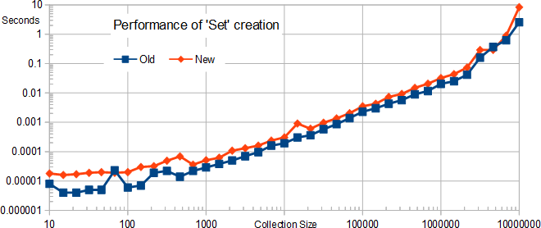
Creation Speed
2 collections to create rather than 1
  'new' about 2 times slower

Slide 10
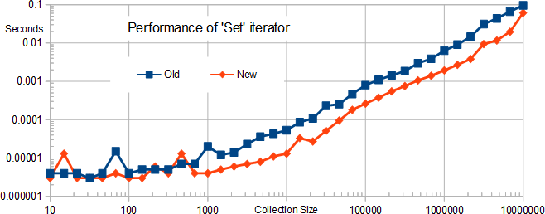
Iteration Speed
simple list rather than sparse tree iteration
  'new' 3 times faster for large sets
iteration faster than creation
  more than 3 iterations needed to outweigh creation

Slide 11
Specified Determinism
Non-determinism is bad
Is OCL deterministic?
11.7.1: Collection::asSequence() : Sequence(T)
A Sequence that contains all the elements from self, in an order dependent on the particular concrete collection type.
11.7.2: Set::asSequence() : Sequence(T)
A Sequence that contains all the elements from self, in undefined order.
Ditto asOrderedSet().
11.9.1 Collection::any
... an indeterminate choice of one of them is returned ...
(non-normative) A.2.5.5 Note that the semantics of the operation as Sequence is nondeterministic.
normative: asSequence unknown, determinate
non-normative: asSequence non-determinate

Slide 12
Implemented Determinism
OCL Set implemented by Java HashSet
  asSequence computed by Java iterator
  iteration order determined by hash codes
  hash code determined by object location
  location dependent on garbage collection timing
Convenient implementation is non-determinate
  OCL is therefore non-determinate
  OCL based applications non-determinate
  M2M transformations non-determinate
    hard to justify, hard to debug

Slide 13
NewCollection Determinism
Every Collection has a deterministic list
  Collection::any can be respecified as the first choice
13% non-Sequence Collection size penalty
swings/roundabouts speed gain/penalty
acceptable cost for a very fundamental fix
new mitigating opportunities...

Slide 14

Specified Eagerness, Invalidity
specification exposition implies full evaluation
  one operation/iteration after another
specification mandates full evaluation
  any invalid collection element => invalid result
  requires full evaluation to check for not-invalid
a->including(b)->excludes(c)
  get: a
  compute: a+b
  check: a+b excludes c
invalidity => full eager evaluation

Slide 15
What is invalid?
null - a well-defined undefined value
invalid - every other bad
  null navigation
  divide by zero
  Sequence/OrderedSet index out of bounds
4-level logic to accommodate invalid
mayBeNull = null or mayBeNull.doSomething()
null = null or null .doSomething()
true or invalid
true

Slide 16
Are Program Failures invalid?
OCL Specification is silent about
  Stack Overflow
  Network Connection Failure
  etc.
Normal OCL usage
  program failures are fatal, result cannot be useful
  program failure as invalid is perverse, inefficient
    failure may be 'caught' and so succeed
OCL-specified Job control
  job failure must be useable in a computation

Slide 17
Program Failure Clarification
Program failures are always 'strict'
  cannot be 'caught' by and/or
  pedantically now 5-level logic
  can only be caught by oclIsFailure()
    supports the obscure Job control use case
invalid sources are enumerable
  many expressions are provably not-invalid
  redundant computations can be skipped
  lazy/partial evaluation can be valid and profitable

Slide 18
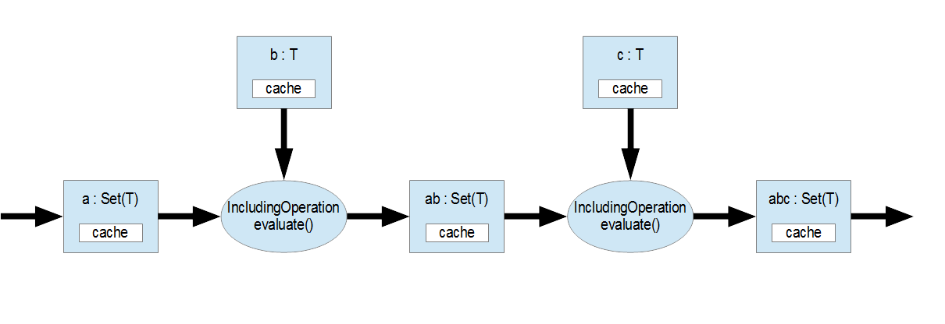
Eager Collection Evaluation
a->including(b)->including(c)
1: load and cache a
2: load and cache b
3: compute ab, 4: cache ab
5: load and cache c
6: compute abc, 7: cache abc
8: propagate abc 3 'large' caches
2
5
1
3
4
6
7
8

Slide 19
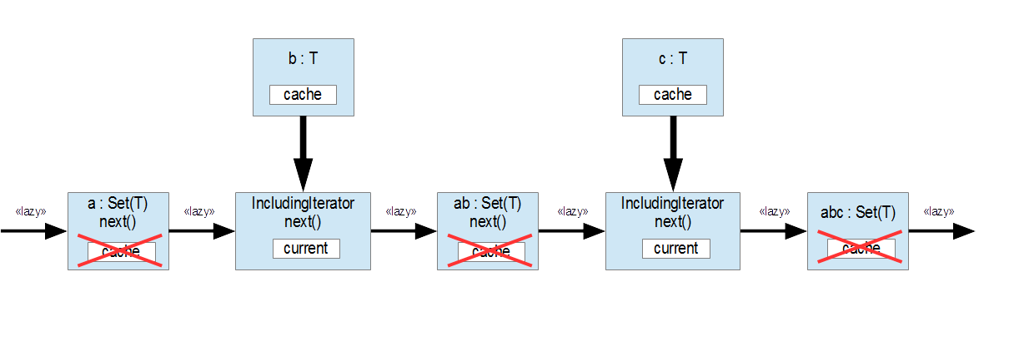
Lazy Collection Evaluation
a->including(b)->including(c)
1: load and cache b
2: load and cache c
3: request abc
4: request ab+c
5: request ab
6: request a+b
7: request a
8: request a 5 small iterators
1
2
8
7
6
5
4
3

Slide 20
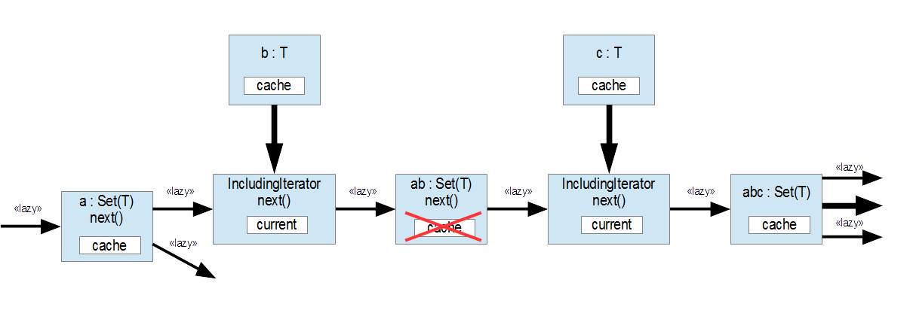
Multi-access Lazy Evaluation
Cache to avoid repeated lazy
first lazy computation populates the cache
further computations re-use the cache

Slide 21
NewCollection modes
lazy Bag, OrderedSet, Sequence, Set
  iterator, list, map
eager/lazily cached Sequence
  iterator, list, map
eager/lazily cached Bag, OrderedSet, Set
  iterator, list, map
lazy/eager/lazily cached Collection Operation
  e.g. IncludingIteration extends NewCollectionValue
  overridden loading iterator performs the algorithm
Gotcha - lazy/cached must be determined early
  awkward as part of a casual API
  'easy' using automated compile-time analysis

Slide 22
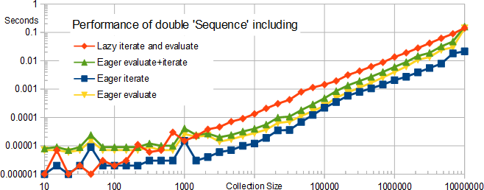
Full Eager/Lazy Performance
a->including(b)->including(c)
  lazy has fewer caches to create
  eager has fewer function calls
  lazy does not incur memory limits

Slide 23
Immutable repeated computation
aCollection->iterate(e; acc : Set(String) |
acc->including(e.name))
eager: each iteration executes including() once
  new collection created for each iteration
    0.5 * N * N element assigns - bad O(N*N) speed
    O(N*N) intermediate elements - bad O(N*N) size
lazy: each iteration daisy chains 2 iterators
  final lazy result
    2 * N * N iterator next() calls - bad O(N*N) speed
    2 * N small iterators - good O(N) size

Slide 24
Mutable repeated computation
OCL side-effect free - no Collection mutation
  Set::including(element) rather than Set::add(element)
  but specification is on observable behavior
  unobserved behavior can perform mutation
Compile-time expression analysis, rewrite
  acc is only accessed by including()
aCollection->iterate(e; acc : Set(String) |
acc->mutableIncluding(e.name))
mutable: each iteration updates collection
  N element assigns - good O(N) speed
  N element result - good O(N) size

Slide 25
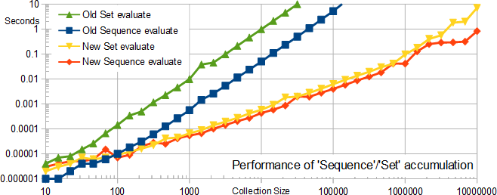

Mutable Accumulation Performance
aCollection->iterate(e; acc : Coll(String) | acc->including(e.name))
clear benefit for modest/large collection
  possible degration for small collections 'in the noise'
exploits a compile time analysis
  alternate internal mutableIncluding library routine

Slide 26
select() idioms
sourceCollection->select(booleanPredicate)
type conformance
OCL 2.0: S->select(oclIsKindOf(MyType)).oclAsType(MyType)
OCL 2.4: S->selectByKind(MyType)
  amenable to global compile-time analysis
    appropriate caching, similar to allInstances
lookup
S->select(element | element.name = wantedName)
  full search for each lookup - O(N)
  applications often have many lookups - O(N*N)
  introduce a value2key cache - O(N)

Slide 27
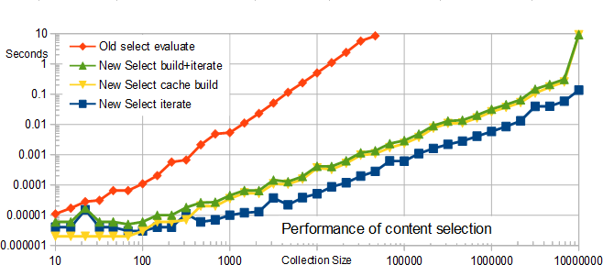
select() lookup performance
let S = Sequence{1..N} in
let t = S->collect(i|Tuple{x=i}) in
S->collect(i | t->select(x = i))
Compile-time analysis to balance trade-offs
    possible for QVT, less obvious for OCL
    huge speed benefit iff there are many lookups
    significant cache cost, perhaps 8 times

Slide 28
Status
Oct 2016: ... Martin's lightning presentation
Nov 2016: Initial Eclipse OCL experiments
  major API compatibility difficulty: next major version
Apr 2017: Results, workshop submission
May 2017: Eclipse OCL integration
  API compatibility resolved by a level of wrappers
  Gotcha, lazy operation calls get wrong parameters
    need lazy operation call / let variable
Today: only available on ewillink/509670 branch

Slide 29
Summary
Deterministic OCL is feasible (and ? required)
    13% non-Sequence Collection memory cost
Partial collection evaluation is feasible
    but only if program failures are not invalid
Lazy collection evaluation is challenging
    huge memory saving, marginal slow down
    lazy variable access must use correct state
Mutable collection evaluation very beneficial
    linear rather than quadratic speed/size cost
Partial+Lazy+Mutable+Deterministic
    mutual speed-ups
    shared compile-time analysis

