Slide 1
Modeling the OCL Standard Library
Edward Willink
Eclipse OCL Project Lead,
Eclipse QVTd Project Lead,
Thales OMG OCL RTF Representative,
Thales OMG QVT RTF Representative
OCL 2011 @ TOOLS 2011
29th June 2011

Slide 2


Overview
OMG OCL Specification Background
Library Concrete Syntax
  DSL and Xtext tooling
Abstract Syntax
  Problems and Solutions
Library Content
  Problems and Solutions
Library Enhancement
Summary

Slide 3


Background : Problems
OCL 1.x part of UML 1.x
OCL 2.0 split off from UML 2.0
  UML 2.0 FTF drafted OCL 2.0
QVT 1.0 reused OCL 2.0
  QVT FTF 'finalized' OCL 2.0
OCL 2.2, 2.3 make minor improvments
Many problems
  typos, inconsistency
  UML-alignment
  incomplete semantics

Slide 4

Background : Solutions
Auto-generate specification
  model-defined specification
    no inconsistency
    consumable by tools
    auto-generated change documentation
This talk - removing intuition for the library
Companion talk - the underlying models

Slide 5
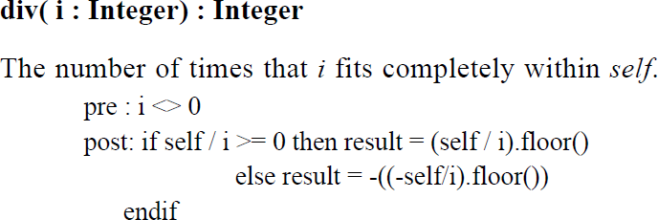
Library Concrete Syntax : Problems
Intuitive (unchecked) exposition

Slide 6
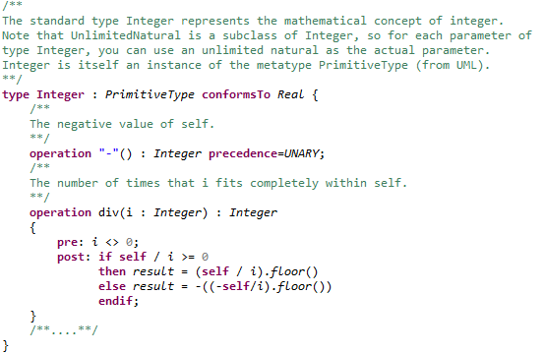
Library Concrete Syntax : Solution
Formal Syntax, Domain Specific Language

Slide 7
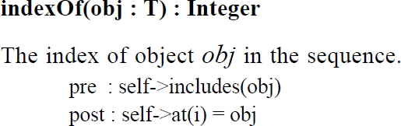
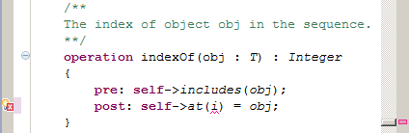
Library Concrete Syntax : Validation

Slide 8
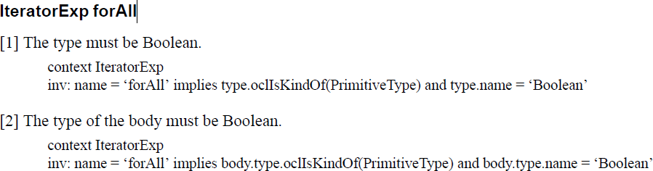
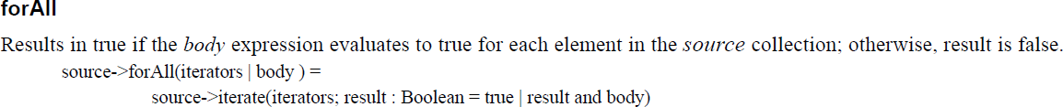
Library Concrete Syntax : Iterations 1
8.3.7
11.9.1
Where is the one/two argument specification?

Slide 9


Library Concrete Syntax : Iterations 2
Body declared using a Lambda Type
Lambda context-type ( parameter-types ) : return-type
  hybrid of Tuple and Operation signatures
Distinct declarations per iterator arity
Iterators ; Accumulator | Body
iterate is a regular iteration

Slide 10

Library Concrete Syntax : Implementation
Some operations could be defined by a body
  some e.g. indexOf only have postconditions
  body requires an OCL code generator
  utility requires a good OCL code generator
Optionally bind feature to an implementation
  perhaps org.omg.ocl.collection.product from OMG

Slide 11
Abstract Syntax Problems : Iteration
An iteration can be invoked from the CS
An iteration can be invoked from the AS
  IteratorExp.name
    references iterator by name
An iteration is not modelled the AS
  cf OperationCallExp::referredOperation
    references an Operation element

Slide 12
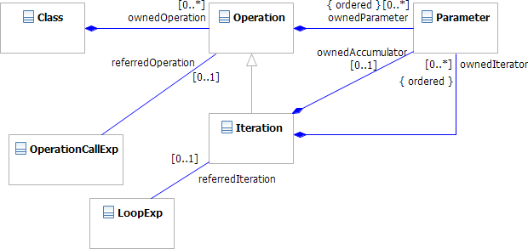
Abstract Syntax Solutions : Iteration
New: Iteration extends Operation
New: LoopExp::referredIteration

Slide 13
Semantic Problems: Overloading
OCL is aligned with UML
  Overloading is a semantic variation point in UML
  Overloading semantics is not specified by OCL
  Overloading is undefined in OCL and UML
Original suggestion
  invariant overloading like Java
    Object.equals(Object)
  static analysis to determine operation signature
  dynamic dispatch on actual type of object

Slide 14
Semantic Solutions: Overloading
Usage
  UML 2.4 - a couple of minor covariant overloads
  OCL 2.3 - fundamental
    OclAny::=(OclAny), Collection::=(Collection) ...
    Real::max(Real), Integer::max(Integer) ...
self-variant overloading
    OclAny::=(OclSelf) : Boolean, Collection::=(OclSelf)
    Real::max(OclSelf) : OclSelf, Integer::max(OclSelf)
  single dynamic dispatch
    common type of source and argument

Slide 15
Semantic Solutions: OclSelf
self - the current context object
OclSelf - the type of self
  statically determinate
    determined at compile time
  a pseudo-type or type template parameter
    never instantiated
    'exists' solely in Library Concrete Syntax declarations
    resolved to a true type in the Abstract Syntax

Slide 16

Abstract Syntax Problems: oclAsSet
The Abstract Syntax cannot be generated for
let a:String = xxx in xxx->notEmpty()
  without static knowledge of whether xxx is null
If xxx is non-null Abstract Syntax represents
let a:String = xxx in Set{xxx}->notEmpty()
If xxx is null Abstract Syntax represents
let a:String = xxx in Set{}->notEmpty()
If xxx is invalid Abstract Syntax (perhaps) represents
let a:String = xxx in invalid->notEmpty()

Slide 17
Abstract Syntax Solutions: oclAsSet 1
Introduce OclAny::oclAsSet() operation
compile-time: object-> is shortform for object.oclAsSet()->
let a:String = xxx in xxx.oclAsSet()->notEmpty()
run-time:
  OclAny::oclAsSet() returns Set{xxx}
  OclVoid::oclAsSet() returns Set{}
  OclInvalid::oclAsSet() returns invalid
library declaration:
OclAny::oclAsSet() : Set<OclAny>
  loses static type information

Slide 18
Abstract Syntax Solutions: oclAsSet 2
library declaration:
OclAny::oclAsSet() : Set<OclSelf>
  static type information
1->forAll(i : Integer | i = 0)
1 UnlimitedNatural
.oclAsSet() Set<UnlimitedNatural>
->forAll(i : Integer | i = 0) over UnlimitedNatural

Slide 19
Library Problems: oclAsType
OCL 1.6 OclAny::oclAsType(OclType) : T
  OclType is an open Enumeration of all types
OCL 2.0 OclAny::oclAsType(OclType) : T
  OclType is a power-set of all types
OCL 2.2 OclAny::oclAsType(Classifier) : T
  T is intuitive
  Classifier at different meta-level
Attempts to define a non-reflective meta-type
Does OCL support Reflection?
  not prohibited by OCL 2.0 Request for Proposals

Slide 20
Library Problems: oclType
OCL 2.0 Element::getMetaClass()
  MOF facility not merged to UML
OCL 2.2 OclAny::oclType() : Classifier
  No Classifier in EMOF
  Classifier at different meta-level
Does OCL support Reflection?
  (OCL 2.0) precondition for Sequence::first()
self.oclType().elementType.oclIsKindOf(CollectionType)
Yes

Slide 21
Library Solutions: oclType
OclAny::oclType() : Class<OclSelf>
OclSelf preserves static type information
self.oclType().ownedAttribute
Arbitrary depth
self.oclType().oclType().ownedAttribute
Class<OclSelf> is a TypeExp

Slide 22
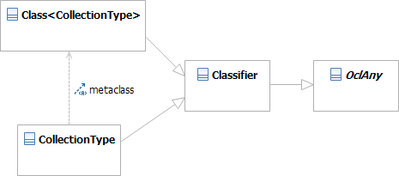
Library Solutions: oclAsType
OclAny::oclAsType<T>(Class<T>) : T
T is declared
Types conform to their Class

Slide 23

Library Problems: allInstances
Declared at different meta-level
BooleanType::allInstances() : Set(Boolean) VoidType::allInstances() : Set(OclVoid) InvalidType::allInstances() : Set(OclInvalid)
    invalid (in OCL 2.3)
Enumeration::allInstances() -- set of literals
    inconsistent return values
Classifier::allInstances() : Set(T) -- instances of self
    intuitive return type

Slide 24
Library Solutions: allInstances
static Classifier::allInstances() : Set<OclSelf>
static models the alternate meta-level
Set<OclSelf> models the return type
static Enumeration::allInstances() : ...
MyEnumeration.ownedLiteral

Slide 25

Library Problems: collect
Return type is irregular
  both Set<T> and Set<Set<T>> return Bag<T>
  cannot be modelled using simple templates
OCL 2.0 Collection does not conform to OclAny
  only homogeneous collections
    enumerate declaration for all depths
OCL 2.2 Collection conforms to OclAny
  heterogeneous collections are Collection<OclAny>

Slide 26
Library Solutions: collect
Open problem
  type system for heterogeneous collections
    extensible to unit element collections
  model collect / collectNested usefully
Reconsider flattening collect
  originally for flat collections
  respecified to hide pragmatic nesting
  untenable for heterogeneous collections

Slide 27
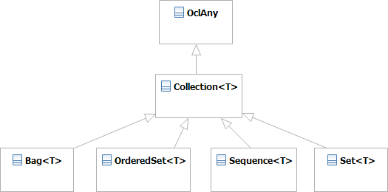

Library Content: OCL 2.2 Collections
Four unrelated concrete Collection Kinds.
asBag/asOrderedSet/asSequence/asSet to convert
incomplete/inconsistent OrderedSet definition

Slide 28
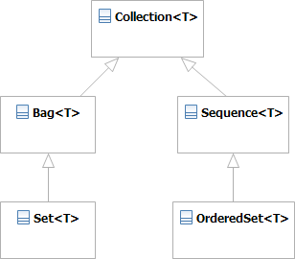
Library Content: Büttner Collections
Two pairs of unrelated concrete Collection Kinds.
Fewer conversions needed
OrderedSet is not a Set
  Set{1,2} wrt OrderedSet{1,2} <> OrderedSet{2,1}

Slide 29
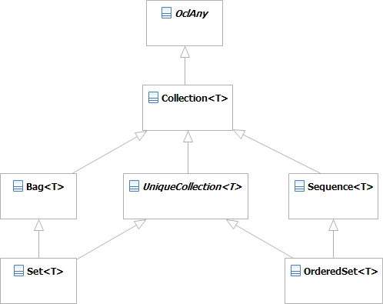
Library Content: New Collections
Set/OrderedSet commonality via abstract UniqueCollection
even fewer conversions/declarations
  Set<T>::union(UniqueCollection<T>) : Set<T>

Slide 30
Not-new OCL Facilities
Overloading / dynamic dispatch
Reflection : oclType(), Class<T>
  was T, used in WFRs
Type-valued Expressions : Class<T>
  used in oclAsType()
Templates/Generics
  used in Collection, Collection::product, Tuples
OclSelf
  was T
Lambda Types / Expressions
  iteration bodies

Slide 31
Summary
Modelled all the OCL Standard Library
    collect() is fudged
  recognised concepts already in use
    OclSelf, templates, lambdas, reflection, overloading
Introduced consistency
  shared Bag/Sequence/UniqueCollection
  Comparable/Summable
Provided a DSL
  declarations and constraints and documentation
  auto-generating specification

