Slide 1
Enrich Your Models with OCL
Edward Willink, MDT/OCL Project Lead
Axel Uhl, SAP
21st March 2011

Slide 2
Overview
MDT/OCL team
Why and When OCL
Introduction to OCL
OCL within Eclipse
OCL Use Cases, coming soon
SAP
Scaling up OCL at SAP

Slide 3
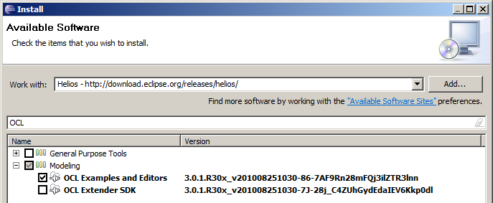
Follow Along
http://www.eclipsecon.org/summiteurope2010/sessions/?page=sessions&id=1710
links to slides and to zip file comprising, model,edit,editor,diagram projects
Install MDT/OCL 3.0.1 Examples and Editors
Import ... Existing Projects from Archive
    ESEExampleTree/model/People1.ecore
Run nested Eclipse, Import ESEExampleTree
    ESEExampleTree/model/default.people_diagram

Slide 4
How Much OCL?
None
  Very simple modeling
  Java augmented modeling
A little
  OCL (and Java) augmented modeling
A lot
  OCL as a powerful formal specification language
    OMG's UML, OCL, QVT, ... specifications
  OCL as the foundation of a transformation language
    MOFM2T (Acceleo), QVT
  OCL as a portable implementation language

Slide 5
Models
The world is full of data
Models are good for controlling data
EMF is good for (meta-)modeling
Extended EMF even better
  EMF editors
  Xtext editors

Slide 6
Rules
The world is full of rules
  password must be at least 6 characters
  password must contain only letters and numbers
Models should be good for applying rules
  direct implementation for simple rules
  semantic validation for complex rules
EMF (meta-modeling) captures simple rules
  multiplicity, ordering, uniqueness, containment
OCL supports complex rules

Slide 7
Behaviors
The world is full of behaviors
EMF (and OCL) support static data models
M2M supports changing/related models
OCL underpins modern modeling specifications
  M2M: OMG QVT, Eclipse QVTo, ATL, Epsilon
  M2T: OMG MOFM2T, Eclipse Acceleo

Slide 8
Object Constraint Language
Requirement:
  an expression languages
Fortran
  provided fundamental expression/function notation
Evolution
  '.' operator for records/structures/objects/operations
OCL
  extension from objects to collections of objects

Slide 9
Overview
Motivation for OCL
OCL Language primer
OCL for modeling
OCL for M2T
OCL for M2M

Slide 10
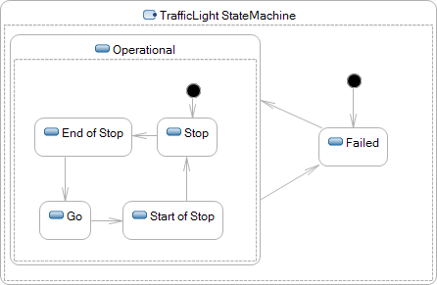

UML State Machines
Need to specify behavior
  amber when End of Stop or Start of Stop
  transition when signal received/time elapsed

Slide 11
UML Solutions
UML 1.x Use your favourite programming language
  Ada/C/...
  Magically inserted by proprietary code generator
UML 2.x Use a neutral specification language
  The Object Constraint Language
    State machine guards/actions
    Class invariants
    Operation bodies, pre/post conditions
    Property initial/derived values

Slide 12
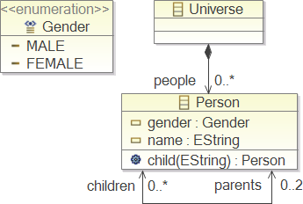
Simple Meta-Modeling
Graphics
  Box
    Class, enumeration
  Compartment
    Property, operation
  Line
    Association
  Decoration
    Composition, navigability
Text
  Name, type, stereotype
  Multiplicity
Example Family Tree Meta-Model
Ecore Diagram
(similar to UML Class Diagram)

Slide 13
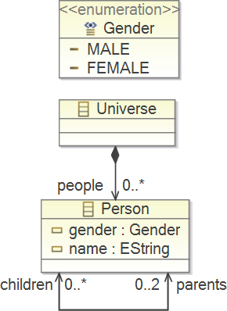
Richer Meta-Modelling
Implicit constraints
  Up to 2 parents
  MALE/FEMALE gender
Arbitrary constraints
  At least 5 characters in name
  1 MALE, 1 FEMALE parent
  Self is not an ancestor of self

Slide 14
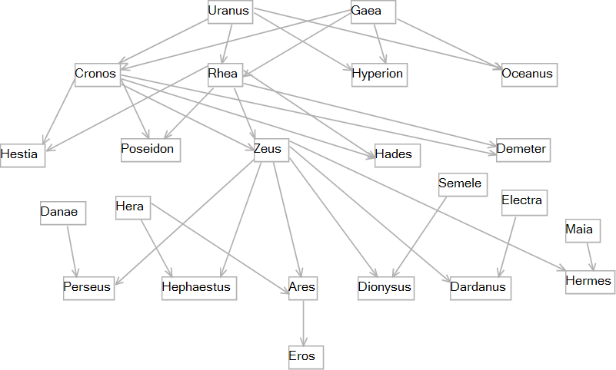
Example Family Tree Model
Simple GMF Diagram Editor
ESEExampleTree/model/default.people_diagram

Slide 15
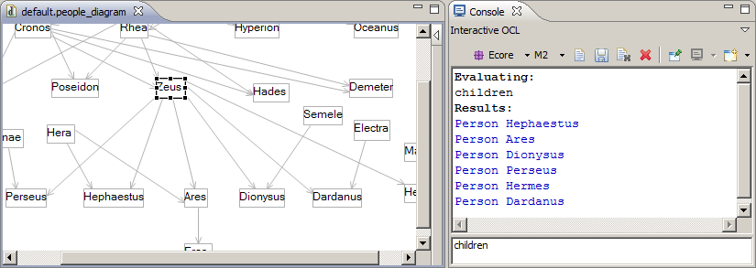

Simple Query Evaluation
Window->Show View->Other... Console
Console: New: Interactive OCL
Select Zeus as the Model Context (in any model editor)
Type children then carriage return

Slide 16
OCL Principles
Natural/Formal Language compromise
    natural language error prone
    formal language unapproachable to many
Specification (not Programming) Language
    declarative, modeling language
    side effect free, no model changes, atomic execution
    strongly typed, using UML generalization

Slide 17
Presentation
OCL has many similarities to Java
  assume Java familiarity
  no point expliaining if ... else ... in detail
  useful to highlight differences
    important language principles
    common novice misunderstandings

Slide 18
Primitive Types
Java: boolean, char, int, double
OCL:
  Boolean
  String
    no characters; just single 'character' strings
    'this is an OCL string' , "this is a Java string"
    same backslash escapes (except no octal for OCL)
  Integer
    no range limit (cf: java.lang.BigInteger)
  Real
    no range limit (cf: java.lang.BigDecimal)

Slide 19
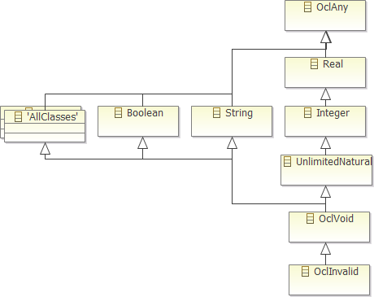
OCL Object Types
Primitive Types
    Boolean, String
    Real, Integer, UnlimitedNatural
      unlimited; no float/double etc distinction
Bottom Types
    OclVoid: any value can be null
    OclInvalid: any value can be invalid
Top Type
    OclAny: every OCL and user type
    conform to OclAny type.

Slide 20
Mathematical Operators
Infix: +, -, *, /
and, or, xor, implies
=, <>, <, >, <=, >= nb =, <>
Prefix: not, -
4.0 * -5
'a' + 'b'
Operators: mod, div, max, min, ...
4.max(5)
Java | OCL
==, != | =, <>

Slide 21

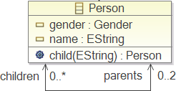
OCL Expressions
If Expressions
if gender = Gender::MALE
then 'he'
else 'she'
endif
Let Expressions
let jack : Person = child('Jack'),
jill : Person = child('Jill')
in jack <> null and jill <> null

Slide 22
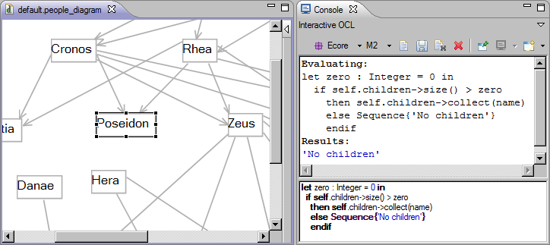
More Complex Query
Selecting Poseidon defines the implicit context variable
self : Person = Poseidon

Slide 23
Object Navigation
Properties
  self.name or just name
  (cf. this.getName() or getName())
Operations
  self.child('John') or just child('John')
  (cf. this.child('John') or child('John'))

Slide 24
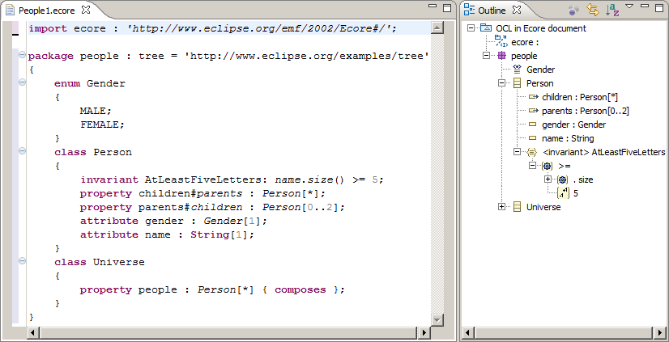
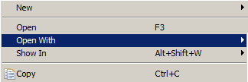

The OCLinEcore Editor
Select model/People1.ecore
Open With... OCLinEcore

Slide 25
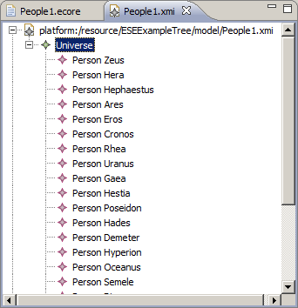
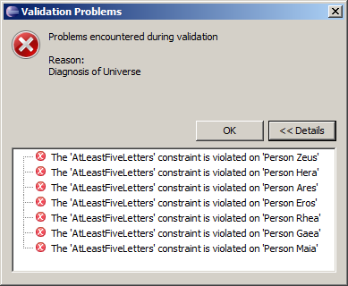
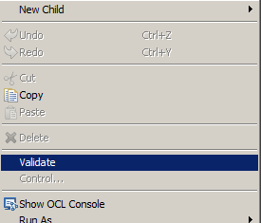
Example Validation Failure
Open model/People1.xmi with Sample Reflective Ecore Editor
Select Universe, Right button menu, Validate

Slide 26
Multiplicities and Collections
Meta-models specify multiplicities
    children : Person[*] {ordered,unique}
    parents : Person[0..2] {unique}
  multiplicities are specification concepts; not objects
Implementations (e.g. Ecore) reify multiplicities
    getChildren() returns a UniqueEList<Person>
  'many' properties have extra implementation objects
    getName() setName(newName)
    getChildren().get(2) getChildren().add(newChild)
OCL needs more than just UML multiplicities

Slide 27
OCL 2.0 Collections
Typed Collections partially reify multiplicities
Collections are different to objects
Navigation from a Collection uses ->
    [Navigation from an Object (OclAny) uses .]
Collections have type parameters
Collections have useful operations
Collections have very useful iterations
Collection(T) | Unordered | Ordered
Non-Unique | Bag(T) | Sequence(T)
Unique | Set(T) | OrderedSet(T)

Slide 28
Example Collection Operations
Collection::size() self.children->size()
'get'
Sequence::at(Integer) self.children->at(1)
    nb 1 is the first index, size() is the last
'add'
Collection(T)::including(T) : Collection(T)
    returns a new collection with added content
'contains'
Collection(T)::includes(T) : Boolean
    tests existing content

Slide 29
Collection::select iteration
Children
self.children
Sons
self.children->select(gender = Gender::MALE)
self.children->select(child | child.gender = Gender::MALE)
self.children->select(child : Person | child.gender = Gender::MALE)
select(iterator : type | body)
    filters to select elements for which the body is true
reject(iterator : type | body)
    filters to reject elements for which the body is true
cf multi-line Java loop

Slide 30
Collection::collect iteration
Children
self.children
Grandchildren
self.children->collect(children)
self.children->collect(child | child.children)
self.children->collect(child : Person | child.children)
collect(iterator : type | body)
    creates a new collection comprising all the bodies
any, exists, forAll, isUnique, iterate, one,

Slide 31
OCL Navigation Operators
anObject. ... object navigation
aCollection-> ... collection navigation
Shorthands
aCollection. ... implicit collect
anObject-> ... implicit collection
 | Object | Collection
. | Navigation | ?
-> | ? | Navigation

Slide 32
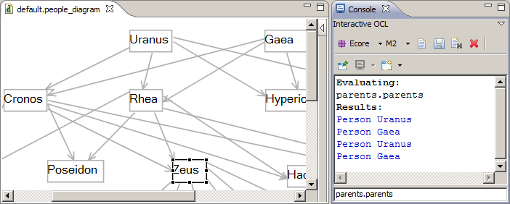
Implicit Collect Query
parents.parents = parents->collect(parents)
3 symbols, compared to 4 lines of Java
4 grandparents, but not all different!

Slide 33
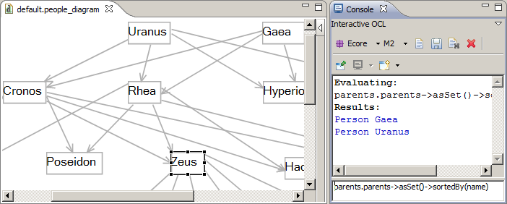
Cleaned up query
parents.parents->asSet()->sortedBy(name)
->asSet() converts to Set(Person), removes duplicates
->sortedBy(name) alphabeticizes

Slide 34
Implicit Collection Conversion
 | Object | Collection
. | Navigation | Implicit collect()
-> | Implicit Collection | Navigation
self->notEmpty()
  Standard OCL idiom
    Converts self (if an object) to a Collection of self
    If self is a defined object
      Implicit collection is not empty - true
    If self is an undefined object (null)
      Implicit collection is empty - false
    If self is an error (invalid)
      Implicit collection is also an error - invalid

Slide 35
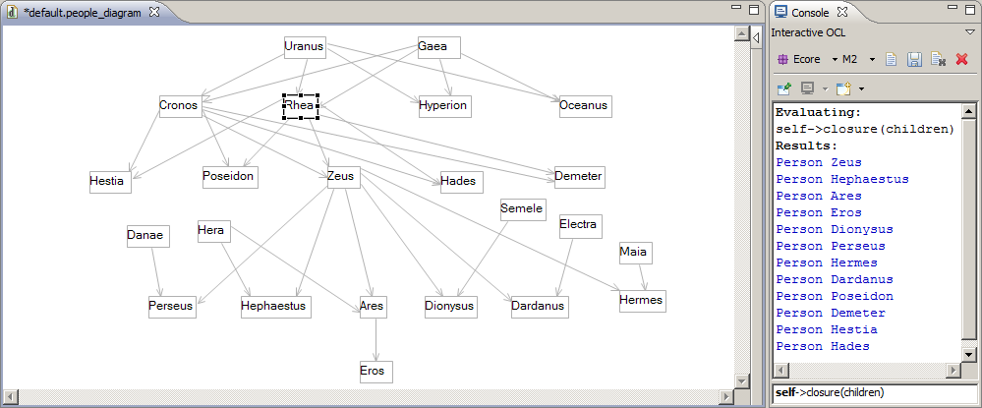
Collection::closure iteration
children, grandchildren, greatgrandchildren etc
self->closure(children)
Implicit collection of self, then closure of all children
[ closure in MDT/OCL 1.2, probably in OMG OCL 2.3 ]

Slide 36
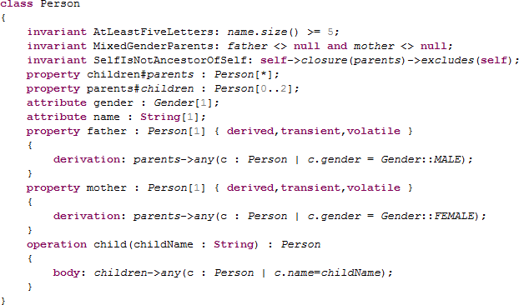
OCL as Implementation
any(x) iteration selects an arbitrary element for which x is true.

Slide 37
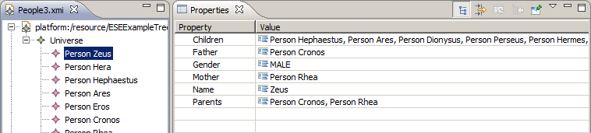
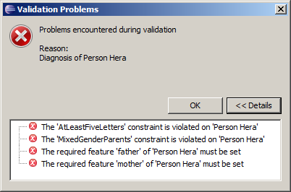
Derived Properties
For Hera
invariant MixedGenderParents: father.gender <> mother.gender;
fails because
father is null and
mother is null

Slide 38
Other OCL Capabilities
No time to mention
Other iterators, operations
Tuples
Association Classes/Qualifiers
@pre values
Messages
States

Slide 39
OMG OCL Progress
OCL 2.2 (current) Collections are objects!
    Collection conforms to OclAny
    No need for Collection/Object polymorphic operations
    Collections can mix Object/Collection content
? OCL 2.4 Specification defined by models
    Auto-generated by Acceleo
    Fix too many consistency/typo/realizability issues
    Aligned with UML 2.4, MOF 2.4, XMI 2.4
Eclipse committers active on OMG RTF

Slide 40
Eclipse MDT/OCL
  Original code contribution by IBM
  Java callable API
    Parse/evaluate OCL 1.x against Ecore meta-models
  Ecore or UML meta-models
  OCL 2.0 (in so far as possible)
  Example Interactive Console
  towards OCL 2.2
  Example Xtext editors (Ecore only)
OMG OCL 1.x
EMFT/OCL 1.0
OMG OCL 2.0
MDT/OCL 1.2
OMG OCL 2.2
MDT/OCL 3.0

Slide 41
Validation History
Use of OCL to define model validation
EMF Validation Framework
    Embed OCL in XML CDATA
EMF, OCL EAnnotations
    Embed OCL in EAnnotation
    Genmodel to integrate
Delegates
    Embed OCL in EAnnotation
    EObject.eInvoke() for dynamic invocation
    OCLinEcore editor for semi-validated editing
Eclipse 3.2
Eclipse 3.3
Eclipse 3.6
EMF 2.6
MDT/OCL 3.0

Slide 42
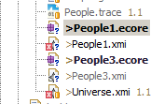
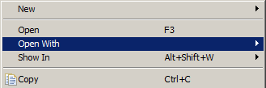

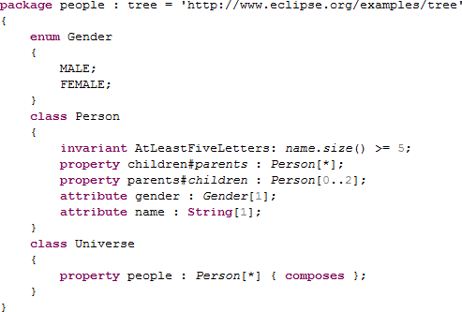
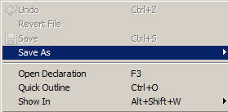

OCLinEcore Editor
  Open with -> OCLinEcore
  Save As *.ecore
    Loses formatting and comments
  Save As *.oclinecore
    Text file preserves comments
  Useful for plain Ecore too:
    Printable/reviewable text
    Searchable/replaceable text

Slide 43
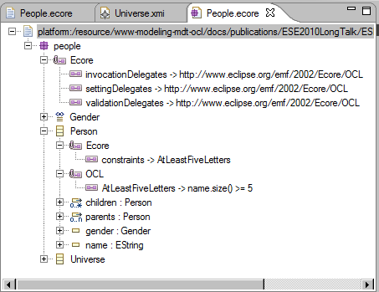
Validation in Sample Ecore Editor
OCLinEcore editor maintains EAnnotations automatically
OCLinEcore editor provides OCL syntax checking
OCLinEcore editor will provide OCL semantic checking

Slide 44
(Example) Tools and Tips
OCLinEcore editor for Ecore/embedded OCL
CompleteOCL editor for OCL documents
EssentialOCL editor for OCL Expressions (Papyrus)
OCL Interactive Console
    Invaluable ability to practice non-trivial expressions
    Page Up/Page Down to reuse expressions
Meta-model reload after change
Genmodel settings for embedded OCL

Slide 45
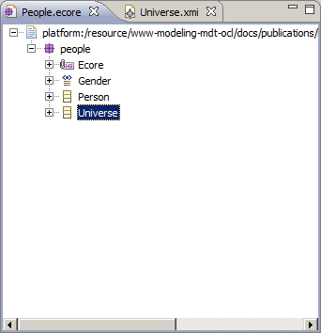
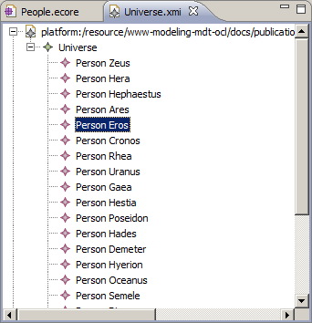
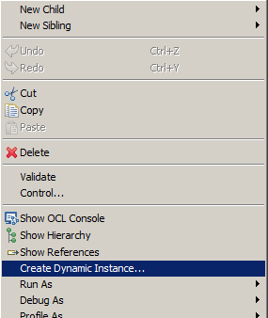
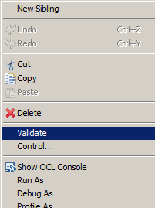
EMF Dynamic Instances
Create/update Ecore meta-model
Create XMI instance of EClass in meta-model
Update XMI model, validate OCL constraints

Slide 46
Meta-model Update
UML
meta-model
realizes
Ecore
meta-model
conformsTo
Model
My.uml
My.ecore
data.my
Edit UML/Ecore meta-model in UML/Ecore editor
    manual export of UML to Ecore in workspace
    manual save of Ecore to workspace
Create Dynamic Instance/Load Model in editor
    validate/evaluate OCL constraints
EMF does not support meta-model mutation
    Model.eClass() reverts to an unresolved proxy
    must exit and re-enter model editor

Slide 47
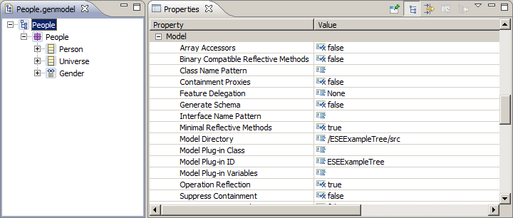
Genmodel settings for OCL
If not set to true
  MDT/OCL 3.0.0 OCL operation bodies not invoked
  MDT/OCL 3.0.1 Error Log as dynamic fallback used

Slide 48
Eclipse MDT/OCL Futures
3.1 Core (Indigo)
    Minor maintenance
3.1 Examples (Indigo)
    New Ecore/UML blind pivot meta-model
    Extensible modelled Standard Library
    Xtext editors
    Super-compliant - anticipating OMG OCL resolutions
4.0 Core + Tools + Examples (Indigo+1)
    3.1 Examples promoted to Core or Tools
      preserved external APIs, significant revision of internal APIs
    OCL to Java code generation

Slide 49
Which OCL Use Cases work When
 | Validate | Evaluate | Console | Editor
Static Java For Ecore | 1.0 | 1.0 | 1.0 Examples | 3.0 Examples
Static Java For UML | 1.2 | 1.2 | 3.1 Examples | 3.1 Examples
Complete OCL For Ecore | 3.1 Examples | 3.1 Examples | 3.1 Examples | 3.0 Examples
Complete OCL For UML | 3.1 Examples | 3.1 Examples | 3.1 Examples | 3.1 Examples
Embedded OCL in Ecore | 3.0 | 3.0 | 3.0 Examples | 3.0 Examples
Embedded OCL in UML | 3.1 Examples | 3.1 Examples | 3.1 Examples | 3.1 Examples
Released in Helios Example functionality in Helios
Example functionality in Indigo, release in Indigo+1

Slide 50
OCL 'Standard' Library
Problems: OMG
    library is not a model
    uses non-UML concepts (Iterator)
    no reflection for OclAny::oclType()
Problems: MDT/OCL
    hard coded, difficult to extend
    UML/Ecore differences, long generic template lists
    Ecore/EMOF discrepancies : EClass/Class
Solution: OMG
    library is a model defined by the new OCL meta-model
Benefit: MDT/OCL
    variants, extensible, unified, compliant

Slide 51
OCL Models
Problems: OMG
    OCL is not fully UML-aligned
    OCL modifies UML models (OclAny)
    Complete OCL modifies UML models
    OCL requires a modified sub-UML @ run-time
Problems: MDT/OCL
    UML/Ecore implementation differences, Ecore extension
    Ecore/EMOF discrepancies
Solution: OMG
    Pivot meta-model defines UML @ run-time
    Pivot model realises OCL-defined merges
Benefit: MDT/OCL
    unified, compliant, Ecore/EMOF hidden

Slide 52
Evaluation
Problems: MDT/OCL:
    OCL interpreted by Java
    OperationCallExp visit is very inefficient
    Slightly hard to extend for QVTo, Acceleo
    OCL within genmodelled Java is just a String
      significant first time parsing costs
Solution: MDT/OCL
    OCL to Java code generation
    Library model references a Java class per feature
    Code efficiency
Benefit: MDT/OCL
    extensible, faster (10 to 100 times ... iteration strategies)
    Java in genmodelled Java

Slide 53
The Re-Evaluation Problem
A set of OCL expressions
A set of model elements
A model change notification
Which of the OCL expressions may have changed its value on which context elements?
Naïve approach
  re-evaluate all expressions for all their contexts
  takes O(|expressions| * |modelElements|)

Slide 54
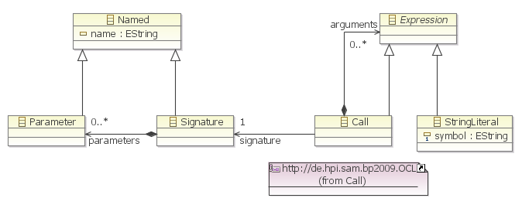
Example
self.signature.parameters->size() = self.arguments->size()

Slide 55
Naïve Re-Evaluation Sequence
That's way too slow!
|expressions| times
|contexts| times

Slide 56
Idea: Find out from Notification which OCLExpressions may have changed
Example: OCLExpression
self.arguments->size() = self.signature.parameters->size()
generates Notification filter
(containment AND ((new value filter incl subs for: Call) OR
(old value filter incl subs for: Call))) OR
((wantedClass conformsTo: Signature) AND (feature: parameters)) OR
((wantedClass conformsTo: Call) AND (feature: signature)) OR
((wantedClass conformsTo: Call) AND (feature: arguments))
Many expressions cause
    many adapters
    with one (often non-trivial) Notification filter each
    which need evaluation for each change Notification

Slide 57
Filter Events for OCLExpressions
{
one-time setup
|affected expressions| times
|contexts| times

Slide 58
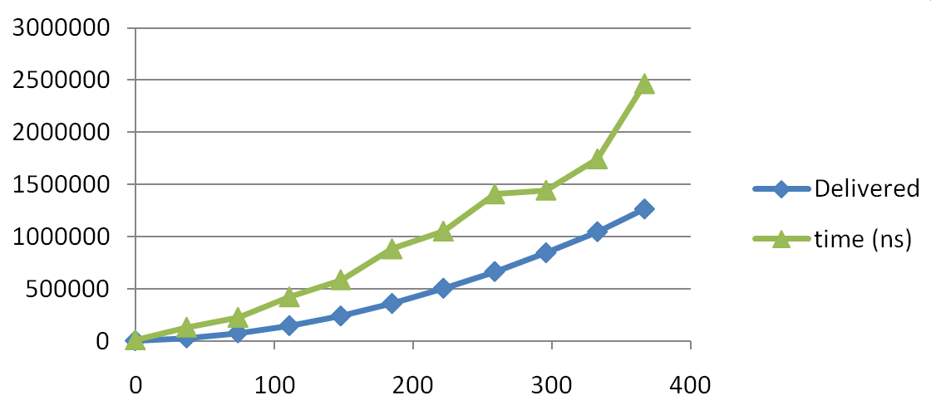
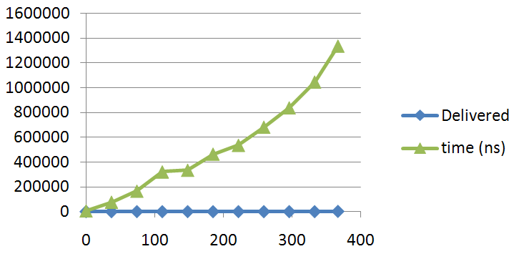
Scaling up Event Filtering
Effort for event propagation still O(|expressions|)
    slowed down even if no Notification delivered
Notification #1
Notification #2
Number of OCLExpressions
Number of OCLExpressions

Slide 59

Idea: Use HashMaps
to map Notification to Set<Adapter>
notifier.eClass() conforms to | Set<Adapter> interested
Parameter | [a1, a7, a15]
Signature | [a1, a3, a9]
… | …
Notification:
- notifier
- oldValue
- newValue
- feature
- eventType
…
…
feature | Set<Adapter> interested
NamedElement.name | [a3, a9, a14]
Call.signature | [a7, a15]
… | …

Slide 60
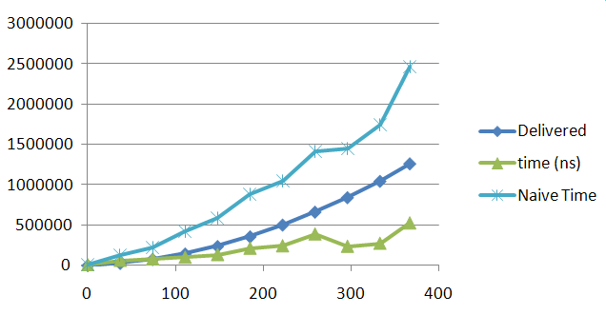
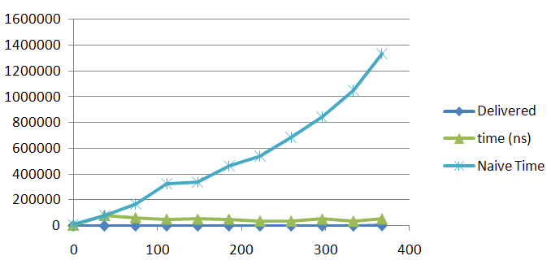
Effects of HashMap-Based Eventing
Faster delivery for
Notifications matched
by event filters
No time increase for
expressions whose filters
don't match a Notification
Notification #1
Notification #2
Number of OCLExpressions
Number of OCLExpressions

Slide 61
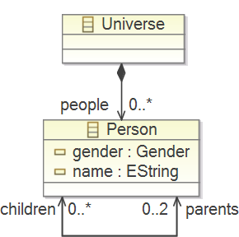
Reducing Contexts for Re-Evaluation
Use partial evaluation to prove value unchanged
  self.name='abc' not affected by name change from 'x' to 'y'
Use Notification object (notifier, oldValue, newValue) to navigate “backwards” to affected context objects
  self.children.children.name
  change attribute name on x:Person
  contexts for re-evaluation:
    x.parents.parents
Tricky for iterators and recursive
operations, but solved.

Slide 62
Reduce Set of Context Elements
{
one-time setup
|affected expressions| times
|affected contexts| times

Slide 63
API Usage Example
EventManager eventManager =
EventManagerFactory.eINSTANCE.createEventManagerFor(
editingDomain.getResourceSet());
final OCLExpression invariant = OCL.newInstance().createOCLHelper().
createQuery(“self.signature.parameters->size()=self.arguments->size()“);
final ImpactAnalyzer impactAnalyzer =
ImpactAnalyzerFactory.INSTANCE.createImpactAnalyzer(invariant,
/* notifyOnNewContextElements */ true, oppositeEndFinder);
Adapter adapter = new AdapterImpl() {
@Override
public void notifyChanged(Notification msg) {
// revalidate invariant on context objects delivered by impact analysis:
Collection<EObject> revalidateOn = impactAnalyzer.getContextObjects(msg);
if (revalidateOn != null && !revalidateOn.isEmpty()) {
revalidate(invariant, revalidateOn);
}
}
};
eventManager.subscribe(impactAnalyzer.createFilterForExpression(), adapter);
Notes:
Query for model changes
Scope: Elements loaded by the Diagram

Slide 64
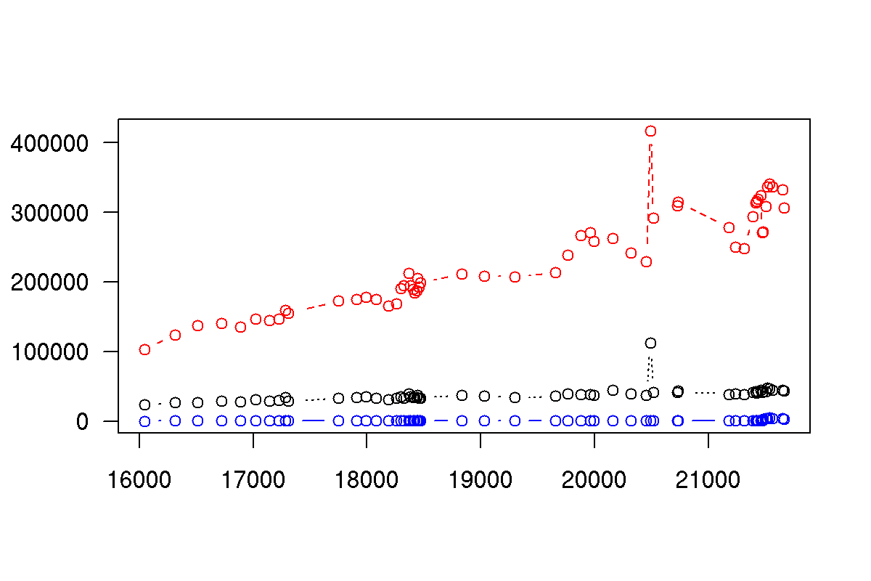
Benchmark Context Reduction
(Average Case)
Naive
Event-Filtered (*6 Speed-Up)
Event-Filtered and Context-Reduced
(*1300 Speed-Up vs. Naive,
*220 vs. Event-Filtered-Only)
Total Re-Evaluation Time in Seconds
Number of Model Elements

Slide 65
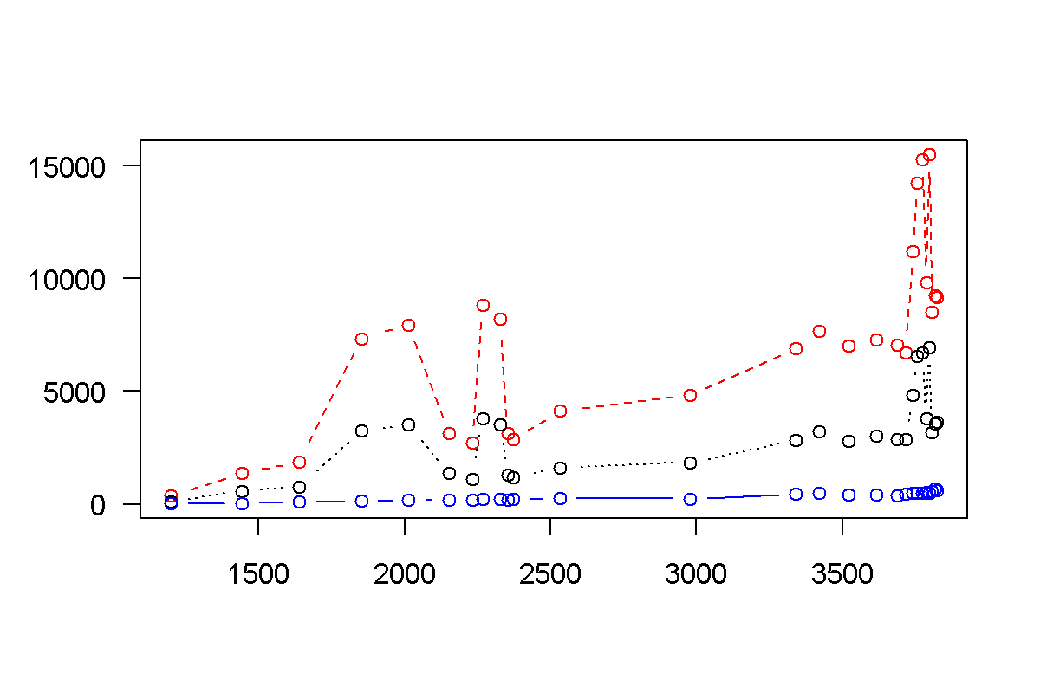
Benchmark Context Reduction (Worst Case)
(apply changes to very central elements, referenced by all other model packages)
Naive
Event-Filtered (*2.4 Speed-Up)
Event-Filtered and Context-Reduced
(*27 Speed-Up vs. Naive, *11 vs. Event-Filtered-Only)
Total Re-Evaluation Time in Seconds
Number of Model Elements

Slide 66
Summary
MDT/OCL originally focussed on Java API
Interactive Modeling Tools require OCL IDE
  EMF, Xtext, Acceleo, QVTo, OCL support
  richer OCL development environment
Extensibility required by QVTo, Acceleo
Efficiency required for serious use
IDE starting to appear
  Console, Editors
Expect/Demand much more
Contributions welcome

Slide 67
OCL Resources
OCL 2.2 Specification http://www.omg.org/spec/OCL/2.2
    Clause 7 is quite readable (many typos)
The Object Constraint Language:
Getting Your Models Ready For MDA
Jos B. Warmer, Anneke Kleppe
Eclipse MDT/OCL projecthttp://www.eclipse.org/projects/project_summary.php?projectid=modeling.mdt.ocl
Impact analysis
GIT: http://anonymous@www.furcas.org/furcas.git/
SVN: https://www.hpi.uni-potsdam.de/giese/gforge/svn/bp2009
Accounts: https://www.hpi.uni-potsdam.de/giese/gforge/

Slide 68
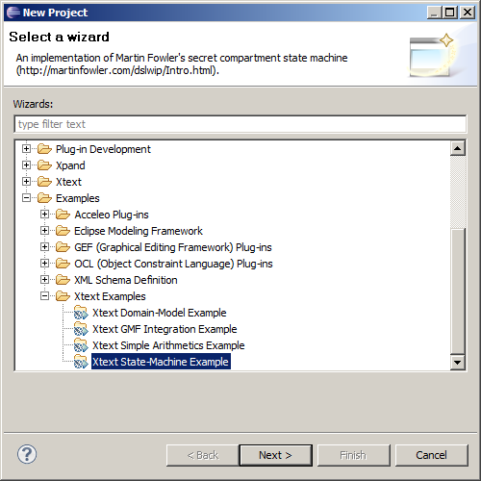
New Project
Edit org.eclipse.xtext.example.validation.FowlerDslJavaValidator
Insert
@Override
public void register(EValidatorRegistrar registrar) {
super.register(registrar);
FowlerdslPackage ePackage = FowlerdslPackage.eINSTANCE;
URI oclURI = URI.createPlatformPluginURI("/org.eclipse.xtext.example.fowlerdsl/model/FowlerDsl.ocl", true);
registrar.register(ePackage, new CompleteOCLEObjectValidator(ePackage, oclURI));
}

Slide 69
Beyond OCL
OMG OCL is a powerful expression language
  Declarative, First Order Predicate Calculus/Logic
  Model-oriented, UML navigation, multiplicities, ...
Formal language supports formal analysis
analysis supports optimisation
OCL's usefulness calls for scalable
implementation

Slide 70
State Machine Example
Very simple hierarchical state machine
  Xtext DSL - similar to Xtext's FowlerDSL
Use OCL to add validation to Xtext
  Complete OCL to keep OCL independent
  OCLinEcore to avoid OCL getting lost
Use Acceleo and OCL to convert to Java
Use QVTo and OCL to flatten state machine

Slide 71
Xtext with independent OCL
Main Eclipse
  meta-modeling
Edit states.xtext
Tailor Editor
Generate States Editor
Edit states.ocl
Run-time Eclipse
  modeling
Exit Run-time
Start Run-time
Edit simple.states
Exit Run-time
Start Run-time
Edit simple.states
  with OCL validation

Slide 72
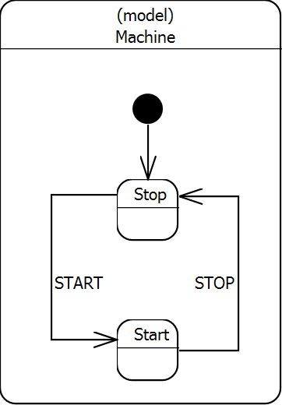
Simple State Machine DSL
module "simple.states"
statemachine Machine
{
events START STOP;
state Start
{
STOP => Stop
}
initial state Stop
{
START => Start
}
}

Slide 73
The Xtext States Grammar http://www.eclipse.org/modeling/mdt/ocl/docs/publications/EclipseCon2011Tutorial
/org.eclipse.ocl.tutorial.eclipsecon2011.states/src/org/eclipse/ocl/tutorial/eclipsecon2011/States.xtext
grammar org.eclipse.ocl.tutorial.eclipsecon2011.States
with org.eclipse.xtext.common.Terminals
generate states "http://ocl.eclipse.org/tutorial/eclipsecon2011/States"
Module: 'module' name=STRING
(machines+=Statemachine)*;
Statemachine: (initial?='initial')? 'statemachine' name=ID
('value' value=INT)? '{'
'events' (events+=Event)* ';'
(states+=State)* '}';
Event: name=ID;
State: SimpleState | CompoundState;
SimpleState: (initial?='initial')? 'state' name=ID ('value' value=INT)?
'{' (transitions+=Transition)* '}';
CompoundState: 'compound' (initial?='initial')? 'state' name=ID
'machine' machine=[Statemachine]
'{' (transitions+=Transition)* '}';
Transition: event=[Event] '=>' state=[State];

Slide 74
Validation
Diagnose inappropriate source text
Xtext grammar
  validates syntax and some semantics
    typos:
    inappropriate names:
Additional Java/Check Validator
  specialized validation
External Complete OCL Validation
Embedded OCLinEcore Validation

Slide 75
External Complete OCL Validation
Xtext States project
  src-gen/.../States.ecore
    auto-generated; don't want to edit it
  META-INF/MANIFEST.MF
    add dependency on
org.eclipse.ocl.examples.xtext.completeocl
  src/.../validation/StatesJavaValidator.java
    generated once; can edit it
Helpwanted: validation.CompleteOCLValidatorFragment

Slide 76
StatesJavaValidator.java
Use Java Validator to invoke Complete OCL
import org.eclipse.emf.common.util.URI;
import org.eclipse.ocl.examples.xtext.completeocl.validation.CompleteOCLEObjectValidator;
import org.eclipse.ocl.tutorial.eclipsecon2011.states.StatesPackage;
import org.eclipse.xtext.validation.EValidatorRegistrar;
public class StatesJavaValidator extends AbstractStatesJavaValidator
{
@Override
public void register(EValidatorRegistrar registrar) {
super.register(registrar);
StatesPackage ePackage = StatesPackage.eINSTANCE;
URI oclURI = URI.createPlatformResourceURI(
"/org.eclipse.ocl.tutorial.eclipsecon2011.states.ocl/model/States.ocl", true);
registrar.register(ePackage,
new CompleteOCLEObjectValidator(ePackage, oclURI));
}
}

Slide 77
Complete OCL Validation 1
/org.eclipse.ocl.tutorial.eclipsecon2011.states.ocl/model/States.ocl
import 'http://ocl.eclipse.org/tutorial/eclipsecon2011/States'
package states
context Statemachine
inv HasInitialState('No initial state'):
states->exists(s : State | s.initial)
endpackage
Evaluates: states->exists(s : State | s.initial)
true => silent, invariant is satisfied
false => invariant is not satisfied
evaluates 'No initial state' to determine warning diagnostic
null => invariant is not satisfied
evaluates 'No initial state' to determine error diagnostic
invalid => exception, evaluation failure
Eclipse OCL Extension
proposed to OMG
Eclipse OCL Pragmatics

Slide 78
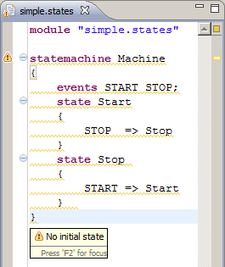
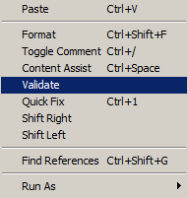
Example Invariant Violation

Slide 79
Complete OCL Validation 2
context Statemachine
def: asError(verdict : Boolean) : Boolean =
if verdict then true else null endif
inv HasInitialState('No initial state'):
asError(states->exists(s : State | s.initial))
context SimpleState
inv NameLength('\'' + name + '\' has ' + name.size().toString()
+ ' characters when at least 4 wanted'):
name.size() >= 4
inv NameIsLeadingUpperCase('\'' + name + '\' must be Leading Uppercase'):
let firstLetter : String = name.substring(1,1)
in firstLetter.toUpperCase() = firstLetter

Slide 80
Complete OCL Validation 3
context SimpleState
def: statemachine : Statemachine =
oclContainer()->oclAsType(Statemachine)
inv UniqueInitialState('There is more than one initial state'):
initial implies statemachine.states->select(initial)->size() = 1
inv EveryEventIsHandled(
let allEvents : Set(Event) = statemachine.events->asSet(),
myEvents : Set(Event) = self.transitions.event->asSet()
in (allEvents - myEvents)->iterate(e : Event;
s : String = 'The following events are not handled:'
| s + ' ' + e.name)):
let allEvents : Set(Event) = statemachine.events->asSet(),
myEvents : Set(Event) = self.transitions.event->asSet()
in (allEvents - myEvents)->isEmpty()

Slide 81
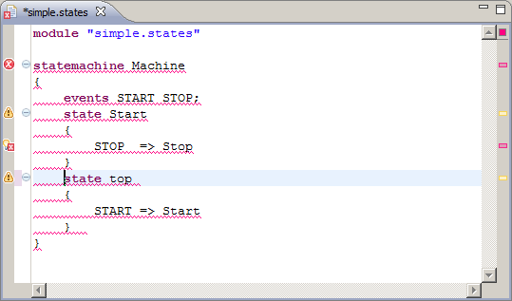

Composite Validation Errors

Slide 82
Complete OCL activation
States.ecore
referredType
States.ocl
eClass,
eType
????
simple.states
Modeling
Tool
load
Xtext
  CompleteOCLEObjectValidator
Interactive Xtext OCL Console
  Manual Load Resource

Slide 83
Model URI Resolution
Main Eclipse, no Global Package Registry
platform:/resource/org.eclipse.ocl.tutorial.eclipsecon2011.states/
src-gen/org/eclipse/ocl/tutorial/eclipsecon2011/States.ecore
Run-time Eclipse, no Project Resources
http://ocl.eclipse.org/tutorial/eclipsecon2011/States
Complete OCL
  editor runs in Main Eclipse
  executed in Run-time Eclipse
OCL Model Registry, Project Package Registry

Slide 84
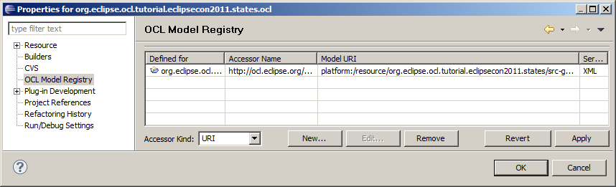
OCL Model Registry
URI mapping
Defined for: org.eclipse.ocl.tutorial.eclipsecon2011.states.ocl
AccessorName: http://ocl.eclipse.org/tutorial/eclipsecon2011/States
Model URI:
platform:/resource/org.eclipse.ocl.tutorial.eclipsecon2011.states/
src-gen/org/eclipse/ocl/tutorial/eclipsecon2011/States.ecore

Slide 85
Complete OCL Playtime 1
Open Simple.states in Run-time Eclipse
  edit and see similar errors to previous slide
  add additional state
Exit Run-time Eclipse
  edit States.ocl
    change NameIsLeadingUpperCase to NameIsUppercase
  restart Run-time Eclipse
  check that NameIsUppercase is working

Slide 86
Complete OCL Playtime 2
Add a ...
Add a StateIsReachable invariant
  tip 1: a sequence of transitions from an initial state reaches the state in question
  tip 2: the closure of all transitions from all initial states includes the state in question

Slide 87
Complete OCL Playtime Answers
inv NameIsUpperCase('\'' + name + '\' must be Uppercase'):
name.toUpperCase() = name
statemachine.events->select(initial)->closure(transitions.state)->includes(self)

Slide 88
Complete OCL Validation
Independent add-on to an Ecore file
  no need to edit the auto-generated Ecore file
  need to register the Complete OCL for validation
Not part of the editor framework
  re-useable in other tool contexts
  need to inform tool of Complete OCL existence
UML specified with additional Complete OCL

Slide 89
Xtext with embedded OCL
Main Eclipse
  meta-modeling
Edit states.xtext
Tailor Editor
Generate OCLStates Editor
Edit states.ecore
GenModel States
Run-time Eclipse
  modeling
Exit Run-time
Start Run-time
Edit simple.states
Exit Run-time
Start Run-time
Edit simple.states
  with OCL validation

Slide 90
Embedded OCL Validation
OCLStates.ecore
embedded
OCL
eClass,
eType
simple.oclstates
Modeling
Tool
load
OCLinEcore editor embeds OCL in Ecore
  no need to inform tools that OCL exists
  EMF automatically invokes OCL via delegates
Ecore can no longer be autogenerated
  often appropriate for stable models anyway

Slide 91
Move Ecore
Move States.ecore, States.genmodel
  from org.eclipse.ocl.tutorial.eclipsecon2011.states/
  src-gen/org/eclipse/ocl/tutorial/eclipsecon2011/States.ecore
  to org.eclipse.ocl.tutorial.eclipsecon2011.oclstates/
  model/OCLStates.ecore
  change all ...States.ecore refs to OCLStates.ecore
  set genmodel Operation Reflection to true

Slide 92
Import rather than Generate Ecore
grammar org.eclipse.ocl.tutorial.eclipsecon2011.States
with org.eclipse.xtext.common.Terminals
generate states "http://ocl.eclipse.org/tutorial/eclipsecon2011/States"
import "platform:/resource/org.eclipse.ocl.tutorial.eclipsecon2011.oclstates/model/OCLStates.ecore"
(Change MWE2 scipt to *.oclstates)
The Generate OCLStates Editor launch may be used

Slide 93
Optional Workaround Bug 322639
Use of EObjectValidator gives
    'An object may not circularly contain itself'
NoEObjectValidator setUseEObjectValidator(false)
import org.eclipse.ocl.examples.xtext.base.utilities.NoEObjectCompositeEValidator;
import org.eclipse.xtext.validation.CompositeEValidator;
/**
* Use this class to register components to be used at runtime / without the Equinox extension registry.
*/
public class StatesRuntimeModule extends org.eclipse.ocl.tutorial.eclipsecon2011.AbstractStatesRuntimeModule
{
public Class<? extends CompositeEValidator> bindCompositeEValidator() {
return NoEObjectCompositeEValidator.class;
}
}

Slide 94
Embedded Constraints 1
/org.eclipse.ocl.tutorial.eclipsecon2011.oclstates/model/OCLStates.ecore
class Statemachine
{
invariant HasInitialState('No initial state'):
(states)->exists(s : State | s.initial);
attribute _'initial' : Boolean[?] { ordered };
attribute name : String[?] { ordered };
attribute value : ecore::EInt[?] { ordered };
property events : Event[*] { ordered composes };
property states : State[*] { ordered composes };
}
_'initial' is OCL syntax for an awkward identifier
(states) is over protective pretty-printing
[?] is UML oriented [1] not [?] is the default
{ ordered } is UML oriented { !ordered unique } is the default

Slide 95
Embedded Constraints 2
invariant UniqueInitialState('There is more than one initial state'):
initial implies (((statemachine).states)->select(initial))->size() = 1;
invariant NameIsLeadingUpperCase('\'' + name + '\' must be Leading Uppercase'):
let firstLetter : String = (name).substring(1, 1)
in firstLetter.toUpperCase() = firstLetter;
invariant NameLength('\'' + name + '\' has ' + ((name).size()).toString()
+ ' characters when at least 4 wanted'):
(name).size() >= 4;
invariant EveryEventIsHandled(
let allEvents : Set(Event) = ((statemachine).events)->asSet() in
let myEvents : Set(Event) = ((self.transitions)->collect(event))->asSet() in
(allEvents - myEvents)->iterate(e : Event ;
s : String = 'The following events are not handled:'
| s + ' ' + e.name)):
let allEvents : Set(Event) = ((statemachine).events)->asSet() in
let myEvents : Set(Event) = ((self.transitions)->collect(event))->asSet() in
(allEvents - myEvents)->isEmpty();
property statemachine : Statemachine[?] { derived } {
derivation: (oclContainer()).oclAsType(Statemachine);
}

Slide 96
Enable Custom Validation Messages
(Vote for EMF Bug 337792 to obviate this)
Use an extended Validator API for
/emf-gen/org/eclipse/ocl/tutorial/eclipsecon2011/
oclstates/util/OCLStatesValidator.java
* @generated not
*/
public class OCLStatesValidator extends OCLinEcoreEObjectValidator {
/META-INF/MANIFEST.MF
add dependency on
org.eclipse.ocl.examples.xtext.oclinecore

Slide 97
Embedded OCL Playtime 1
Open model/OCLStates.ecore with OCLinEcore
(in org.eclipse.ocl.tutorial.eclipsecon2011.oclstates)
  edit and verify semantic checking
  add additional state
Open model/OCLStates.ecore with Sample Ecore
  browse to see xxx and xxx$message EAnnotations

Slide 98
Embedded OCL Playtime 2
In Run-time Eclipse open simple.oclstates (in org.eclipse.ocl.tutorial.eclipsecon2011.states2classes)
  verify invariant checking
Exit Run-time Eclipse
Add a new constraint to OCLStates.ecore
Regenerate Java with OCLStates.genmodel
In Run-time Eclipse open simple.oclstates
  verify new invariant

Slide 99
Acceleo with integral OCL
Main Eclipse
  meta-modeling
States Editor
states.ecore Model
Run-time Eclipse
  modeling
Edit generate.mtl
or simple.states
Run Generate Simple States
Inspect *.java
simple.states
generate.mtl
*.java

Slide 100
Use of OCL for M2T
Acceleo is the Eclipse realisation of MOFM2T
  OMG specification for Model to Text transformation
  exploits/extends OCL for core expressions
Tutorial Example
  generate Java classes from State Model
  one class for the State Machine
  one class for each State
  one method for each Event

Slide 101
States to Java Classes
package simple.states;
public class Stop implements Machine.State {
private final Machine sm;
public Stop(Machine sm) {
this.sm = sm;
}
public void doSTOP() {
sm.setState(STATES.STATE_Stop);
}
}
module "simple.states"
statemachine Machine
{
events START STOP;
state Start
{
START => Start
}
initial state Stop
{
STOP => Stop
}
}
package simple.states;
public class Machine {
public interface State {
public void doSTART();
public void doSTOP();
enum STATES {
STATE_Start,
STATE_Stop
}
}

Slide 102
Xtext files as Eclipse Models
Xtext maintains Concrete Syntax text files
  behave as EMF models
  Open With->Sample Ecore Model Editor
    shows CST as an Ecore model
XtextResourceFactory not XMIResourceFactory
  defined by plugin.xml
    works in nested Eclipse
    doesn't work standalone

Slide 103
Xtext files as Standalone Models
XtextResourceFactory not registered
  invoke XXXStandaloneSetup.doSetup()
    injected references to
      org.eclipse.xtext
      org.apache.log4j
  either export from 'editor' plugin (Bug 339083)
    edit MANIFEST.mf to re-export
  or import to consumer plugin
    edit MANIFEST.mf to add dependencies

Slide 104
Acceleo configuration to use Xtext
/org.eclipse.ocl.tutorial.eclipsecon2011.states2classes/ src/org/eclipse/ocl/tutorial/eclipsecon2011/states2classes/files/Generate.java
Acceleo generator runs Standalone
Edit 'Generate.java'.registerPackages
  invoke 'editor' Standalone setup
* @generated NOT
*/
@Override
public void registerPackages(ResourceSet resourceSet) {
super.registerPackages(resourceSet);
StatesStandaloneSetup.doSetup();
// resourceSet.getPackageRegistry().put(
// org.eclipse.xtext.example.fowlerdsl.FowlerdslPackage.eINSTANCE.getNsURI(),
// org.eclipse.xtext.example.fowlerdsl.FowlerdslPackage.eINSTANCE);
}

Slide 105
Acceleo Control Logic
[template public generate(m : Module)]
[comment @main /]
[for (e : Statemachine | m.machines)]
[file (e.name + '.java', false, 'UTF-8')]
[generateStatemachineClass(m, e)/]
[/file]
[for (s : State | e.states)]
[file (s.name + '.java', false, 'UTF-8')]
[generateStateClass(m, e, s)/]
[/file]
[/for]
[/for]
[/template]
Whitespace copied to output; limited indentation
OCL: e.name + '.java' e.states

Slide 106
Acceleo Text Template 1
[template public generateStateClass(m : Module, e : Statemachine, s : SimpleState)]
package [m.getPackageName()/];
public class [s.getStateClassName()/] implements [e.name + '.State'/] {
private final [e.getStateMachineClassName()/] sm;
public [s.getStateClassName()/]([e.getStateMachineClassName()/] sm) {
this.sm = sm;
}
[for (t : Transition | s.transitions)]
public void [t.event.getEventMethodName()/]()
{ sm.setState(STATES.[t.state.getStateEnumName()/]); }
[/for]
}
[/template]
OCL:
t.state.getStateEnumName()
package simple.states;
public class Stop implements Machine.State {
private final Machine sm;
public Stop(Machine sm) {
this.sm = sm;
}
public void doSTOP() {
sm.setState(STATES.STATE_Stop);
}
}

Slide 107
Acceleo Queries
Queries support modularisation
  repeated sub-expression can be factored out
[query getStateEnumName(s : State) : String =
'STATE_' + s.name/]
[query getInitialState(e : Statemachine) : State =
e.states->any(initial)/]

Slide 108
Acceleo Text Template 2
[template public generateStatemachineClass(m : Module, e : Statemachine)]
package [m.getPackageName()/];
public class [e.getStateMachineClassName()/] {
public interface State {
[for (v : Event | e.events)]
public void [v.getEventMethodName()/]();
[/for]
enum STATES {
[for (s : State | e.states) separator (',\n') after('\n')]
[s.getStateEnumName()/][/for]
}
}
...
public [e.getStateMachineClassName()/]() {
setState(State.STATES.[e.getInitialState().getStateEnumName()/]);
}
package simple.states;
public class Machine {
public interface State {
public void doSTART();
public void doSTOP();
enum STATES {
STATE_Start,
STATE_Stop
}
}
public Machine() {
setState(State.STATES.STATE_Stop);
}

Slide 109
Acceleo OCL Playtime
Launch Generate Simple States
  see the generation errors
correct simple,states
ReLaunch, no errors
Change the enums from STATE to ENUM prefix
ReLaunch, verify changes
Change enums to all upper case
  hint String.toUpperCase()
Change internal States interface to an abstract class with default no change event methods.
Eliminate the 'EveryStateIsHandled' editor validation

Slide 110
QVTo with integral OCL
Run-time Eclipse
  modeling
Edit FlattenStates.qvto
or compound.states
Run Flatten States to XMI
or Flatten States
Inspect flattened.xmi
Inspect flattened.states
Main Eclipse
  meta-modeling
States Editor
states.ecore Model
compound.states
FlattenStates.qvto
flattened.xmi
flattened.states

Slide 111
QVTo configuration to use Xtext
QVTo generator runs as a Plugin
  no action needed
QVTo can transform 'Xtext' to 'Xtext'
But to-'Xtext' must be serializable XMI
  no orphans, no missing multiplicity >=1 objects
    obscure/cannot write diagnostics
  use 'Xtext' to *.xmi for debug

Slide 112
QVTo feature
Output mode ill-defined by specification
  implemented as append by M2M/QVTo
Transformation re-run appends
  additional root object in XMI file
    may be useful for manual comparison of old/new
    guarantees non-serializability to Xtext
Manually delete output file before transformation

Slide 113
QVTo debugging tips
QVTo debugger is good
  breakpoint, single line stepping, variable browser
  not perfect, variables may be wrong 'self'
Debugger more useful if
  implement *Impl.toString() to explain self
  'var' used to cache partial/temporary states

Slide 114
Statemachine Flattening Example
module "compound.states"
statemachine Outer {
events START STOP;
initial state Start value 4 {
START => CompoundA }
state Stop value 5 {
STOP => CompoundB }
compound state CompoundA machine Inner {
START => Stop }
compound state CompoundB machine Inner {
STOP => Stop }
}
statemachine Inner {
events LEFT RIGHT;
initial state Left value 1 {
LEFT => Right }
state Right {
RIGHT => Left }
}
module "flattened.compound.states"
statemachine Outer {
events STOP RIGHT LEFT START;
initial state Start value 4 {
START => CompoundA_Left }
state Stop value 5 {
STOP => CompoundB_Left }
state CompoundA_Left value 1 {
LEFT => CompoundA_Right
START => Stop }
state CompoundA_Right {
RIGHT => CompoundA_Left
START => Stop }
state CompoundB_Left value 1 {
LEFT => CompoundB_Right
STOP => Stop }
state CompoundB_Right {
RIGHT => CompoundB_Left
STOP => Stop }
}

Slide 115
root mapping
mapping HIER::Module::model2FLATModel() : FLAT::Module {
name := 'flattened.' + self.name;
var name2state : Dict(String, HIER::State);
var allMachines : Set(HIER::Statemachine) =
self.machines.allMachines()->asSet();
var allStates : Set(HIER::State) =
allMachines.states->asSet();
var allCompoundStates : Set(HIER::CompoundState) =
allStates->select(oclIsTypeOf(HIER::CompoundState))
->collect(oclAsType(HIER::CompoundState))->asSet();
var rootMachines : Set(HIER::Statemachine) =
allMachines->select(m : HIER::Statemachine
| not allCompoundStates->exists(machine = m));
machines := rootMachines->map machine2machine(name2state);
}

Slide 116

transitive closure
Warning because closure() not in OCL 2.0, 2.2
  resolution adopted in OCL 2.3
  due for approval this week OMG, Arlington, VA
Eclipse OCL has and continues to pioneer solutions to OMG OCL specification issues

Slide 117
machine 2 machine mapping
mapping HIER::Statemachine::machine2machine(name2state : Dict(String,
HIER::State)) : FLAT::Statemachine {
var exitTransitions : Dict(FLAT::Event, FLAT::State);
name := self.name;
events := self.allMachines().events->asSet().map event2event();
states := self.states.map state2states(name2state, Sequence{});
self.states.map state2transitions(name2state,
Sequence{}, exitTransitions);
}
  pass 1 all events flattened
  pass 2 all states flattened
    name2state cache, hierarchy Sequence
  pass 3 transitions added to flattened states
    to-compound => initial
    from-compound => all exitTransitions

Slide 118
iterate to form concatenated string
query HIER::State::getStateName(hierarchy : Sequence(HIER::CompoundState)) : String {
return hierarchy->iterate(c : HIER::CompoundState;
s : String = self.name |
c.name + '_' + s)
}

Slide 119
conditional hierachical selection
query HIER::State::initialStateName(hierarchy :
Sequence(HIER::CompoundState)) : String {
var stateName : String = self.getStateName(hierarchy);
return if self.oclIsKindOf(HIER::CompoundState)
then let compoundState : HIER::CompoundState =
self.oclAsType(HIER::CompoundState)
in compoundState.machine.states->any(initial)
.initialStateName(hierarchy->append(compoundState))
else stateName
endif
}

Slide 120
simple navigation/logic
mapping HIER::SimpleState::simpleState2state(
name2state : Dict(String,HIER::State),
hierarchy : Sequence(HIER::CompoundState)
) : FLAT::SimpleState {
var stateName : String = self.getStateName(hierarchy);
name := stateName;
value := self.value;
initial := hierarchy->isEmpty() and self.initial;
name2state->put(stateName, result);
}

Slide 121
iterate to create objects
mapping HIER::SimpleState::simpleState2transitions2(
name2state : Dict(String, HIER::State),
hierarchy : Sequence(HIER::CompoundState),
exitTransitions : Dict(FLAT::Event, FLAT::State)
) : FLAT::State {
init {
var stateName : String = self.getStateName(hierarchy);
result := name2state->get(stateName);
}
transitions := exitTransitions->keys()->iterate(v : FLAT::Event;
acc : Sequence(HIER::Transition) =
self.transitions.map transition2transition(name2state, hierarchy)
| acc->append(object FLAT::Transition
{ state := exitTransitions->get(v); event := v; })
);
}

Slide 122
QVTo OCL Playtime

