Slide 1
At last an OCL Debugger
Edward Willink
(Eclipse MMT co-lead)
Eclipse OCL lead
Eclipse QVTd lead
Eclipse QVTo committer
OMG OCL 2.5 RTF chair
OMG QVT 1.3 RTF chair
EclipseCon Europe, Ludwigsburg
4th November 2015

Slide 2

Overview
OCL Context
Why a debugger is hard
EMF/Eclipse techniques

Slide 3
OCL Context
Implementation Specification
Models - Structure
Ecore
UML
Xtext
Rich Models - Behavior
Ecore
+ Java
Xcore
OCLinEcore
OCL
Xbase
Applications
Programs
Imperative
Transformations
e.g. QVTo
Declarative
Transformations
e.g. ATL, QVTr

Slide 4


Launching a Java Debugger
User
Program
loads
reads
User
Data
Java
Debugger
Command Line
Debug Launcher
Java etc, new process
    start program in debug mode (with arguments)
      program acquires its data
    single mouse selection + action

Slide 5
Launching an OCL Debugger
OCL
constraint
OCL
Debugger
Command Line
Debug Launcher
User
Models
Independent OCL, new process
    start OCL debugger (launch dialog)
      select (load) a Constraint / Expression
      select (load) some model objects

Slide 6
Independent Debugger
Real Application
Independent Debugger
Application
Model API
Models
Models
OCL
reload
OCL API
Embedded
OCL
transcribe
Complete OCL
Parser, Evaluator, Editor, Debugger
Evaluator
Reload models, transcribe OCL
No break points to help locate problem
Hard to select code to debug
Different evaluator/models/...

Slide 7

ResourceSet Discovery
Modeling
Application
ResourceSet
Resources
EObjects
setSelection
OCL
Application
selectionChanged
ISelection
EMF Modeling Applications use EMF EObjects
UI applications share selections
  e.g. editor selection to outline view
OCL application can listen to selection changes
  reuse EObject

Slide 8
OCL Injection
Diagnostian
Validation
Registry
EPackage
Validators
Ecore
constraints
install
use
OCL Menu
Action
OCL
Validators
OCL
constraints
iterate
over
click
Resources
Modeling
Application
ResourceSet
Resources
Modeling
Application
ResourceSet
EObjects
EObjects
EMF Modeling Applications use Diagnostician
  per-EPackage Validation Registry Java code
Additional menu actions can be contributed
OCL action can add additional OCL constraints

Slide 9
Mars.1 Modeling EPP + Xtext + OCL
New Project Example Complete OCL Tutorial
Open XtextTestFile.xtext
Open ExtraXtextValidation.ocl
(Validity View, Xtext Console closed)

Slide 10
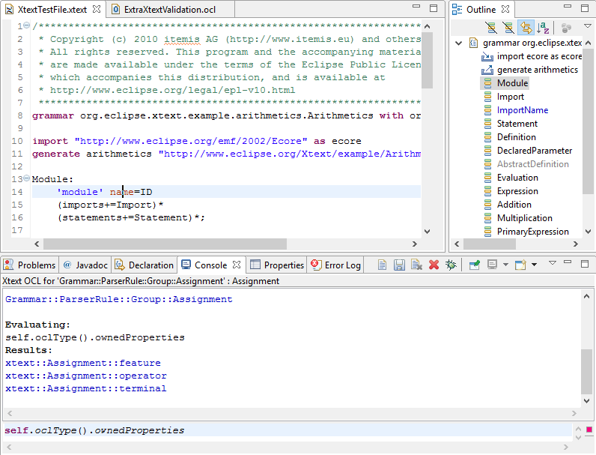
ResourceSet Discovery Demo

Slide 11
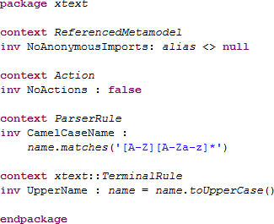
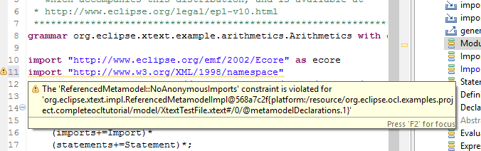
OCL injection Demo

Slide 12
Alternate Validation
Validating
Application
use
Diagnostian
Validation
Registry
Validators
Constraints
use
iterate over
Resources
Modeling
Application
ResourceSet
Resources
Modeling
Application
ResourceSet
EObjects
EObjects
Alternate validation, not necessarily OCL
  discovers ResourceSet by shared selection
  performs some or all validations
  presents more detailed results more helpfully

Slide 13
Alternate Validation Debugging
Validating
Application
OCL
Debugger
use
Diagnostian
Validation
Registry
Validators
Constraints
use
iterate over
Modeling
Application
ResourceSet
Resources
Modeling
Application
ResourceSet
EObjects
Validating application is 'our' application
  can use 'our' API to interact with debugger
  just need to add a 'Debug' button

Slide 14
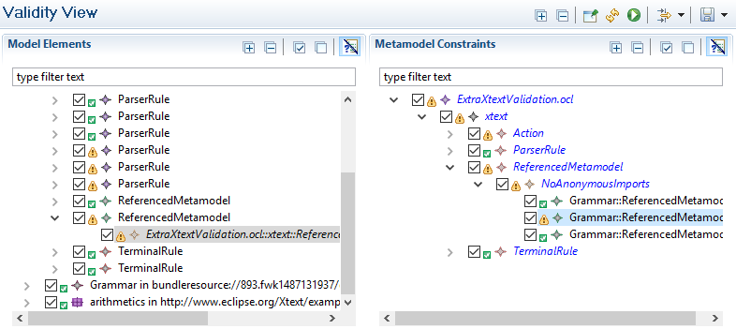
Alternate Validation Demo

Slide 15
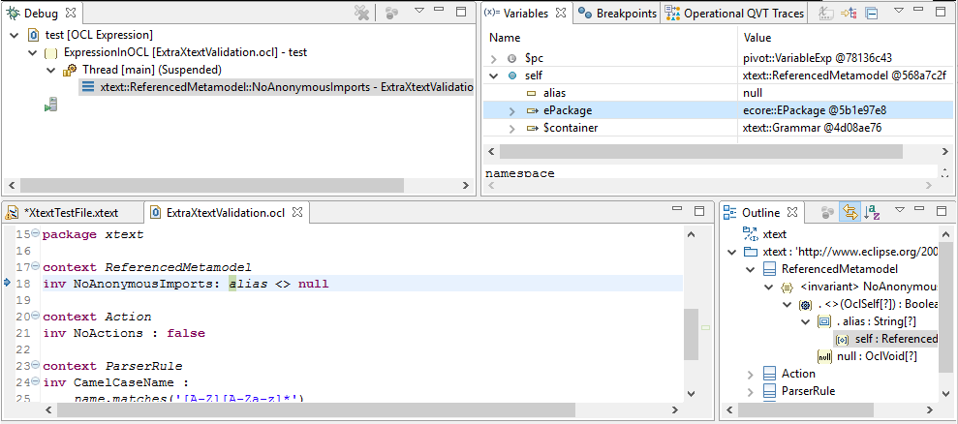
OCL Debugger Demo

Slide 16
OCL Debugger
2013: Dresden OCL debugger
2014: Eclipse OCL/QVTi debugger (Luna)
Ecore OCL
Debugger
Pivot OCL
Acceleo
Eclipse QVTo
Debugger
QVTi
Debugger
Debugger
QVTs
QVTp
Eclipse Tools
QVTm
QVTu
Eclipse QVTc
Eclipse QVTr

Slide 17
Summary
OCL useless by itself
  needs to complement something else
OCL Debugger useless by itself
  needs to start in conjunction with something else
Eclipse / EMF provide helpful mechanisms

Slide 18
OCL Overview
Executable specification language
  used for the hard bits of UML, ...
  simple model ops
    if self <> null then self.name else 'no-self' endif
  powerful collection operations
    self.children->isUnique(name)
Side effect free
    contributes to strong analysis and optimisation
Useless
    needs a model providing environment

