Slide 1
The OCLforUML Profile
Edward Willink
(Eclipse MMT co-lead)
Eclipse OCL lead
Eclipse QVTd lead
Eclipse QVTo committer
OMG OCL 2.5 RTF chair
OMG QVT 1.3 RTF chair
Papyrus Summit, Ludwigsburg
3rd November 2015

Slide 2


Overview
UML - quite useful
  analysis / structure / behavior
OCL - specifies the hard bits
  behavior / function / execution
OCL + UML - some gaps
  => OCLforUML Profile
  potentially part of the next OCL specification

Slide 3
UML Specification
Specification of everything relevant
Numeric accuracy is very relevant
  nearest $1 inadequate for retail banking
  nearest $0.000000001 dollar probably excessive
  $32767 maximum amount inadequate
  what happens to $32769 ? -$32767 !

Slide 4
Number specification approaches
Comments
  totally informal
Constraints
  inv: (0 <= self) and (self <= 255)
  requires Constraint reverse engineering

Slide 5
Number Specifications
pre UML 2.4 - just Integer (or UnlimitedNatural)
UML 2.4 - Integer or Real (or UnlimitedNatural)
no finer grain control
  e.g. 8 bits ??
also DataType behavior
  why no default MyInteger operations?
ExecutableUML (Mellor & Balcer 2002)
type Currency is real range [0..100000] precision 0.01

Slide 6
Fixing UML
UML has totally failed to support numbers
OCL needs numbers
OCL can fix UML with a Profile
  the OCLforUML profile

Slide 7
Minimal Numerics for OCL
Principle: User DataType can be
  non-numeric
  Integer-like
  Real-like
Practice: Ecore DataTypes
  EInt / EIntegerObject etc etc
  SysML, ... Primitive Types

Slide 8
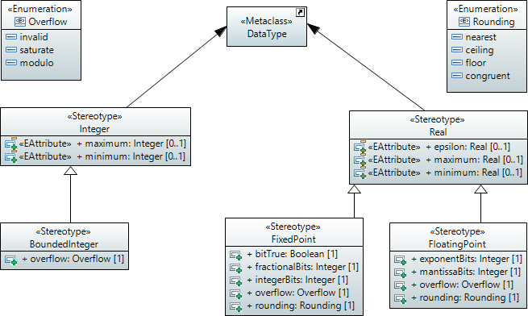
Numeric Stereotypes

Slide 9
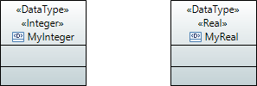
Integer, Real stereotypes
<<Integer>> stereotype: DataType is Integer
<<Real>> stereotype: DataType is Real
OCL Integer/Real operations may be used
interchange uses string serialization

Slide 10
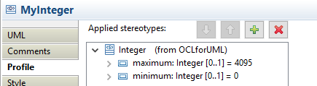
Basic Integer specification
12 bit unsigned integer

Slide 11
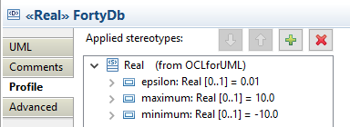
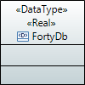
Basic Real specification
1% accuracy up to +/-10

Slide 12
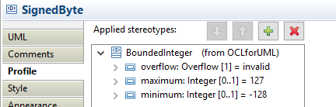

BoundedInteger specification
8 bit signed integer with no overflows

Slide 13
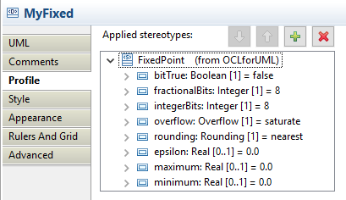
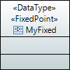

FixedPoint Real specification
16 bit number with 8 bit fractional precision

Slide 14
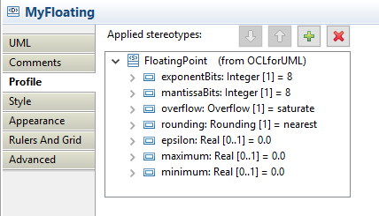
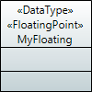
FloatingPoint Real specification
16 bit number with 8 bit exponent

Slide 15
Validation
UML - mostly class / state / activity diagrams
  no real objects, just their classes
But also object diagrams
  'real' objects
  test environment for constraints

Slide 16
Validation dilemma
Object diagram of a stable state
  constraints should be satisfied
Objects diagram illustrating a transient state
  constraints may not apply
pre-Luna - no object diagram validation
Luna - object diagrams must be valid
Mars - configurable (default no validation)

Slide 17
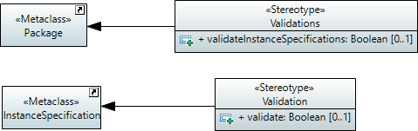


Validation configuration
No UML ability to configure validation
  OCLforUML Profile provides stereotypes
    Validation::validate
      configures an individual InstanceSpecification
    Validations::validateInstanceSpecifications
      configures default for all InstanceSpecifications in a Package

Slide 18
Null
Source of numerous program failures
  null has many but not all behaviors of an object
Navigating from null fails
  NPE in Java
  invalid in OCL
self.parent.name.toUpper()
  two / three hazards

Slide 19
Null mitigation
C++ references - int&
  works
Java annotations - @NonNull,@Nullable
  works locally, fails globally (no system annotations)
Groovy, Python, Xbase - safe navigation - x?.y
  moves the problem sideways

Slide 20
Eclipse OCL for Mars
prototyping OCL 2.5/...
add safe navigation x?.y x?->y
  yet another two operators - no added value
  almost everything can-be null
need non-null object declarations
  already defined by UML MultiplicityElement::lower
    x : X[?] -- is nullable
    x : X[1] -- is non-null

Slide 21
Null-free Collections
In OCL
  collection can contain null elements
  iterators may be null
  OCL's collection operations are all hazardous
In practice
  very few collections contain null elements
need null-free collections
  textual syntax extension
    type[collection-multiplicity | element-multiplicity]
    e.g. Set(String)[2..4|1] -- Set of two to four non-null Strings

Slide 22
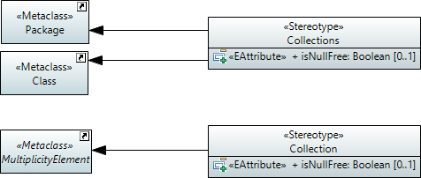
Null-free configuration
No UML ability support for null-free
  OCLforUML Profile provides stereotypes
    Collection::isNullFree
      configures an individual MultiplicityElement
    Collections::isNullFree
      configures default for all MultiplicityElements in a Class/Package

Slide 23
Post-OCL 2015 workshop
In UML, no null elements in multi-values
  declaring null-free/null-full is redundant
OCL could move to null-free by default
  just declare the rare null-full cases
  matches universal practice
But null-full Collections are needed
  e.g. Map.values()
UML / OCL conflict needs resolution

Slide 24
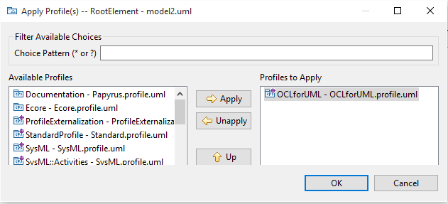
Oops - not supported by Papyrus
Open with UML Model Editor
  select Model/Package then
  UML Model Editor->Package->Apply Profile

Slide 25
Summary
UML deficient wrt OCL tooling
Remedied by the OCLforUML profile
  DataType behavior / numeric precision
  Validation enable / disable
  Collections null-free / null-full

