Slide 1
OCL Advances and the OCL VM
Edward Willink
OMG OCL RTF
Eclipse OCL Project Lead
OMG QVT RTF
Eclipse QVT Declarative Project Lead
Eclipse/OMG Workshop
Reston
25th March 2012

Slide 2


Overview
Why OCL?
Recent Advances
  Embedded OCL with the OCLinEcore editor
  Independent OCL with the Complete OCL editor
OCL Virtual Machine
  Flexible Accurate Values
  Fast Operations
  Fast Scheduling
Summary

Slide 3
OCL or Xbase?
Xbase
  very good, well supported
  tied to Java as an implementation platform
OCL
  specification language
  so what?

Slide 4

Java gets it wrong
1 not always equal to 1.0 in Java
  Set{1, 1.0} may have two elements
Must use BigInteger for unlimited numbers
Has assignment
  uncontrolled side effects
  not declarative
  cannot be analyzed
  cannot support optimized re-evaluation
    Eclipse OCL introduced an Impact Analyzer (Indigo)

Slide 5
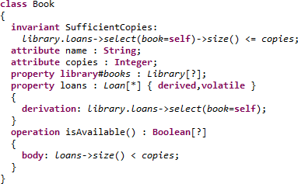
OCLinEcore Editor
OCL in Ecore using Xtext
  persist directly as *.ecore, or as *.oclinecore
Checked, readable, accessible constraints

Slide 6
OCL in Ecore usage
Technology: EAnnotations with delegate URIs
Invariants (EAnnotation for EClass)
  executed as part of EMF Validation
    e.g. Validate action in any Ecore editor
Derived/Initial Properties
  executed as part of eGet('XX'), getXX
Operation bodies
  executed as part of eInvoke('YY'), yy()
Provided OCL plugins are installed

Slide 7
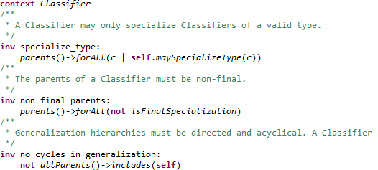
CompleteOCL Editor
Complementary OCL document
  persist as *.ocl

Slide 8
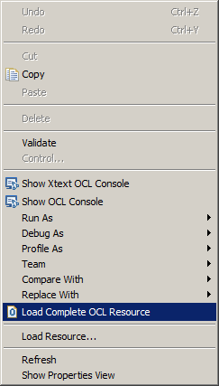
Complete OCL Usage
Complementary independent document
  not known to complemented model/tooling
  pre-Juno: requires manual Java loading
Juno: "Load Complete OCL Resource"
  wherever a ResourceSet is accessible
    Sample Ecore Editor/EMF Generated Editor
    Xtext Editor/Xtext Generated Editor
  impose style checking - uppercase terminals
  diagnose bad usage - all references have opposites

Slide 9
Specification Tooling
OCL tooling now useable
  OCLinEcore for primary models with OCL
  Complete OCL for secondary OCL
OCL 2.5 specification auto-generated from
  Xtext annotated EBNF grammars
  UML/Ecore + OCL models
Eclipse OCL 2.5 tooling auto-generated from
  the same specification models
Same approach planned for QVT

Slide 10
OCL2Java Code Generation
Helios, Indigo
  OCL in Ecore as EAnnotations
    genmodel: Strings containing unchecked OCL
    run-time: compile and interpret
Juno (optional)
  OCL in Ecore as EAnnotations
    genmodel: OCL converted to Java code
    genmodel: dispatch tables for fast execution
    run-time: direct Java execution by OCL VM

Slide 11
OCL VM: Polymorphic Value Hierarchy
Everything is-a Value
Primitive values
  {Boolean, Integer, Real, String, UnlimitedNatural}Value
Templated Collection values
  {Bag, OrderedSet, Sequence, Set}Value
Infrastructure values
  {Invalid, Lambda, Null, Tuple}Value
Model Element values
  {Object, Type}Value ...

Slide 12
Polymorphic Values
Integer/Real have unlimited size
  BigInteger/BigDecimal in Java - not polymorphic
Multiple implementations of IntegerValue
  simplest implementation like java.lang.Integer
    wrapper for int
    overflow detector for add/subtract/.... => growth
  bigger implementation uses java.math.BigInteger
  efficiency of small representation
  automatic conversion to larger representation

Slide 13
Polymorphic Object Values
Objects/Model Elements are also Values
  but EObject is not a Value
  so EObjectValue adapts EObject to be a Value
  'simple' adapters for other technology spaces
All model elements normalised to ObjectValue
Meta-model elements are normalised as well
  all types are TypeValues

Slide 14
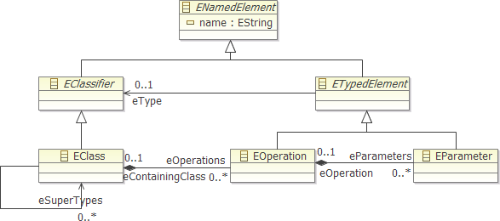

'Ecore' Operation Call : a.b(c,d)
Tree search over type and supertypes --- a
  Linear search for operation name --- b
    Linear search to match argument types --- (c,d)
      Tree search for conformant type/supertype --- c then d
Select best unique match

Slide 15
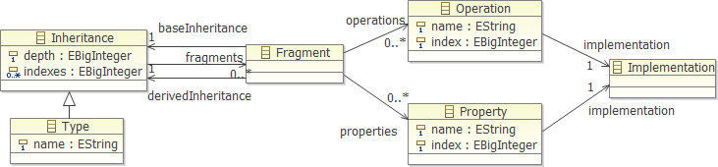
'OCL VM' Operation Call
Fragment provides derived view of base
  may have overloaded entries
Linear search of fragments at required depth
  Direct index to operation

Slide 16
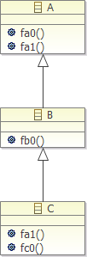
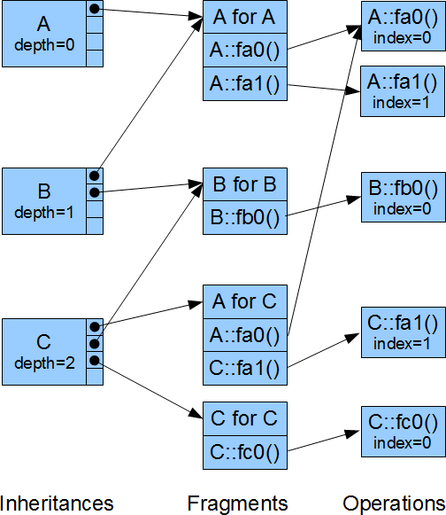



Example OCL VM dispatch
Problem
  fa1() for a C
Compile-time
  A::fa1
  A for ? index 1
Run-time
  C
  A is depth 0
    A for C
  A::fa1 is index 1
    C::fa1

Slide 17
Dispatch comparison
Direct Ecore
  potentially 6D search
    all super classes
    all operations
    all parameters
    all super classes again
OCL VM Dispatch tables
  1D search over width of inheritance tree
    usually 1, sometimes 2 or 3 steps

Slide 18
Auto-generated to ...Tables.java
private static final ExecutorOperation[] _Integer__Real = {
OCLstdlibTables.Operations._Integer___mul_ /* _'*'(OclSelf) */,
OCLstdlibTables.Operations._Integer___add_ /* _'+'(OclSelf) */,
OCLstdlibTables.Operations._Integer__0__sub_ /* _'-'() */,
OCLstdlibTables.Operations._Integer__1__sub_ /* _'-'(OclSelf) */,
OCLstdlibTables.Operations._Integer___div_ /* _'/'(OclSelf) */,
OCLstdlibTables.Operations._Real___lt_ /* _'<'(OclSelf) */,
OCLstdlibTables.Operations._Real___lt__eq_ /* _'<='(OclSelf) */,
OCLstdlibTables.Operations._Real___lt__gt_ /* _'<>'(OclSelf) */,
OCLstdlibTables.Operations._Real___eq_ /* _'='(OclSelf) */,
OCLstdlibTables.Operations._Real___gt_ /* _'>'(OclSelf) */,
OCLstdlibTables.Operations._Real___gt__eq_ /* _'>='(OclSelf) */,
OCLstdlibTables.Operations._Integer__abs /* abs() */,
OCLstdlibTables.Operations._Integer__compareTo /* compareTo(OclSelf) */,
OCLstdlibTables.Operations._Real__floor /* floor() */,
OCLstdlibTables.Operations._Integer__max /* max(OclSelf) */,
OCLstdlibTables.Operations._Integer__min /* min(OclSelf) */,
OCLstdlibTables.Operations._Real__round /* round() */,
OCLstdlibTables.Operations._Integer__toString /* toString() */
};
private static final ExecutorFragment[] _Integer =
{
Fragments._Integer__OclAny /* 0 */,
Fragments._Integer__OclComparable /* 1 */,
Fragments._Integer__OclSummable /* 1 */,
Fragments._Integer__Real /* 2 */,
Fragments._Integer__Integer /* 3 */
};
private static final int[] __Integer = { 1,2,1,1 };
static final ExecutorProperty[] _NamedElement = {
PivotTables.Properties._Element__Comment,
PivotTables.Properties._Element__Constraint,
PivotTables.Properties._NamedElement__isStatic,
PivotTables.Properties._NamedElement__name,
PivotTables.Properties._NamedElement__ownedAnnotation,
PivotTables.Properties._Element__ownedComment,
PivotTables.Properties._NamedElement__ownedRule
};

Slide 19



genmodel integration
OCL Examples & Editors Genmodel Adapter
  .../XXXTables.java
  .../bodies/*Body.java
  .../impl/*Impl.java
  MANIFEST.MF needs manual edit
    depends on org.eclipse.ocl.examples.library
Provided
  Global OCL Preference
    "Realisation of OCL embedded in Ecore models" set to "Generate Java code in xxxBodies classes"
  No "http://www.eclipse.org/OCL/GenModel" GenAnnotation
    with"Use Delegates" set true

Slide 20
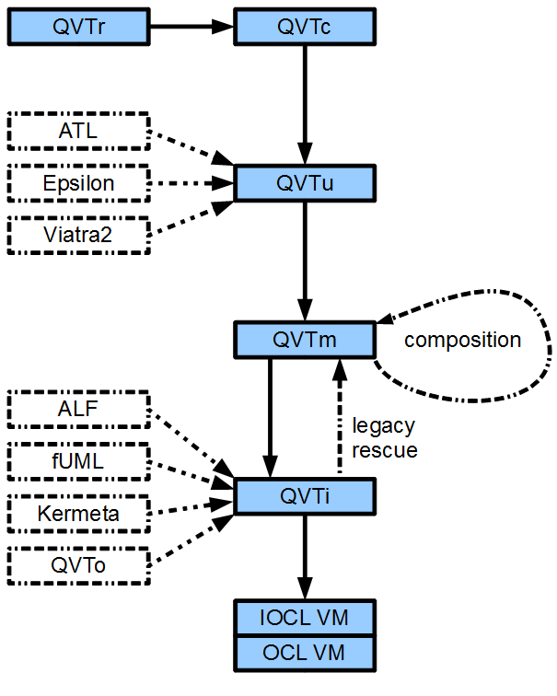
(Imperative) OCL VM for QVT
Simple OCL VM
  AST walker
  QVT richer AST
Code generated VM
  dispatch tables
  flattened code
  inlined operations
Debugging tools

Slide 21
Simple Interpreted OCL VM
Program is an Abstract Syntax Graph (AST)
  VariableExp
    references variable to read as a value
  PropertyCallExp
    references object and property to read as a value
  OperationCallExp
    references operation to apply to some values
Run-time Interpretation
  tree-walking evaluation visitor
Extensible with new AST node classes

Slide 22
Code Generated OCL VM
Program is an Abstract Syntax Graph (AST)
Compile-Time Code Generation
  tree-walking code generating visitor
Run-time Execution
  direct Java, direct model accesses
Extensible with new AST node classes
Optimisable
  direct model access getXX() rather than eGet('XX')
  inlining of non-polymorphic (final) operations

Slide 23
Summary
OCL Tooling
  editors ready for specification usage
OCL VM
  polymorphic specification value system
  normalising adapters to practical objects
  efficient tables for normalised meta-models
  fast polymorphic dispatch of operations
  foundation for QVT and other Tx languages

