Slide 1
Embedded OCL Integration and Debugging
Edward Willink
Willink Transformations Ltd
Eclipse Foundation
MMT Component co-Lead
OCL Project Lead
QVTd Project Lead
QVTo Committer
OMG (Model Driven Solutions)
OCL 2.3, 2.4 (2.5) RTF Chair
QVT 1.2, 1.3 RTF Chair
OCL 2014 @ MODELS 2014
30th September 2014

Slide 2


Overview
OCL Debugging
  source code stepping / visualization
OCL Integration
  use of OCL as part of a (much) larger application
Integrated OCL Debugging
  diagnosing OCL problems in the larger application

Slide 3
OCL Debugger
2013: Dresden OCL debugger
2014: Eclipse OCL/QVTi debugger (Luna)
Ecore OCL
Debugger
Pivot OCL
Acceleo
Eclipse QVTo
Debugger
QVTi
Debugger
Debugger
QVTs
QVTp
Eclipse Tools
QVTm
QVTu
Eclipse QVTc
Eclipse QVTr

Slide 4


Launching a Debugger
Java etc, new process
    start program in debug mode (with arguments)
      program acquires its data
Independent OCL, new process
    start OCL debugger (launch dialog)
      select (load) a Constraint / Expression
      select (load) some model objects
Integrated OCL, ongoing process
    select (re-use) a Constraint / Expression
    select (re-use) some model objects
    start debugger

Slide 5
OCL Context
Models
OCL
Complete OCL
Parser
Evaluator
Editor
Debugger
OCL useless by itself - no model access
Complete OCL - provides model access
Useful for learning / practice
Real models, real problems, real applications?

Slide 6
Applications with embedded OCL
Application
Model API
Models
OCL API
Embedded
OCL
Parser
Evaluator
EMF model API - de facto standard
Embedded OCL
    UML - via Constraints
    (EMOF - via magic)
    Ecore - via EAnnotations
OCL API - tool/vendor-specific

Slide 7
Debugging approaches
Application
Model API
Models
OCL API
Embedded
OCL
?
Host Debugger
Parser
Evaluator
OCL Debugger
Use host debugger
    verbose/semi-readable tooling code
Use 'printf' - e.g. oclLog()
    massive log files
Practice expressions in an independent console
    replicate application content externally
Use independent debugger
    replicate application content externally

Slide 8
Independent Debugger
Real Application
Independent Debugger
Application
Model API
Models
Models
OCL
reload
OCL API
Embedded
OCL
transcribe
Complete OCL
Parser, Evaluator, Editor, Debugger
Evaluator
Reload models, transcribe OCL
No break points to help locate problem
Hard to select code to debug
Different evaluator/models/...

Slide 9
Debugging Use Cases
Simple Object Re-use
OCL injection
OCL constraints
Alternate validation
Embedded execution

Slide 10
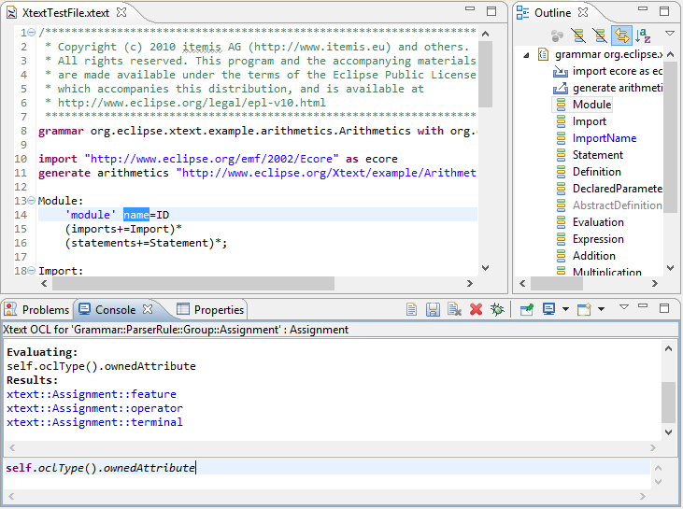
Simple Object Reuse(1)

Slide 11
Simple Object Reuse(2)
Modeling
Application
ResourceSet
Resources
EObjects
Resources
EObjects
setSelection
OCL
Application
selectionChanged
ISelection
EMF Modeling Applications use EMF EObjects
UI applications share selections
  e.g. editor selection to outline view
OCL application can listen to selection changes
  reuse EObject

Slide 12
Simple Object Reuse Debugging
Modeling
Application
ResourceSet
Resources
EObjects
Resources
EObjects
setSelection
OCL
Application
selectionChanged
ISelection
OCL
Debugger
OCL application (Console)
  reuses application objects
  reloads/retypes constraint
Debug button to execute constraint

Slide 13
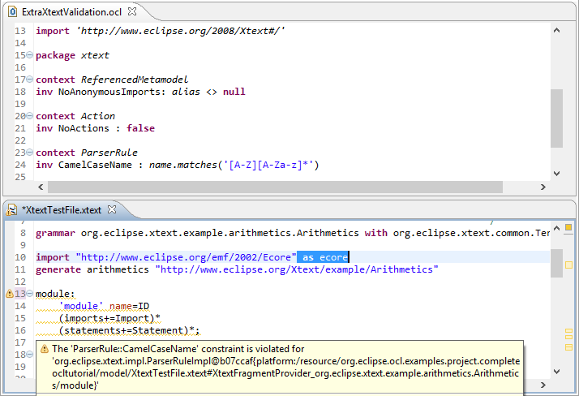
OCL injection (1)

Slide 14
OCL Injection(2)
Resources
Modeling
Application
ResourceSet
EPackage
Validators
Diagnostian
Validation
Registry
EObjects
Resources
Ecore
constraints
Resources
EObjects
EObjects
install
OCL Menu
Action
EObjects
OCL
Validators
OCL
constraints
EObjects
use
EObjects
iterate
over
click
Resources
Modeling
Application
ResourceSet
Resources
Modeling
Application
ResourceSet
EObjects
Resources
EObjects
Resources
EObjects
EObjects
EMF Modeling Applications use Diagnostician
  per-EPackage Validation Registry Java code
Additional menu actions can be contributed
OCL action can add additional OCL constraints

Slide 15
OCL Injection Debugging
No OCL application for debugger to extend
  see later
  explain OCL constraints first

Slide 16
OCL Constraints (1)
Ecore Constraint
  hand-coded Java - compiled models only
EMF Delegated Constraint
  code replaced by two strings
    delegate URI - selects the delegate technology
      e.g. "http://www.eclipse.org/emf/2002/Ecore/OCL"
    technology-specific constraint body
      e.g. "loans->size() <= 2"
  at run-time
    delegate registry provides relevant language support
    language support parses and executes the body

Slide 17
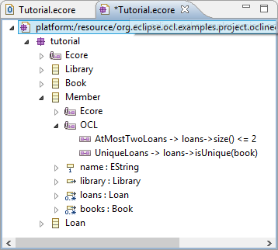
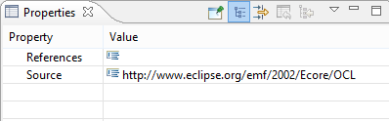
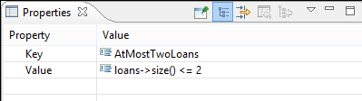
OCL Constraints (2)
<eClassifiers xsi:type="ecore:EClass" name="Member">
<eAnnotations source="http://www.eclipse.org/emf/2002/Ecore">
<details key="constraints" value="AtMostTwoLoans UniqueLoans"/>
</eAnnotations>
<eAnnotations source="http://www.eclipse.org/emf/2002/Ecore/OCL">
<details key="AtMostTwoLoans" value="loans->size() &lt;= 2"/>
<details key="UniqueLoans" value="loans->isUnique(book)"/>
</eAnnotations>
<eStructuralFeatures xsi:type="ecore:EAttribute" name="name" ordered="false" lowerBound="1"
eType="ecore:EDataType http://www.eclipse.org/emf/2002/Ecore#//EString"/>

Slide 18
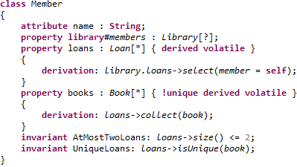
OCL Constraints (3)
OCLinEcore editor
  unified view of model and constraints
  hides the underlying integration complexities

Slide 19
OCL Constraint debugging
validateUniqueLoans(...)
EObject
Delegate
Registry
OCL Delegate
Registration
eClass
EClass
eAnnotations
EAnnotation
role: 'Ecore constraint'
name: 'UniqueLoans'
URI: 'http://www.eclipse.org/emf/2002/Ecore/OCL'
body: 'loans->isUnique(book)'
OCL Parser
Evaluator
OCL
Debugger
EMF validation uses generated validateXXX(...)
    hand-coded Java
or delegated Strings to e.g. OCL support
which may include debugging

Slide 20
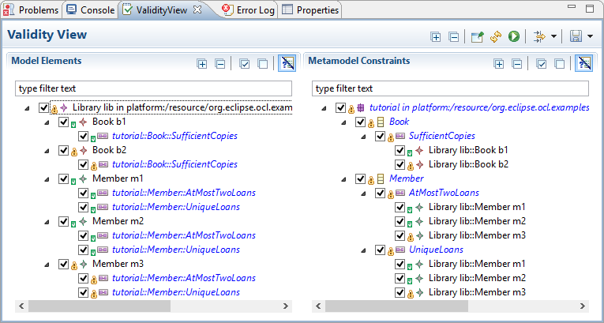
Alternate Validation (1)

Slide 21
Alternate Validation(2)
Validating
Application
use
Resources
Modeling
Application
ResourceSet
Validators
Diagnostian
Validation
Registry
EObjects
Resources
Constraints
Resources
EObjects
EObjects
use
iterate over
Resources
Modeling
Application
ResourceSet
Resources
Modeling
Application
ResourceSet
EObjects
Resources
EObjects
Resources
EObjects
EObjects
Alternate validation, not necessarily OCL
  discovers ResourceSet by shared selection
  performs some or all validations
  presents more detailed results more helpfully

Slide 22
Alternate Validation Debugging
Validating
Application
OCL
Debugger
use
Resources
Modeling
Application
ResourceSet
Validators
Diagnostian
Validation
Registry
EObjects
Resources
Constraints
Resources
EObjects
EObjects
use
iterate over
Resources
Modeling
Application
ResourceSet
Resources
Modeling
Application
ResourceSet
EObjects
Resources
EObjects
Resources
EObjects
EObjects
Validating application is 'our' application
  can use 'our' API to interact with debugger
  just need to add a 'Debug' button

Slide 23
Integrated OCL Debugger (1)
Application
Model API
Models
OCL API
Embedded
OCL
OCL Evaluator
Application exploits OCL API
  vendor-specific
  no sign of any standard
Vendor has not supplied a debugger

Slide 24
Integrated OCL Debugger (2)
Application
Model API
Models
OCL API
Embedded
OCL
Evaluator
OCL Evaluator,
OCL Debugger
Uses EMF de facto API
Evaluator/Interpreter can watch for breakpoints
  even if application not in debug mode

Slide 25
Integrated OCL Debugger (3)
Application
Model API
Models
Generated
OCL code
Embedded
OCL
Host Debugger
OCL Debugger
Interpreted OCL is inefficient
  generated (Java) code much better
  but only semi-readable
Must enhance host debugger
  shoud be possible in Eclipse

Slide 26
Integrated debugging summary
Add debug button to OCL application
    Simple Object Re-use (Eclipse OCL Luna)
    Alternate validation (Eclipse OCL Luna)
OCL evaluator enhanced by debug capabilities
    OCL injection (experimental)
    OCL constraints (experimental)
    Integrated interpreted execution (experimental)
Host debugger enhanced with OCL relevance
    Integrated compiled execution (one day)

Slide 27
Integration enablers
Eclipse platform
    multiple applications
    shared menu selection
    plugin registrations and extension points
    additional menu actions
EMF
    de facto modeling API
      selection -> EObject -> Resource -> ResourceSet traversal
    standard extensible validation
    delegation of validate, get, invoke for model objects
(Eclipse) OCL (Ecore/UML or Pivot)
    implements delegation plugin

Slide 28
Summary
Integration
  non-extra-tooling support for OCL
Debugging
  independent
  dependent
    reuse models
    reuse constraints
    reuse activation
Future:... OCL enhanced Host Debugger

