Slide 1
OCL Specification Status
Edward Willink
Willink Transformations Ltd
Eclipse Foundation
MMT Component co-Lead
OCL Project Lead
QVTd Project Lead
QVTo Committer
OMG (Model Driven Solutions)
OCL 2.3, 2.4, 2.5 RTF Chair
QVT 1.2, 1.3, 1.4 RTF Chair
OCL 2016 @ MODELS 2016
2nd October 2016

Slide 2

Overview
What we have
How we got here
Where we go now

Slide 3

Simple Black Box view of OCL
U
s
e
r
s
Concrete Syntax
OCL
Standard Library
Semantics
Specification exposition imperfect
  Precise Concrete Syntax Grammar
More functionality

Slide 4
White Box view of OCL
U
s
e
r
s
Concrete Syntax
OCL
M
o
d
e
l
s
Loader
Standard Library
Abstract
Syntax
XMI
Semantics
Saver
Specification totally inadequate
  Missing / Unimplementable
Rewrite / Design

Slide 5



OCL History
OCL evolved from Syntropy
OCL 1.3 specified as part of UML 1.3
    specifies the parts that need formal words
'OCL 2.0' split off from UML 2.0 (Sept 2003 FAS)
    OCL useable in its own right
    No resources available to complete specification
QVT 1.0 (Jul 2007 FAS) specified as an OCL extension
    (May 2006) OCL 2.0 draft approved TBDs and all
OCL 2.1/2.2, 2.3, 2.4 provides limited improvements

Slide 6
OCL 2.2
84 resolved issues
and/or/xor have distinct precedence
oclAsType() returns a 'power set'
Collection conforms to OclAny
String::+()

Slide 7

OCL 2.3
27 resolved issues
oclAsType() returns a Classifier
arbitrary characters in Strings/names - _'\n'
no case conversion for implicit opposites
forAll etc are not reserved words
eliminate 'undefined' - use 'null' / 'invalid'
  3.5-valued Booleans
    4-valued inputs - true, false, null, invalid
    3-valued outputs - true, false, invalid
closure()

Slide 8
OCL 2.4
58 resolved issues
oclAsSet() longform of object->name
=,<> compare DataType by value/Class by identity
idempotent
  4-valued Booleans
    4-valued inputs - true, false, null, invalid
    4-valued outputs - true, false, null, invalid
selectByKind, selectByType

Slide 9
OCL 2.5?
206 issues to resolve
easy typo issues done in 2.2, 2.4
systemic pre-UML 2.0 faults

Slide 10
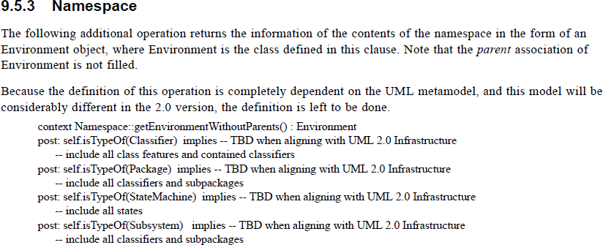
OCL 2.3.1 / ISO/IEC 19507 (2012)

Slide 11
OCL Specification Progress
OCL 2.5 RFP (Feb 2014)
  OMG requests, consortia respond with submission(s)
  initial submission deadline Dec 2014 - extended
  extended deadline Aug 2015 - lapsed
    RFP blocks RTF usage of JIRA
OCL 2.5 RTF (chartered Sep 2015)
  Issues maintained in JIRA
OCL xxx RFC
  consortium submits, OMG adopts/iterates/rejects

Slide 12
OCL Specification Slow Progress
Mostly just EDW, 4 jobs
  OCL @ OMG => fully modeled OCL '2.5'
  OCL @ Eclipse => protototype of OCL '2.5'
    ASBH working on CS2AS automation
  QVT @ OMG => fully modeled QVT '2.0'
  QVTd @ Eclipse => protototype of QVT '2.0'
    HHR working on advanced optimizations
June 2016 goals: OCL 2.5, QVTr execution
September 2015: QVTc/QVTr scheduling failing
  focus on Eclipse QVTc/QVTr: see EXE 2016 paper

Slide 13
OCL specification
OCL 2.0 ... 2.4
  best / rushed human endeavours
  numerous inconsistencies
OCL '2.5'
  auto-generated from the models
  no inconsistencies

Slide 14
Model-to-specification Automation
Currently error prone manual FrameMaker
autogenerate from models
  MOFM2T (Acceleo) to FrameMaker MIF
  Xtend to FrameMaker MIF
  Xtend to Textile => Eclipse Help / HTML / PDF
  Xtend to Latex => Next OMG specification
Latex in use for Isabelle academic exposition
  replaces semi-formal Annex

Slide 15

Specification-to-compiler Automation
OCL specification is incomplete
Xtext covers large parts of an implementation

Slide 16
OCL 2.0 ... 2.4 Models
Model
  Abstract Syntax (AS) - inaccurate / unuseable
Text
  Language Grammar - fragmented
  Concrete Syntax (CS) - implied
  CS to AS - semi-formal text
  Name lookup - semi-formal text
  Disambiguation - informal hints
  Standard Library - informal text
  Execution semantics - informal text / annex

Slide 17
OCL '2.5' Models
Models
  Abstract Syntax (AS) - OCL.uml + UML.uml
  Language Grammar - OCL.xtext (AEBNF)
  Concrete Syntax (CS) - OCLCS.uml
  CS to AS - OCLCS2AS.ocl
  Name lookup - OCLNameResolution.ocl
  Disambiguation - OCLDisambiguation.ocl
  Standard Library - OCLstdlib.oclstdlib
Text
  Execution semantics - informal text / Isabelle

Slide 18
Modules, Merging
QVT
Time
Messages
States
OCL core
UML core
Grammar
Concrete
Syntax
Disambiguation
Rules
CS2AS
Rules
Name Lookup
Rules
Abstract
Syntax
WF
Rules
AEBNF
(Xtext)
UML
'OCL'
'OCL'
'OCL'
UML
OCL
DSL

Slide 19
Model-to-compiler Automation
Today:
  QVTo from UML models to internal Ecore/Java
  Xtext from 'AEBNF' grammars to internal Ecore/Java
Imminent:
  OCL CS2AS + name lookup + disambiguation
Close: QVTr to Java
  UML2AS,

Slide 20

Metamodels, Models
Metamodels: UML, Ecore, XSD, Java, ...
    Enhance each with OCL support
    Migrate to a normalized OCL metamodel
    Relatively few metamodel objects
      specify e.g. UML2AS normalization
Models: EObject, XMLElement, java Object, ...
    Enhance each with OCL support
    Migrate to a normalized OCL Object
    Many model objects
      specify effective execution

Slide 21
Model-to-executor Automation
Today:
  Hand coded Java interpreter
  Hand coded Java code generator
  Isabelle semantics exposition
What abstraction defines execution?
  constructive supports
    autogenerated interpreter
    autogenerated code generator
? reverse engineer manual code

Slide 22
New ?interesting ?fundable work
lambdas
patterns
  comprehensions
semantics - Isabelle
constructive semantics - ?

Slide 23
Old necessary unfundable work
Open classes
Library model
XMI
UML alignment, templates, stereotypes
Grammar, Models
Sub-language/library modules
Specification consistency

Slide 24
Summary
Major deficiencies in OCL specification
'Re'-design being prototyped in Eclipse OCL
  some parts good
  some parts bad / too-Eclipse
  extended by Eclipse QVTc / QVTr
EDW distracted by Eclipse QVTr pressures
Help wanted

Slide 25
Model content
Cannot just model what we 'have'
Must address
  UML alignment
    templates
    stereotypes
    missing EMOF elements
  OCL concepts
    open classes
    synthetic types
    lambda expressions

Slide 26
Eclipse OCL / QVT Prototyping
Models
  extensible pivot internal AS representation ... XMI
  Extensible OCL Standard Library Model
Omissions
  stereotypes, templates, ... UML
Reified
  lambda expressions
New
  pattern expressions, type 'constructors'

